Slide 1
Public relations, advertising and promotions

Slide 2
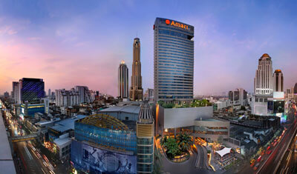
(Eco-Hotel & Service Quality System) จาก TUV Rheinland Cert GmbH
(โรงแรม อมารี วอเตอร์เกท กรุงเทพฯ สืบค้นเมื่อ 1 ธันวาคม 2560 จาก จาก https://th.amari.com/watergate/green.aspx)

Slide 3
Making important decisions in news and marketing communications
(Target audience)
[Publicity and Public relations (PR) objectives]
[Publicity and Public relations (PR) budget]
(Publicity and public relations message and vehicles)
(Implementing the publicity and public relations plan)
(Evaluating the publicity and public relations plan)

Slide 4
Making important decisions and marketing PR.
(Target audience)
[Publicity and Public relations (PR) objectives]

Slide 5
Making important decisions in press releases and marketing PR.
[Publicity and Public relations (PR) budget]
(Publicity and public relations message and vehicles)

Slide 6
(Implementing the publicity and public relations plan)
(Evaluating the publicity and public relations plan)

Slide 7
Setting advertising objectives
(To inform)
(To persuade)
(To remind)
(Reinforcemetn advertising)

Slide 8
(Advertising and consumer promotion)
(To inform)
(To persuade)
(To remind)
(Reinforcement advertising)

Slide 9
Deciding on the selection of advertising news.
(Message generation)
(Message evaluation and selection)
(Message execution)
(Legal issure)

Slide 10
Deciding on the selection of advertising news.
(Message generation)
(Message evaluation and selection)
(Selling proposition)

Slide 11
Promotion Management Procedures
(Detemining tarการ [Detemining target customer (market)]
[Selectiong sales promotin tools (Strategey)]
(Developing the sales promotion program)
(Pretesting the sales promotion promotion program)
(Implementing the sales promotion program)
(Evaluating the sales promotion results)
(Defining sales promotion budget)
(Establishing sales promotin objectives)

Slide 12
Deciding on the selection of advertising news.
[Determining target customer (market)]
(Establishing sales promotion objectives)
(Defining sales promotion budget)

Slide 13
Deciding on the selection of advertising news.
[Selection sales promotion tools (Strategy)]
(Developing the sales promotion program)
(Pretesting the sales promotion program)

Slide 14
Steps in marketing communications
1
(Target audience)
2
(The massage)
(The communication channel)
3

Slide 15
4
(The promotion mix)
5
(Measuring promotion results)
(Managing and coordinating the marketing
communication process)
6

Slide 16
(The promotion mix)
(Personal selling)
(Advertising)
[public relations (PR)]
(Sales promotion)

Slide 17
(The promotion mix)
(Personal selling)
(Advertising)
[Public relations (PR)]
(Sales promotion)

