Slide 1
Consumer behavior for hotel and accommodation businesses

Slide 2
กระบวนการบริโภค (Stages in the consumption process)

Slide 3
Steps in the process of consuming or using services for hotel and accommodation businesses
ขั้นก่อนการซื้อ (Prepurchase issuse)
ขั้นการซื้อ
(Purchase issues)
ขั้นภายหลังการซื้อ (Postpurchase issues)

Slide 4
โมเดลพฤติกรรมผู้บริโภคหรือโมเดลการตัดสินใจซื้อ ของผู้บริโภค

Slide 5
(The Model of buyer behavior)
1. (Marketing: stimuli environment)
2. (Buyer’s black box)
3. (Buyer responses)

Slide 6
(Factors influencing consumer behavior)
(Cultural)
(Culture)
(Social)
(Groups and social networks)
(Personal)
(Age and life cycle stage)
(Subculture)
(Social class)
(Family)
(Roles and status )
(Psychological)
(Motivation)
(Perception)
(Learning)
(Beliefs and attitudes)
(Buyer)

Slide 7
(Personal factors )
1
2
3
4
5
(Occupation)
(Age and life cycle stage)
(Economic situation)
(Life style)
personality

Slide 8
(Psychological)
(Beliefs and attitudes)
(Motivation)
4
3
1
(Learning)
2
(Perception)

Slide 9
Consumer purchase decision process
1
2
3
4
5
(Problem recognition)
(Information search)
(Alternative evaluation)
The purchase decision is where the consumer decides on the brand.
Behavior after purchase

Slide 10
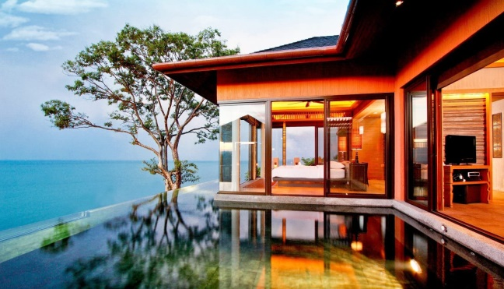
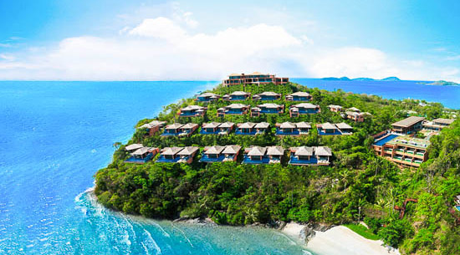
Maslow's hierarchy of needs
(Self- actualization needs)
(Esteem needs)
(Social needs)
(Safety needs)
(Physiological needs)

Slide 11
(Current trends in consumer behavior)
(Perceived value oriented marketing)
(Increasing time poverty)
(A desire for more customized products)
(Greater interest in and access to information via the web)

