Slide 1
Introduction to the behavior of tourists in the hotel and accommodation business.

Slide 2
Characteristics and components for the hotel and accommodation business
07
01
1. Location Based on location
06
02
6. Based on target market
2. Baeed on size of Property
05
03
04
5. Based on theme
3. Based on the level of service
4. Based on the length of stay

Slide 3
(Location Based on location)
1
(City center)
2
(Motel)
(Suburban hotels)
3
(Floating hotels)
4

Slide 4
(Location Based on location)
5
(Airport hotels)
(Resort hotels)
6
7
(Boatels hotels)
8
(Rotels hotels)

Slide 5
(Based on size of Property)
01
(small hotel)
02
(Medium sized hotel)
(Large hotels)
03
04
(Maga hotel)
05
(Chain hotels)

Slide 6
(Based on the level of service)
(Economy/ Budget hotel)
(Mid market hotel)
(Luxury hotel)

Slide 7
(Based on the length of stay)
(Transient hotel)
(Residential hotel)
(Semi residential hotel)

Slide 8
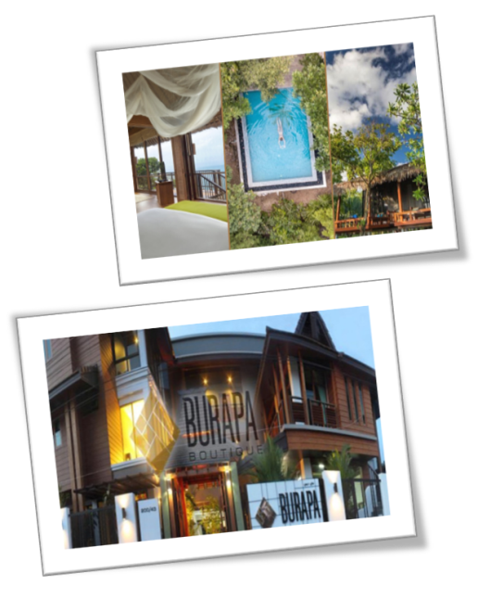
หลักเกณฑ์โรงแรมตามแนวคิดหลัก (Based on theme)
1
โรงแรมเฮอริเทจ
(Heritage hotel)
2
โรงแรมรักษ์โลก
(Ecotels)
3
โรงแรมบูติค
(Boutique hotel)
4
โรงแรม สปา
(Spa)

Slide 9
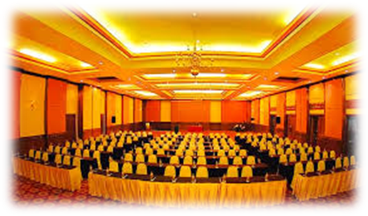
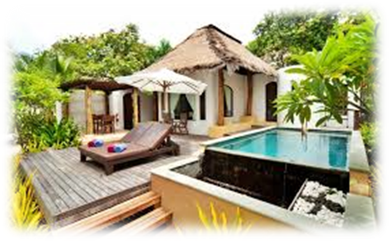
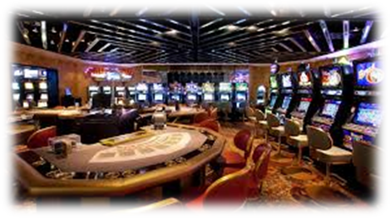
(Based on target market)
01
(Convention hotel)
02
(Resort hotel)
(Suite hotel)
03
04
(Commercial hotel)
05
(Casino hotel)

Slide 10
Marketing process
(Understand the marketplace and customer needs and wants)
(Design a customer valuedriven marketing strategy)
(Construct an integrated marketing progrm that delivers superior value)
(Engage customers, build profitable realationships, and create customer delight)
(Capture value from customers to create profits and customer equity)

