Slide 1

An overview of Financial Literacy
By Aj. Nalin Simasathiansophon
www.ssru.ac.th

Slide 2





An overview of Financial Literacy
Financial literacy is the ability to understand how money works: how someone makes, manages and invests it, and also expends it (especially when one donates to charity) to help others.

Slide 3
The framework contains 4 sections, focusing on …
A : Money and transactions;
B : Planning and managing finances;
C : Risk and reward; and
D : Financial landscape.
Each section covers a) awareness, knowledge and understanding; b) confidence, motivation and attitudes; and c) skills and behavior.
Financial Literacy Framework of OECD
Source: OECD (2015)

Slide 4
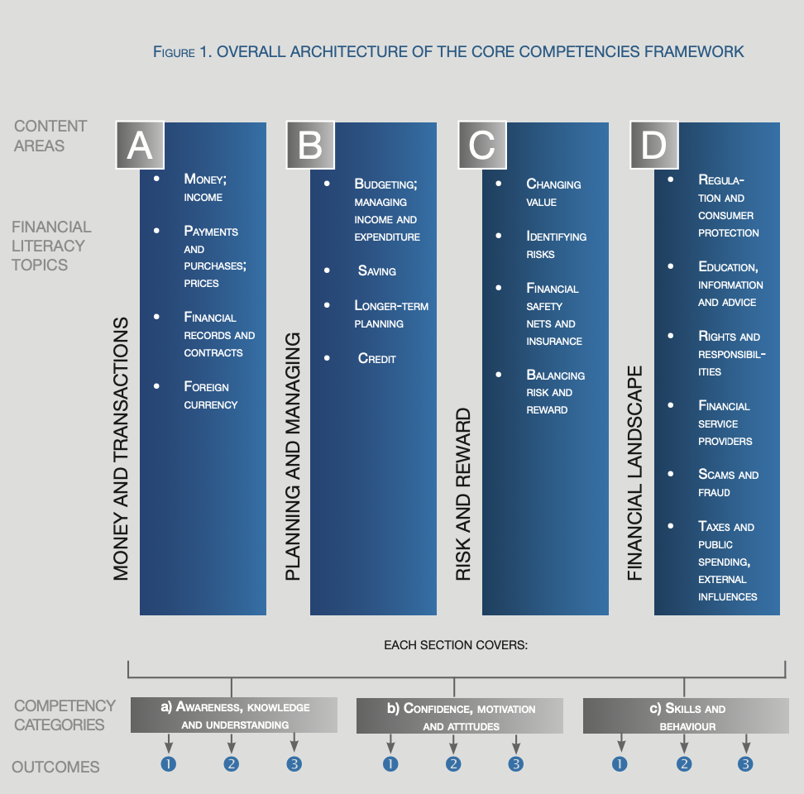
Financial Literacy Framework of OECD

Slide 5
Thailand Financial literacy rate
Data from Organization for Economic Co-operation and Development (OECD) shows that in year 2014-2015 Thailand has been ranked 17, scores 12.8 out of 21 scores, from 30 countries about financial literacy rate. Average score is around 13.2.

Slide 6
Thailand Financial literacy rate (Cont.)
Average rate of Thailand financial literacy is 61.0%
There are three categories:
  Overall financial skills (21 scores)
  Knowledge (7 scores)
  Behavior (9 scores)
  Attitude (5 scores)
Among this rate, Thais age 10-19 has the lowest rate of financial skills

Slide 7
Thailand Financial literacy rate (Cont.)
Criteria | Lowest score (year 2016) | Average score | Highest score (Year 2016)
Knowledge (7 scores) | 0.0 | 3.4 | 7.0
Behavior (9 scores) | 0.0 | 5.6 | 9.0
Attitude (5 scores) | 1.0 | 3.8 | 5.0
Overall (21 scores) | 2.7 | 12.8 | 21.0
Source: National Statistical Office, 2019

Slide 8
Overall Financial Skill

Slide 9
Knowledge

Slide 10
Behavior

Slide 11
attitude

Slide 12
Problem in Thailand
From those four categories, it can be concluded that …
  Thais have low financial knowledge, such as effective interest rate, portfolio risk, interest rate for loan, risk and rate of return, inflation and its impacts, etc.

Slide 13
Financial Literacy in Thailand 2020
Source: BOT (2020)
Note: survey according to OECD criteria with 11,901 families.

Slide 14
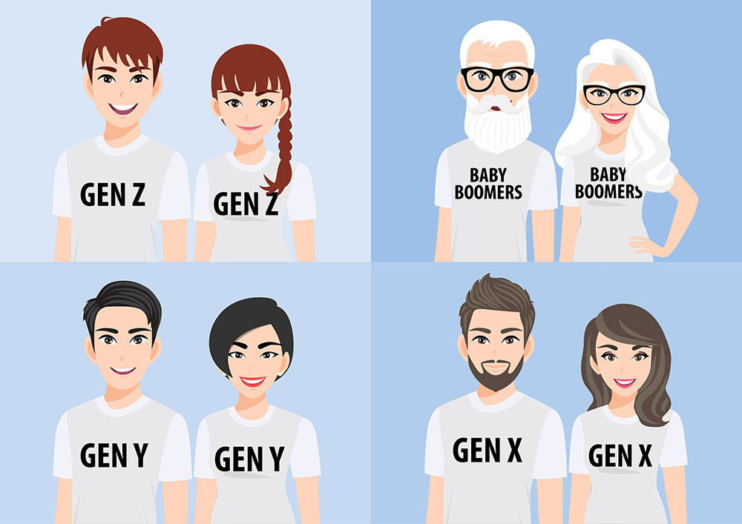
Financial Literacy Regarding to Generation

Slide 15





Level of Knowledge among Thais
79.4% of Thais understand about interest rate for both borrowing and 73.6% of Thais understand about interest rate for saving, but only 1:3 can calculate effective interested rate.
61.9% understand inflation, where the same amount of money cannot buy the same amount of goods and services anymore.
61.1% understand time value of money when inflation happen (money today worth less tomorrow)

Slide 16



Financial Management Situation
74.7% of Thais have saving account, but ...
Only 38% have emergency saving. They must, at least, cover 3-6 months for expenses
84.7% have retirement plan,
but only 1/5 that can follow the plan

Slide 17
Financial Management Situation (Cont.)
43.5% carefully do a budgeting, but only 1/5 save their salary before using it.
38.9% can manage their salary for expenses and paying debt
86.6% believe that they need to make a plan for future use
74.5% have a goal for personal finance and try to reach that goal.

Slide 18


Investment situation
58.8% understand about risk diversification: diversify your investment will help you to deversify risks.
70.3% understand about risk and return: high risk, high return

Slide 19

Financial Literacy Principles
1. Financial goals; spend less than you earn and save early
2. Budgeting; have a plan for using money

Slide 20


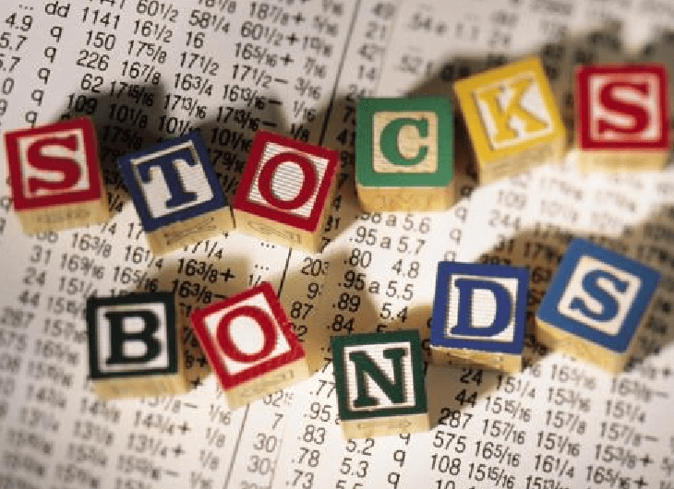


3. Investments; if you have money left, you should invest in …

Slide 21
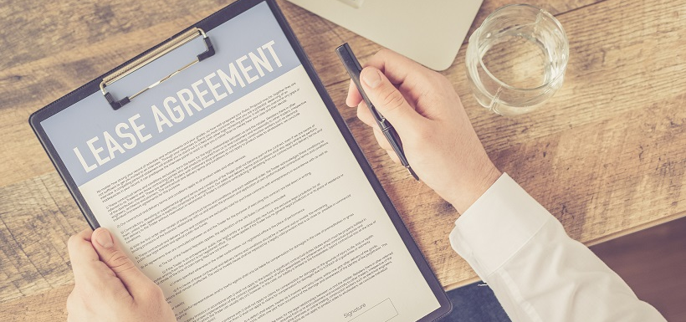
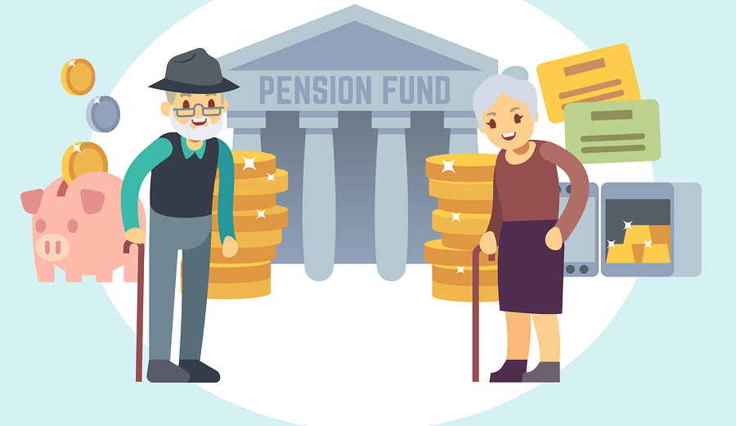
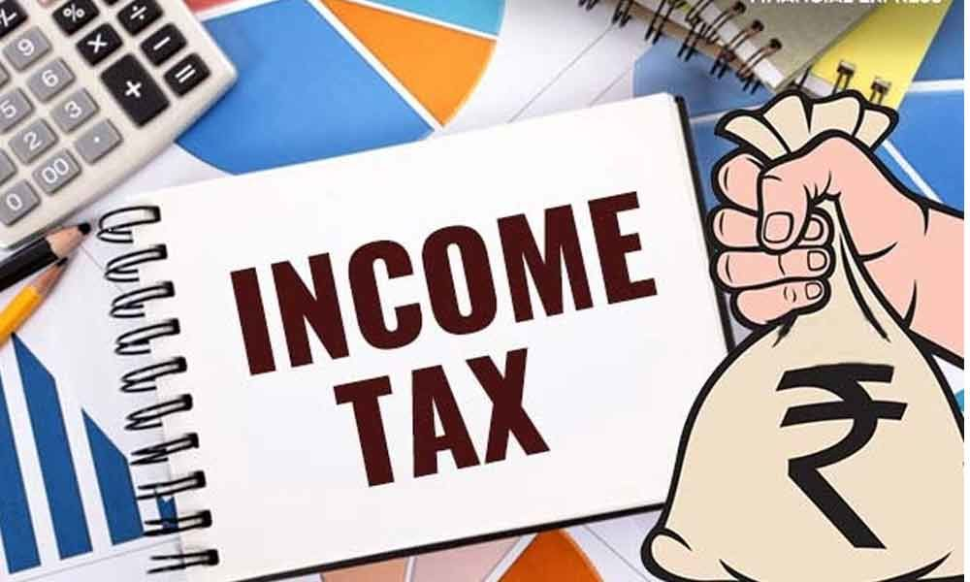
4. Retirement; Pension fund
5. Contracts
6. Employment: tax and benefits at workplace

Slide 22
Resouces
Financial Consumer Protection Center, Bank of Thailand (2022).Thailand Financial Literacy Reports. Retrieved from https://www.1213.or.th/th/Pages/flsurveyreport.aspx

Slide 23
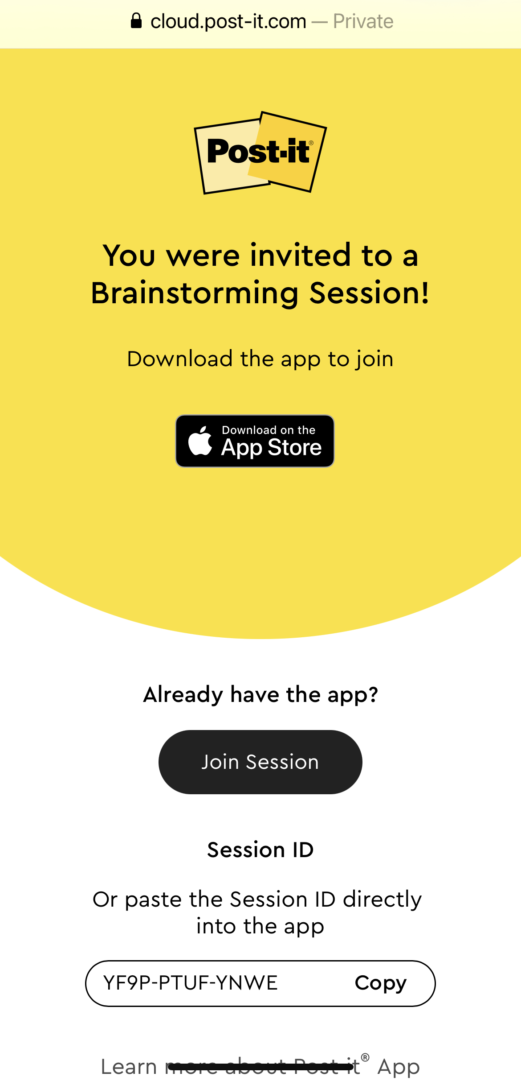
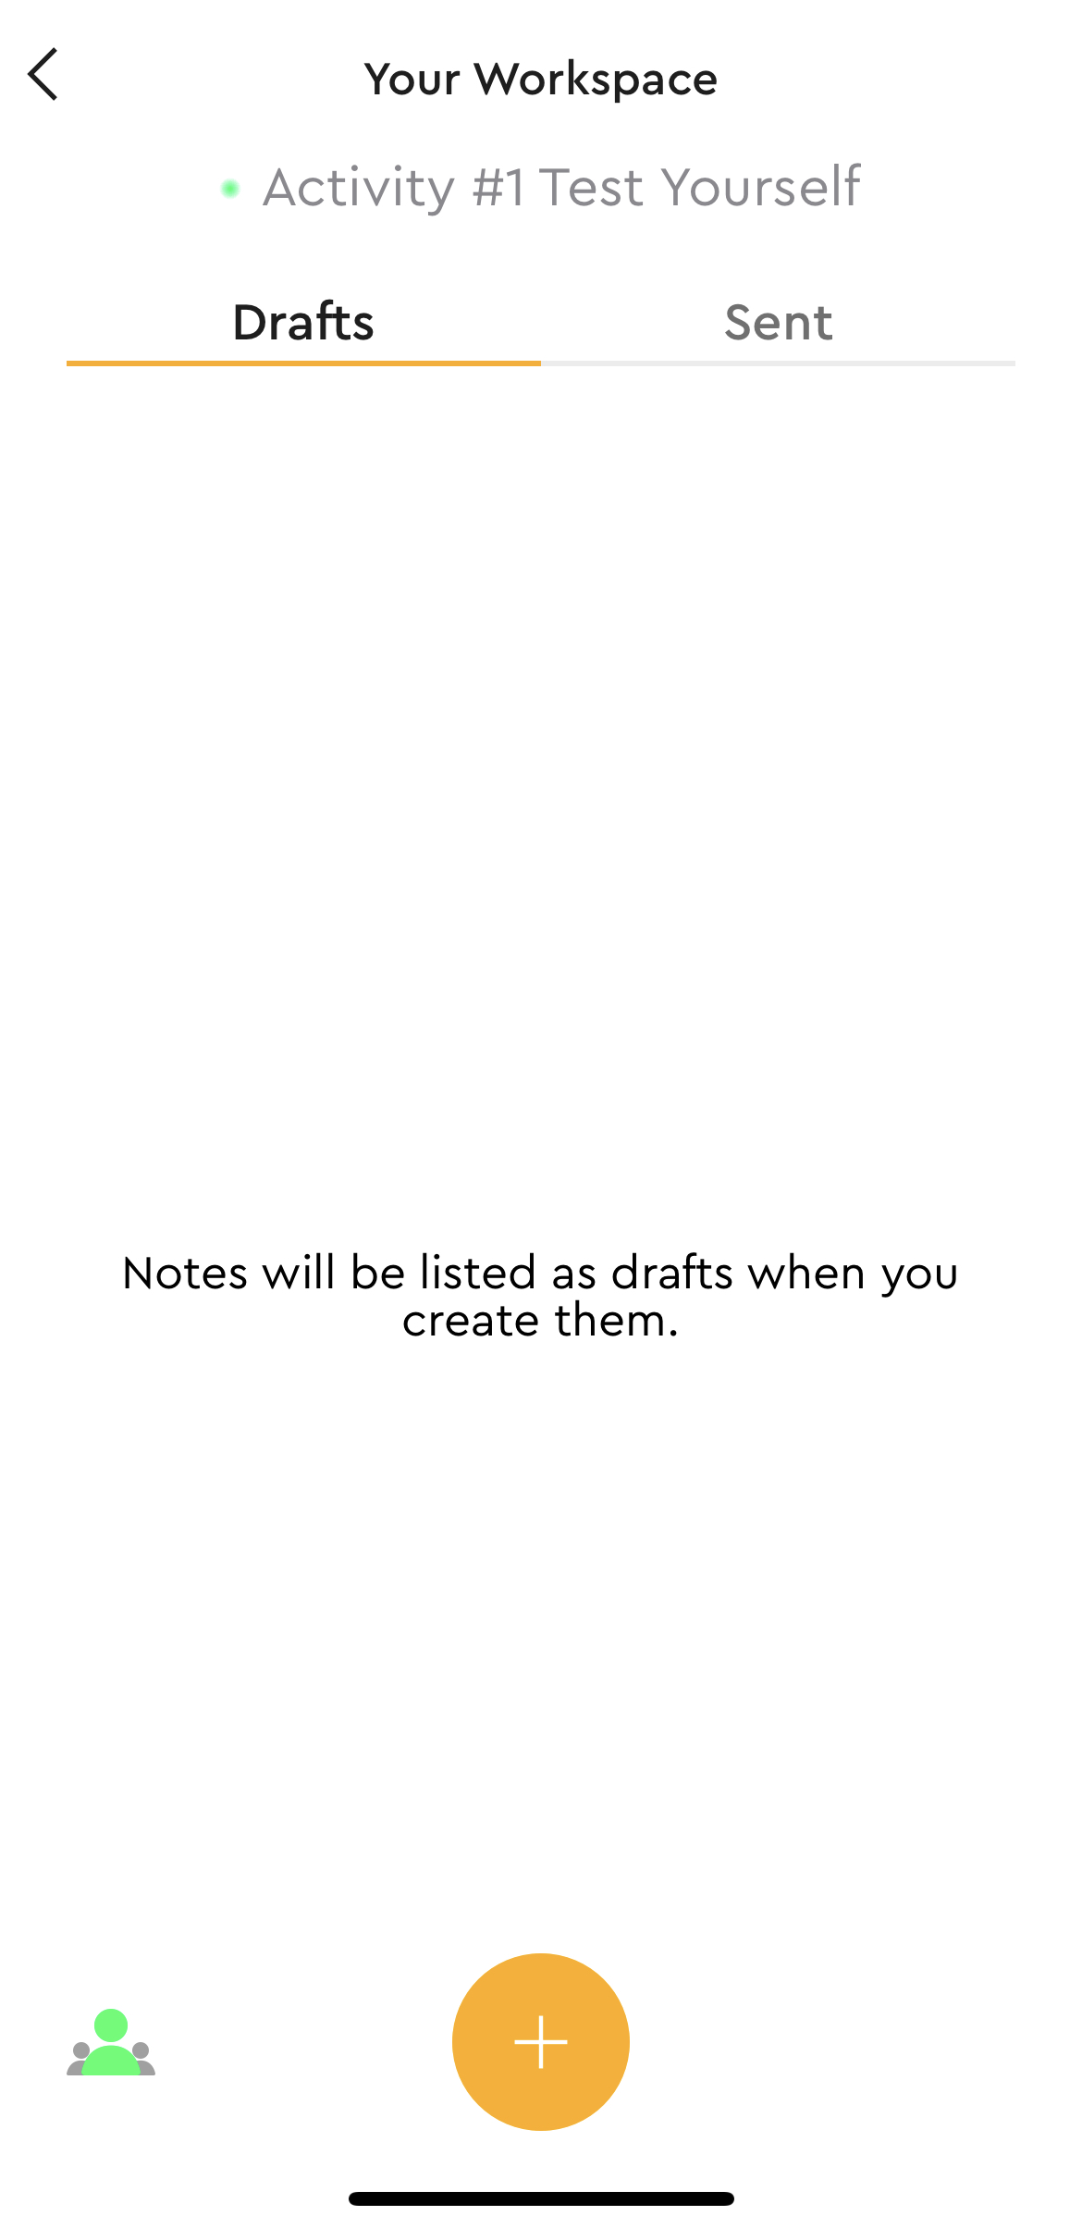
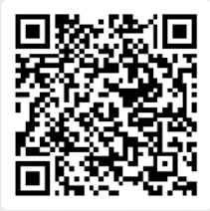
Activity #1 : Test YOurself
Please write your opinion for each question on Post-it App.
Please download the Post-it app.
Click ‘Join Session’ and put session
  Session ID: P4LV-NFWN-YFAF
  Or join by Session link
  https://cloud.post-it.com/brainstorming/P4LVNFWNYFAF
  OR join by Session QR code
Put your Name-ID and click ‘+’ sign to add your idea

Slide 24
Dingtalk Contact
Dingtalk mail
xyr_rzckkt86f@Dingtalk.com

Slide 25

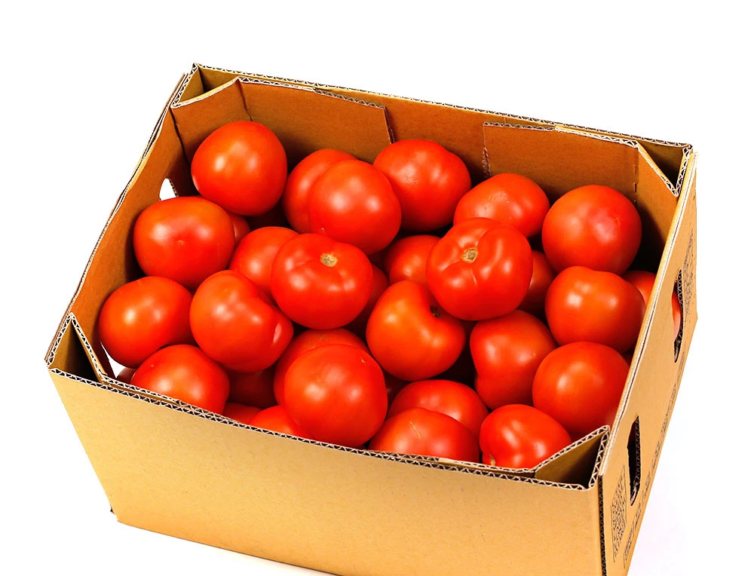
At the market
You can buy tomatoes by the kilogram or by the box
Which choice you will choose? 12 baht per kg or 40 baht for a 5 kg box?
Give a reason to support your answer…

