Slide 1
Introduction To Customer Relationship Management
Ms.Nalin Simasathiansophon

Slide 2
Pre-Test
Please go to joinmyquiz.com, then enter this code: 0922 2123
Or go to this link:
You need to put your real name when log-in to the quiz.
https://quizizz.com/join?gc=09222123

Slide 3
Definitions of Customer Relationship Management (CRM)
CRM is an integrated approach to identifying, acquiring and retaining customers.
By enabling organizations to manage and coordinate customer interactions across multiple channels, departments, lines of business and geographies, CRM helps organizations maximize the value of every customer interaction and drive superior corporate performance.
CRM is the core business strategy that integrates internal processes and functions, and external networks, to create and deliver value to targeted customers at a profit. It is grounded on high-quality customer-related data and enabled by information technology.

Slide 4
Case study: Why Starbucks wins at CRM
Three major objectives of CRM
1. Customer Acquisition: the “right” customers will be attracted to the business or product, based on known or learned characteristics.
Starbucks have loyalty program, My Starbucks Rewards.
2. Customer Retention: numbers of loyal customer
Among 10.4 million users (in year 2015), 6.2 million are gold members
The Starbuck’s loyalty program creates an incentive for customer retention through its three levels – welcome, green and gold.
3. Customer profitability: deliver profit to loyal customers
Users can work their way to gold status through increasing their purchase frequency, which earns them “stars”. These stars can be redeemed for free food and drinks.
Source: https://marketingdiscussions.wordpress.com/2015/11/09/why-starbucks-wins-at-crm/

Slide 5
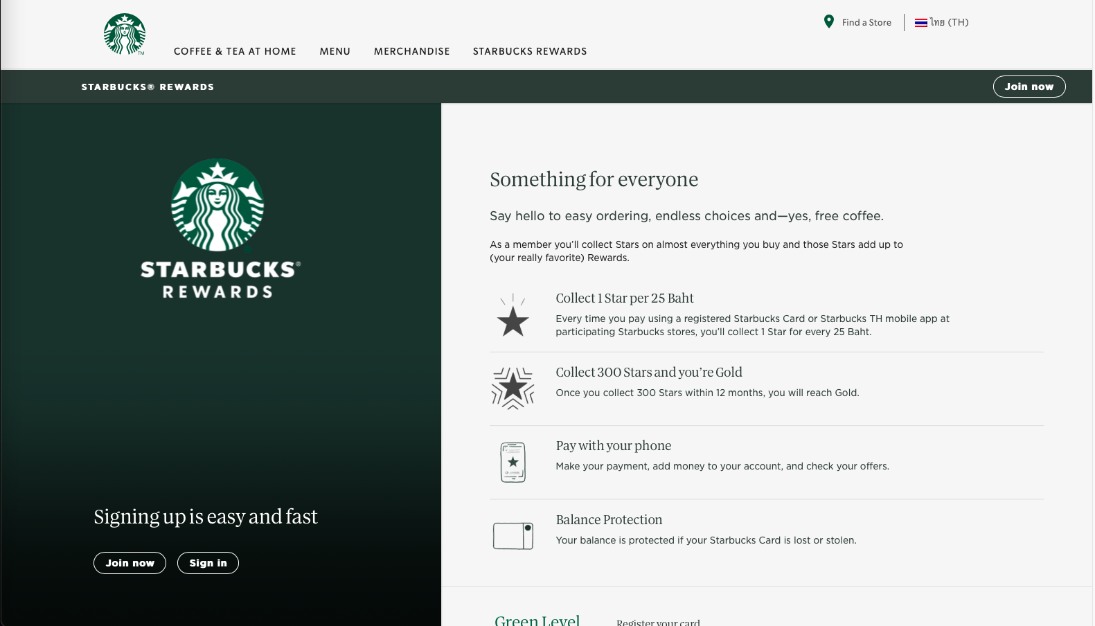

Slide 6
Types of CRM
Type of CRM | Dominant characteristic
Strategic | Strategic CRM is a core customer-centric business strategy that aims at winning and keeping profitable customers.
Operational | Operational CRM focuses on the automation of customer-facing processes such as selling, marketing and customer service.
Analytical | Analytical CRM is the process through which organizations transform customer-related data into actionable insight for either strategic or tactical purposes.

Slide 7
1. Strategic CRM
Strategic CRM is focused upon the development of a customer-centric business culture dedicated to winning and keeping customers by creating and delivering value better than competitors.
Resources will be allocated where they would best enhance customer value.
There are reward systems to promote employee behaviors that enhance customer satisfaction and retention.
Customer information will be collected, shared and applied across the business.
A customer-centric firm is a learning firm that constantly adapts to customer requirements and competitive conditions.

Slide 8
Case Study: Honda Australia
Honda developed a strategy themed Customers For Life, based on data integration and a whole-of-customer view. Honda found customer-related data in numerous spreadsheets and databases across the business. These were integrated into a single CRM platform, supplied by salesforce.com, and hosted in the cloud. This was enriched with customer information from Honda Australia Rider Training (HART), Automobile Association memberships and several other sources to create a single comprehensive data source and reporting system. Honda then removed responsibility for managing customer relationships from individual departments, and moved it to the CRM unit.

Slide 9
2. Operational CRM
Operational CRM automates customer-facing business processes. CRM software applications enable the marketing, selling and service functions to be automated and integrated.
Marketing Automation (MA) applies technology to marketing processes.
Sales Force Automation (SFA) applies technology to the management of a company’s selling activities.
Service Automation involves the application of technology to customer service operations. Service automation helps companies to manage their service operations, whether delivered through a call centre, contact centre, field service, the Web or face-to-face, with high levels of efficiency, reliability and effectiveness.

Slide 10
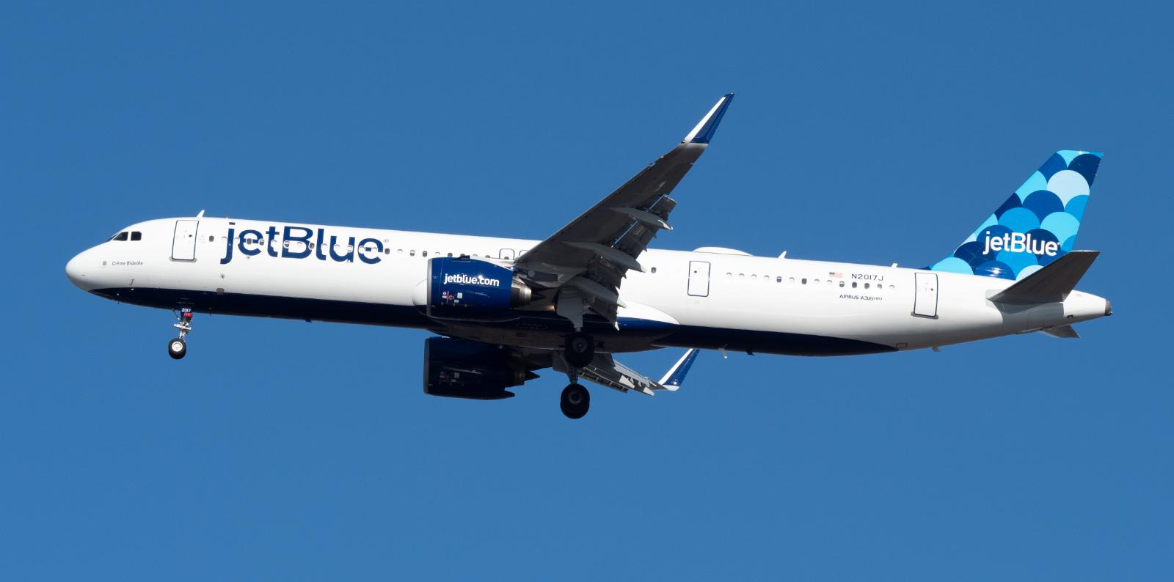
Case study of Service Automation : JetBlue
JetBlue is a successful US low-cost carrier known not only for its prices, but for friendly and helpful customer service, winning multiple JD Power customer service awards. It created its first Twitter account in 2007.16 Initially, like so many new technology users, the company felt that Twitter would be a sales promotion channel. Indeed, JetBlue has been imaginative in building its following and promoting ticket sales over the new channel. As its competence grew, JetBlue was able to use Twitter for real-time customer service. An anecdote is that a customer tweeted that he had left sunglasses at one of the stages before boarding and head office team monitoring the Twitter-feed was able to arrange for them to be found and returned to the passenger prior to boarding the aircraft. Customer frustrations, experiences and pleasant surprises are easier to capture at the moment they are experienced, and JetBlue’s active engagement with customers over Twitter improves its ability to feel the experience as a customer does and make necessary improvements quickly.

Slide 11
3. Analytical CRM
Analytical CRM, also called analytic CRM, is concerned with capturing, storing, extracting, integrating, processing, interpreting, distributing, using and reporting customer-related data to enhance both customer and company value.
Analytical CRM builds on the foundation of customer-related information. Customer- related data may be found in enterprise-wide repositories: sales data (purchase history), financial data (payment history, credit score), marketing data (campaign response, loyalty scheme data) and service data.
Analytical CRM can lead companies to decide that selling approaches should differ between customer groups. Higher potential value customers may be offered face-to-face selling; lower value customers may experience telesales.
Analytical CRM underpins the operational CRM decisions making.

Slide 12
Misunderstandings about CRM
CRM is not database marketing: Analiytical CRM shows that data will be used for marketing purpose, market segmentation, targeting, offer development and customer communication.
CRM is a marketing process: Operational CRM can use customer- related data to produce customized products and services.
CRM is an IT issue: It is not since CRM technology provides tools that can be used to generate better value for customers. CRM implements by two parts: people and process. People develop and implement the processes that are enabled by the IT. IT is, therefore, a part of most CRM strategies.

Slide 13
Misunderstandings about CRM (Cont.)
CRM is about loyalty schemes: Not all CRM implementations are link to loyalty schemes.
Loyalty schemes may play two roles in CRM implementations. First, they generate data that can be used to guide customer acquisition, retention and development. Second, loyalty schemes may serve as an exit barrier.
CRM can be implemented by any company: Any company can implement strategic and operational CRM, but not analytical CRM.
At the very least, data are needed to identify which customers are likely to generate most value in the future, and to identify within the customer base the segments or customers that have different requirements. Only then can different offers be communicated to each customer group to optimize company and customer value over the long term. If these data are missing then analytical CRM cannot be implemented.

Slide 14
CRM Constituencies
Companies implementing CRM
Customers and partners of those companies
Vendors of CRM systems (i.e. IBM)
CRM cloud solutions providers (i.e. salesforce.com, Microsoft Dynamics)
Social media players
Vendors of CRM hardware and infrastructure (vendor who provide technologies, such as computer, servers, etc.)
Management consultants: provides strategy, business, application and technical consulting

Slide 15
MoDels of CRM
IDIC Model
Identify who your customers are
Differentiate your customers (value now and future value)
Customize the offer and communication to met customer expectations
Interact with customers to understand their expectations
The IDIC model
Companies should take four actions in order to build closer one-to-one relationships with customers:

Slide 16
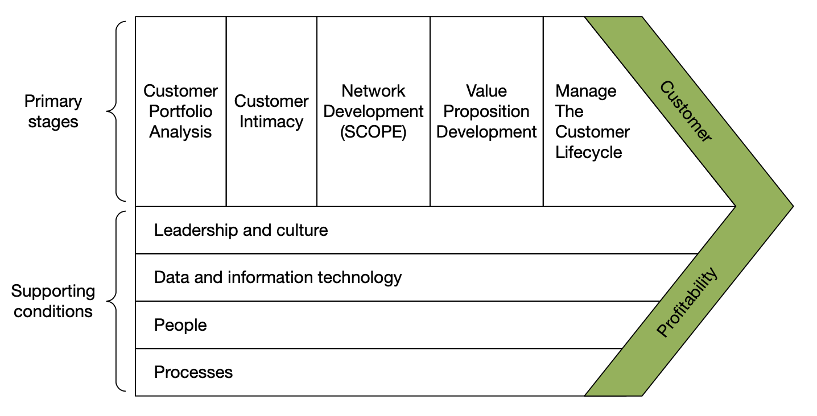
MoDels of CRM (Cont.)
The CRM Value Chain

Slide 17
MoDels of CRM (Cont.)
Payne and Frow’s 5-process model
This model clearly identifies five core processes in CRM: the strategy development process, the value creation process, the multi-channel integration process, the performance assessment process and the information management process. The first two represent strategic CRM; the multi-channel integration process represents operational CRM; the information management process is analytical CRM.

Slide 18
Payne’s model of CRM (Cont.)

Slide 19
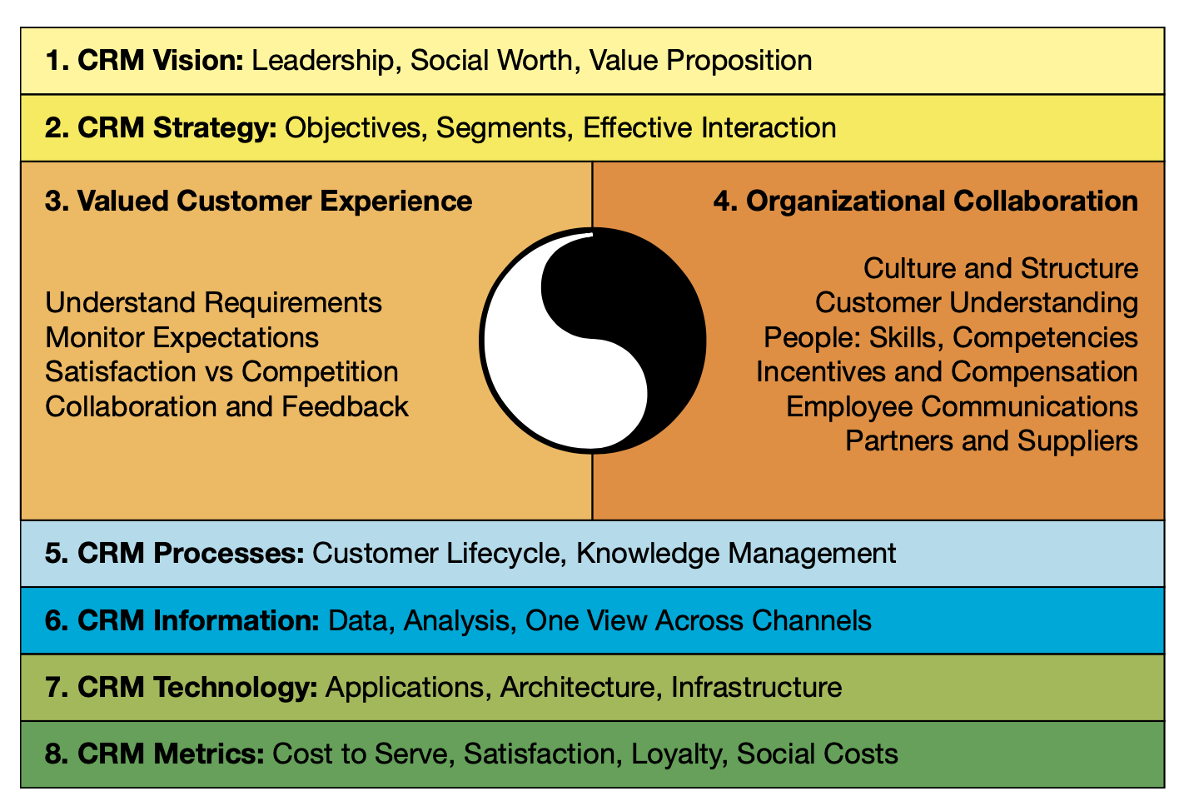
The Gartner competency model
The model suggests that companies need competencies in eight areas for CRM to be successful.

Slide 20
VDO: the outcomes of using CRM in Airline Business (SouthWest Airlines)

