Slide 1

An Overview of Financial Management
Career Opportunities
Issues of the New Millennium
Forms of Businesses
Goals of the Corporation
Agency Relationships

Slide 2

What is Finance?
Finance is the study of how people and business evaluate investments and raise Capital to fund them (--How to get and use money)

Slide 3
Career Opportunities in Finance
Money and capital markets
Investments
Financial management

Slide 4
Responsibility of the Financial Staff
Maximize value of shareholder’s wealth by:
  Forecasting and planning
  Investment and financing decisions
  Coordination and control
  Transactions in the financial markets
  Managing risk

Slide 5
Alternative Forms of Business Organization
Sole proprietorship
Partnership
Corporation

Slide 6

Sole Proprietorship
A sole proprietorship is a business
that is owned and operated by one person. The enterprise has no existence apart from its owner.

Slide 7

Partnership
A partnership is an association of two or more persons acting as co-owners of a business for profit.

Slide 8
Sole proprietorships & Partnerships
Advantages
  Ease of formation
  Subject to few regulations
  No corporate income taxes
Disadvantages
  Difficult to raise capital
  Unlimited liability
  Limited life

Slide 9

Corporation
A corporation is “an artificial being, invisible, intangible, and existing only in contemplation of the law”*. As such, a corporation is a separate legal entity apart from the individuals who own it.

Slide 10
Corporation
Advantages
  Unlimited life
  Easy transfer of ownership
  Limited liability
  Ease of raising capital
Disadvantages
  Double taxation
  Cost of set-up and report filing

Slide 11
Financial Goals of the Corporation
The primary financial goal is shareholder wealth maximization, which translates to maximizing stock price.
  Do firms have any responsibilities to society at large?
  Is stock price maximization good or bad for society?
  Should firms behave ethically?

Slide 12
Is stock price maximization the same as profit maximization?
No, despite a generally high correlation amongst stock price, earning per share (EPS), and cash flow.
Current stock price relies upon current earnings, as well as future earnings and cash flow.
Some actions may cause an increase in earnings, yet cause the stock price to decrease (and vice versa).

Slide 13
Factors that affect stock price
Projected cash flows to shareholders
Timing of the cash flow stream
Riskiness of the cash flows

Slide 14
Factors that Affect the Level and Riskiness of Cash Flows
Decisions made by financial managers:
  Investment decisions
  Financing decisions (the relative use of debt financing)
  Dividend policy decisions
The external environment

Slide 15
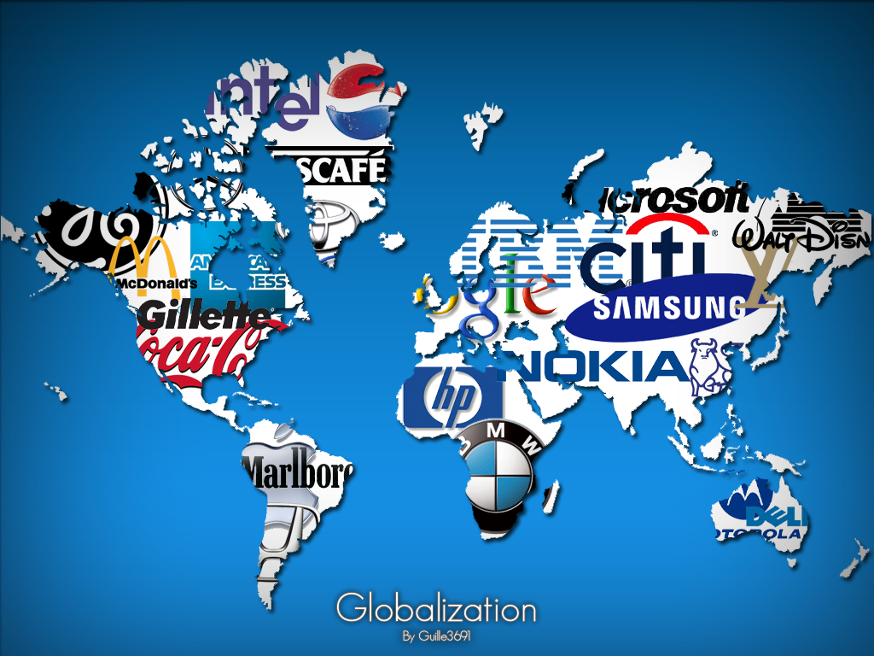
Financial Management Issues of the New Millennium
The effect of changing technology
The globalization of business

Slide 16

Fintech Definition
It is a terms “finance” and “technology” and refers to any business that uses technology to enhance or automate financial services and processes.
Money transaction on hands
Source: https://www.macthai.com/wp-content/uploads/2018/10/k-plus-all-new-design-app-2.jpg

Slide 17
Top 10 Fintech Startup in Southeast Asia (July 14, 2021)
Source: https://www.vcbay.news/2021/07/14/top-10-fintech-startups-in-southeast-asia/

Slide 18


Mobile banking vs. Social banking
Source: https://techsauce.co/tech-and-biz/how-bank-can-utilize-mobile-banking-data
Source: https://tuemaster.com/blog/ธนาคารยุคใหม่-social-banking-และ-mobile-banking/

Slide 19
Comparison between mobile and social banking
Mobile Banking
Social Banking
Slow loan approvement due to using man power
Complicate money transfer: open-close time lag
Need to open the bank account
Fast loan approvement due to using AI
Easy to transfer money
People who don’t have bank account can access loan: no need collateral or bank statement
Source: https://tuemaster.com/blog/ธนาคารยุคใหม่-social-banking-และ-mobile-banking/

Slide 20
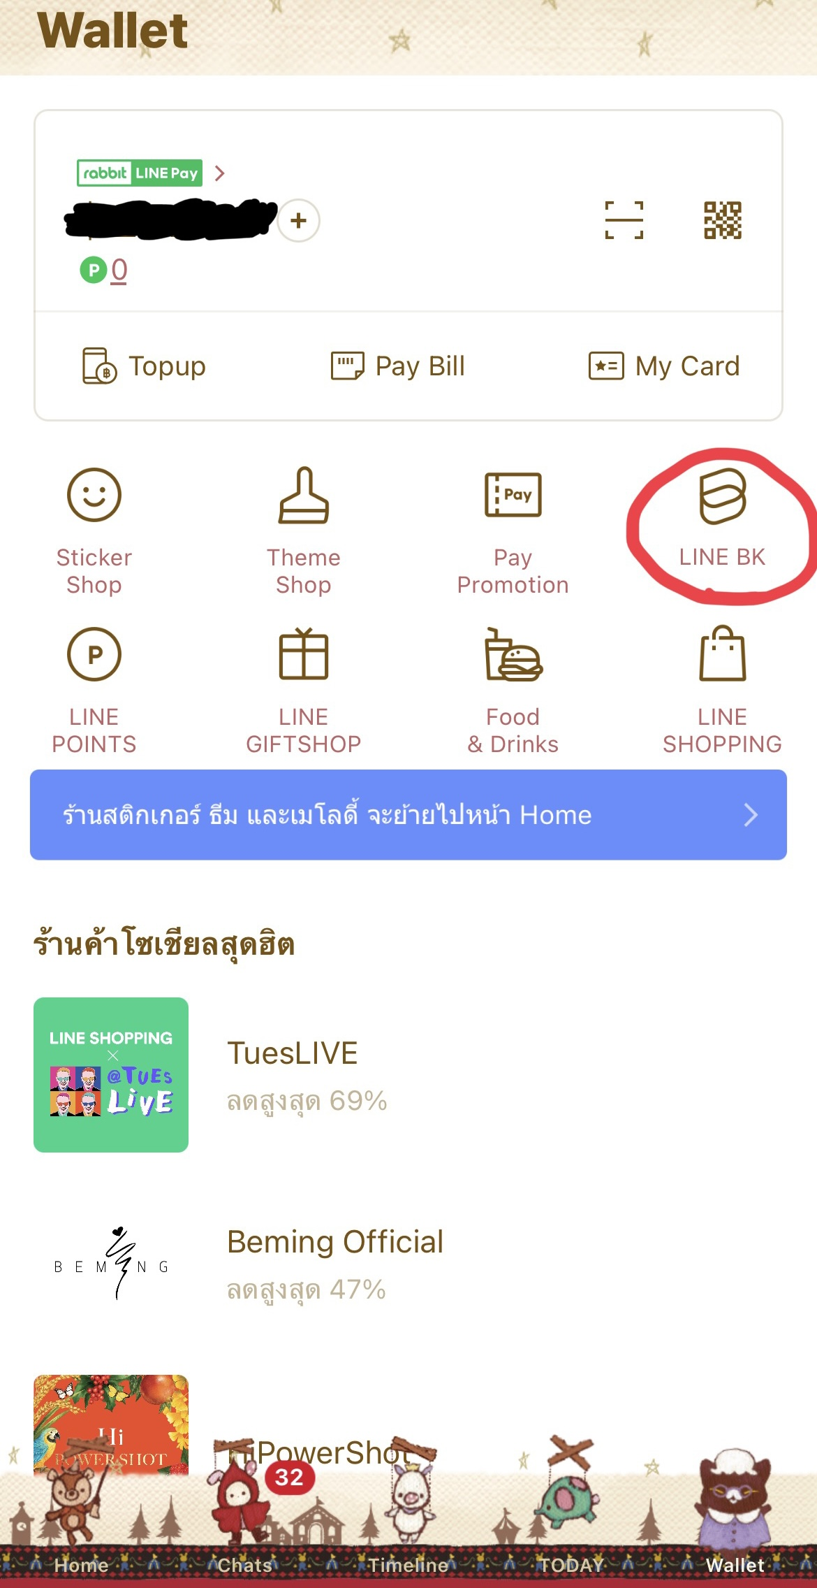

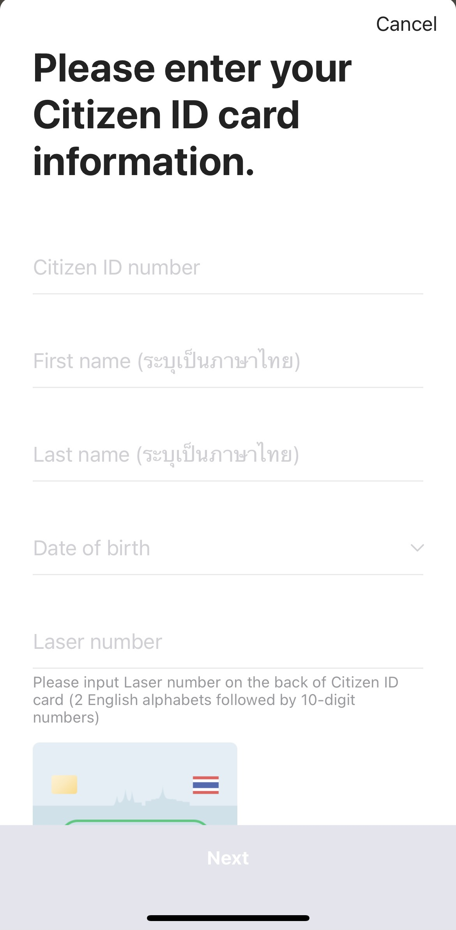
Line App. and KBank Joint Venture
Source: https://linecorp.com/en/pr/news/global/2020/65

Slide 21
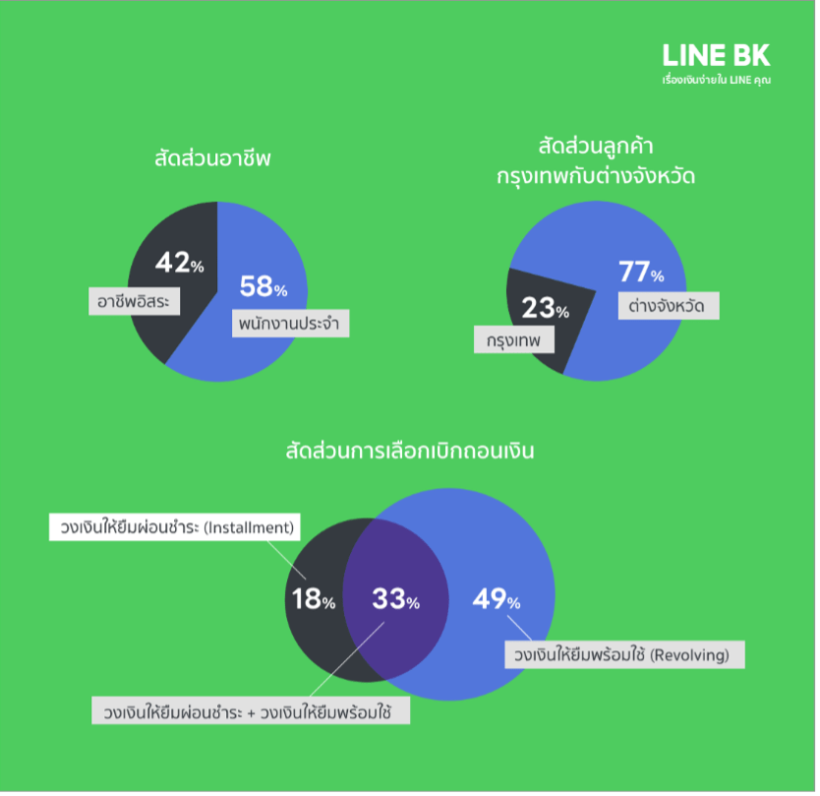
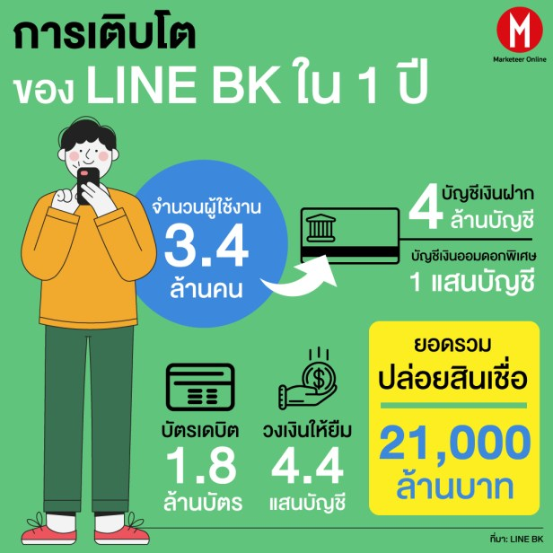
Case study: Line BK
Source: https://marketeeronline.co/archives/238821

Slide 22
Resources
https://tuemaster.com/blog/ธนาคารยุคใหม่-social-banking-และ-mobile-banking/
https://linecorp.com/en/pr/news/global/2020/65
https://thaifintech.org/top-10-fintech-startup/
https://www.macthai.com/wp-content/uploads/2018/10/k-plus-all-new-design-app-2.jpg
https://moneyandbanking.co.th/article/cover-story-mb449
https://marketeeronline.co/archives/238821

Slide 23

Speaker: Mr.Topp Jirayut Srupsrisopa #toppjirayut #beartai

