Slide 1
Topic 1 Introduction to Marketing Management
Dr.Nalin Simasathiansophon

Slide 2
Pre-test

Slide 3
Pre-test

Slide 4
Pre-Test

Slide 5
Understanding Marketing Management
Why is Marketing Important?
What is Marketing?
What is Marketing Management?
What is Marketed?
Who Markets?
Core Marketing Concepts

Slide 6
“Good marketing is no accident”
(Kotler Keller, 2016)
Why Is Marketing Important?
Finance, operations, accounting, and other business functions won’t really matter without sufficient demand for products and services so the firm can make a profit. Thus, financial success often depends on marketing ability.

Slide 7
Why Is Marketing Important?
Marketing Decision Making
Marketing builds strong brands and a loyalty customer base, intangible asset that contribute heavily to the value of a firm (by CEO or CMO)
In an Internet-fueled environment where consumers, competition, technology, and economic forces change rapidly and consequences quickly multiply, marketers must choose features, prices, and markets and decide how much to spend on advertising, sales, and online and mobile marketing.

Slide 8
Why Is Marketing Important?
Marketing Decision Making

Slide 9
WHAT IS “MARKETING” ?
Marketing ≠ Selling
Identifying and meeting human and social needs. Lead to “meeting needs profitably”
Marketing is the activity, set of institutions, and processes for creating, communicating, delivering, and exchanging offerings that have value for customers, clients, partners, and society at large. - (AMA: American Marketing Association, 2008)
The process by which companies create value of customers and build strong customer relationships in order to capture value from customers in return.

Slide 10
WHAT IS “MARKETING” ?
A simple model of marketing process
Kotler, P. and Armstrong, G. (2012). Principles of marketing. 14th ed. Boston: Pearson Prentice Hall.

Slide 11
What is Marketing Management ?
Marketing Management is seen as the art and science of choosing target markets and getting, keeping, and growing customers through creating, delivering, and communicating superior customer values.
Marketing Process
Marketing Situation Analysis
Marketing Plan Development
Target Market
Implementation
Control
Organization Objective
Customer Satisfaction
Marketing
Management
(AMA: American Marketing Association, 2008)

Slide 12
Marketing Management Tasks
1. Developing marketing strategies and plans
2. Capturing marketing insights
3. Connecting with customers
4. Building strong brands
5. Creating value
6. Delivering value
7. Communicating value
8. Conducting marketing responsibly for long-term success

Slide 13
10 MINUTES BREAK

Slide 14
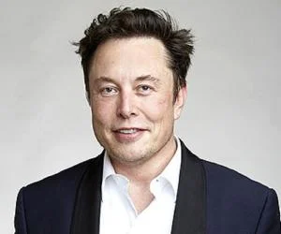
What is Marketed?
Marketers market 10 main types of entities/categories:
Goods
Services
Events
Experiences
Persons
Places
Properties
Organizations
Information
Ideas
Notes:
Proporties: combine 2 things: real proporties (i.e. real estate) and financial property (i.e. stocks and bonds)
Organizations: museums, performing arts organizations, corporations, and nonprofits use marketing to boost their public images and compete for audiences and funds.

Slide 15
Who Markets?
Marketers and Prospects
A marketer is someone who seeks a response -attention, a purchase, a vote, a donation - from another party, called the prospect.
If two parties are seeking to sell something to each other, they are both marketers.

Slide 16
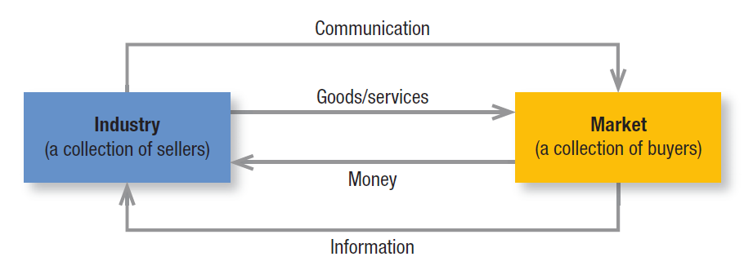
Who Markets?
Market
Economists describe a market as a collection of buyers and sellers who transact over a particular product or product class.
Kotler, P. and Keller, K. L.. Marketing management. 2012 - Prentice Hall - Upper Saddle River, N.J. (P.30)

Slide 17
Structure of Flows in a Modern Exchange Economy
Kotler, P. and Keller, K. L.. Marketing management. 2012
- Prentice Hall - Upper Saddle River, N.J. (P.29)

Slide 18
Key customer markets
Consumer Markets
Companies selling mass consumer goods and services.
Business Markets
Companies selling business goods and services often face well-informed professional buyers.
Global Markets
Companies, in the global marketplace, navigate culture, language, legal, and political differences while deciding which country and how to enter, how to adapt and communicate.
Nonprofit and Governmental Markets
Companies selling nonprofit organizations with limited purchasing power

Slide 19
Core Marketing Concepts
Needs, Wants, and Demands
Segmentation, Target Markets and Positioning (STP)
Offerings and Brands
Marketing Channels
Paid, Owned, and Earned Media
Impressions and Engagement
Value and Satisfaction
Supply Chain
Competition
Marketing Environment

Slide 20
The New Marketing Realities

Slide 21
The New Marketing Realities
The marketplace is dramatically different from even 10 years ago, with new marketing behaviors, opportunities, and challenges emerging.
The three transformative forces are:
Technology
Globalization
Social responsibility

Slide 22
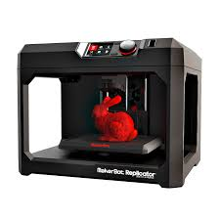
Technology
Internet / Mobile Internet
Smart phones
Social media
What else???
3D Printer
Cryptocurrency
Big Data
https://positioningmag.com/1164161

Slide 23
Technology

Slide 25
Globalization
The world has become a smaller place. New transportation, shipping, and communication technologies have made it easier for consumers to know the rest of the world, to travel, to buy and sell anywhere.

Slide 26
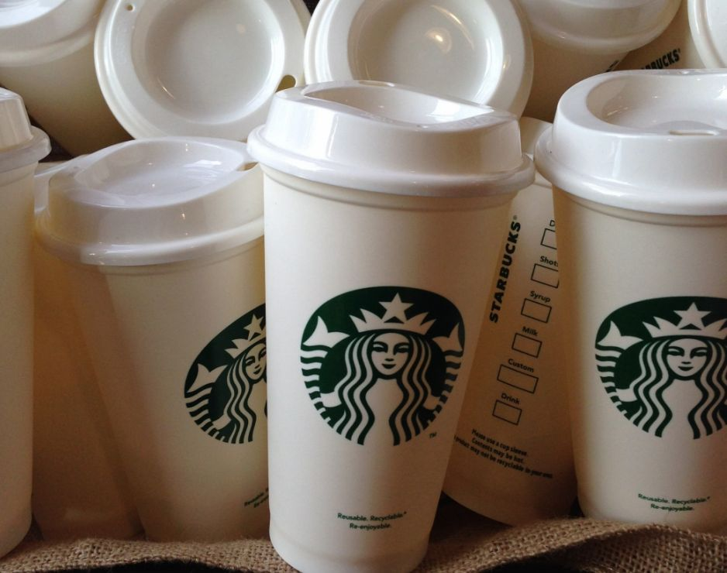
Social Responsibility (Marketing 3.0)
The private sector is taking some responsibility for improving living conditions, and firms all over the world have elevated the role of corporate social responsibility (CSR).
Marketers must consider the ethical, environmental, legal, and social context of their activities.

Slide 27
References
Kotler, P. and Keller, K.L. 2016. Marketing Management. 15 ed. Pearson: Boston.

