Slide 1
Orientation for Internship
This Photo by Unknown Author is licensed under CC BY

Slide 2
Schedule
Today
Preparation for internship
Organization Cultural Differences
Rules and Duties
Internship Handbook
Self Study
CHM Next
https://elchm.ssru.ac.th/next/course/index.php?categoryid=3
Select course ‘CHM108 Basic Excel and Digital Marketing’

Slide 3
Workplace Selection
The business must register as
✓Company limited (Co., Ltd.) ✗ Partnership Limited (Part., Ltd.)
✓Website and physical location
If pass the criteria above, can be business located in Thailand or abroad.

Slide 4
Position Selection
Related with international business
Human Resources
Marketing
Accounting
Export-import
Logistics
Management

Slide 5
Evaluation Structure
Evaluation Method | Weight Average
Attendance & Participation in Orientation Seminar | 10%
Host’s Evaluation in Work Performance | 30%
Inspector/advisor’s Evaluation | 10%
Final Report | 20%
Presentation using Power Point | 10%
Weekly Report | 20%
Total | 100%

Slide 6
DIB3511 Preparation for Internship DIB4513 Internship
English Exit Exam (SSRU TEP)
Less than 70 must join the English Training Program
If pass 70 or pass English Training Program
Pre-internship 2 months
Internship 4 months
Note: In case you want to intern 1 workplace for the whole pre-internship + internship period, we will allow you to shorten down the period of pre-internship into 1 month and internship 4 months (in total 5 months)
Write the Internship Request Form by downloading from this website: https://chm.ssru.ac.th/en/page/internship-form-inter
After you write this form, send it to IB supervisor for recheck and sign thier name. Then send this form to One-stop service (Salaya campus)
After you receive the request form back, you can send this form to the workplace
If the company receive you for internship, let them sign thier name at the 2nd page and send that page back to you.
Then you must make a photocopy or scan that page and send it to IB supervisor

Slide 7
Example of Internship Request Form (Thai version)

Slide 8
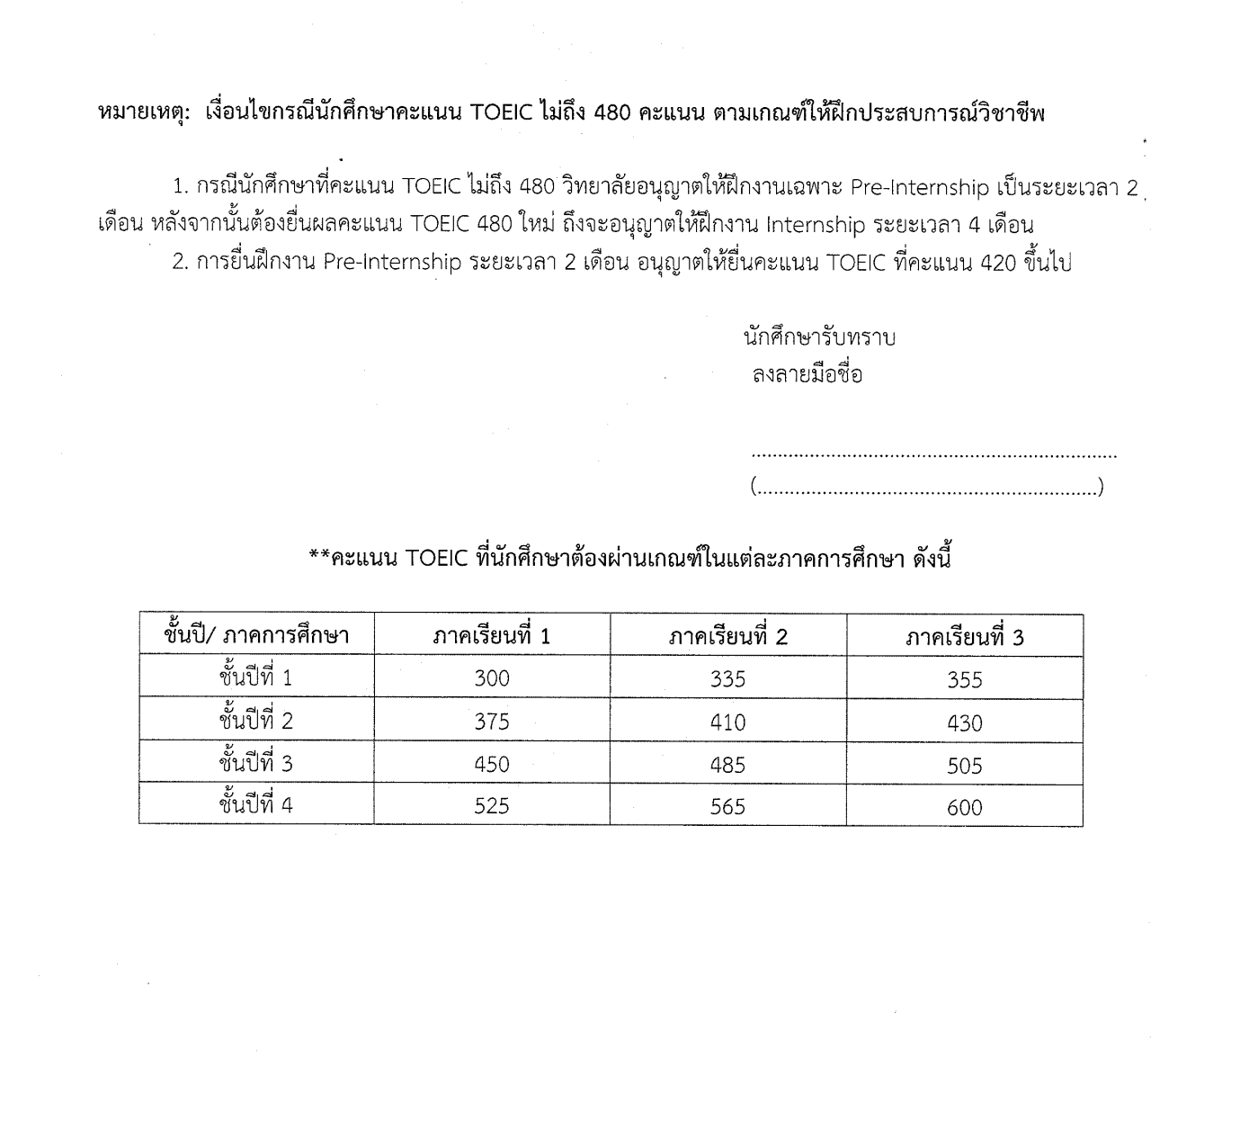
Example of Internship Request Form (page 2)

Slide 9
Example of Receiving Letter (Thai version)

Slide 10
การยื่นขอจบการศึกษา
TOEIC 600 คะแนน ยื่นที่ One-Stop Service และตรวจสอบความสมบูรณ์ของเกรดเฉลี่ย
1
รายงานตัวบัณฑิต ณ One-Stop Service สำนักงานอธิการบดี ชั้น 1 โดยนักศึกษาจะได้รับ Transcript และ ใบรับรองคุณวุฒิ (นำไปใช้สมัครงานได้)
2
มหาวิทยาลัยอนุมัติใบปริญญาบัตร
3
รอประกาศรับปริญญา (ขึ้นอยู่กับช่วงเวลาการยื่นขอจบ กรุณาเช็คเว็บไซต์กองพัฒนานักศึกษา)
4
รับปริญญา
5

Slide 11
Components of Internship Report
20%

Slide 12
1. Front Cover
Use hard paper cover with the format given in Appendix B
DIB3511 Preparation for Internship : Blue color
DIB4513 Internship : Pink color

Slide 13
2. Front Inner Cover
Use a regular A4 paper, printed identically to the cover

Slide 14
3. Preface
You must sign above your name, for example ...
(Dr.Nalin Simasathiansophon)

Slide 15
4. Table of Content
Must consistent with your report

Slide 16
5. Chapters
Total of 3000 words or 12-15 pages, Line Spacing 1.5, Time New Roman 12 points
Chapters’ structure
Chapter 1: Introduction
Chapter 2: Content of the report (see more in “Details of Chapter 2: Content of Report Writing”) *
Chapter 3: Conclusions and Recommendations (see more in “Details of Chapter 3: Conclusions and Recommendations”)
Chapter 4: References (see more in “Details of Chapter 4: References”)
*See next slide

Slide 17
CONTENT of Chapter 2
1. Organization Profile (500 words)
-History
-Industry/Product
-Organization Structure
-Vision/Mission
2. Department Description (750)
3. SWOT (500)
4. Job/Internship Profile (750)
-Position
-Responsibilities
-Issues
-Knowledge/Adjustment
5. Conclusion & Recommendation (500)
6. Ref & Appendix

Slide 18
6. Appendices
See more in “Details of Appendices of Final Report”

Slide 19
More Detail in Internship Handbook

Slide 20
7. Back Inner Cover
Use regular A4 paper

Slide 21
8. Back Cover
Use hard paper cover
DIB3511 Preparation for Internship : Blue color
DIB4513 Internship : Pink color

Slide 22
PRESENTATION (10%)
10 minutes +5 minutes Q&A
Use your own word
Bullet point
Print out the report

