Slide 1
Chapter 2
Innovation and Technology in 21st Century Learning

Slide 2
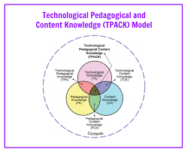
Technological Pedagogical Content Knowledge
The technological pedagogical content knowledge framework describes the kinds of knowledge required by teachers for the successful integration of technology in teaching. It suggests that teachers need to know about the intersections of technology, pedagogy, and content.
Source: https://en.wikipedia.org/wiki/Technological_pedagogical_content_knowledge

Slide 3
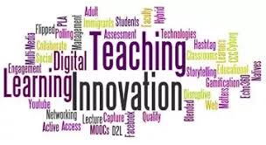
Concepts of Educational Innovation
“Educational innovation” means the adoption of new ideas, new methods, or new things, or the development, improvement, change or addition of old ideas, old methods, or old things that help the learning process for the prosperity of a person. and society continuously throughout life.

Slide 4
Successful 3 Elements of Educational Innovation
Foresight
Implement
Idea
Successful innovation needs all three elements: idea, implement, and foresight.
Innovation
Foresight in education focuses on success for improvement students’ learning behaviors.

Slide 5
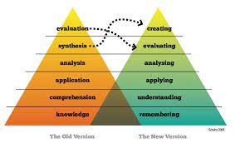
Bloom’s Taxonomy for Learning
Bloom’s taxonomy is a hierarchical framework for cognition and learning objectives.

Slide 6
Principles of Educational Innovation

Slide 7
Deep Learning and Teaching for Mastery in Singapore
Actively processing, not passive receiving
Questioning information, not uncritically scanning
Using and testing ideas, not just memorizing
Thinking broadly, not narrowly
Motivated by ideas, not by tests
Ideas taken forward, not left behind
Interactive whole-class teaching
Collaboration
Source: https://www.youtube.com/watch?v=zL7w0LFYezk

Slide 8
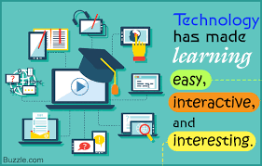
Concepts of Educational Technology
Educational technology means the use of technology in teaching and learning to provide additional opportunities for learners to explore and make discoveries mathematical concepts more efficient and effective.

Slide 9
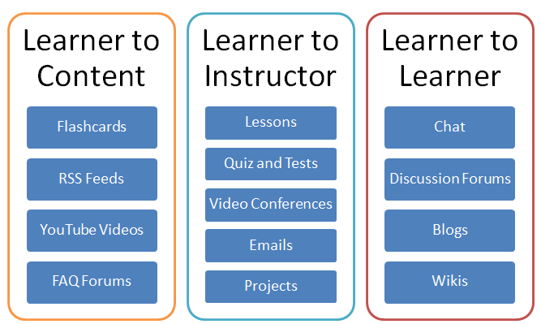
Examples of Educational Technology

Slide 10
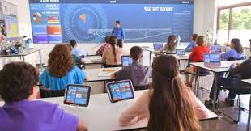
Impact of Technology in Classrooms
Using technology in classrooms has the potential to create increased student motivation, increased social interaction, positive outcomes, enhanced student learning, and enhanced student engagement. Technology is capable of unlocking keys of learning with all students.
Source: https://files.eric.ed.gov/fulltext/ED554557.pdf

Slide 11
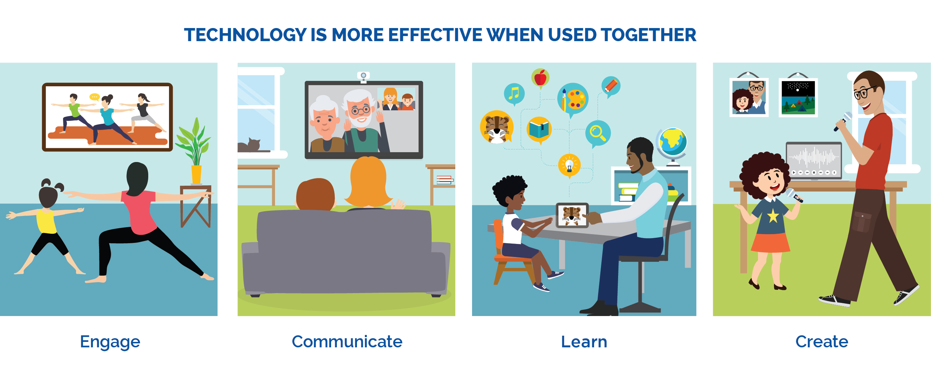
Principles of Educational Technology
Considered implementation
Appropriate tools, techniques, or process
Facilitate the application of senses, memory and cognition
Enhance teaching practice
Improve learning outcomes

Slide 12
Information Technology
Information technology is the use of computers and telecommunications to create, process, store, retrieve, and exchange all kinds of electronic data and information.

Slide 13
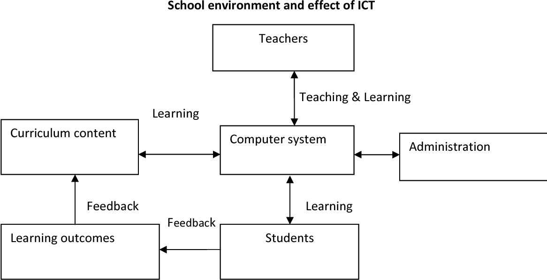
School Environment and Effect of ICT
Source: Semantic Scholar

Slide 14
Principles of Using ICT in School
Educational problems
Added value
Sustainability
Multiple uses
Lowest cost
Reliability
Ease of use
Source: National University of Singapore (January 6, 2012)

Slide 15
Innovation and Technology in Math Class
Technology provides additional opportunities for learners to see and interact with mathematical concepts. Students can explore and make discoveries with games, simulations and digital tools.
The teachers should produce very good teaching materials, and very innovative teaching ideas to engage the students in the classrooms.
Source: https://www.edutopia.org/video/singapores-21st-century-teaching-strategies-education-everywhere-series

Slide 16
Innovation and Technology in Math Class (cont.)
Today, knowledge is no more a monopoly among the teachers. Because students can get knowledge from a myriad of sources. And hence, the role of the teacher today is facilitation. That means facilitate students where they could get the right knowledge, how they could synthesize things, how they could discern the information that they get.
Source: https://www.edutopia.org/video/singapores-21st-century-teaching-strategies-education-everywhere-series

Slide 17
Innovation and Technology in Math Class (cont.)
Students could ask questions at the same time, and the teacher could see their thinking on the technology tool that they use. And kids get more excited, because they are using the tools that they are very, very good in using. Not just a pen and pencil.
Source: https://www.edutopia.org/video/singapores-21st-century-teaching-strategies-education-everywhere-series

Slide 18
Innovation and Technology in Math Class (cont.)
The world has changed. And teaching cannot stay stagnant. So the teachers recognize the fact that they cannot teach the same way that they are taught ten/twenty years ago. That they have to be very adaptive in their matters. And when they do that well, they know they're going to engage the kids. And when you engage the kids, that is where real learning takes place.
Source: https://www.edutopia.org/video/singapores-21st-century-teaching-strategies-education-everywhere-series

Slide 19
Assignment
Watch on the suggested YouTube
https://www.texthelp.com/resources/blog/what-are-the-benefits-of-using-technology-for-math/
Topics for submission: (via E-mail Chaweewan.ka@ssru.ac.th)
Connect Math Concepts to the Real Word:
Title : (at 0:01/1:40) ……………………………..
List of two cheese brands and price used in the VDO
Example: (at 0:14/1:40) “sharp cheddar cheese” low price! $2.99.
3. Which one is cheaper? Explain (in Thai).

Slide 20
Q & A

Slide 21
END

