Slide 1
IAC3306 Cabin crew management
Unit 7 : Duty Assignment
AJ.Korawin K.

Slide 2
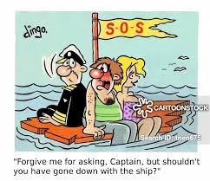

Slide 4
The flight crew includes the captain (or commander) and the co-pilot or first officer.
Captain is in charge of the team including the passengers.
The captain is responsible for and has authority over everything that happens on an aircraft before, during and at the end of a flight.

Slide 5
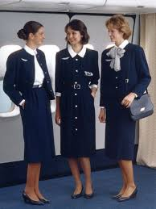
The leader of the cabin crew is the purser or in-charge flight attendant and take order directly from captain.

Slide 6
Cabin Crew Team Structure
Cabin crew members play a key role with regard to passenger and operational safety.
The number of cabin crew on board, and their performance, are significant factors in the successful evacuation of aircraft.
Therefore, a minimum number of cabin crew members are required to effectively conduct a timely evacuation and increase the survivability of passengers during an accident.

Slide 7
The number of cabin crew on each flight depends on the size and type of the aircraft. A bigger aircraft will need more crew. For instance an Emirates A380 will need 24 crew members to operate at its full potential with a full cabin of passenger.
Airlines will sometimes add cabin crew based on the number of passengers on board and the service level required for the flight.
The cabin crew is a team that must work in harmony in order to ensure safety and comfort of the passengers.

Slide 8
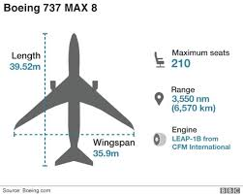
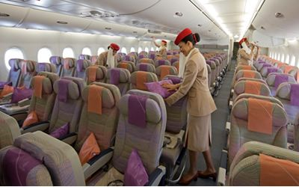

Slide 10
https://youtu.be/mQKVvfgU_Yc ATR flight safety
https://youtu.be/Yutqpup_X4o Plan Evac
https://youtu.be/-IBKI6RDH-s A320 Evac
https://youtu.be/nIq8Zjwzi2Y slide depoly
https://youtu.be/3FYPevALUME 737 Ditching

Slide 11
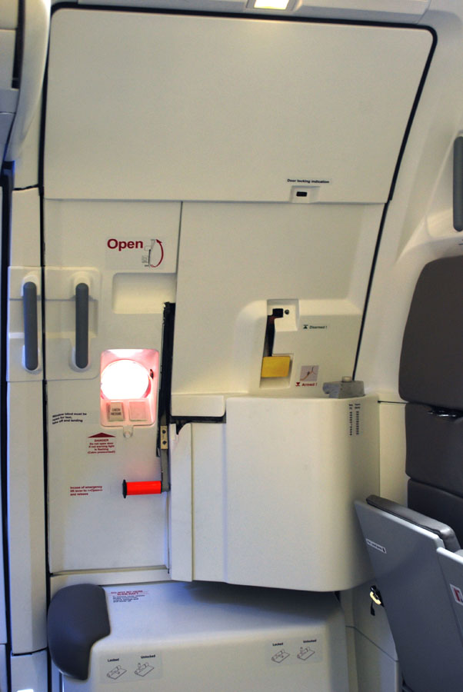
Door Primary

Slide 12
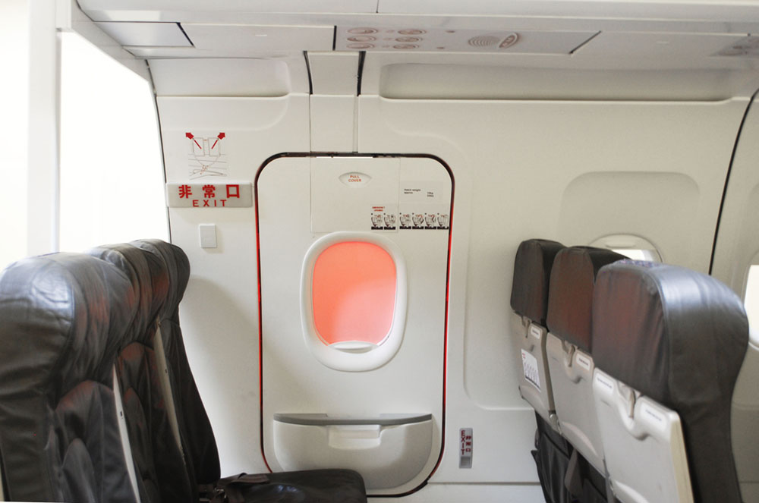
Hatch

Slide 14
Jump Seat Primary seat

Slide 15
Working Position
P : primary
A: Assist

Slide 16
1R
2R
3R
4R
3L
1L
2L
4L

Slide 17
WORKING ROUTINE

Slide 18
The air cabin crew of a commercial airline share responsibility for the safety and comfort of its passengers.
Duties include:
greeting passengers as they board and exit the plane
showing passengers to their seats and providing special attention to certain passengers, such as the elderly or disabled
serving meals and refreshments
checking the condition and provision of emergency equipment and information for passengers
.

Slide 19
demonstrating emergency equipment and safety procedures
administering first aid
dealing with emergencies
supplying passengers with newspapers, magazines and in-flight entertainment
selling duty-free commercial goods and pursuing sales targets
producing written flight reports after completing a journey

Slide 20
Prior to flight duty, cabin attendants confirm their individual roles for safety in the cabin, and directions on how to use emergency equipment, etc. To prepare for an emergency, they carry out image training of evacuating passengers by watching a video.
Before every flight, they confirm the emergency procedure and check the emergency equipment

Slide 21
Security Check
10 mins before boarding cabin crew will check cabin galley toilet to search for any suspicious items.
-Seat ; on/under ,seat pocket , overhead bin, Galley, Toilet
After a security check of the cabin and make sure preparations are complete, they welcome the passengers onboard and that time will not allow no authorized person to enter the cabin except under permission.

Slide 22
Prior to take-off and landing ;cabin attendants check
Passengers fastened seat belts,
Baggage are stored properly,
Infant life-vest distributed incase of oversea flight.
During flight,
They pay attention to any trouble in the cabin,
Sick passengers, etc. If there is a sick or injured passenger, they provide first aid using the medical kit always kept in the cabin fill in log book.

Slide 23
After arrival at the destination,
The cabin attendants review the general flight,
Discuss things they noticed,
Prepare for the next flight duty.

Slide 24
Check whether baggage are stored properly by hands and eyes

Slide 25
POST FLIGHT
Security Check
Debrief

