Slide 1
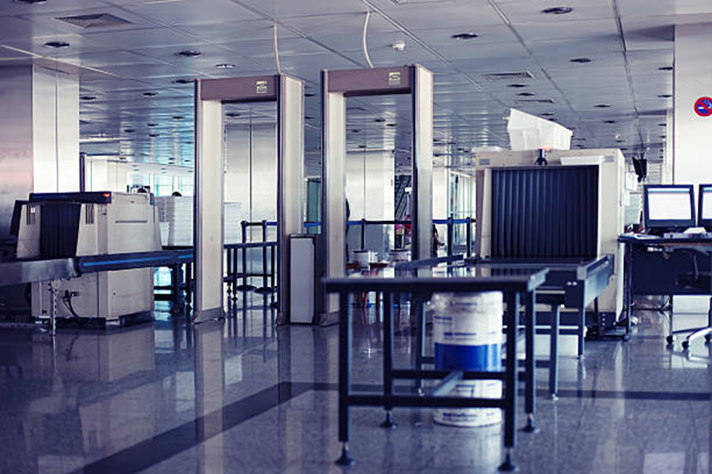
IAC3503 English for Airline and traveling
Unit 3 Security check and Boarding gate announcement

Slide 2
Conversation Vocabulary And Phrases
Instead of “Where are you flying today?” the agent may ask “What’s your final destination?”
You can say “Here you go” anytime you give something to somebody
To check your bags means to put them on the airplane inside the cargo compartment. The small bag you take with you on the airplane is called a carry-on. You need to put your carry-on bags through the X-ray machine at security.
The scale is the equipment that tells you the weight of your luggage (45 kilograms, for example)
A stopover or layover is when the airplane stops in a different city before continuing to the final destination
If the agent says that your luggage will go straight through, it means it will go directly to the final destination (and you don’t need to pick it up during your stopover)
Boarding passes are the tickets that permit you to enter the airplane
When a plane begins boarding, it means that the passengers start to enter the plane. Usually boarding time is 30-60 minutes before takeoff (when the plane leaves)

Slide 3
“Excuse me, where is the American Airlines check-in desk?”
“How many bags can I check?”
“Will my luggage go straight through, or do I need to pick it up in [Chicago]?”
“How much is the fee?” If your bag is heavier than the weight limits, or if your bag is larger than the size limits, you may need to pay extra: an oversized baggage fee or overweight baggage fee (this can be $75 to $300). Some airlines in the United States also charge a fee for ALL checked bags (usually $15 to $30).
“Please mark this bag as ‘fragile.’” Say this if you have fragile or sensitive items in your bag that might break
“Is the flight on time?” The agent will respond either “Yes” if the flight is on time, or “There’s a 20-minute delay” (for example) if the flight will leave later than expected.

Slide 4
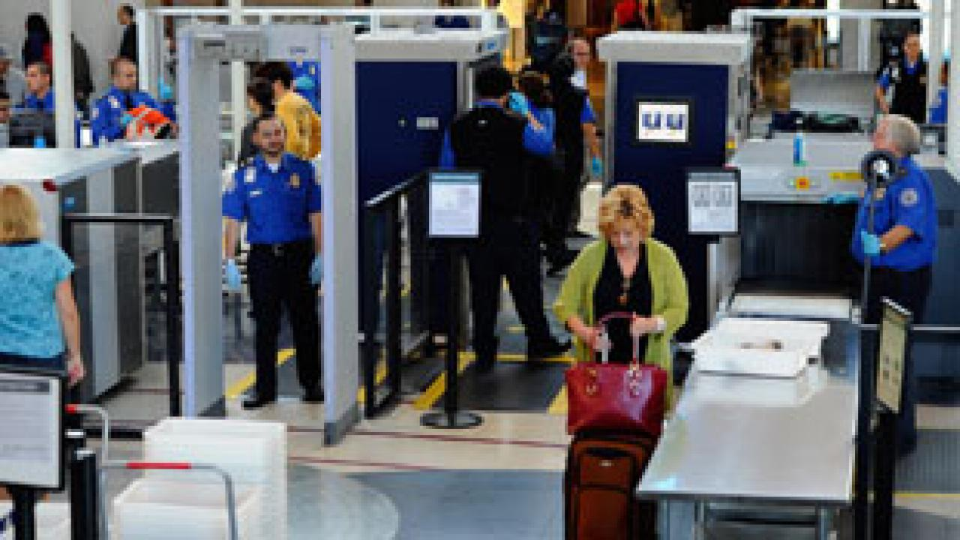
security check point
Conveyor Belt

Slide 5
There are two pieces of equipment in security: you put your bags through the X-ray machine, and you walk through the metal detector. Some airports also use a body scanner for a more careful check.
The X-ray machine has a conveyor belt that moves your bags automatically through the machine. You can put small items like keys or money into plastic bins.

Slide 6
In the picture below, the woman is walking through the metal detector. Her suitcase is on the conveyor belt after going through the X-ray machine.

Slide 7
AT security checked point
The question will be asked:
Do you have your passport? Or
May I see your passport and boarding pass?
And then you have to line up and:
Take off your shoes.
Take off your belt.
Take off your jacket
And put them on the tray.

Slide 8
AT security checked point
Here is the dialogue at the security check point.
Security staff: May I see your passport and boarding pass?
Thank you. Move ahead.
Security staff2: Excuse me, please remove your shoes, coat, and your belt and put your cellphone and computer in the bin. Ok. Now walk through the x-ray.
You need to empty your pockets and put those items in the bin as well.

Slide 9
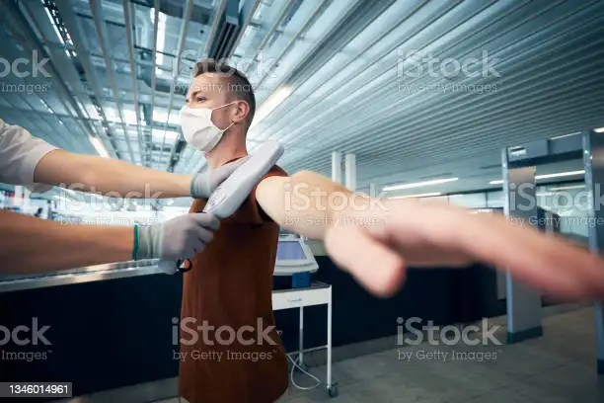
AT security checked point
Now please step through the scanner.
Beep beep beep
Security staff: Stretch out your arms. I’m going to scan your body.
Are you wearing any jewelry?
You: I think my necklace triggered the alarm.
Security staff: Ok. You are clear. Have a great flight.
You: Thanks.

Slide 10
AT security checked point

Slide 11
AT security checked point

Slide 12
Agent: Please lay your bags flat on the conveyor belt, and use the bins for small objects.
Dan: Do I need to take my laptop out of the bag?
Agent: Yes, you do. Take off your hat and your shoes, too.
(he walks through the metal detector)[BEEP BEEP BEEP BEEP]
Agent: Please step back. Do you have anything in your pockets – keys, cell phone, loose change?
Dan: I don’t think so. Let me try taking off my belt.
Agent: Okay, come on through.(he goes through the metal detector again)
Agent: You’re all set! Have a nice flight. “you’re finished and everything is OK.”

Slide 13
Phrasal Verbs: SET OFF and GO OFF
When the alarm sounds, we say “the alarm went off.” To describe what caused the alarm to sound, we say “set off” – for example, “My keys set off the alarm” or “My keys set off the metal detector.”

Slide 14
security, departure lounge, Terminal, boarding pass, flight, check-in counter, gate , crew, departure
When you take a trip on an airplane, there’s so much to do and see at the________. First, you should go to the _____ to leave your bags and get a _______ from the staff/ You can look at the ______ monitor to see if your_____ will leave on time. Then, you must get in line to _______ they will ask you to take off your shoes and leave your keys in the tray. Next, you walk to your_____ and take a seat in the______ to wait until your plane is ready. When you go on board, the_____ will help you find your seat.

Slide 15
Announcement at the gate
Airports are divided into terminals (the major sections of the airport) and each terminal has many gates. The gate is the door you go through to enter the airplane. Here are a few announcements you might hear while you are at the gate, waiting for the plane to board

Slide 16
“There has been a gate change.”
(this means the flight will leave from a different gate)
“United Airlines flight 880 to Miami is now boarding.”
(this means it’s time for passengers to enter the plane)
“Please have your boarding pass and identification ready for boarding.”
“We would like to invite our first- and business-class passengers to board.”

Slide 17
“We are now inviting passengers with small children and any passengers requiring special assistance to begin boarding.”
“We would now like to invite all passengers to board.”
(this means everyone can enter the plane)
“This is the final boarding call for United Airlines flight 880 to Miami.”
(this means it is the FINAL OPPORTUNITY to enter the plane before they close the doors)
“Passenger John Smith, please proceed to the United Airlines desk at gate 12.”

Slide 18
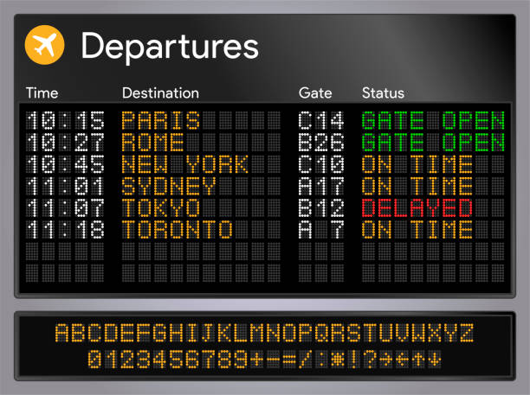
Announcement at the gate
All Nippon Airways flight NH916 to Haneda is now boarding
Please have your boarding and identification ready for boarding.

Slide 19
Announcement at the gate
Passengers for flight NH9116 to Haneda, please, go to Gate 29
Good morning this is an announcement for all passengers travelling to Haneda, this flight is delay for 1 hour because of the weather.
Passengers for flight TG 772 to LAX, please go to the Gate 32.
All passengers travelling to Tokyo on flight TG640, please have your boarding passes and passports ready for boarding. Flight TG640 now boarding at Gate 21.

Slide 20
Announcement at the gate
Passengers for flight CI 635 to SFO, please go Gate 39.
This is the final boarding call for passenger Jiab and Joom flying to DXB on flight EK 805, your flight is ready to leave, please go to Gate 5 immediately, the door of the plane will be closed in 5 minutes.
Passengers for flight SQ 618 to Singapore, please go to Gate 13.

Slide 21
Announcement at the gate
This is an announcement for passengers travelling to AMS on flight KL807 for all passengers with express boarding tickets and passengers travelling with young children, please go to Gate 7 for boarding.

Slide 22
Announcement at the gate
United Airline flight UA 2038 to Arizona is now ready for boarding, with all passengers for this flight proceed to Gate 44.
This is the last call for passengers travelling to JKT on Galuda235, due to leave at 1130, will any remaining passengers, please go immediately to Gate 41 where the flight is now closing.
Excuse me, I have a ticket for the BR212 to SEA, I was told to wait for announcements,

Slide 23
Announcement at the gate
Could you tell me what’s happening? Is that EVA air?
Yes, I’m afraid the flight has been delayed because of technical problem, the departure time is 1445. oh, no another 2 hours.
This is the final call for passenger Olivia, traveling on Japan airline flight JL 808 to LAX departing at 1230, will passenger Olivia, please go to Gate 12 where the flight is ready to depart.

Slide 24
This is an important announcement, due to extreme weather condition, Bangkok Airport has closed until tomorrow noon. Will all passengers on BA010, due to depart at 1000, please report the airport information desk, thank you.

Slide 25
Announcement at the gate
Delta airline regret to announce the delay of flight DL 4088 to Texas, due to depart at 1200, this flight is now scheduled to depart at 1345

Slide 26
boarding
Good morning, lady and gentlemen, we are about to begin boarding, Thai Airways flight TG481 to MEL and we would like to begin pre-boarding with our first-class passenger. Next, our business-class passengers may now board, and we would like to welcome all passengers with children, people in wheelchair, any priests, nuns, rabbis, imams.

Slide 27
boarding
Good evening lady and gentlemen, welcome to flight 134 with the service from Nevada to Chicago, now ready to begin boarding. Please take a look at boarding pass and listen to your group to be called before approaching a Gate. We first invite elderly passengers with those needing special assistance, and now begin boarding of parent with small children, and then first class, business class, and finally economy class from row 30-38 and then 39 to 50.

Slide 28
https://www.espressoenglish.net/travel-english-conversations-in-the-airport/

Slide 29
https://docs.google.com/document/preview?hgd=1&id=18mXxNW3s10j9rPG55uWi3nH1_ptvKaaYNOJmt8DzJZg
https://www.liveworksheets.com/worksheets/en/English_as_a_Second_Language_(ESL)/At_the_airport/At_the_airport_-_Listening_lm6112yh

