Slide 1
Speak English at the airport
Catch the taxi to the airport.
You: I’d like to go to the airport.
Taxi driver: what airport would you like to go? That’s because there are two airports in Bangkok.
You: I’m not sure, I’d like to fly to Haneda Japan by ANA.
Taxi driver: that’s Suvarnabhumi Airport.
You: yes, that’s right, thank you.

Slide 2
Speak English at the airport
Before you go abroad, what should you prepare? And what you have to know?
Terminal
what terminal do you check-in at the airport?
What documents do you need to check-in?
How many carry on baggage can you take on the flight?
How do we say?
Who do we talk to?

Slide 3
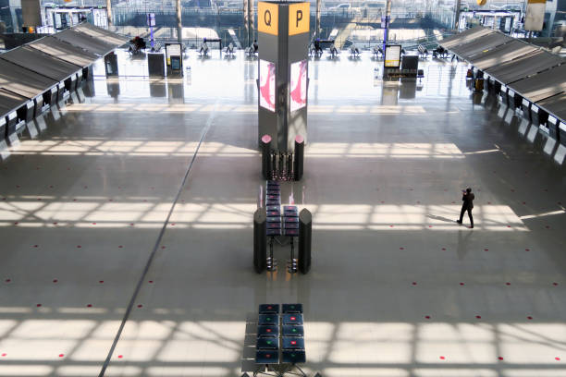
Speak English at the airport
Row at the terminal

Slide 4
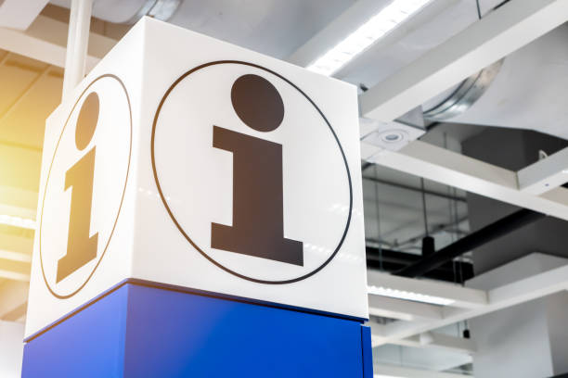
Speak English at the airport
You: excuse me, where can I find All Nippon airways check-in counter?
I’m looking for All Nippon airways check-in counter.
A.O.T. staff: They are at J,K,L,M row right there.
You: Thanks.
A.O.T. staff: your welcome

Slide 5
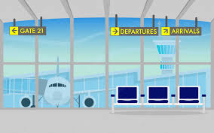
Speak English at the airport
Departures: to leave the place
Departure terminal
Terminal= A big building
Arrival= when you are at destination

Slide 6
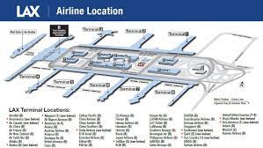
Speak English at the airport
Arrival= when you are at destination
What do we carry? Suitcase, bag or luggage

Slide 7
Speak English at the airport

Slide 8
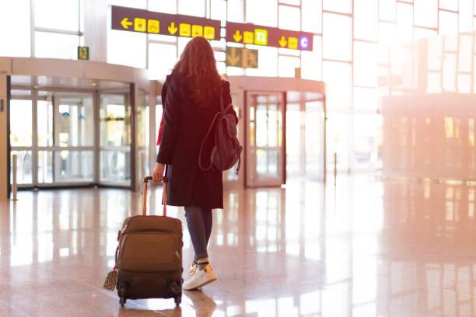
Speak English at the airport
What do we carry? Suitcase, bag, baggage or luggage
When you are talking to someone at the airport, they could use all of these words.

Slide 9
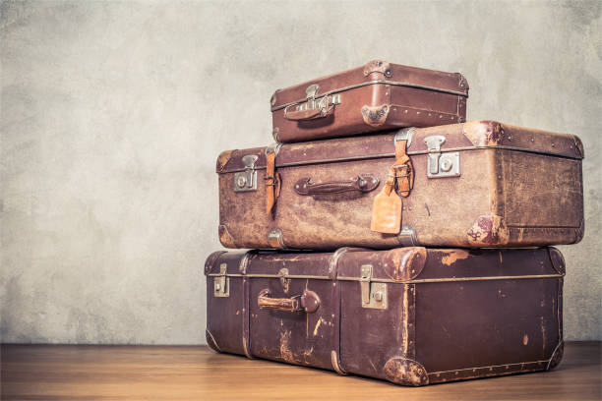
Speak English at the airport
You might see these questions.
How much luggage do you have?
How many bags do you have?
Do you have any suitcase?

Slide 10
Speak English at the airport
The difference between check-in and carry on luggage
Check-in bag
Check-in luggage
Check-in bag
All of these must be loaded into the compartment (under the airplane)

Slide 11
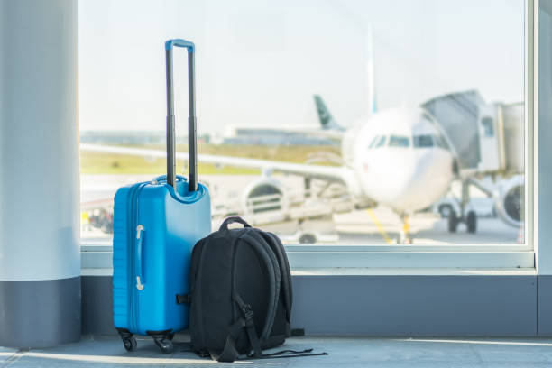
Speak English at the airport
But if you don’t want to load you bag, luggage under the airplane, and your baggage is small enough to be loaded in overhead compartment, you can carry it with you by:
Carry-on baggage, luggage, and bag

Slide 12
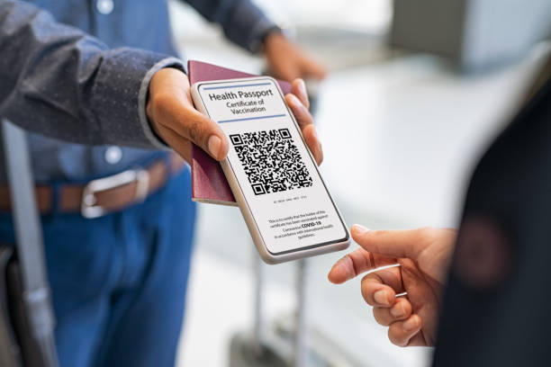
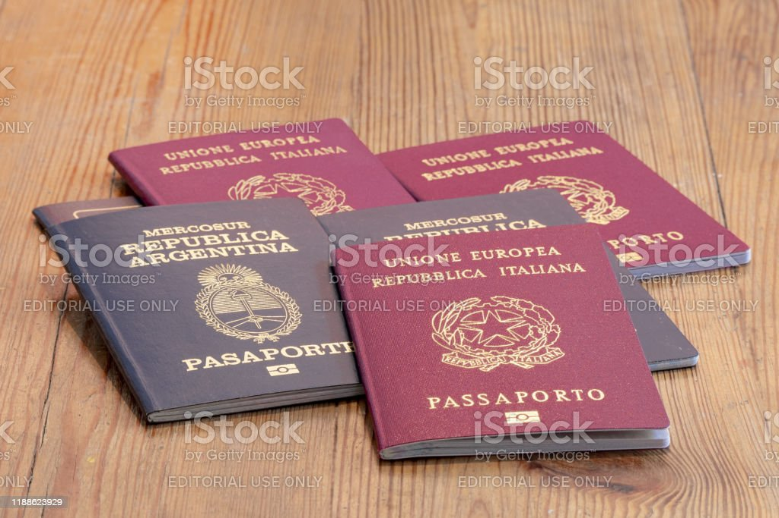
Speak English at the airport
The sentence that you might be asked at the check-in counter.
Do you have a e-ticket, and a passport?, or
May I see you e-ticket and a passport?

Slide 13
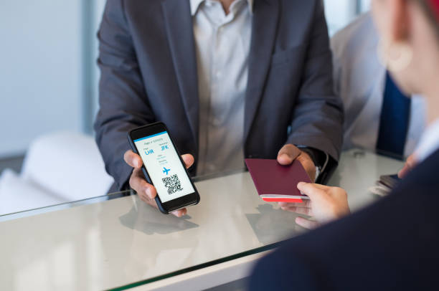
Speak English at the airport
After the staff have checked your documents, he or she might ask:
Do you have any check-in luggage?
Do you have any bag to check-in? or he or she might aske you:
Do you have any carry-on?

Slide 14
Speak English at the airport

Slide 15
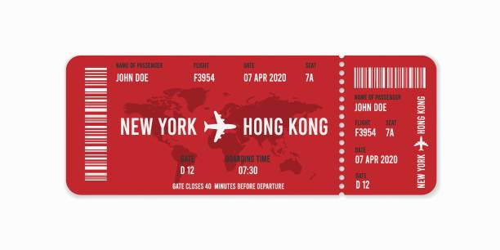
Speak English at the airport
What you have to do after getting boarding pass:
Check flight number.
Seat number.
What is the departure gate?
Board=get on

Slide 16
Speak English at the airport
You: I would like to fly to Osaka.
Staff: How many baggage do you have?
You: I just have only one suitcase and carry on bag.
Check-in counter
Staff: Hello, welcome to Thai Airways. May I see you e-ticket and passport? Ok, you have a window seat.
Staff: do you have any luggage? Do you have any carry on bags?
You: yes, I have one carry on bag and one check-in baggage.
Staff: perfect. Could you place it on the scale for me, that would be great.

Slide 17
Speak English at the airport
Check-in counter
you: here you go.
Staff: thank you. And I see you’ve chosen a window seat, is that still okay for you?
You: I think so.
Staff: Let me print your boarding pass, and you will be ready to go.
You: Ok.
Staff: here it is, you are all set.

Slide 18
Speak English at the airport
Staff: You’re going to depart from terminal 1 Gate C3,
You: when do I need to be there?
Staff: you should get to your gate about one hour before departure.
You: how do I get to the gate?
Staff: You use the escalator down to the first floor, and then turn left to Starbucks coffee shop and turn right you will see the Gate C3.
You: Thank you for your help
You’re welcome. Enjoy your flight.

Slide 19
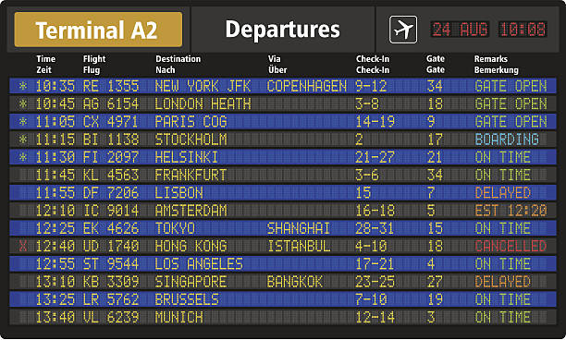
Speak English at the airport
Staff: Here is your boarding pass.
You are boarding at GATE A11. Have a nice trip.

Slide 20
Speak English at the airport
Exchange currency at the currency exchange desk
How to exchange money in English.
You: excuse me, I need to exchange some money.
Where can I get the best rate around here?
Officer: the best place to go is right outside of the airport. It’s called “Thai exchange”
They are open until midnight.
You: thank you.

Slide 21
Speak English at the airport
You: I’d like to exchange some money.
Exchange staff: ok, can you fill out this form and then wait in line?
So, you want to change Baht to U.S. dollar. That’s correct?
You: yes, that’ right.
Exchange staff: can I see you passport?
You: here you are.
Exchange staff: you want to exchange 70,000 Baht to Dollars.
The current rate is 35 Baht per one dollar, so you will get 2,000 dollars.
You: o.k. that’s fine.

Slide 22
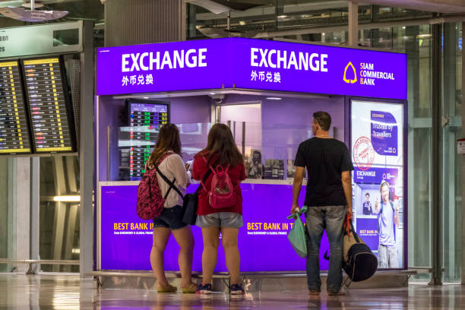
Speak English at the airport
Exchange staff: would you like that in small or large bills, a mix of both?
You: I’d like a mix of both.
Exchange staff: ok. No problem
Please sign here. And here
eighteen hundred dollar notes,
And twenty ten dollar notes.
Have a nice day.

Slide 23
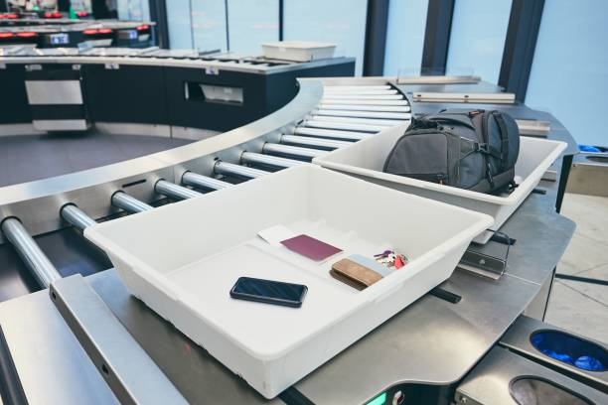
Speak English at the airport
A security check
The question will be used to ask you:
Do you have your passport? Or
May I see your passport and boarding pass?
And then you have to line up and:
Take off your shoes.
Take off your belt.
Take off your jacket
And put them on the tray.

Slide 24
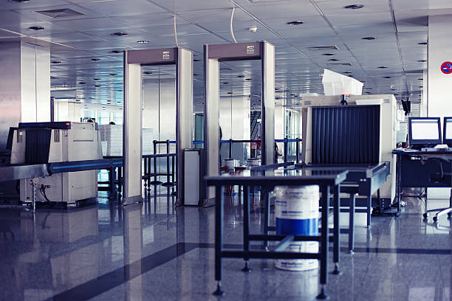
Speak English at the airport

Slide 25
Speak English at the airport
Here is the dialogue at the security check point.
Security staff: May I see your passport and boarding pass?
Thank you. Move ahead.
Security staff2: excuse me, please remove your shoes, coat, and your belt and put your cellphone and computer in the bin. Ok. Now walk through the x-ray.
You need to empty your pockets and put those items in the bin as well.

Slide 26
Speak English at the airport

Slide 27
Speak English at the airport

Slide 28
Speak English at the airport

Slide 29
Speak English at the airport
Security staff: do you have any liquid in your bag?
You: I do, I have a water bottle and some liquid soap.
Security staff: you need to take those out.
You can drink your water or throw away.
You: I’ll throw it out.
Security staff: do you have a laptop in your bag?
You: I do.
Security staff: remove and place it in the bin.

Slide 30
Speak English at the airport

Slide 31
Speak English at the airport
Now please step through the scanner.
Beep beep beep
Security staff: stretch out your arms. I’m going to scan your body.
are you wearing any jewery?
You: I think my necklace triggered the alarm.
Security staff: Ok. You are clear.
Have a great flight.
You: thanks.

Slide 32
Speak English at the airport

Slide 33
Speak English at the airport
Vocabulary
Departure boarding gate
Departure terminal duty free shop
Depart departure lounge
Bags, suitcases, luggage, baggage boarding call
Check-in bags, carry on bags
Check-in counter
Passport, boarding pass
Security check, currency exchange

