Slide 1
Customer Service
Unit 8
IAC3306 Cabin Crew Management

Slide 3
1
2
Singapore Airlines
Qatar Airways

Slide 4
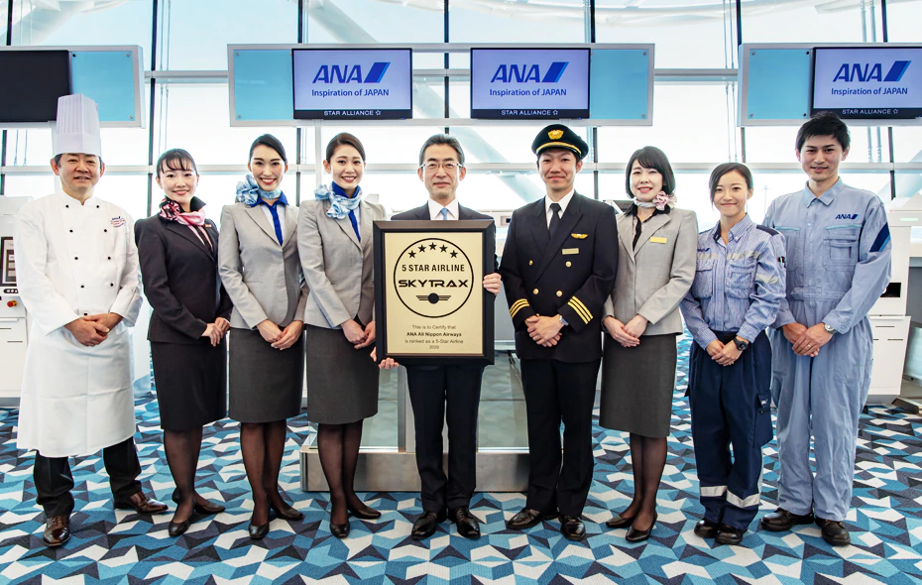
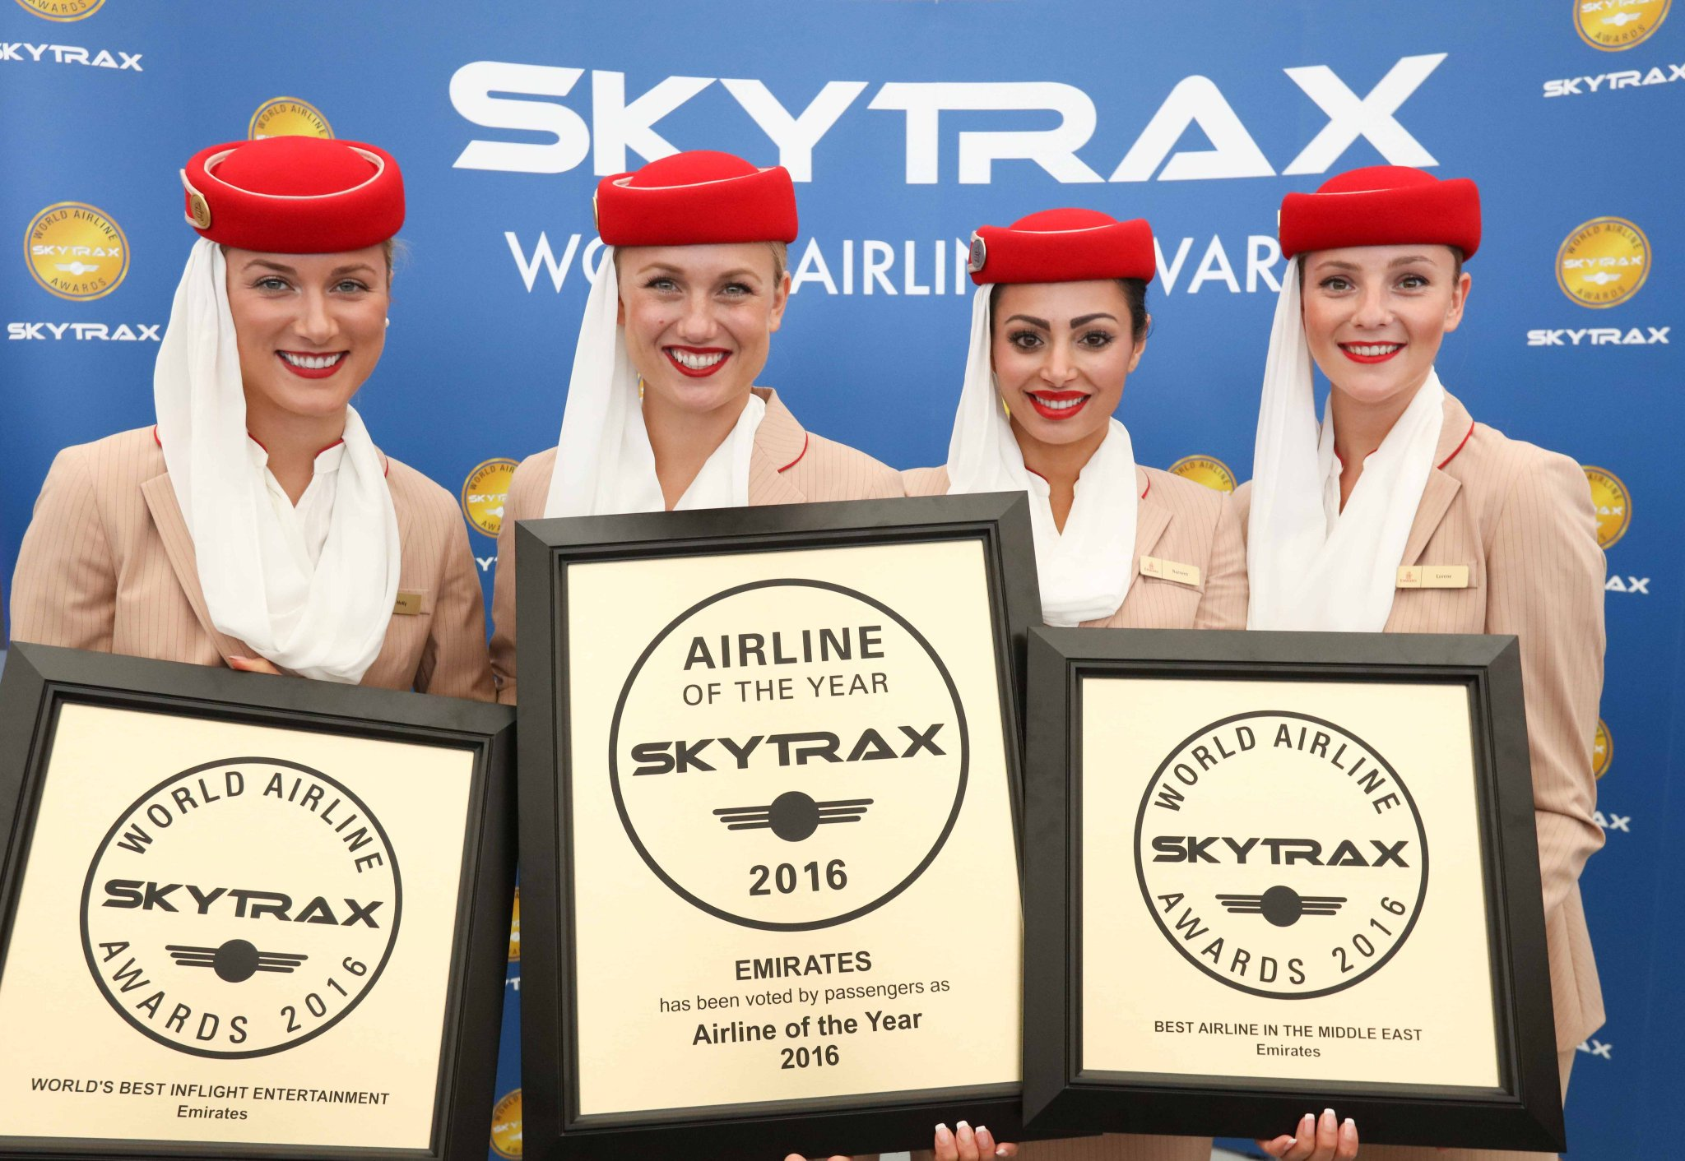
3
4
Emirates

Slide 5
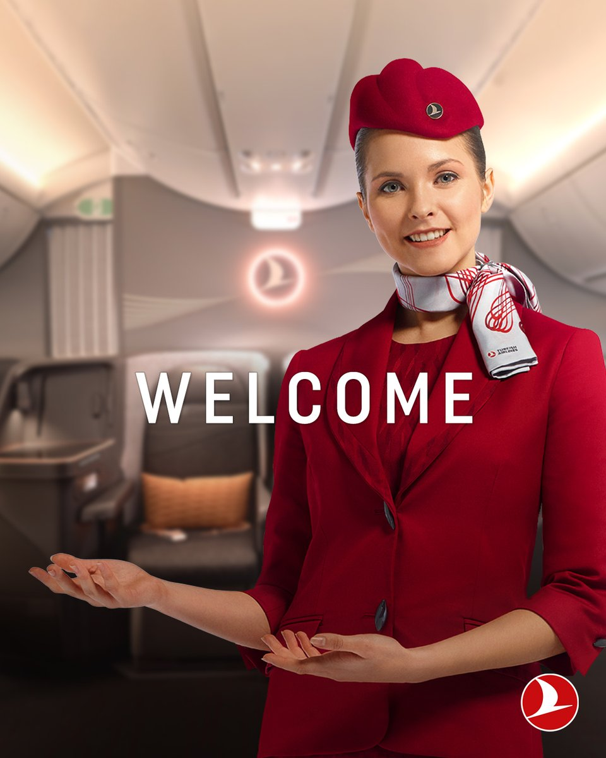
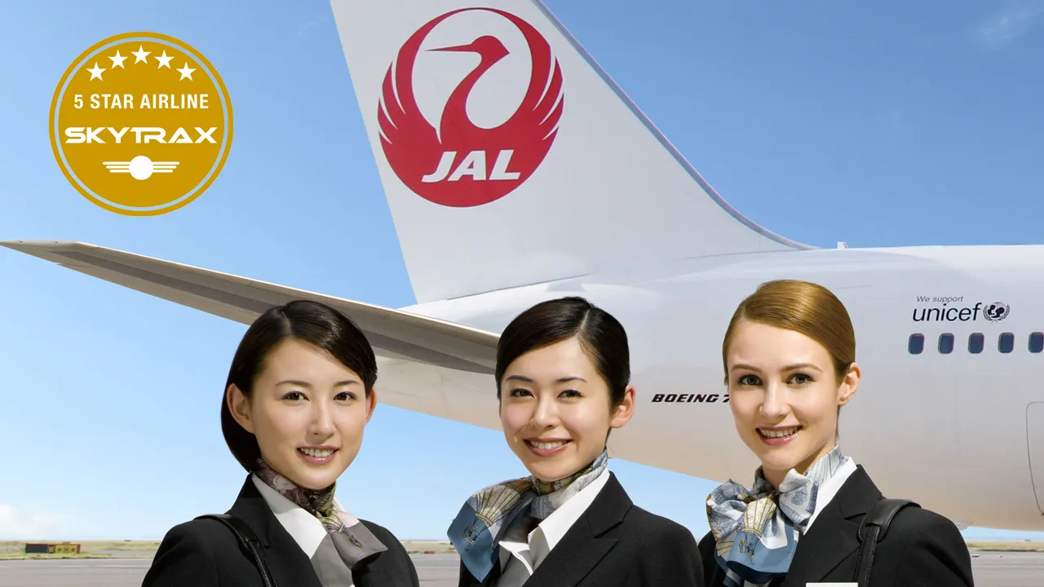
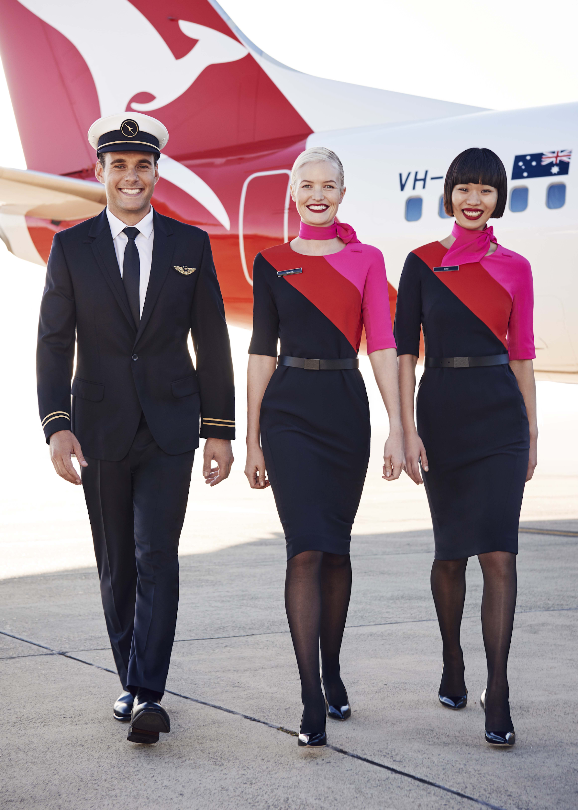
5
6
Japan Airlines
Turkish Airlines
Qantas Airways

Slide 6
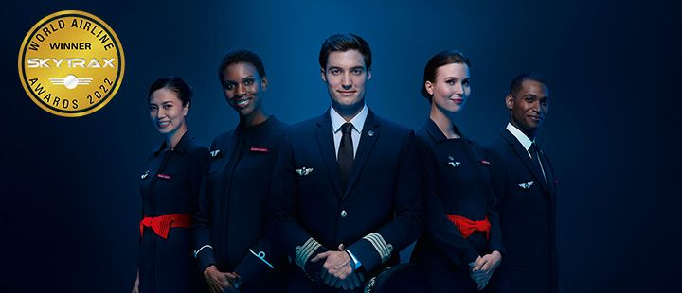
7
8
Turkish Airlines
Air France

Slide 7
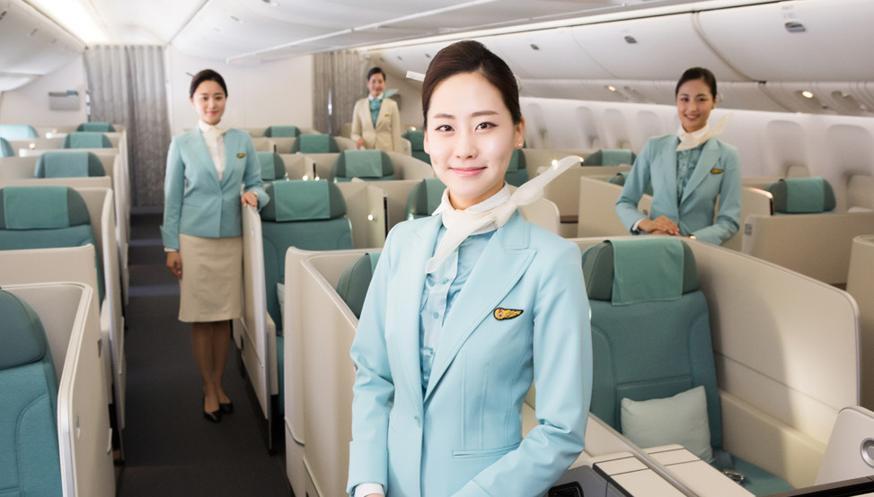
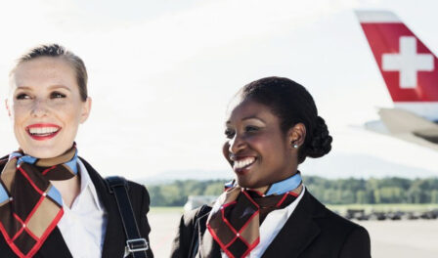
9
10
Swiss Air
Korean Air

Slide 8
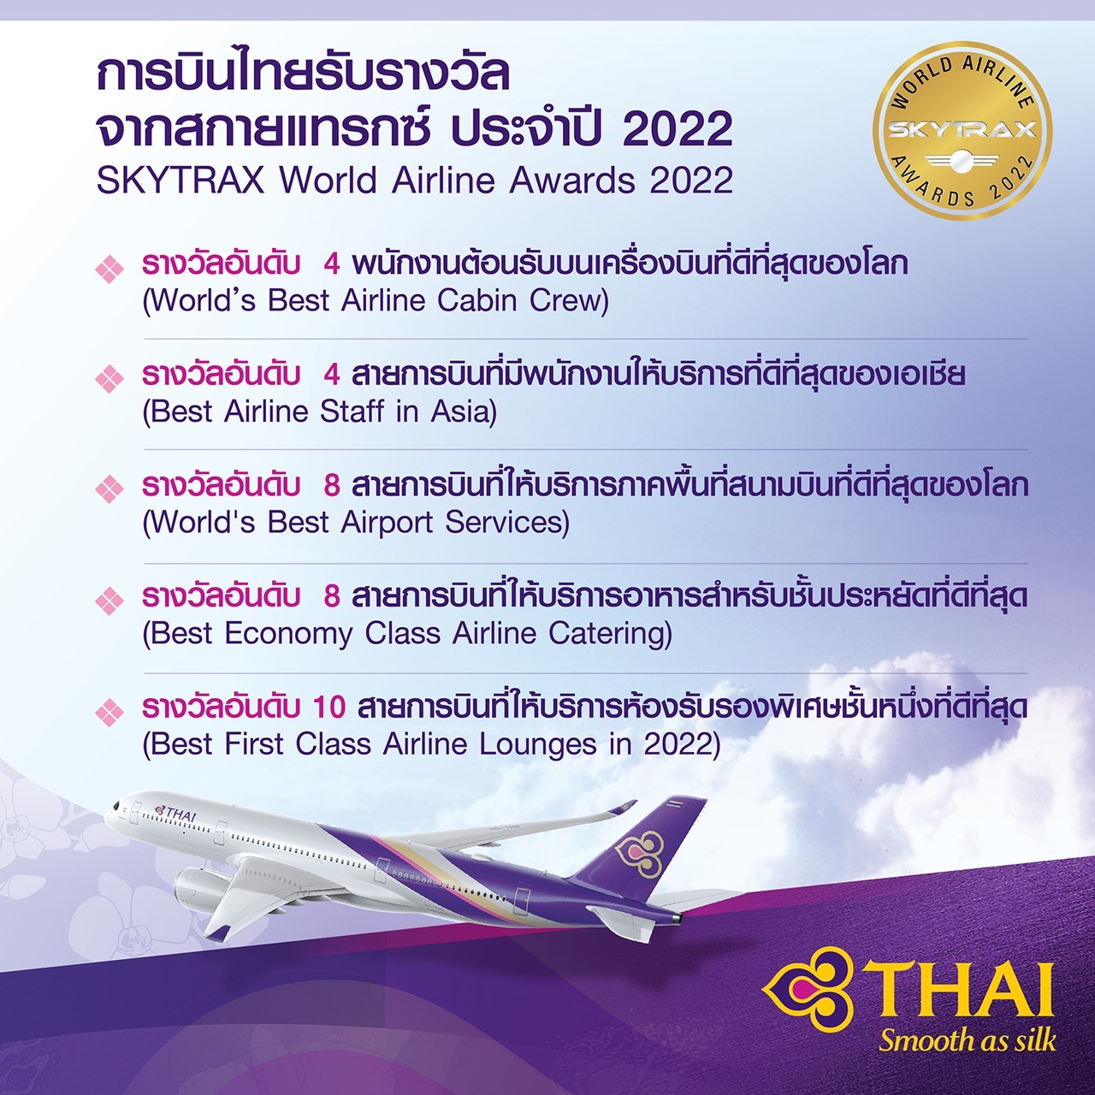
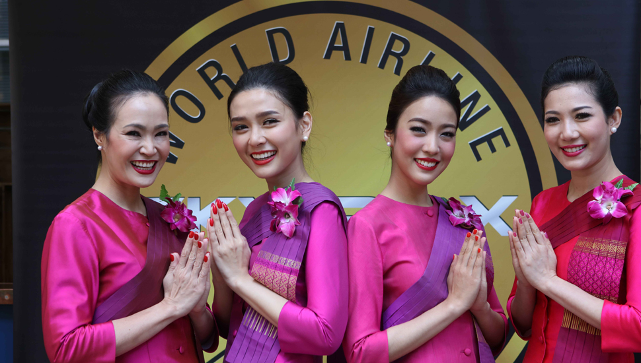

Slide 10
The world's Top 10 Airlines of 2022 voted for by travelers around the world.
CABIN SERVICE
1 | Boarding assistance
2 | Service friendliness/hospitality
3 | Service attentiveness/efficiency
4 | Staff language skills, interact
5 | Meal service efficiency
6 | Cabin presence through flight
7 | Cabin PA announcements
8 | Cockpit PA information
9 | Assisting families
10 | Problem solving skills, can-do attitude
11 | Staff attitudes can-do attitude
12 | Staff service consistency, same standard
13 | Staff grooming

Slide 11
R (Reliability)
R (Responsiveness)
A (Assurance)
RATER
Model
E (Empathy)
T (Tangibles)

Slide 12
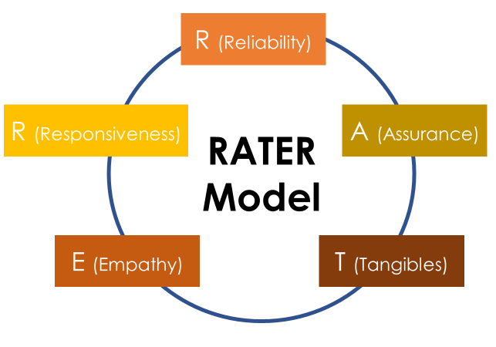
A tool for evaluating the quality of service or customer service quality.
It was created by Valarie Zeithaml & Leonard Berry, 1998
Evaluate in 5 dimensions.

Slide 13
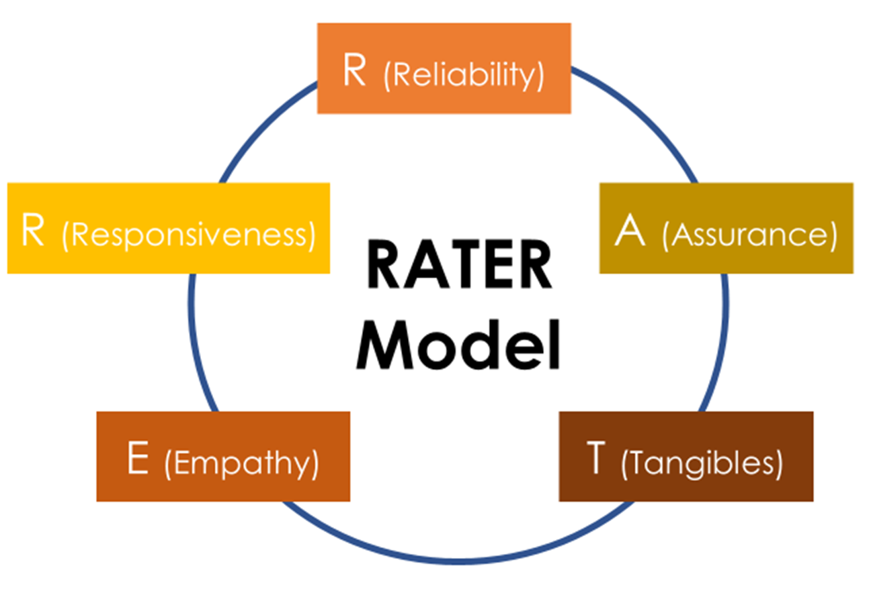
R (Reliability)
Reliability refers to the delivery of services that the airlines promised to
provide to passengers.
They set their expectations
on the services that they will gain from messages through
those advertising campaigns.

Slide 14
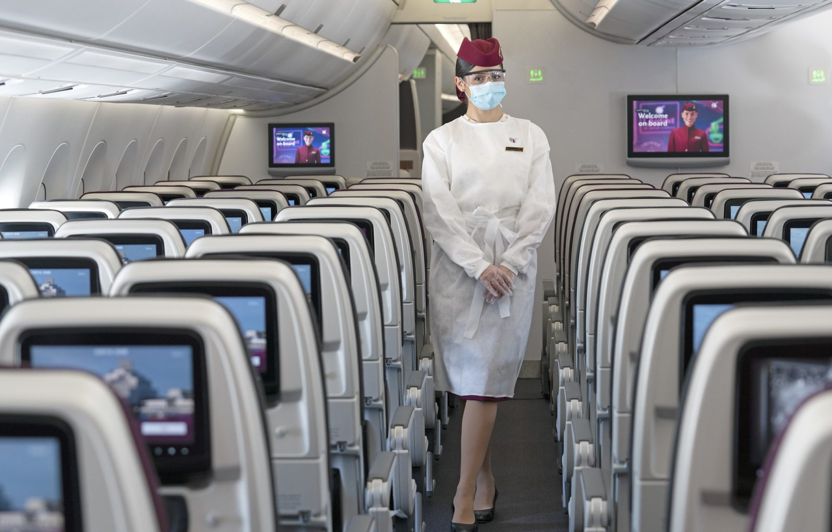
R (Reliability)
https://www.paddleyourownkanoo.com/

Slide 15
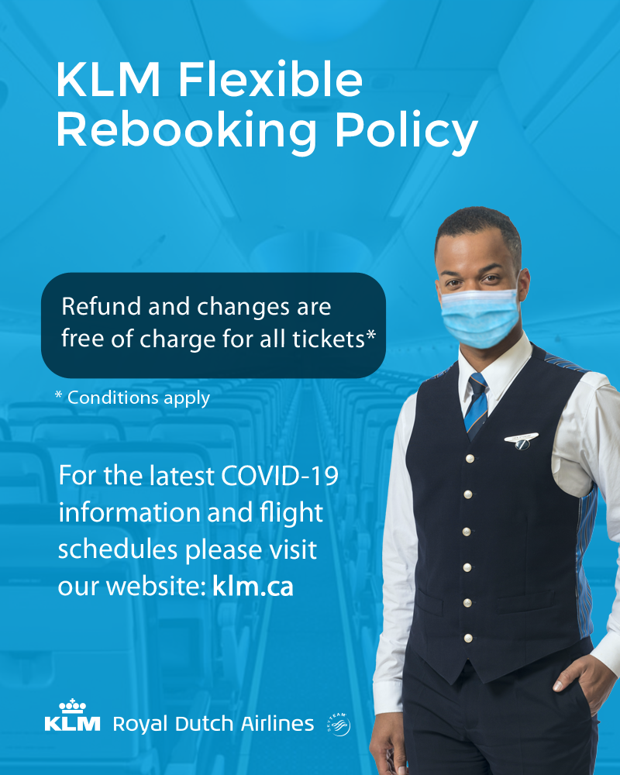
R (Reliability)
https://republika.co.id/

Slide 16
A (Assurance)
Assurance refers to the ability of the airlines to build trust and credibility to
customers.
The customers will
trust cabin crew when they demonstrate knowledge and expertise on both safety and services.

Slide 17
R (Responsiveness)
Doctor on board

Slide 18
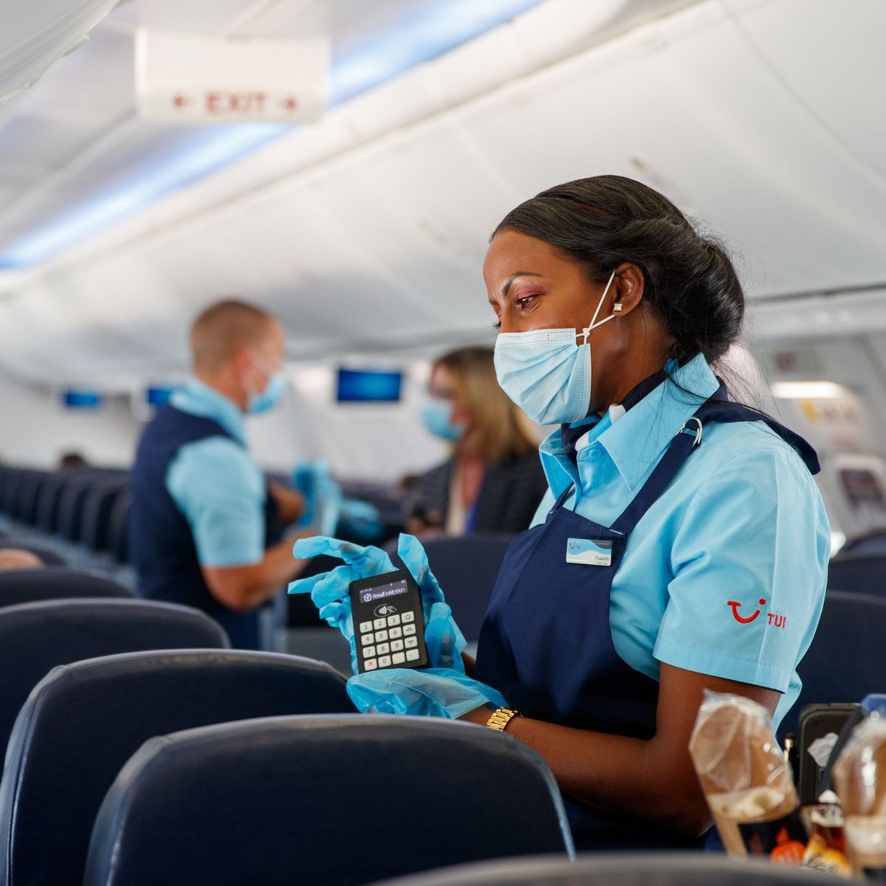

Slide 19
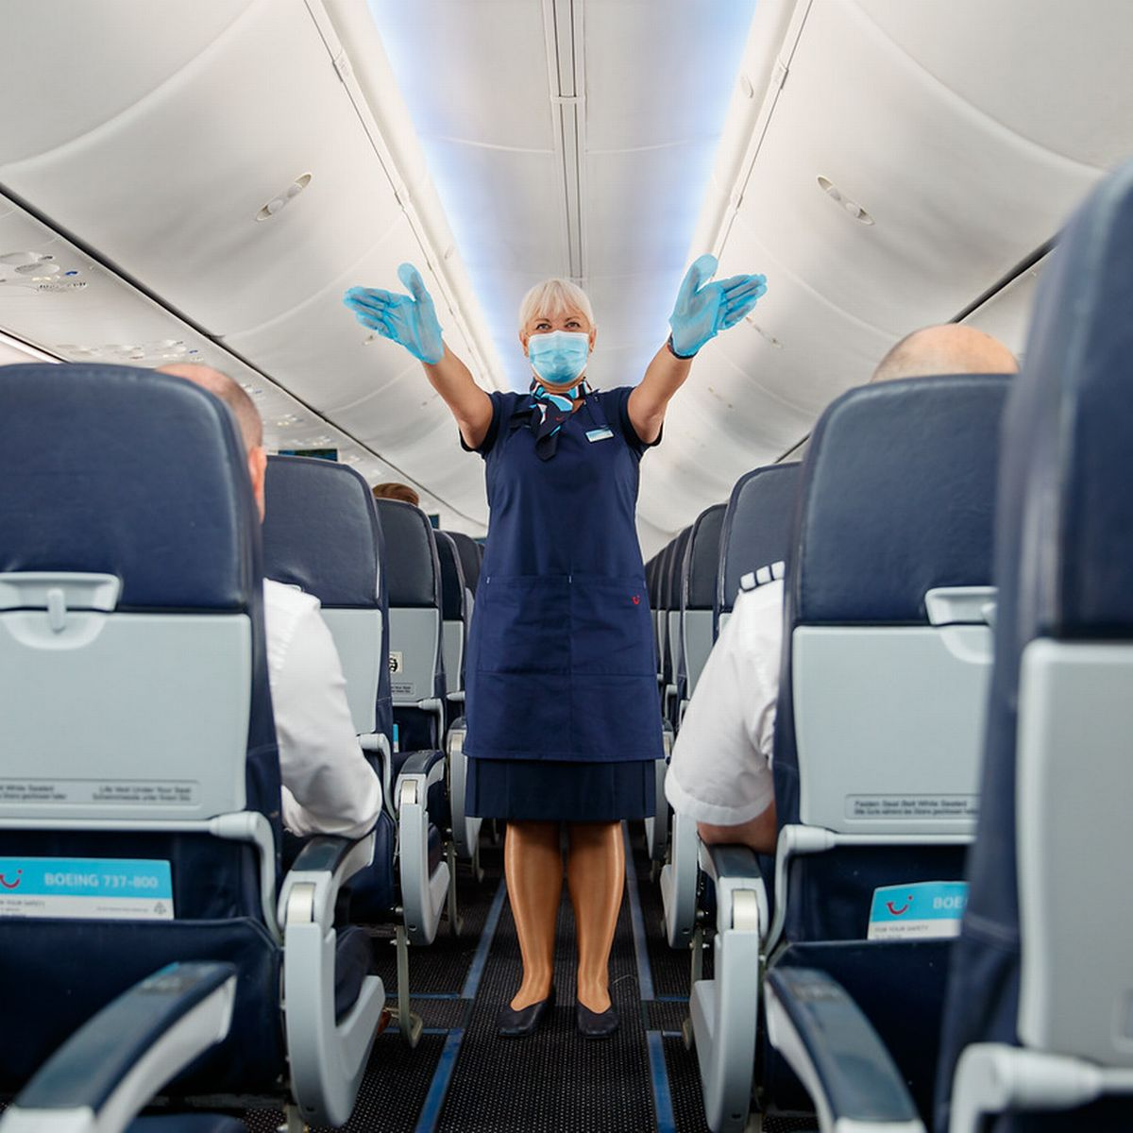

Slide 20
T (Tangibles)
Tangible refers to the physical aspects of in-flight services, such as cabin crew’s uniform, passengers’ seats, IFE, passenger cabin environment, meals and beverages, and other facilities in the aircraft.

Slide 21
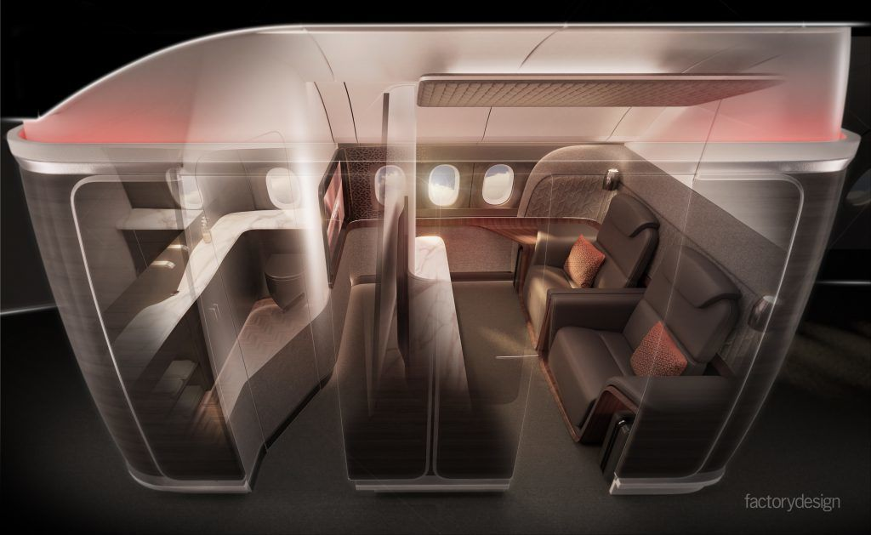
T (Tangibles)
Etihad Residence Suite
https://www.executivetraveller.com/

Slide 22
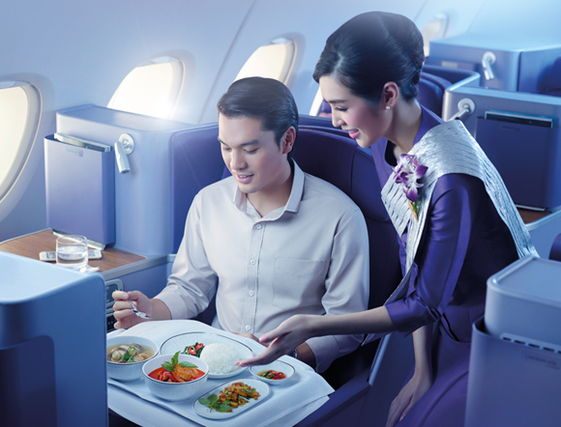
T (Tangibles)
Samrab – set of meal

Slide 23
E (Empathy)
Empathy refers to the cabin crew’s empathic behavior and show this feeling to customers in order to show that they care and are ready to support the customers.

Slide 24
E (Empathy)
extra

Slide 25
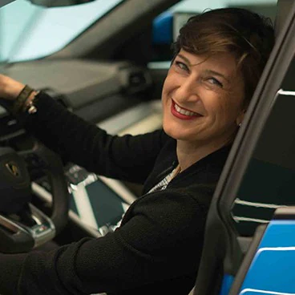
E (Empathy)
https://www.emirates.com/th/english/experience/review/service/

Slide 26
R (Responsiveness)
Responsiveness refers to ability and willingness to provide quick and quality service to passengers. The passengers want to receive the services that meet their expectations in a time manner.

Slide 28
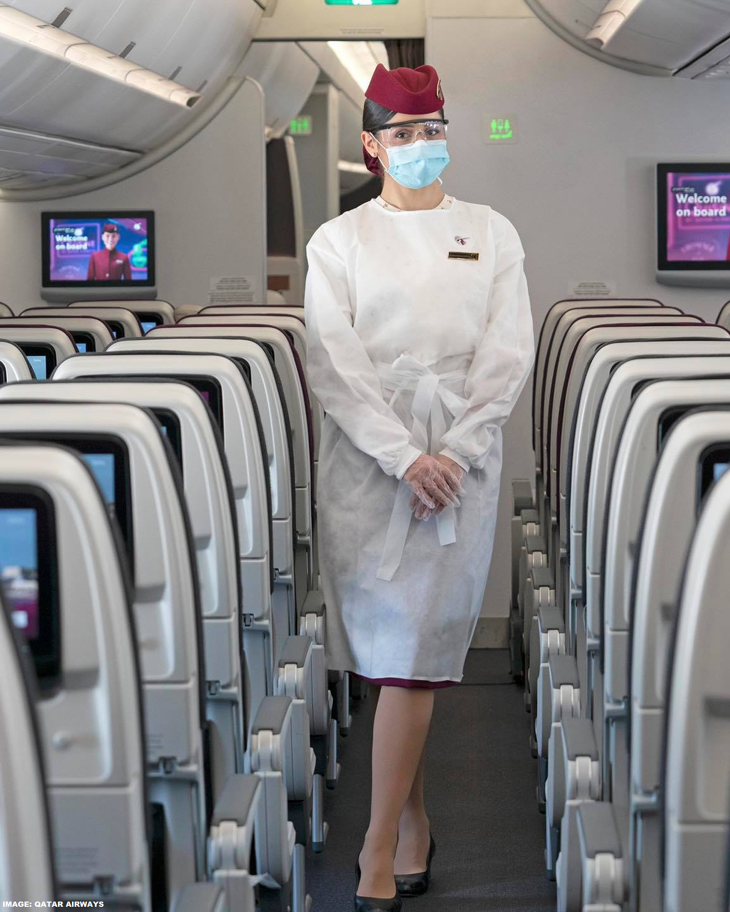
Customer Service Competency, ability
1. Product Knowledge
2. Company Knowledge
3. Communication Skills
4. Problem Solving Skills
5. Growth Mindset
Tell me about……..
https://www.paddleyourownkanoo.com/

Slide 29
1. Product Knowledge
Passengers require……………. | Do not respond…………… | Do respond
Why the flight delays? I have a connecting flight to Melbourne. Can you make sure that I won’t miss that flight? | I don’t know. I have no idea. | I apologize for the delay. Let me inform the ground staff and our Purser that you have a connecting flight to Melbourne. They might be able to find a solution about your connecting flight.

Slide 30
2. Company Knowledge
Passengers require……………. | Do not respond…………… | Do respond
What is the situation of your airline during COVID-19 pandemic? | That’s a big trouble. The airline cuts thousands of jobs. | I understand that our airline is facing the crisis of the global COVID-19 pandemic like other airlines. The airline offers redundancy payment for employees who decided to leave the company. The airline tries to do the best thing for everyone and tries to save the company in this difficult time.

Slide 31
3. Communication Skills
Passengers require……………. | Do not respond…………… | Do respond
Do you have anything for me to eat because I need to take a pill? | Please wait until we start the meal service. | Certainly. By the way, can I offer you some snacks or sandwiches because our dinner is being warmed in the oven? It takes about 30 minutes to be ready.

Slide 32
4. Problem Solving Skills
Passengers require……………. | Do not respond…………… | Do respond
Can I move to sit with my father? We travel together but the ground staff assigned us the separated seat. | The flight is full today. It is difficult to do that. | Well, let me ask a passenger who sit next to your father to swap his seat with you. If he doesn’t want to swap the seat, we can ask a gentleman who sit next to you to swap.

Slide 33
5. Growth Mindset
Passengers require……………. | Do not respond…………… | Do respond
Why you cannot tell me about the taste of this Cabernet Sauvignon? | I don’t drink wine. | Well, this Cabernet Sauvignon is a brand-new product in our Business Class. I will taste it after this flight. By the way, let me tell the information about the wine by using the information from the wine label.

Slide 34
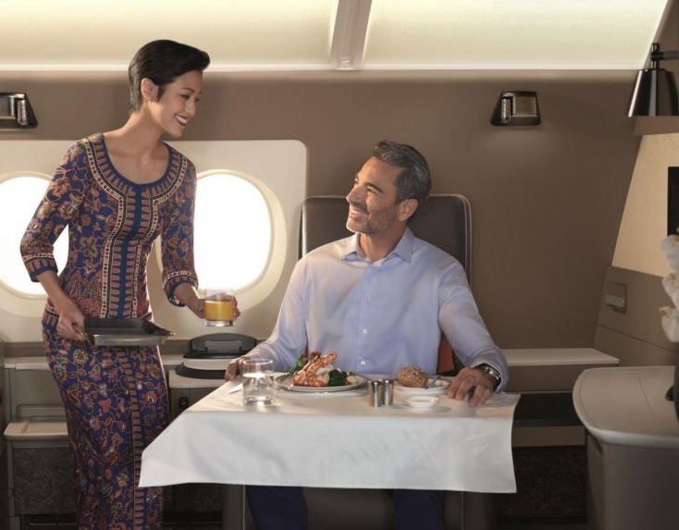
Customer Service Communication
1. Verbal communication
2. Non-verbal communication
3. Clearly
4. Effectively
5. Positively
6. Use command when giving safety instruction
Polite, courteous, gracious
https://www.straitstimes.com/lifestyle/travel/

Slide 35
1.
A passenger doesn’t want to………. | Use positive communication | Try to avoid using command during services.
sit down and fasten her seat belt. | Could you please sit down and fasten your seat belt? The aircraft is taxiing. | You have to sit down and fasten your seat belt.

Slide 36
2.
A passenger doesn’t want to………. | Use positive communication | Try to avoid using command during services.
put his carry-on baggage in the overhead locker. | May I put your carry-on baggage in the overhead locker for takeoff? You may bring it down after the seat blet sign is switched off. | Put your carry-on baggage in the overhead locker now.

Slide 37
3.
A passenger doesn’t want to………. | Use positive communication | Try to avoid using command during services.
switch off her mobile phone before takeoff. | It would be best if you could switch off your mobile phone before takeoff. You may switch it on and change to the flight mode after takeoff or after the seat belt sign is switch off. | You need to switch off your mobile phone before takeoff.

Slide 38
4.
Passengers don’t want to………. | Use positive communication | Try to avoid using command during services.
open the window shade for landing. | I understand your concern about the sunlight that is too bright. However, please open the window shade for helping us to observe any situation outside the aircraft during the flight landing. | You must open the window shad for landing. It’s the safety requirement.

Slide 39
5.
Passengers don’t want to………. | Use positive communication | Try to avoid using command during services.
put their seat backs upright during the meal service. | Are you willing to put your seat back upright during the meal service? The passengers behind you would appreciate when he has more room during he is having his meal. | I don’t think it’s a good idea to recline the seat back while another person sits behind you and he is having a meal.

Slide 40
6.
Passengers don’t want to………. | Use positive communication | Try to avoid using command during services.
pass a dirty meal tray to cabin crew. | Did you finish your meal? Do you mind passing me your meal tray? | Finished? Pass your meal tray to me.

Slide 41
7.
Passengers don’t want to………. | Use positive communication | Try to avoid using command during services.
stay seated. | Would it be possible to stay seated until the aircraft has a complete stop at the terminal and the seat blet sign is switched off? | Don’t you know that you need to stay seated until we stop at the terminal? We are now taxiing.

Slide 42
 | Asking politely / Request question | Polite respond
1 | Would you mind helping me with.... ? | Yes, Sir / Madam
2 | Do you mind if I…………………………? | Of course.
3 | Would it be possible to……….............? | Sure.
4 | Do you think you could……...............? | Certainly.
5 | Is it OK if……………………………….....? | No problem.
6 | Could you possibly………………….....? | I’m afraid I can’t do that.
7 | Could you………………………………..? | I’m sorry. I can’t do that.
8 | May I ask you to…………………………?

Slide 43
 | OK could possible Could May mind helping
1 | Is it………if you put your bag under the seat in front?
2 | Do you think you ….….switch off your mobile phone during takeoff?
3 | Would it be ……….. to put your seat back upright for landing?
4 | ……….. you possibly stow the tray table for landing?
5 | ……….. I ask you to pass me your empty tray?
6 | Do you ……….. if I ask you to move from the seat at the exit row?
7 | Would you mind ……….. me with putting your bag in the overhead locker?

Slide 44
 | willing Can can’t
8 | Are you ……… to swap/exchange the seat with the lady?
9 | ………. you open the window shade?
10 | I’m afraid I ……….. do that.

