Slide 1
Public Address
Unit 5
IAC3306 Cabin Crew Management

Slide 2
https://www.slideshare.net/

Slide 3
https://www.slideshare.net/

Slide 4
https://www.slideshare.net/

Slide 5
https://www.slideshare.net/

Slide 6
https://www.slideshare.net/

Slide 7
https://www.slideshare.net/

Slide 8
https://www.slideshare.net/

Slide 9
https://www.slideshare.net/

Slide 10
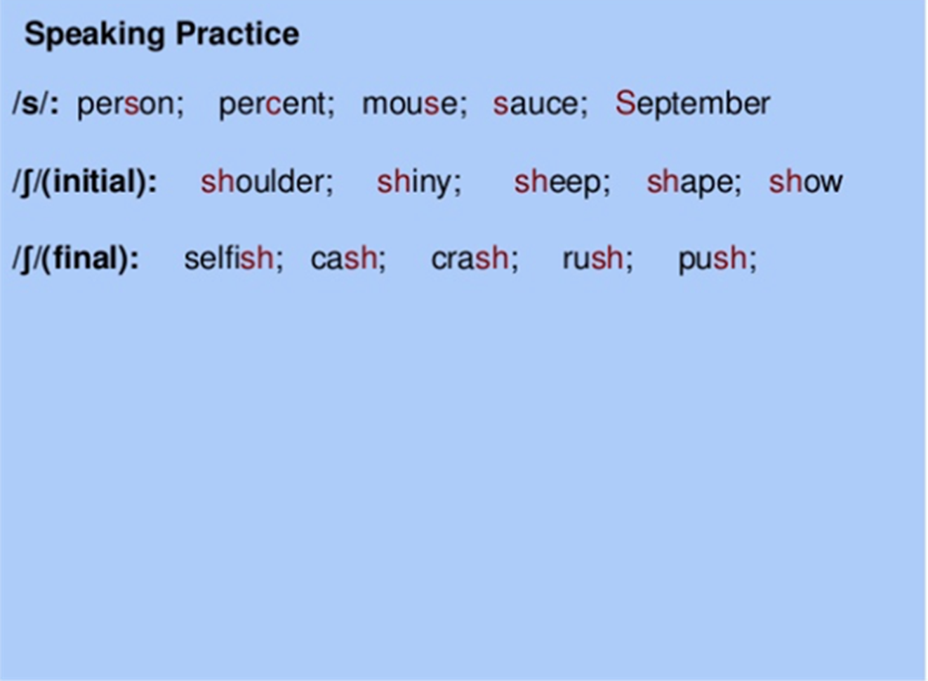
https://www.slideshare.net/

Slide 11
https://www.slideshare.net/

Slide 12
https://www.slideshare.net/

Slide 13
https://www.slideshare.net/

Slide 14
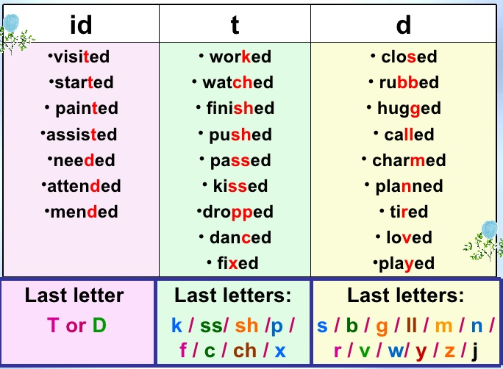
https://www.educaplay.com/

Slide 16
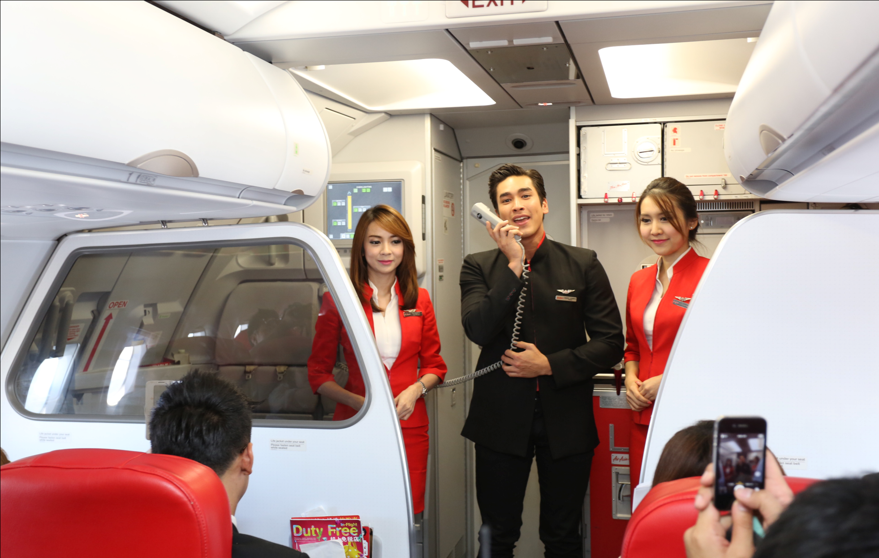
https://mgronline.com/travel/detail/9570000108055
What are purposes for doing public announcements?

Slide 17
https://mgronline.com/travel/detail/9570000108055
What are the instructions and information from PA?

Slide 18
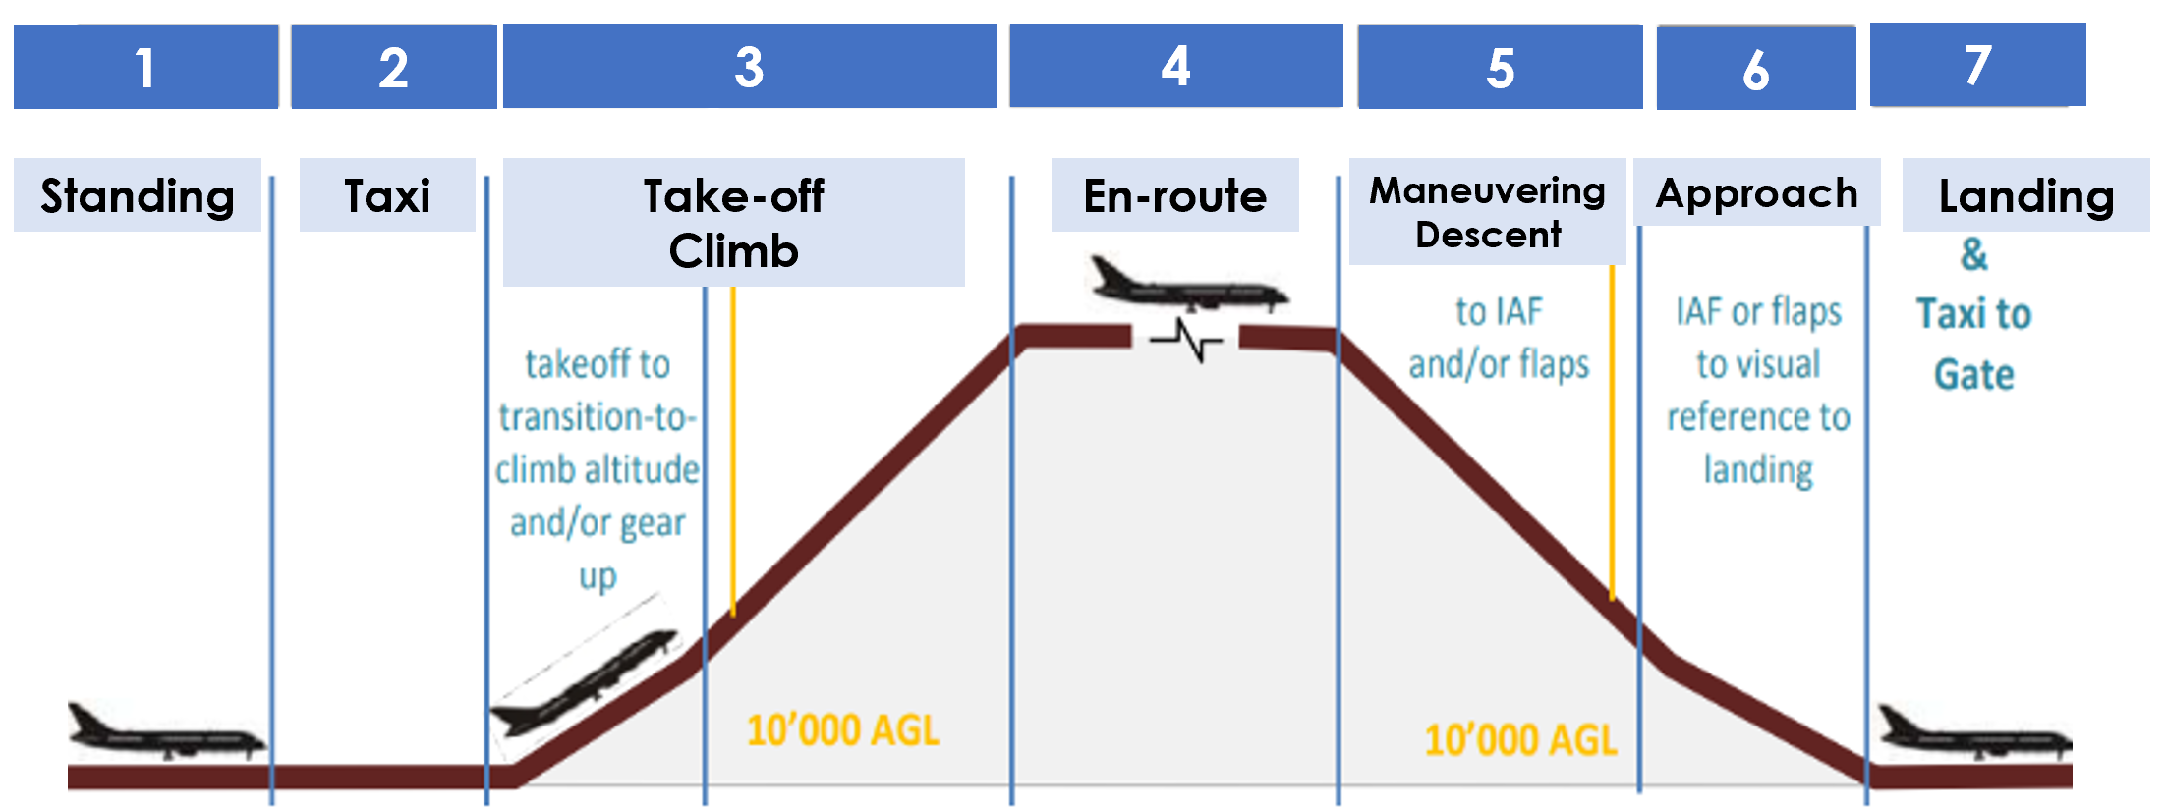
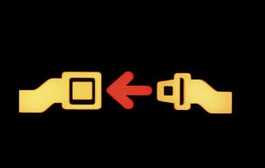
Fasten Seatbelt
Sign Off
Fasten Seatbelt
Sign Off
Fasten Seatbelt Sign On
Fasten Seatbelt Sign
On
Fasten Seatbelt
Sign Off

Slide 19
1. Welcome PA
2. Boarding and Fasten Seat Belt Sign On PA
3. Door Closure PA
4. Safety Demonstration PA
5. Prepare for Takeoff PA
6. Delay on Ground PA

Slide 20
1. All flight PA
2. Rough air PA
3. Duty free PA
4. Cabin secure PA
5. Prepare for landing PA

Slide 21
1. Farewell PA
2. Final farewell PA

Slide 22
1. Welcome PA
2. Boarding and Fasten Seat Belt Sign On PA
3. Door Closure PA
4. Safety Demonstration PA
5. Prepare for Takeoff PA
6. Delay on Ground PA

Slide 23
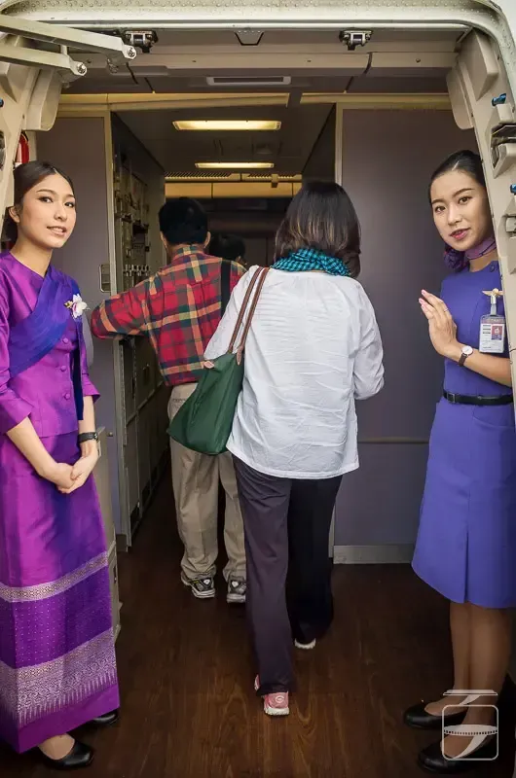
Good afternoon, Ladies and Gentlemen.
My name is……………….and I am your Purser today. On behalf of the cabin crew team, I would like to welcome you on board SSRUIC flight to London.
Emirates. (2016). Ab initio Modules. Service. Dubai: Training Team.
1. Welcome PA
https://100travelstories.com/blog/flying-thai-airways/

Slide 24
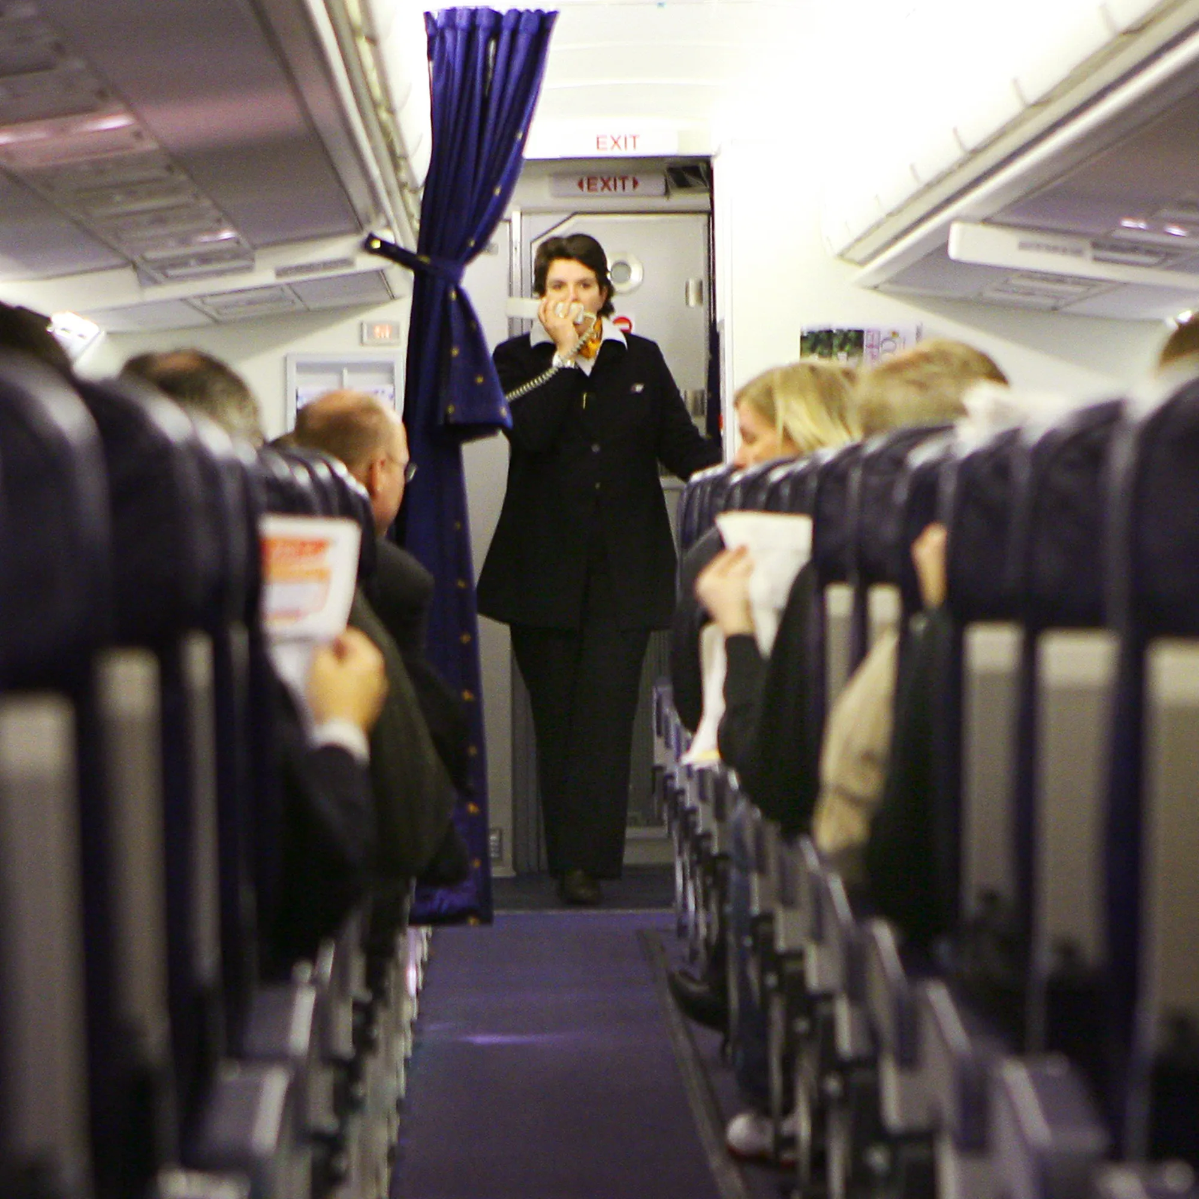
Ladies and Gentlemen.
As we are now departing to London, may I ask you to please turn off your mobile phone and ensure it remains switched off for the duration of the flight. You may use your mobile phone again once the aircraft has landed and left the active runway.
Emirates. (2016). Ab initio Modules. Service. Dubai: Training Team.
2. Boarding and Fasten Seat Belt Sign On PA
https://www.refinery29.com/

Slide 25
Please return to your seat, fasten your seat belt, put your seat back upright, fold your table and open the window shade. Video screens, handsets, and footrests also need to be stowed.
Emirates. (2016). Ab initio Modules. Service. Dubai: Training Team.
2. Boarding and Fasten Seat Belt Sign On PA
https://www.refinery29.com/

Slide 26
If you are seated next to an emergency exit, please read carefully the special instructions card located by your seat. If you do not wish to perform the functions described in the event of an emergency, please ask a flight attendant to reseat you.
Emirates. (2016). Ab initio Modules. Service. Dubai: Training Team.
2. Boarding and Fasten Seat Belt Sign On PA
https://www.refinery29.com/

Slide 27
We remind you that this is a non-smoking flight. Smoking is prohibited on the entire aircraft, including the lavatories. Tampering with, disabling or destroying the lavatory smoke detectors is prohibited by law.
Thank you.
Emirates. (2016). Ab initio Modules. Service. Dubai: Training Team.
2. Boarding and Fasten Seat Belt Sign On PA
https://www.refinery29.com/

Slide 28
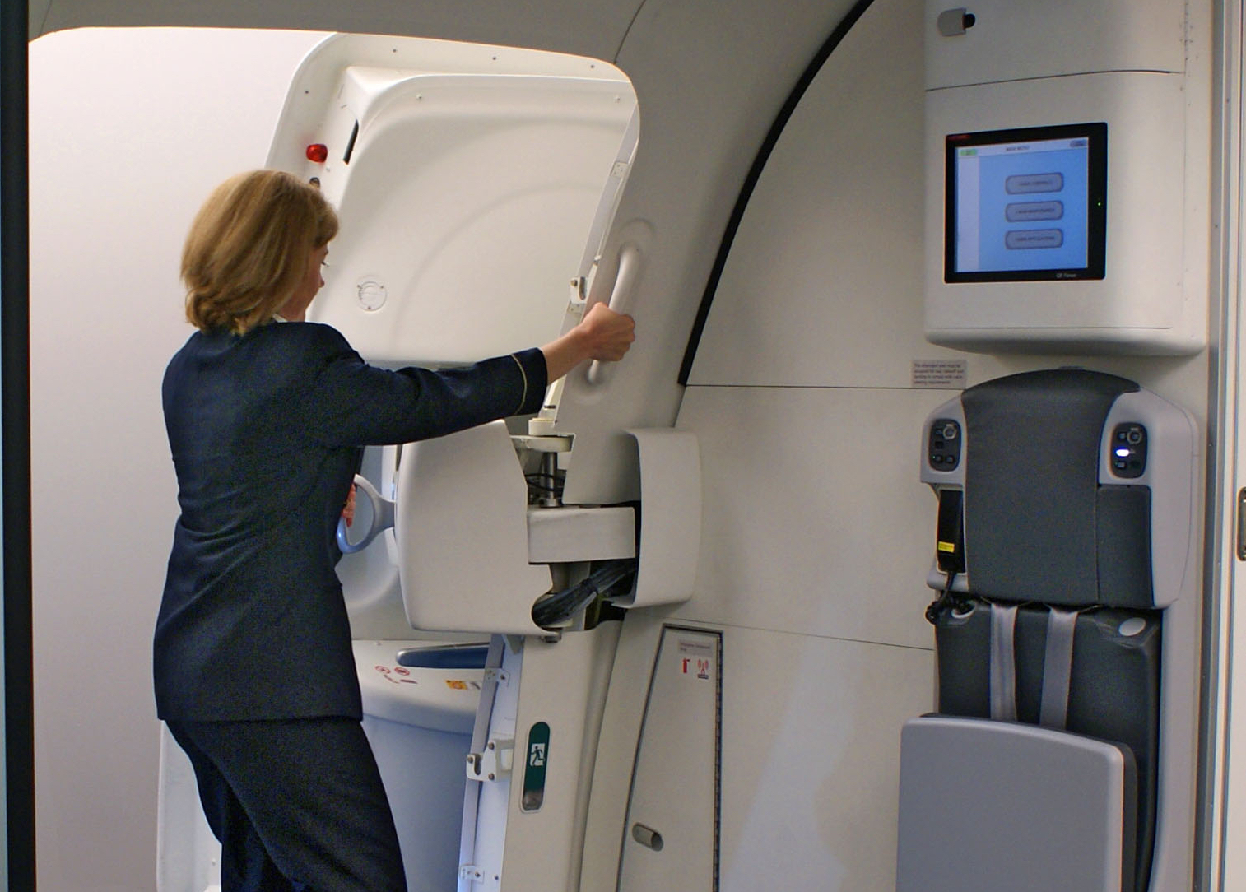
Ladies and Gentlemen.
My name is ……………and I’m your purser on SSRUIC flight to London. On behalf of Captain…………………. and the entire crew, welcome aboard. Our flight time will be 11 hours and 15 minutes.
Emirates. (2016). Ab initio Modules. Service. Dubai: Training Team.
3. Door Closure PA
https://www.paddleyourownkanoo.com/

Slide 29
At this time, make sure your seat backs and tray tables are in full upright position and your seat belt is correctly fastened. Also, your portable electronic devices and mobile phone must be switched off during take-off and landing, and until an announcement is made upon arrival.
Thank you.
3. Door Closure PA
https://www.paddleyourownkanoo.com/

Slide 30
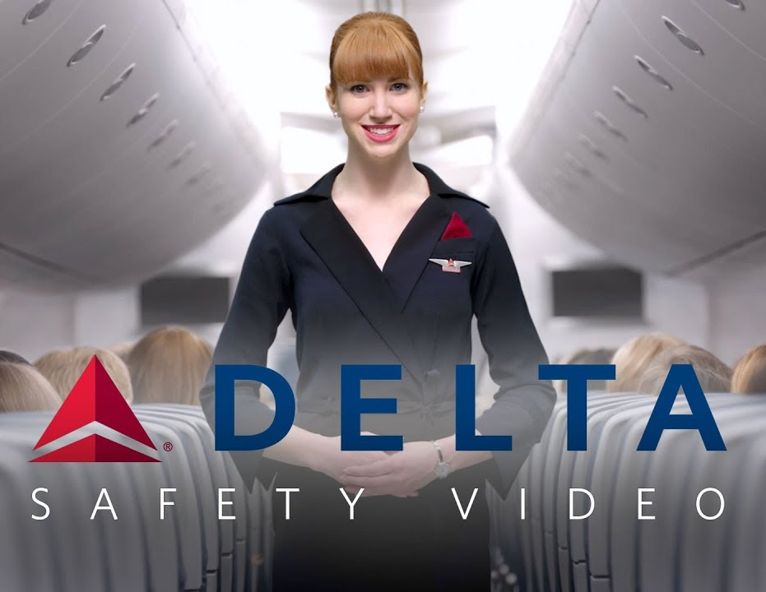
In a short moment, cabin crew will show the safety aspects of this aircraft. Please watch and listen carefully.
Emirates. (2016). Ab initio Modules. Service. Dubai: Training Team.
5. Safety
Demonstration PA
https://www.youtube.com/

Slide 31
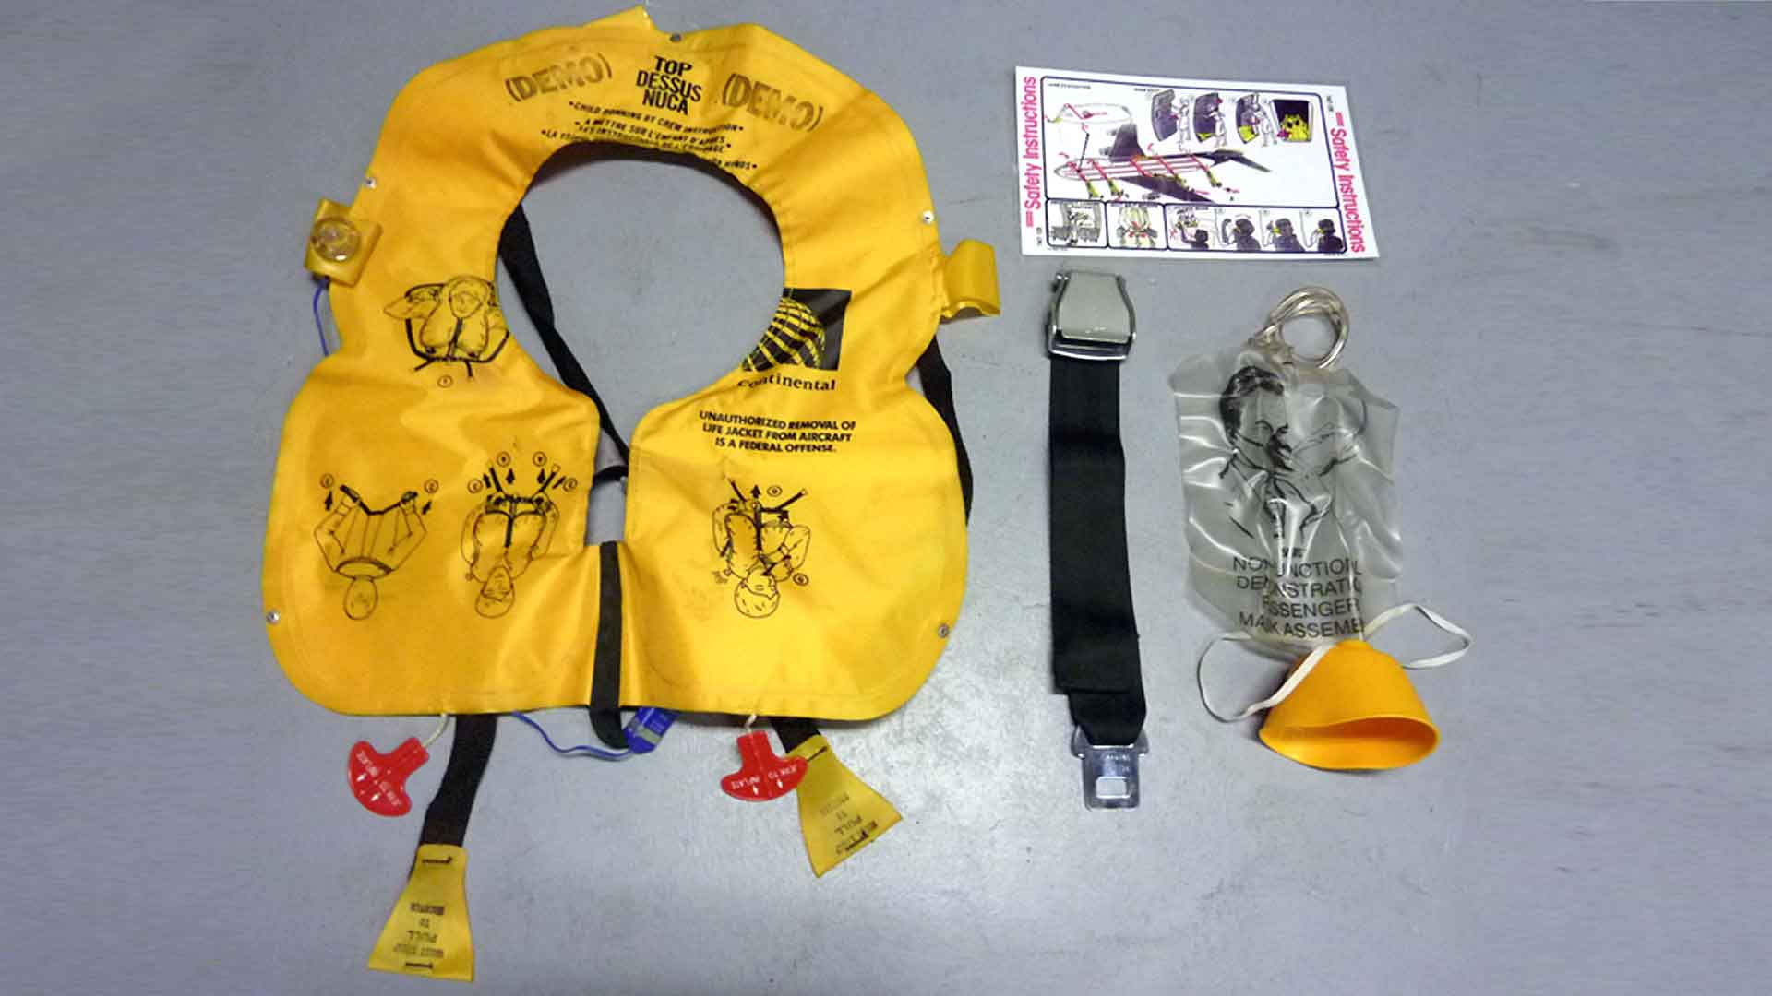

Slide 32
Ladies and Gentlemen, to ensure your…………, the cabin crew will now demonstrate how to use safety equipment on board.
Your seat belt must be…………during takeoff and landing, and when the seat belt sign is on. Put the metal fitting into the buckle and tighten the seat belt by pulling the strap. To release the seat belt, lift the flap of the buckle. Whenever seated, please fasten your……………low and tight at all times.
Safety Demonstration Script
safety
fasten
Seat belt

Slide 33
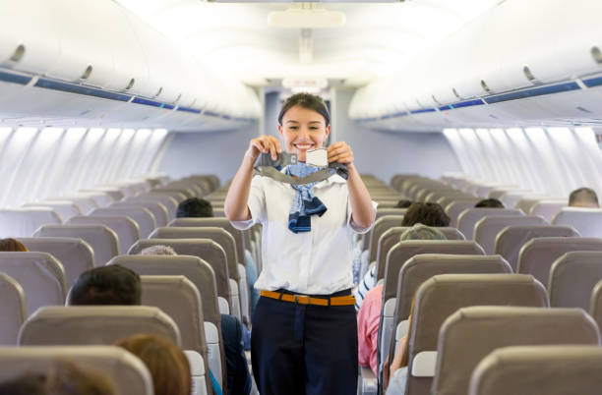
Safety Demonstration Script
Metal fitting
Buckle
Strap
Flap of the buckle

Slide 34
During takeoff and landing, all electronic devices must be turned off.
In case of the cabin decompression,…………….will be dropped automatically from the ceiling compartment. Pull down the…………toward yourself, cover over your nose and mouth, secure it with the strap, and breath normally, and continue using the mask until you are advised by the cabin crew. Put your own mask on first before…………….others.
Safety Demonstration Script
assisting
mask
oxygen masks

Slide 35
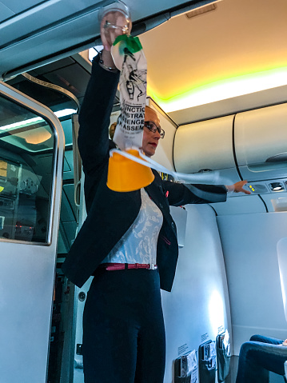
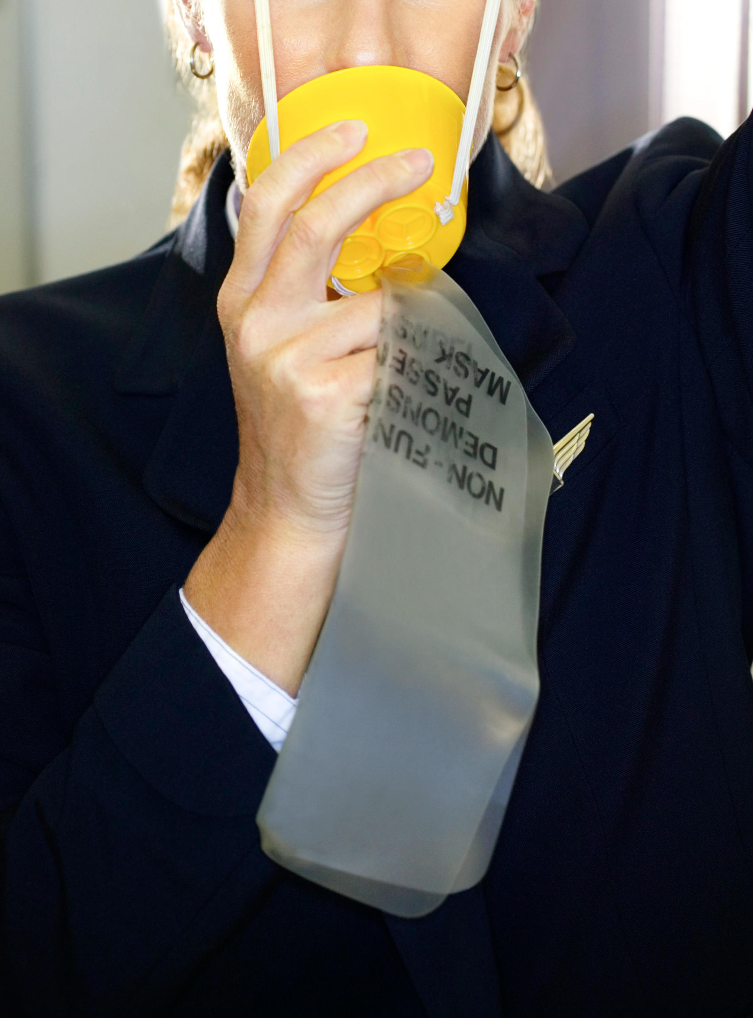
Safety Demonstration Script
https://en.freejpg.com.ar/

Slide 36
In case of emergency, your life vest is located under your seat or indicated otherwise. Put the……………on over your head. Connect the hook or the buckle to fasten the vest. Tighten the vest by pulling the strap. Pull the red tab to……… the vest before………….the aircraft. If the inflation system fails, inflate the vest by blowing into the mouthpieces. A light will come on automatically when in the water.
Safety Demonstration Script
inflate
live vest
exiting

Slide 37
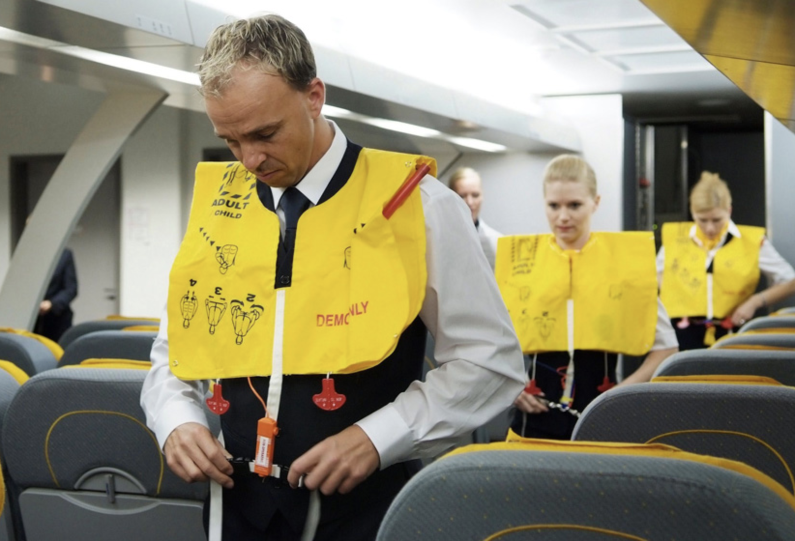
Safety Demonstration Script
Mouthpieces
Red tab
Hook or buckle
https://www.noigroup.com/

Slide 38
In the event of an emergency, please assume the………. position.
In case of emergency, the light will lead you to the emergency………... Leave your belongings, remove your high heel shoes, and proceed to the nearest exits which may be behind you.
Should you require further assistance, please contact our flight attendants or study the safety…………..in your seat pocket.
Thank you.
Safety Demonstration Script
brace
exit
pamphlet

Slide 39
Safety Demonstration Script
https://www.travelandleisure.com/

Slide 40
Ladies and Gentlemen.
We regret to inform you that this flight has to be delayed due to technical problems. We expect to leave shortly. Please remain on board, unfasten your seatbelt and refrain from smoking.
Please accept ore apologies for the inconvenience.
Emirates. (2016). Ab initio Modules. Service. Dubai: Training Team.
6. Delay on Ground PA
https://i2.wp.com/jdasolutions.aero/blog/

Slide 41
1. All flight PA
2. Rough air PA
3. Duty free PA
4. Cabin secure PA
5. Prepare for landing PA

Slide 42
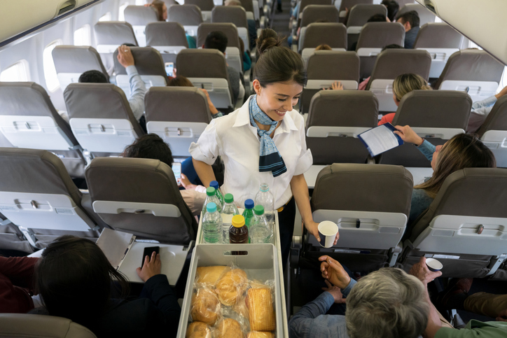
May I wish you a pleasant flight with us today? If there is anything I, or member of my team can do to assist you, please let us know.
On this flight, dinner will be served, and approximately three hours before landing, breakfast will be served.
Emirates. (2016). Ab initio Modules. Service. Dubai: Training Team.
1. All flight PA
https://soyummy.com/healthiest-airplane-food/

Slide 43
Beverages, snacks, and fruit will be available at any time during the flight.
We will not serve alcohol to passenger under the age of 18 and those who appear intoxicated. The consumption of your own alcoholic beverage is not permitted.
Thank you.
1. All flight PA
https://soyummy.com/healthiest-airplane-food/

Slide 44
As we are passing through an area of rough air, please return to your seat and make sure that your seat belt is tightly fastened.
Emirates. (2016). Ab initio Modules. Service. Dubai: Training Team.
2. Rough air PA
https://www.traveller.com.au/

Slide 45
Ladies and Gentlemen.
We are pleased to advise you that our cabin crew will shortly be passing through the cabin offering a wide selection of Duty-Free products. Please take the opportunity to look at your duty-free magazine to make your selection.
Emirates. (2016). Ab initio Modules. Service. Dubai: Training Team.
3. Duty free PA
https://www.paddleyourownkanoo.com/

Slide 46
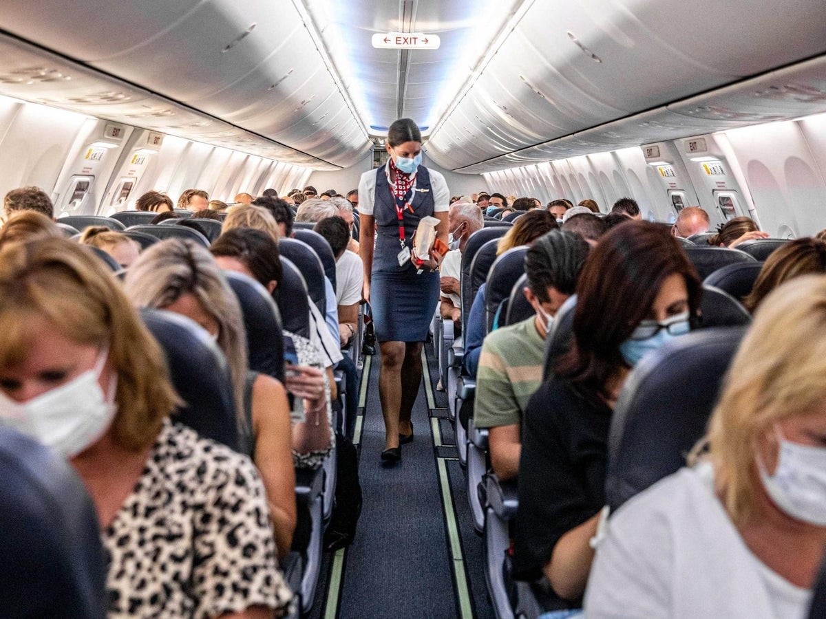
As we shall shortly be arriving at London, would you please return to your seat? Make sure your hand luggage is placed under the seat in front of you or in the overhead locker; your seat back is upright with the armrest down. Window blinds should be opened.
Emirates. (2016). Ab initio Modules. Service. Dubai: Training Team.
4. Cabin Secure PA
https://www.independent.co.uk/

Slide 47
Tray tables and footrests should be folded and stowed and your seatbelt securely fastened.
To ensure you are fully aware of the exit nearest to you and the safety features on this aircraft, read the Safety Procedure Card in your seat pocket. If you have been using your personal electronic devices, please ensure that they are switched off.
Emirates. (2016). Ab initio Modules. Service. Dubai: Training Team.
4. Cabin Secure PA
https://www.independent.co.uk/

Slide 48
1. Farewell PA
2. Final farewell PA

Slide 49
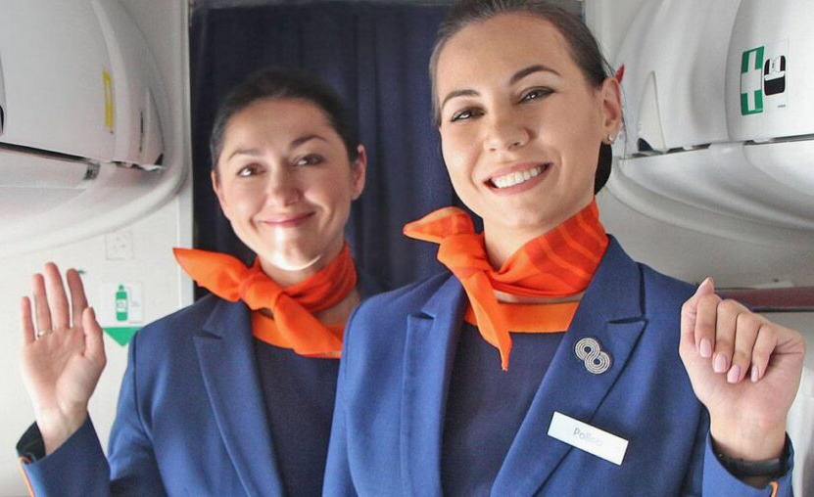
Ladies and Gentlemen.
Welcome to London, where the local time is……….and the temperature is…………degree Celsius. For your comfort and safety, remain seated with your seatbelt fastened until the aircraft has come to the complete stop and the seatbelt sign has been switched off. For those of you who would like to use your mobile phone, it is now safe to do so.
3. Farewell PA
https://giftobserver.com/gifts-for-flight-attendants/

Slide 50
Before leaving the aircraft, make sure you take all personal belongings with you. Check your seat pocket and the overhead locker. If you are transferring to another flight and need assistance, please contact the Airport Service Staff meeting the flight.
Emirates. (2016). Ab initio Modules. Service. Dubai: Training Team.
3. Farewell PA
https://giftobserver.com/gifts-for-flight-attendants/

Slide 51
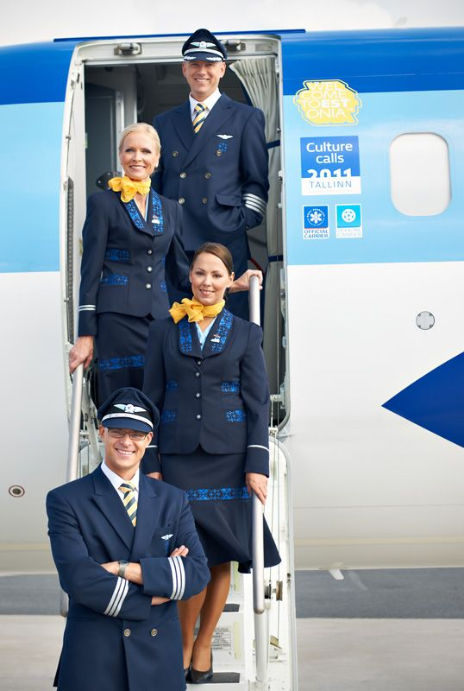
I would like to thank you for choosing SSRUIC.
I hope that you have enjoyed your flight and look forward to seeing you again soon. Good morning.
Emirates. (2016). Ab initio Modules. Service. Dubai: Training Team.
3. Final farewell PA
https://www.pinterest.dk/pin/104638391314742151/

