Slide 1
CIQ
Unit 4
IAC3306 Cabin Crew Management

Slide 2
Immigration
Customs
Quarantine
 | Scenario 1
 | Welcome to Thailand. Where do you live?
John | Germany.
 | What is the purpose of your visit to Thailand?
John | I’m going to visit my sister. She lives in Nakhon Pathom.
 | How long do you plane to stay in Thailand?
John | Two weeks.
 | What is your job in Germany?
John | I’m a university lecturer.

Slide 3
Customs
Quarantine
Immigration
 | Scenario 2
 | May I look at your passport and customs declaration form, sir?
John | Certainly. Here you are.
 | Do you have anything to declare?
John | No, nothing. Just the normal allowance.
 | What do you have in your suitcase?
John | There are clothes, personal belongings, and a bottle of wine.
 | Do you have anything else besides these?
John | No, I don’t.
 | That’s fine. Thank you. You can proceed. Have a nice stay in Thailand

Slide 4
Immigration
Customs
Quarantine
 | Scenario 3
 | Hello. Can you put your suitcase through the X-ray machine?
John | Certainly.
 | Can you open your suitcase?
John | Okay. One moment please.
 | What is in this plastic bag? Is it a bag of fresh mushrooms?
John | Yes. It’s from Thailand.
 | You haven’t been declared on the incoming passenger card.
John | Oh, I’m sorry. I forgot. I didn’t have intention to smuggle it into Australia.
 | It is needed to be seized and destroyed.

Slide 5
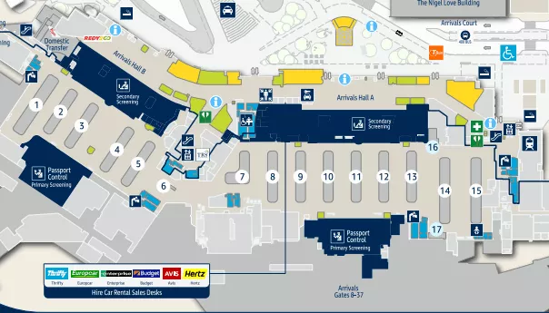
Inbound
Arrival hall
Immigration
Customs
Baggage claim
Quarantine

Slide 6
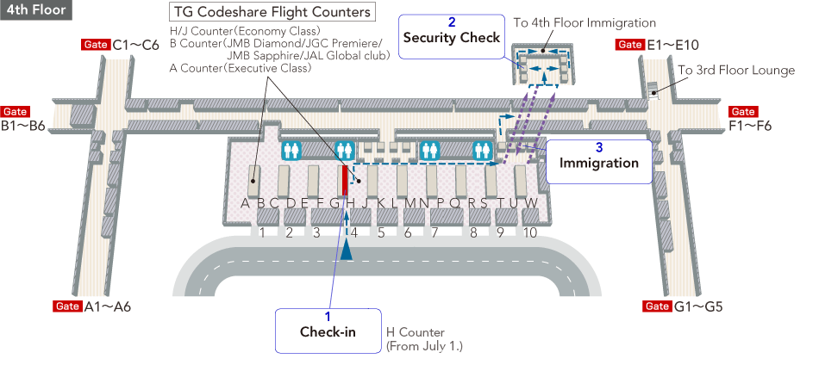
Departure hall
Immigration
https://www.jal.co.jp/en/inter/airport/bkk/info/

Slide 7
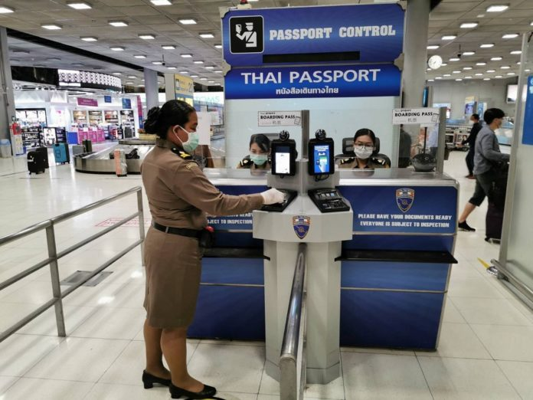
Immigration
Immigration officer is an authority that has responsibility to control people traveling to and from one country to another.
The officers have the work station at the border at the entry points to the airside at the airport.
Immigration can be called “passport control” or “border control”.
https://www.khaosodenglish.com/

Slide 8
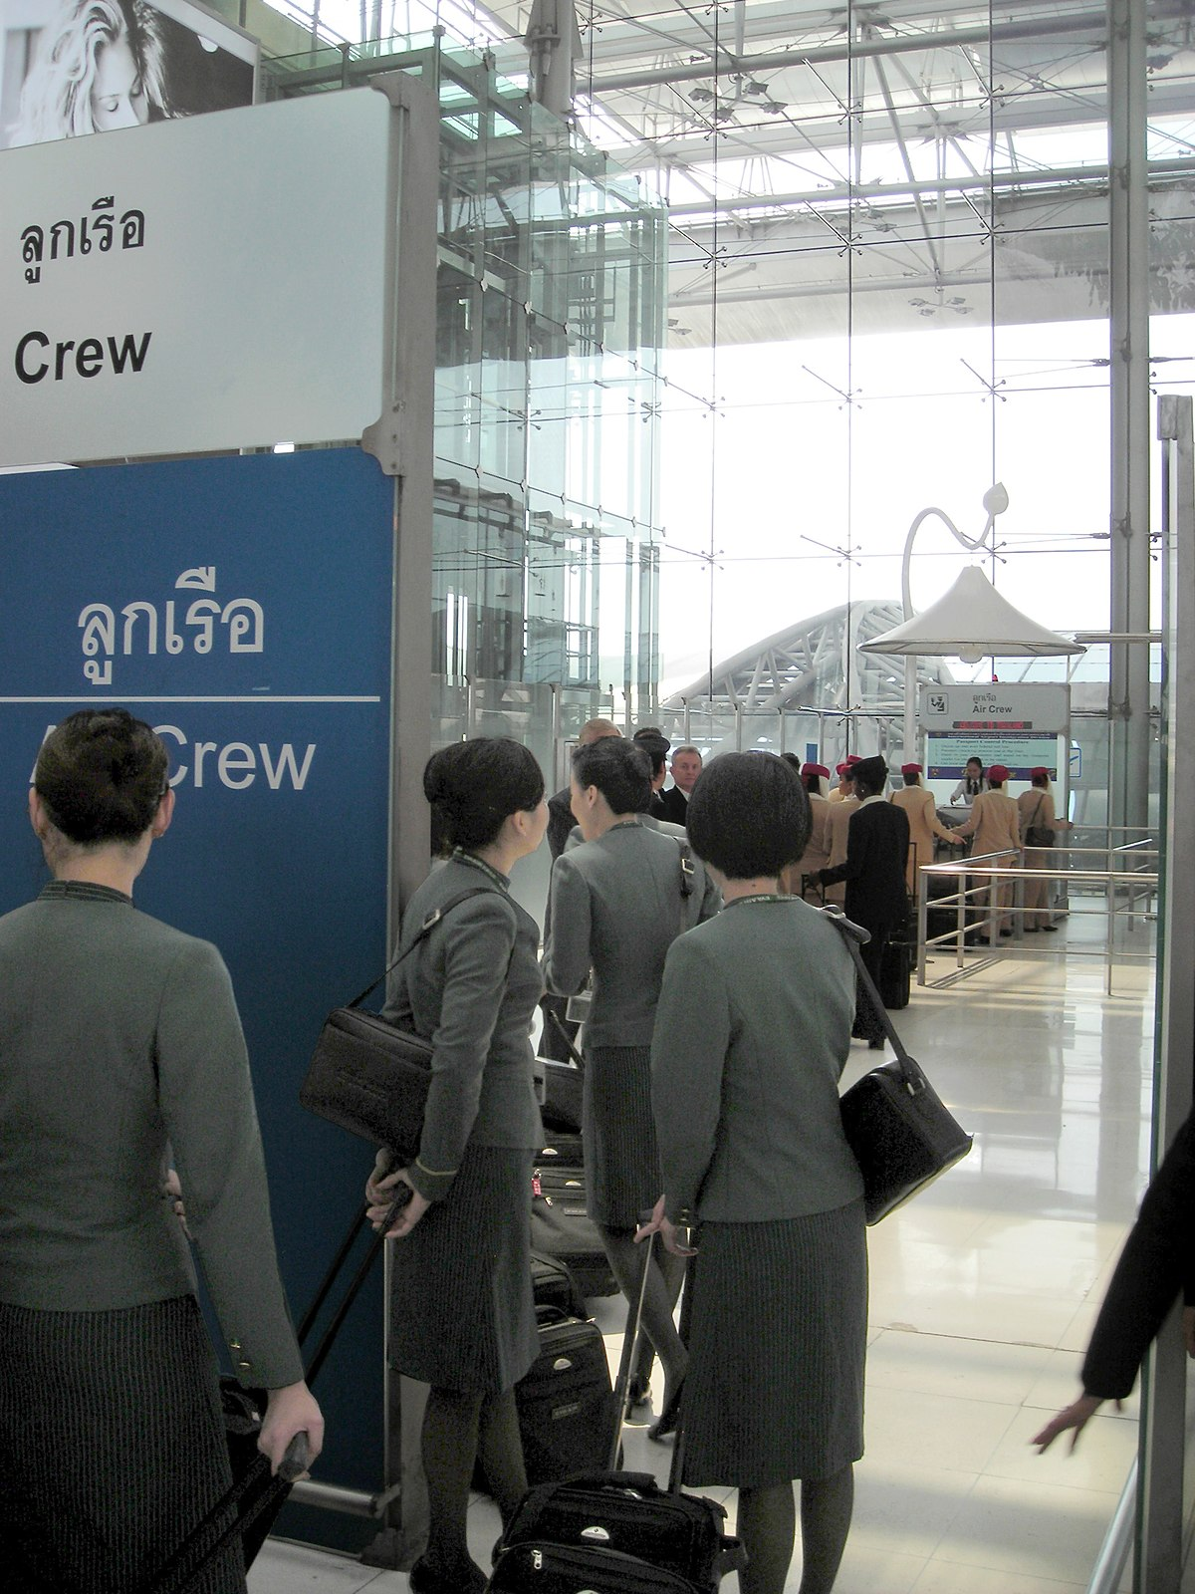
Immigration
Crew are required to show a passport, a valid license, an airline staff identification card, a departure and arrival card, a visa, and a General Declaration form (Gen Dec).
Not expire

Slide 9
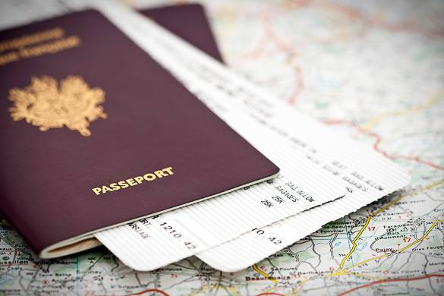
Immigration
Crew are required to show a passport, a valid license, an airline staff identification card, a departure and arrival card, a visa, and a General Declaration form.
https://www.nyhabitat.com/

Slide 10
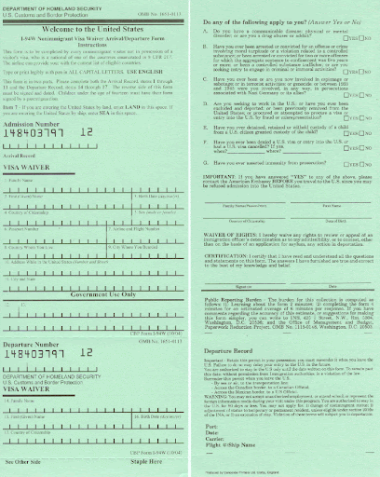
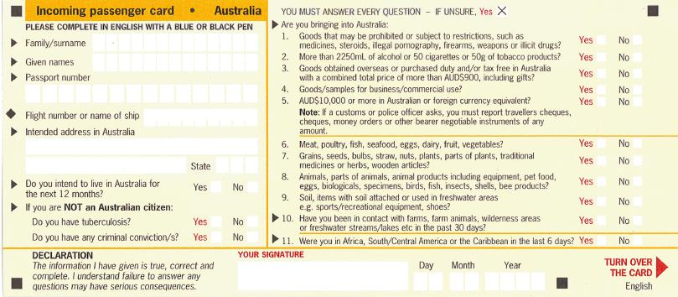
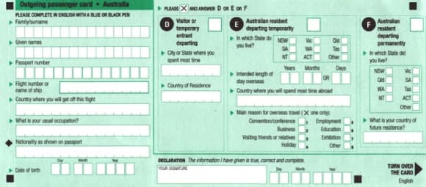
I-94 of USA.
Incoming Card - Australia
Outgoing Card - Australia

Slide 11
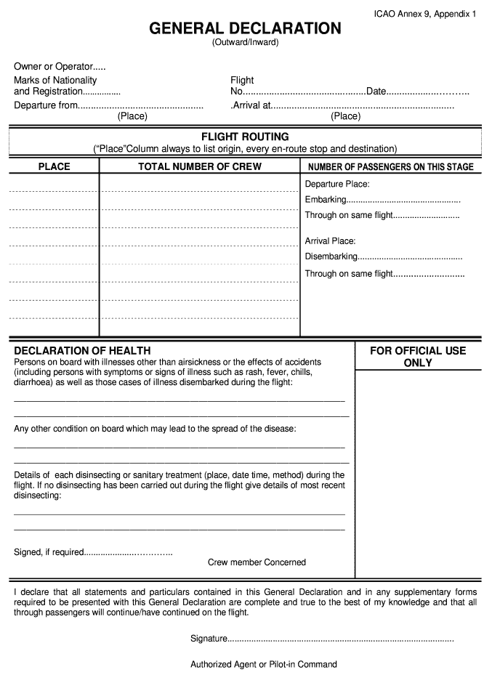
A General Declaration form. Only one form is presented to the immigration officer for entire crew in each flight.
Immigration
all

Slide 12
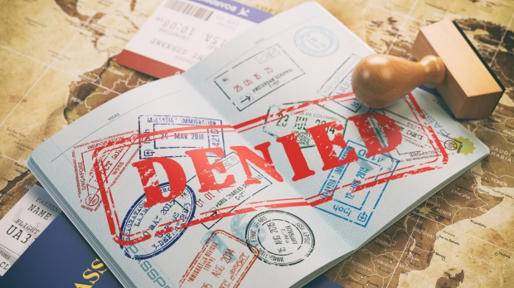
Immigration
Inadmissible Passenger (INAD)
The term INAD refers to passengers who are not accepted by immigration authority to enter the country.
The passengers become INAD because they don’t have a valid visa, a valid passport, or don’t meet the travel condition and requirement of the destination country.
https://www.traveller.com.au/

Slide 13
Immigration
Deportee
They are persons who has entered the country illegally or legally but the authority of the country decided to expel them because of these reasons, for example, staying longer than the duration of the stay allowed by the visa (visa violation, overstay), violating the laws of the country, or travel to the country with fake travel documents.
Permitted by law
https://www.tsi-mag.com/

Slide 14
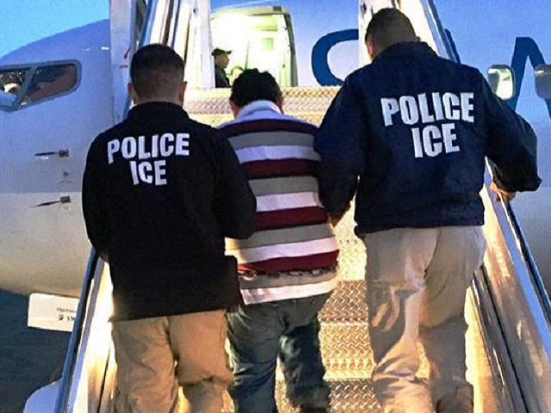
Immigration
Deportee
DEPUS can travel as a deportee back to the origin country without accompanying by an authorized escort.
DEPAS means a person who is under arrest and travel as a deportee back to the origin country with accompanying by an authorized escort.
Go with
https://hauphuchaum.com/

Slide 15
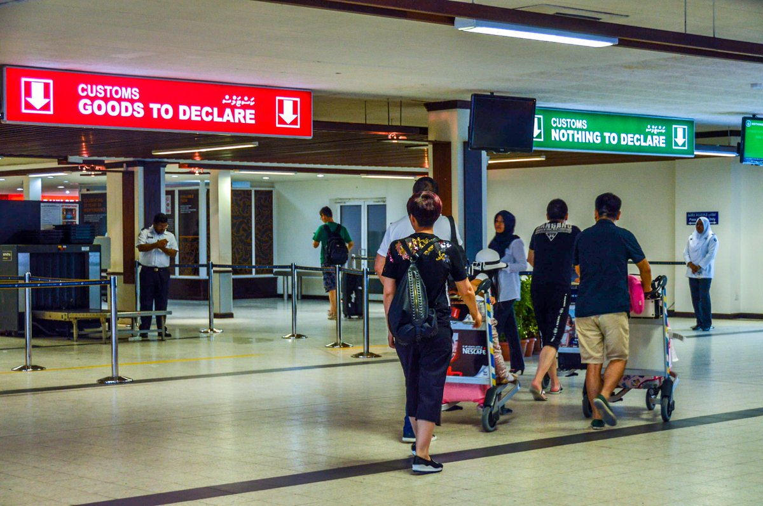
Customs
Customs is an authority involved in the implementation and enforcement of legislation on import and export of each country. Their duty is to control on duties of import and export goods, ensure safety and security on smuggling of drugs and counterfeits.
use
Use by law
https://twitter.com/customsmv
Imitation, copy
Illegal movement of goods

Slide 16
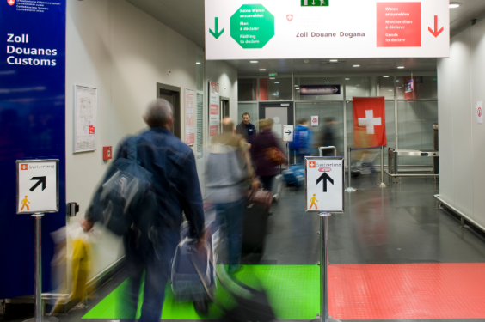
Customs
The duty-free allowance for passenger varies a bit from country to country. The following example is the duty-free allowance for passengers who enter Thailand.
200 cigarettes or 250 grams of cigars and tobacco or altogether weighting not more than 250 grams at the maximum,
1 liter of alcoholic liquor,
Personal effects in reasonable quantity and of which value not exceeding 10,000 Baht,
Used household effects on permanent change of domicile in reasonable amounts.
https://www.ezv.admin.ch/

Slide 17
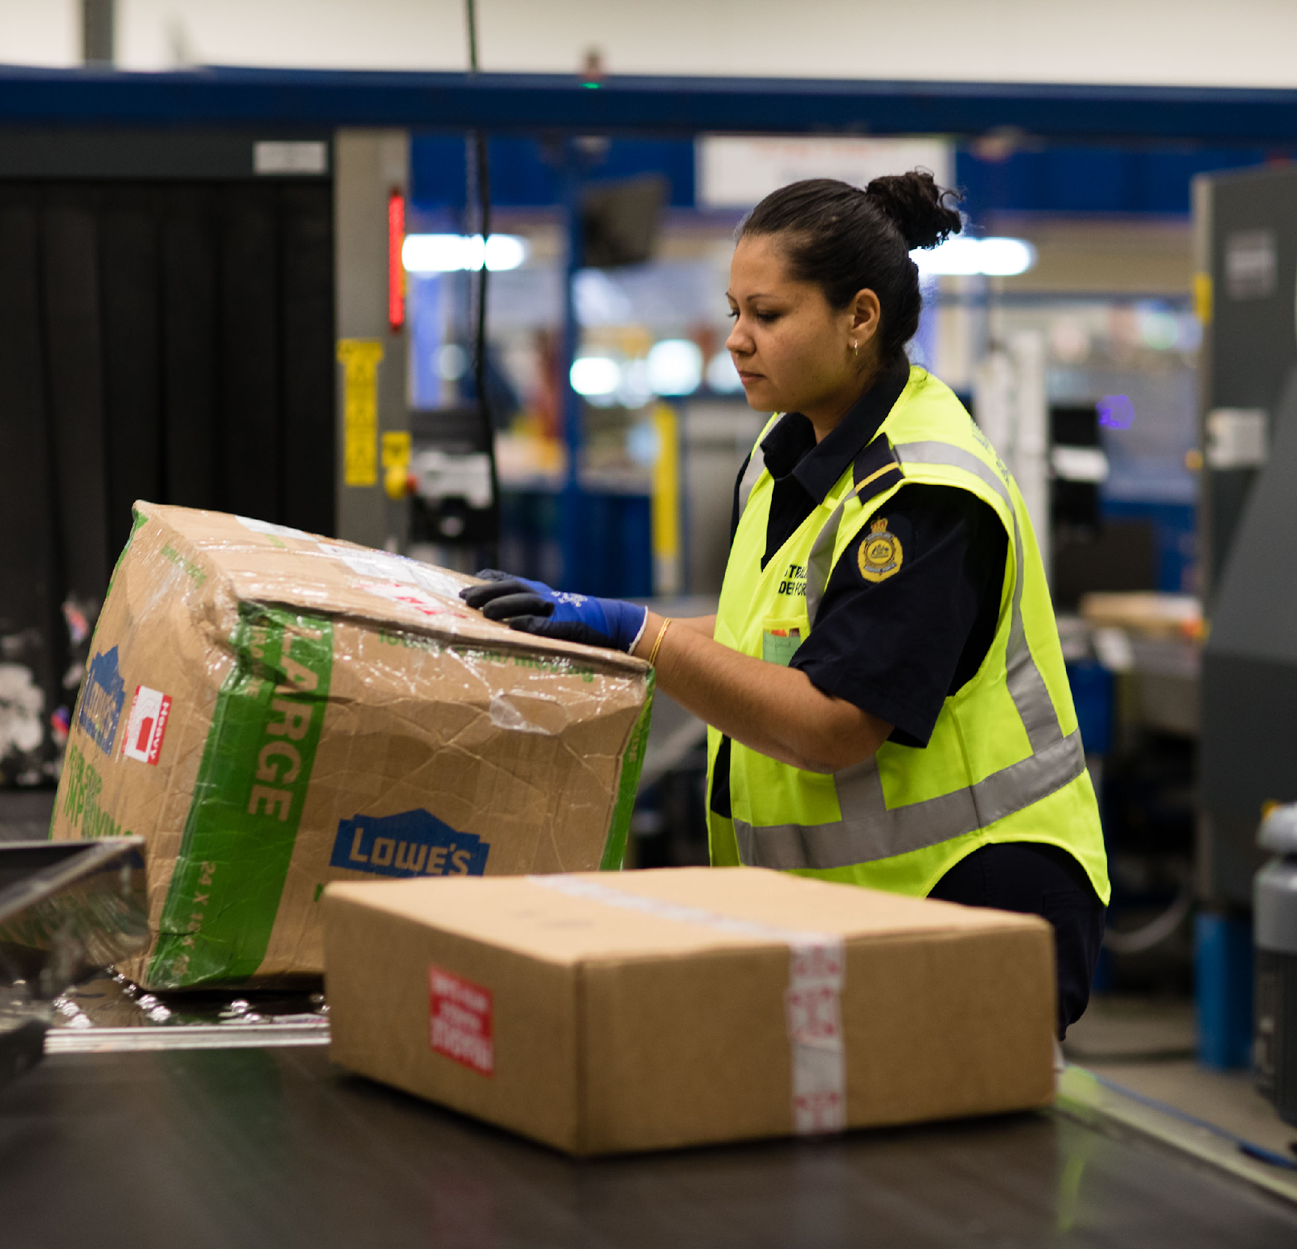
Customs
Prohibited Goods
They are goods for which either the import into or export out of Thailand are prohibited.
Narcotics
Pornographic materials
Counterfeit trademark goods and IPR infringing goods
Fake note or coins
Reserved animal of CITES-listed wildlife
Drug, illegal drugs
Sexual matters
https://www.abf.gov.au/
Protect to keep safe

Slide 18
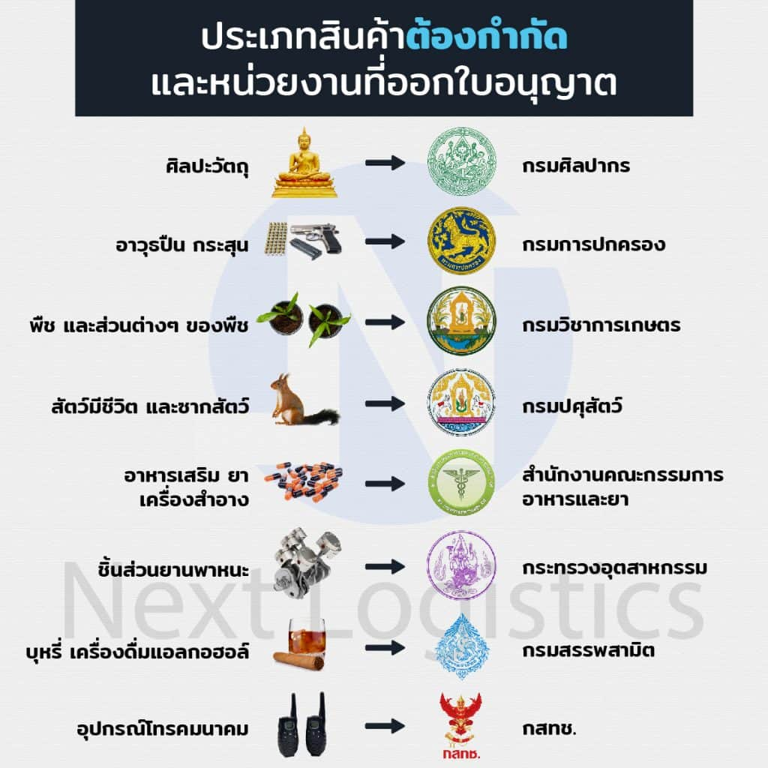
Customs
Restricted Goods
They are goods of which the imports and exports are restricted by law and therefore require a permit from related government agencies. The permit must be presented during Customs formalities.
limit
Give authorization to do something

Slide 19
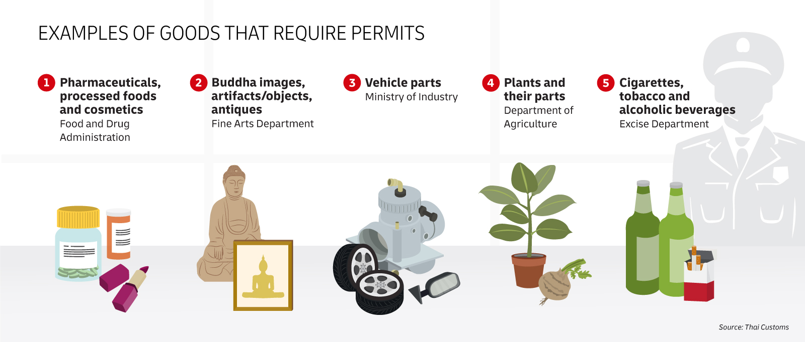
Customs – Restricted Goods

Slide 20
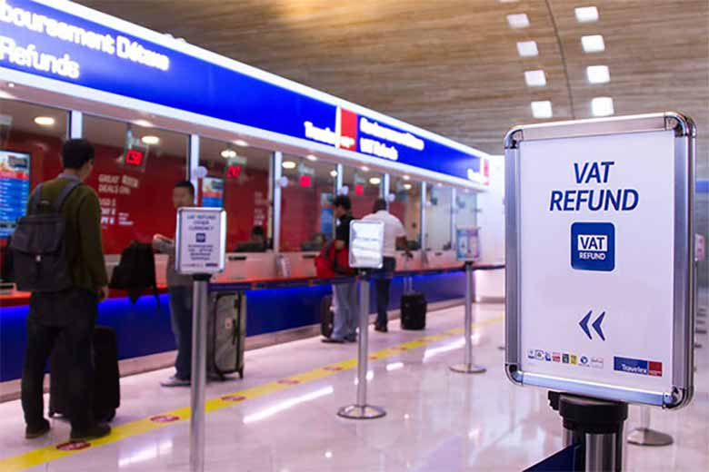
Customs
VAT Refund
Outbound passengers can apply for VAT refund and completed form for VAT refund application for tourist. This form should be presented with the purchased goods and receipts to Customs officers at the Customs Office at the departure hall and claim the VAT refund.
https://www.wheremilan.com/

Slide 21
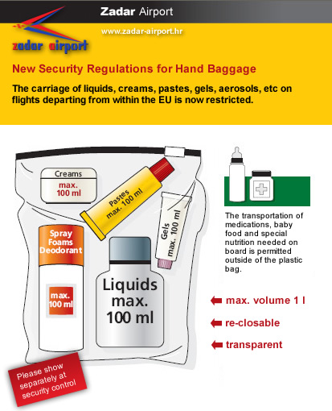
Customs
Limitation of gel, aerosol, liquid
All liquids, gels, aerosol and the like must be carried in containers with a capacity not greater than 100 milliliters each.
Containers must be placed in a transparent re-sealable plastic bag with a maximum capacity not exceeding 1 liter.

Slide 22
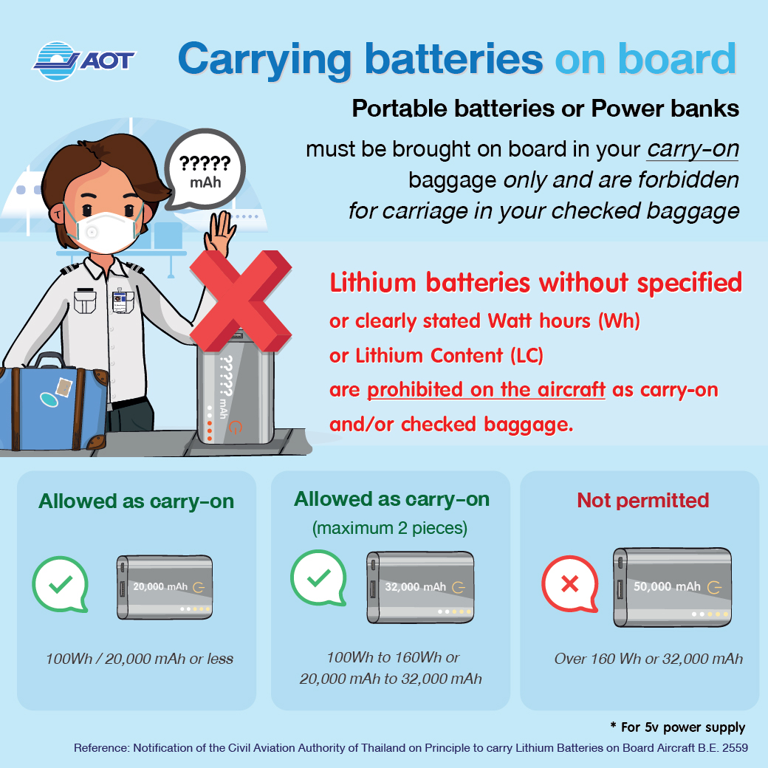
CAAT Batteries Requirement
According to the Civil Aviation Authority of Thailand (CAAT)’s Notification on Principle to Carry Lithium Batteries on Board Aircraft B.E. 2559 (2016). Passengers carry spare (uninstalled) lithium ion and lithium metal batteries which is considered as Dangerous Goods must follow these requirements.

Slide 23
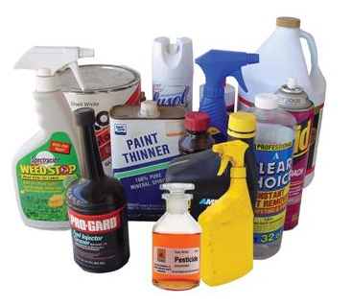
Dangerous Goods
They may seem harmless, but when they are transported by air they can be very dangerous.
Vibrations, static electricity, temperature, and pressure variations can cause items to leak, generate toxic fumes, start a fire, or even explode if these products are not handled properly (FAA, 2021).
https://greatamericandisposal.com/

Slide 24
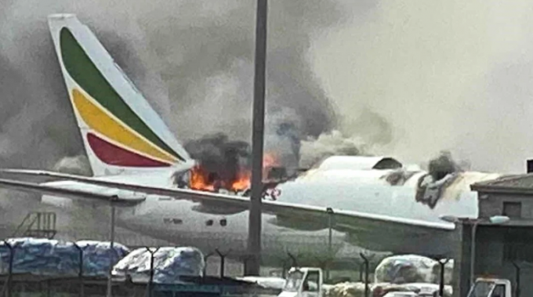
Latest freighter fire prompts new questions on lithium battery safety
https://theloadstar.com/

Slide 25
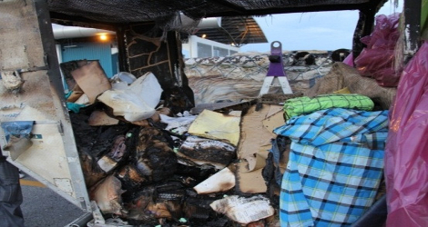
Singapore Airlines – Airbus A330 (9V-STO) flight SQ446
https://www.aviation-accidents.net/

Slide 26
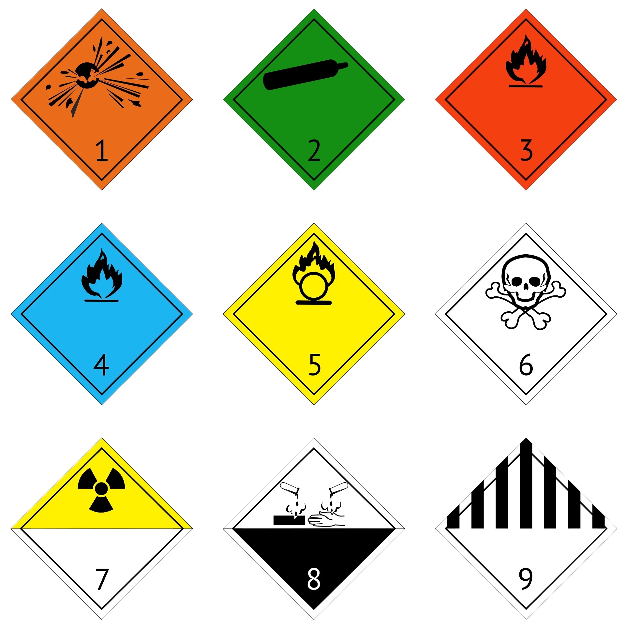
Dangerous Goods
1. Explosive Goods,
2. Gases,
3. Flammable Liquids,
4. Flammable Solids,
5. Oxidizing Substances and Organic Peroxides,
6. Toxic and Infectious Substances,
7. Radioactive Material,
8. Corrosive Substance,
9. Miscellaneous Dangerous Goods.

Slide 27
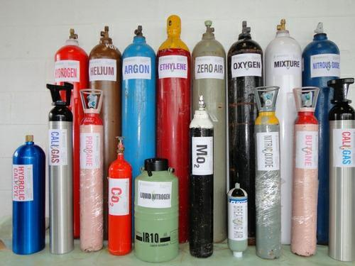
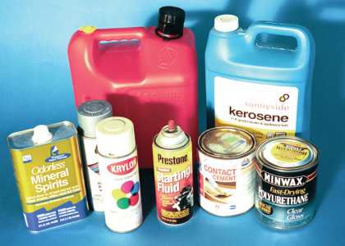
Explosive Goods
Gases
Flammable Liquid

Slide 28
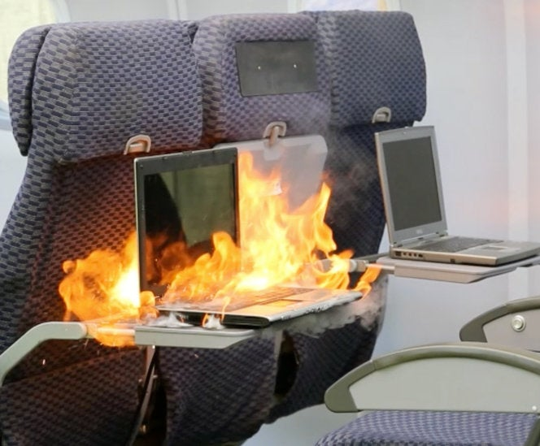
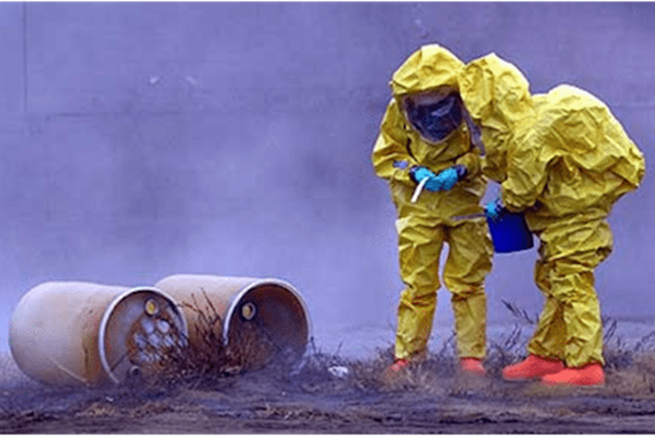
Flammable Solids
Oxidizing Substance
Toxic Substance

Slide 29
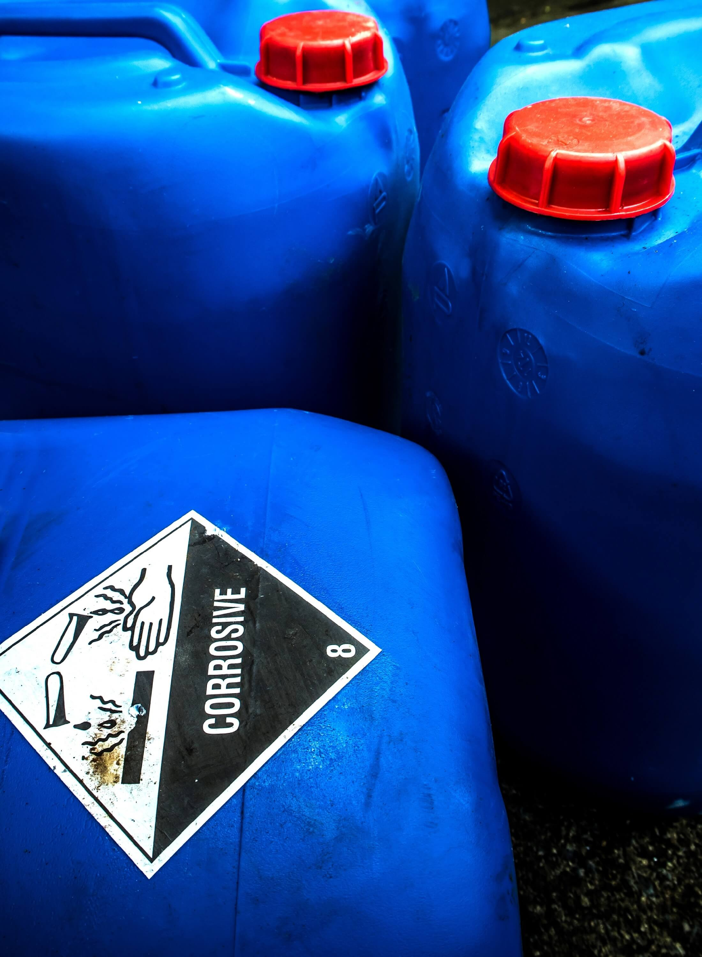
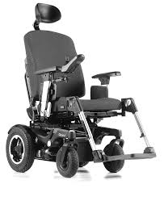
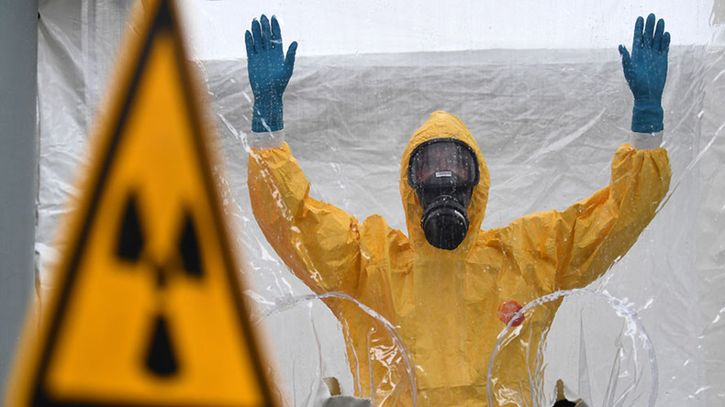
Radioactive Materials
Corrosive Substance
Miscellaneous

Slide 30
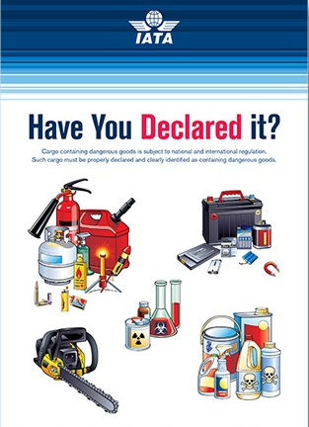
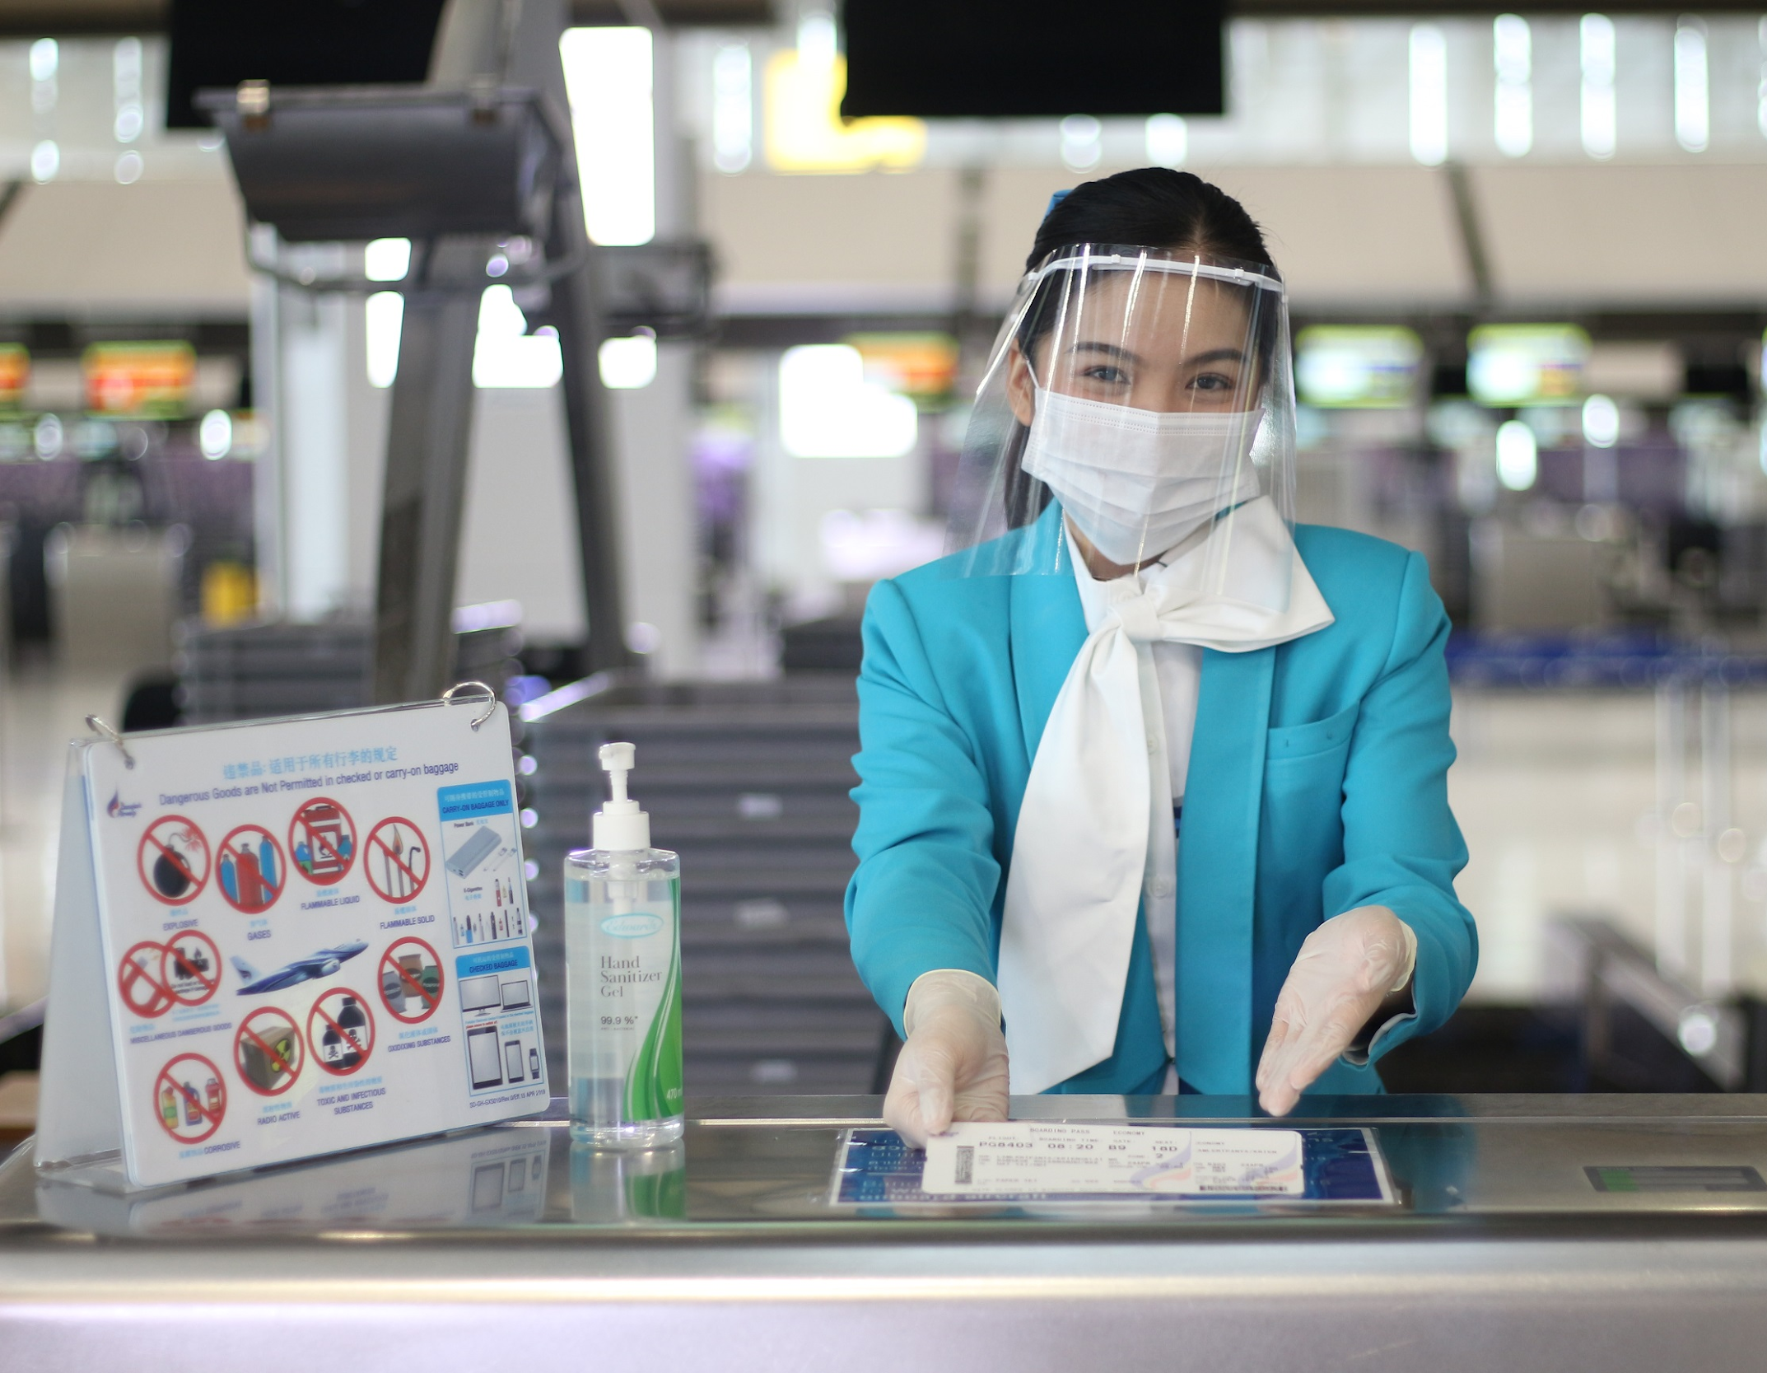
Dangerous Goods
When cabin crew detect passengers’ dangerous goods onboard an aircraft, they have to follow handling and removal dangerous items recommendations from ICAO in one of the following ways.
1. Placed in the passenger’s hold baggage before check-in, unless the item would endanger the safety of the aircraft.
https://www.bangkokair.com/

Slide 31
Dangerous Goods
2. Confiscated and subsequently properly disposed of or destroyed.
3. Confiscated and kept in storage by the airport authorities or relevant aircraft operator for later return to the passenger.
Take and seize
https://blog.scandlearn.com/

Slide 32
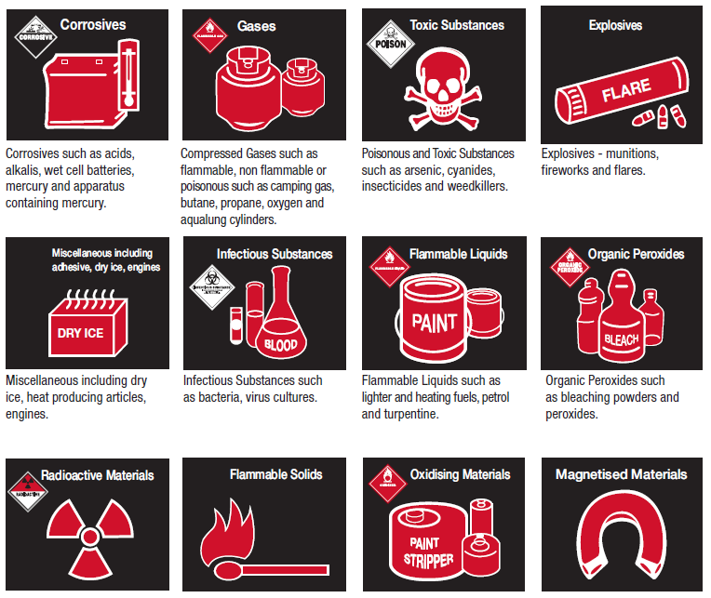
Dangerous Goods
4. Removed and, once properly prepared and packaged, transported in the hold of the aircraft for later return to the passenger at the ticketed destination.

Slide 33
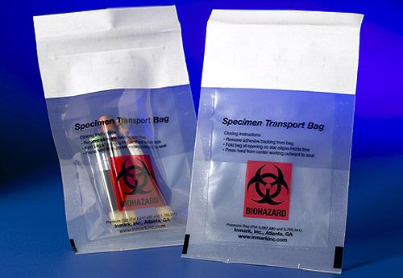
Dangerous Goods
5. Sealed in an appropriate way so that passenger could not use the item, or its content, to commit an act of unlawful interference or endanger the safety of the aircraft (ICAO, 2021).
https://www.extrapackaging.com/biohazard/

Slide 34
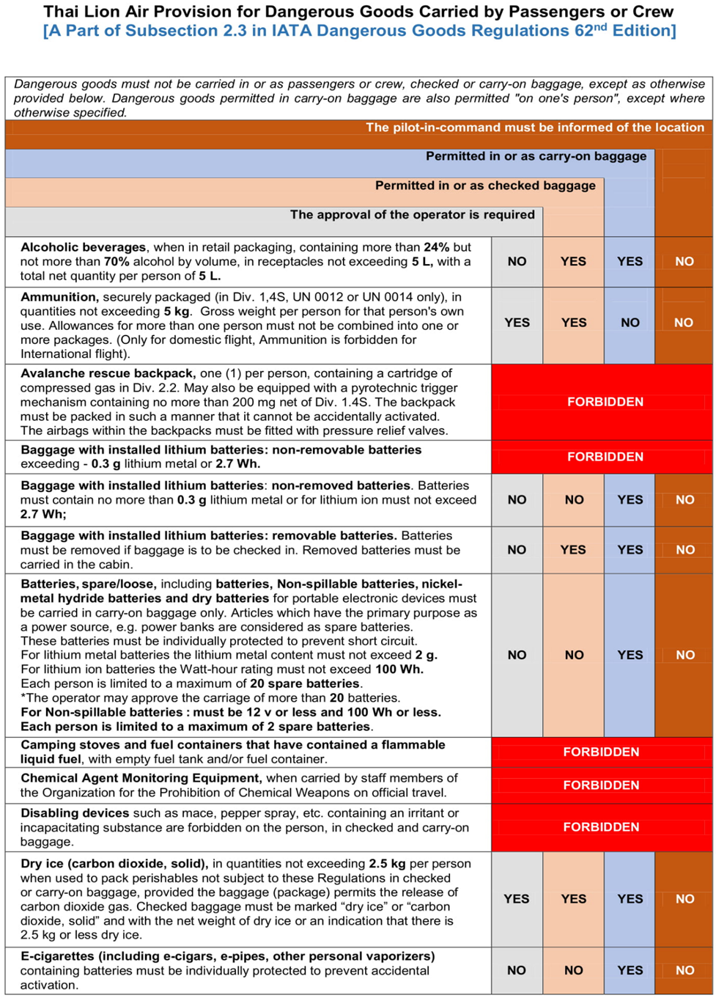
Permitted in carry-on baggage
Permitted in checked baggage
Approve
Not allowed

Slide 35
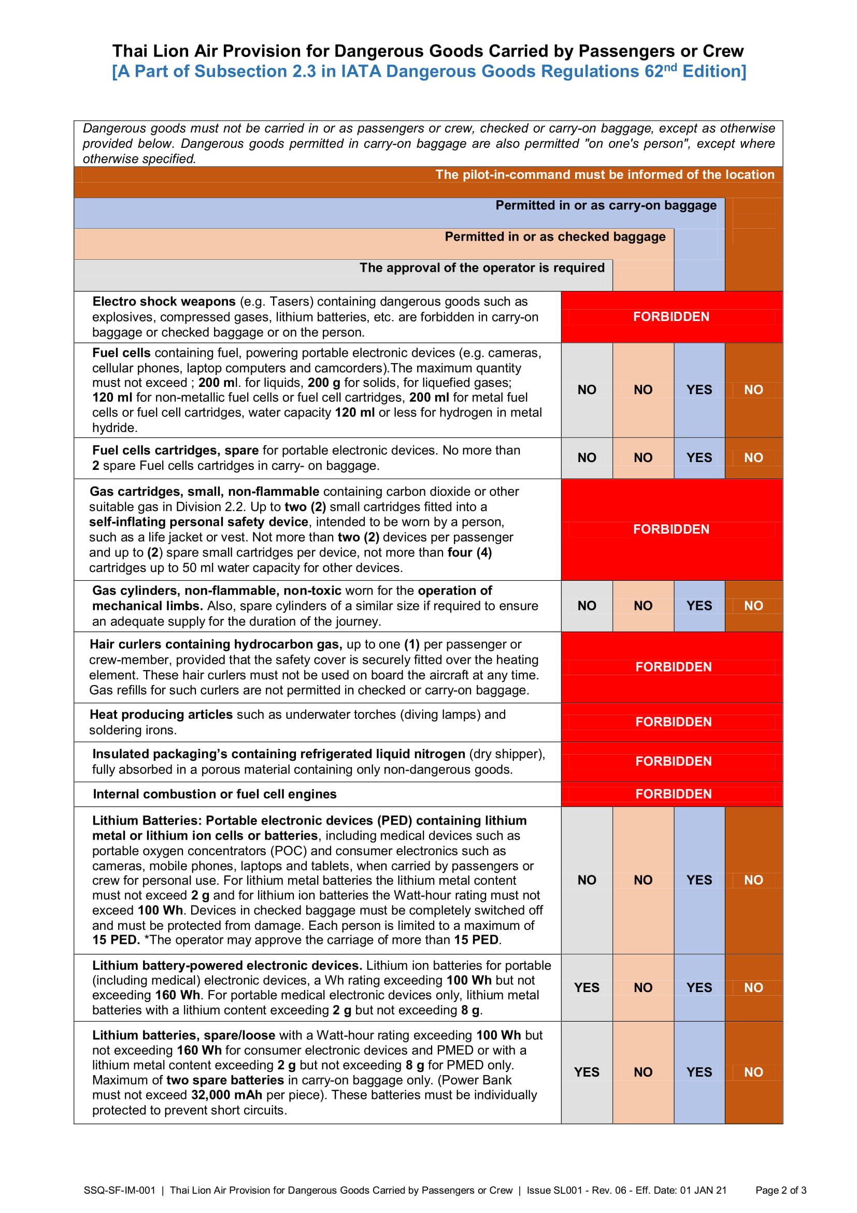

Slide 36
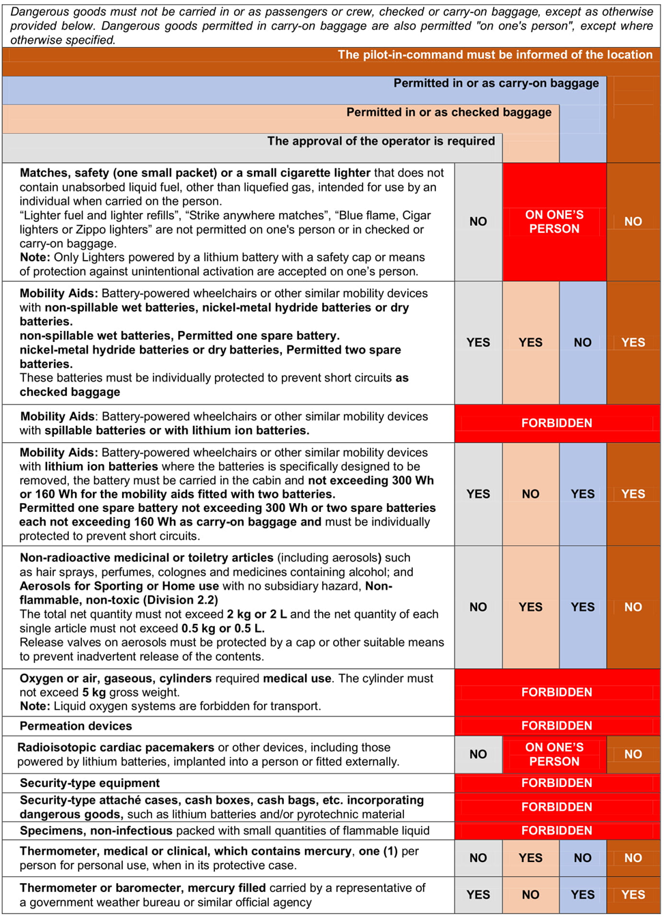

Slide 37
 | Exercise 1- True/False
1. | Immigration officer is an authority that has responsibility to control people traveling to and from one country to another. True
2. | A General Declaration form is for passengers. False
3. | TM6 is an immigration form of Thailand. True
4. | The term INAD refers to passengers who are not accepted by immigration authority to enter the country. True
5. | Deportees are persons who has entered the country illegally or legally but the authority of the country decided to expel them. True
6. | DEPUS means a person who is under arrest and travel as a deportee back to the origin country with accompanying by an authorized escort. False
7. | Quarantine officers have duty to control on duties of import and export goods, ensure safety and security on smuggling of drugs and counterfeits. False

Slide 38
 | Exercise 1 - True/False
8. | Prohibited goods are items that customs offices allow passengers to import to the country. False
9. | To bring restricted goods into Thailand, a person require a permit from related government agencies. True
10. | Dangerous goods can be very dangerous when they are travelled by air. True
11. | Power banks are allowed to put in the suitcase or checked baggage. False

Slide 39
 | Exercise 2- Answer the question.
1. | What is a government agency that give the permit to export a restricted good of a Buddha image? The Fine Arts Department
2. | What is a government agency that give the permit to export a restricted good of food and cosmetics? Food and Drug Administration
3. | What is the duty-free allowance for alcoholic liquor? 1 liter
4. | What does customs in red channel means? GOODS TO DECLARE
5. | What can cause items to leak, generate toxic fumes, start a fire from dangerous goods during they are transported by air? Vibration and pressure
6. | How many class of dangerous goods? 9
7. | Is pornographic materials a prohibited goods? Yes
8. | Is reserved animal of CITES-listed wildlife a prohibited goods? Yes

Slide 40
 | Exercise 2- Answer the question.
9. | Can a passenger carry 2.5 kg. of dry-ice in a passenger cabin? Yes
10. | Does a can of hair spray is permitted to be stowed in a checked baggage? No

