Slide 1
Introduction to Cabin Crew
Unit 1 IAC3306 Cabin Crew Management

Slide 2
Line id : nokmek
Email: Korawin.ku@ssru.ac.th
Mobile: 0639914288

Slide 3
Course Outline
The course provides knowledge on personality & grooming, good appearance, service mind, personal touch
Passenger handling,
In-flight service rules and regulations,
In-flight Service Mock-up & Procedure, briefing and assignment.
Cabin safety emergency equipment and procedure

Slide 4
Learning Outcome
Attendance 10%
Individual assignment 10%
Final Project 20%
Midterm 20%
Final 30%
Total 100%

Slide 5
Individual assignment
Choose 1 airline and explain the airline’s cabin crew details; Example
Their uniform
Qualification/ requirements

Slide 6
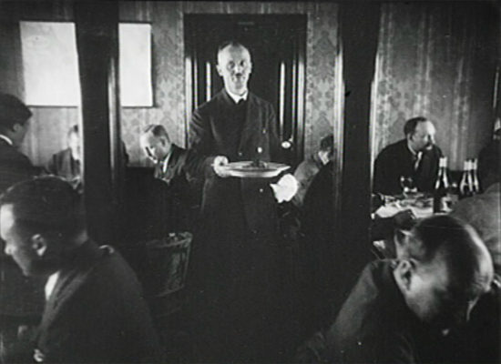
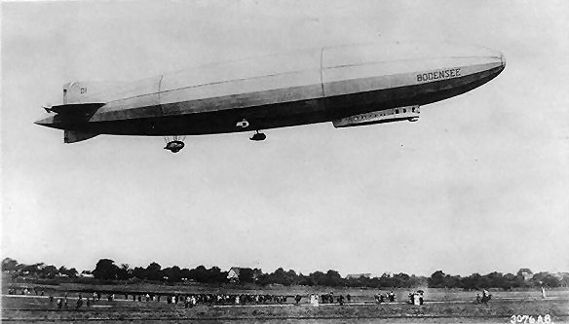
1912
The very first flight attendant was a German whose name is Heinrich Kubis.
He started working on the airship DELAG Zeppelin LZ-10.
History of Cabin Crew
1903 The Wright Brothers
https://www.wegointer.com/
https://www.outdooractive.com/

Slide 7
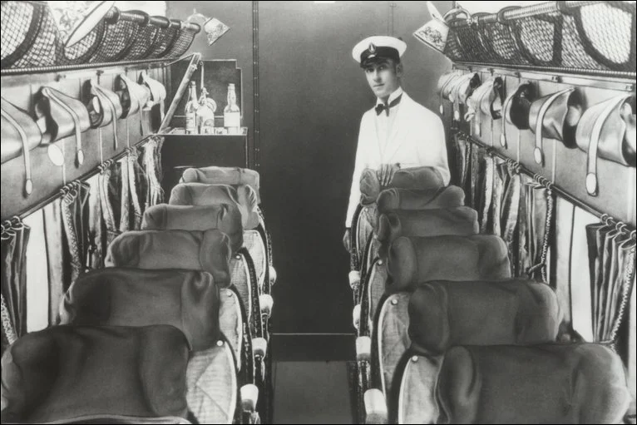
1920s
After the WW I was ended in 1919, military airplanes were turned to be civilian planes for commercial air transportation.
Airlines employed stewards to serve food, load and unload.
decade
change
Cabin boy
change
https://confessionsofatrolleydolly.com/

Slide 8
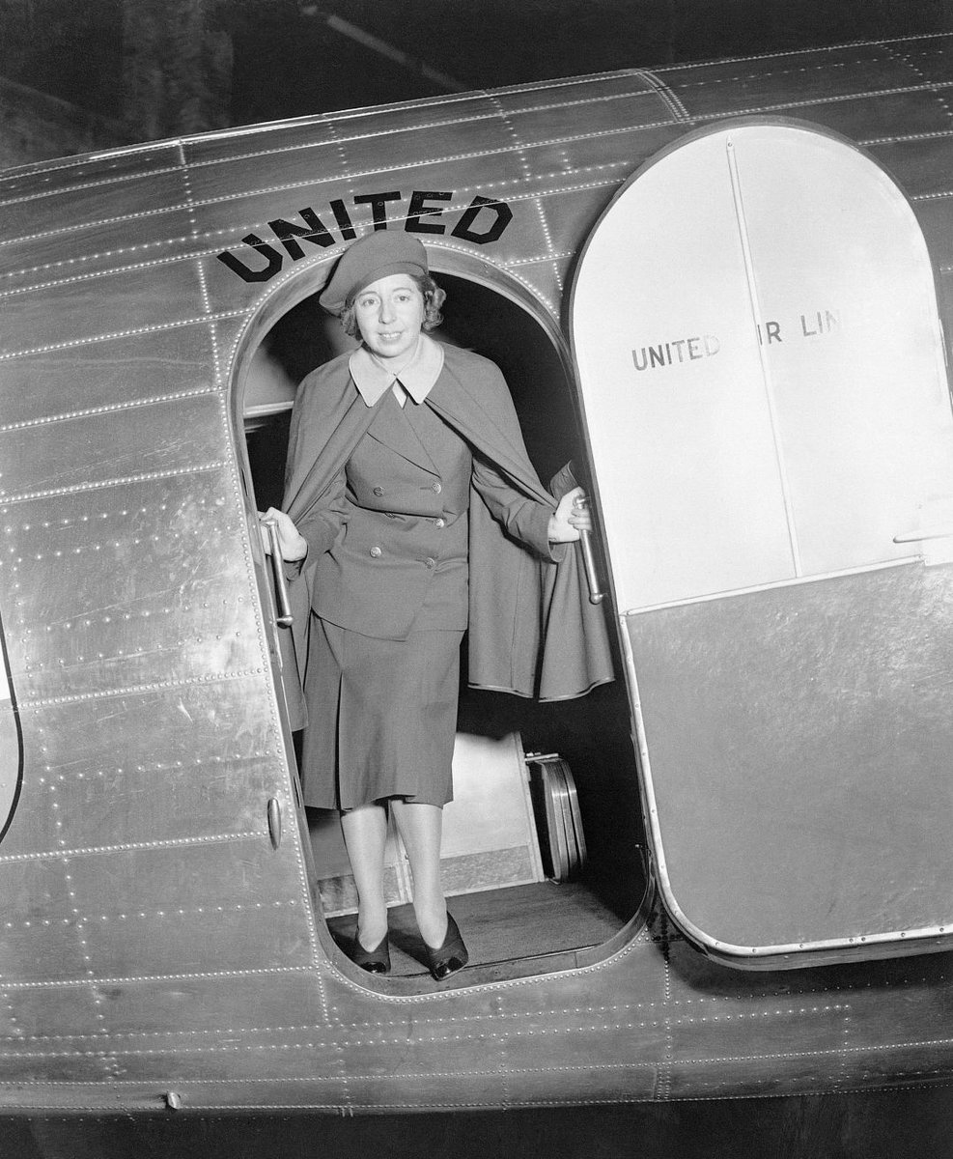
1930s airsick
United Airlines employed, Ellen Church, the first female flight attendant who was a registered nurse.
Airlines put nurses on the plane to look after passengers in unpressurized and uncomfortable passenger cabin.
a process in which conditioned air is pumped into the cabin of an aircraft or spacecraft in order to create a safe and comfortable environment.
https://twitter.com/

Slide 9
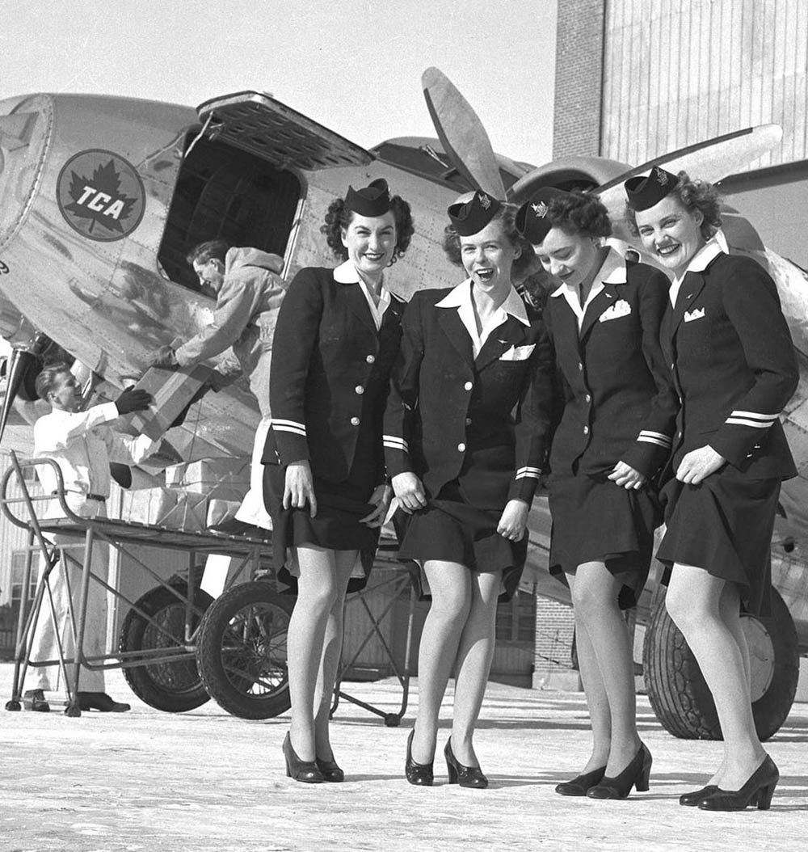
1940s
During the WW II (1939-1945) nurses were called to join the armed forces and airlines employed young women who are not nurses to work as flight attendants. Their tasks include both safety and service on board.
https://www.pinterest.com/

Slide 10
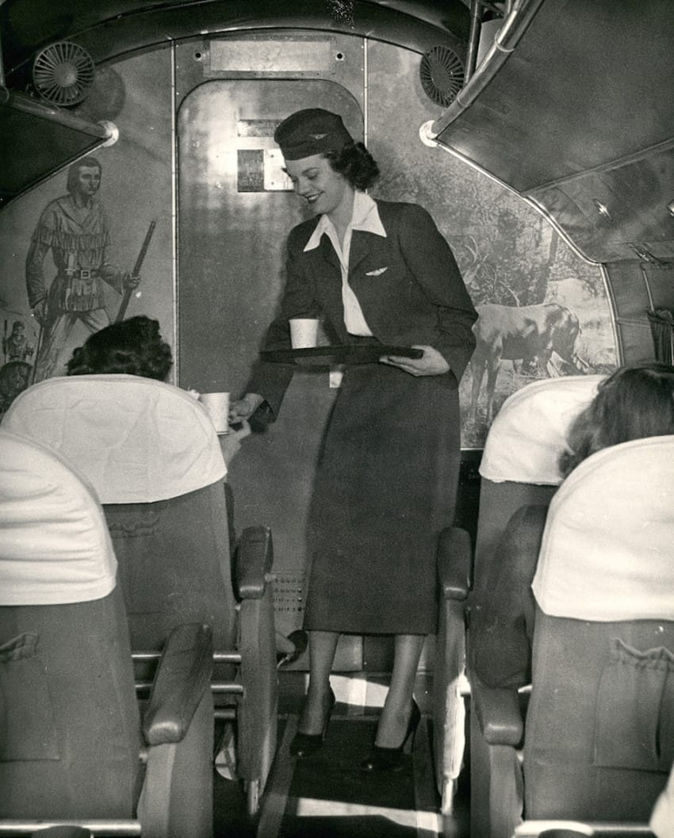
1950s
The government and regulatory agencies required flight attendants to have trainings in safety procedure.
They are required to be a safety professional who can prevent any hazards during the flight.
danger
https://doyouremember.com/

Slide 11
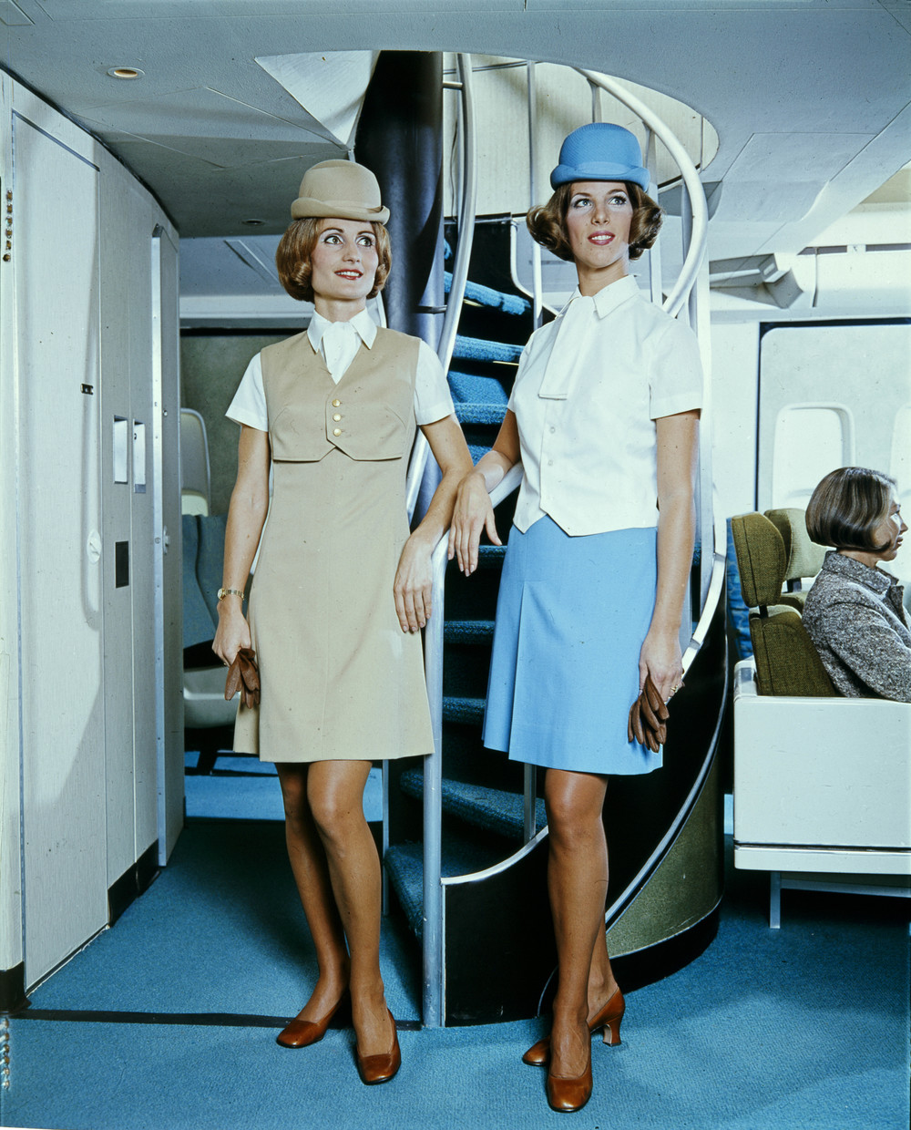
1960s
Flight attendants became more popular with thousand of applicants applied for this position.
Airlines kept promoting flight attendants by providing them fashionable uniforms from famous designers.
http://www.stewardessstory.com/

Slide 12
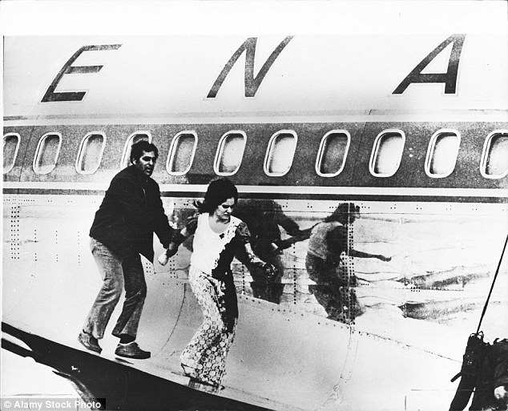
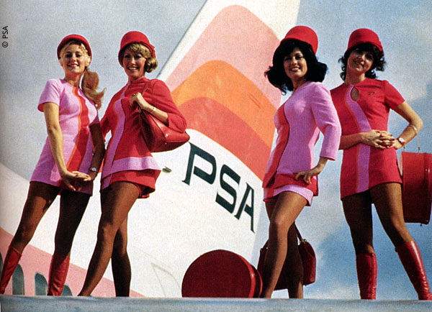
1970s
Airlines experienced challenges from escalating fuel costs, global inflation, rising labor cost, and low economic growth in this period. Their businesses were slow down. Besides this, hijackings still became threats for air travel safety and security.
Strict safety and security training for flight attendants are required by regulatory bodies.
Flight attendants played a significant role in safety, security, and services in flight.
Problem, difficulty
increase
https://www.theguardian.com/
To steal, to force
ICAO, IATA, CAAT, EASA
http://www.bartbarrett.com/

Slide 13
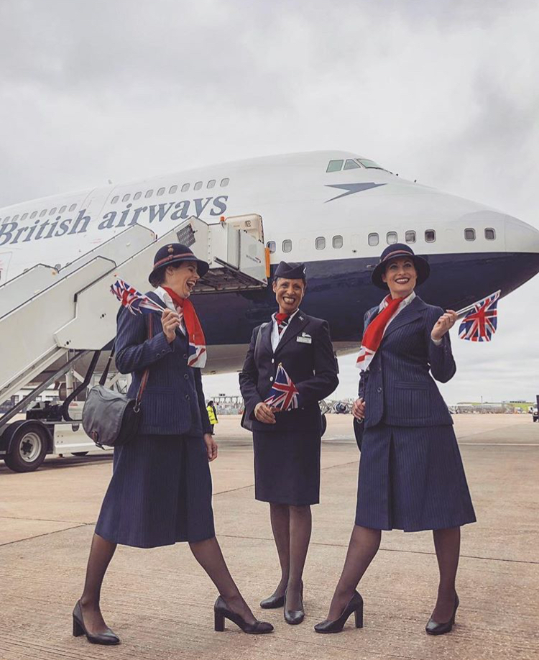
1980s – 1990s
These are decades of progress due to the trend of deregulation and open sky that promoted international travel and trade, air traffic, and economic growth.
Flight attendants transformed to be in more functional business look.
https://confessionsofatrolleydolly.com/

Slide 14
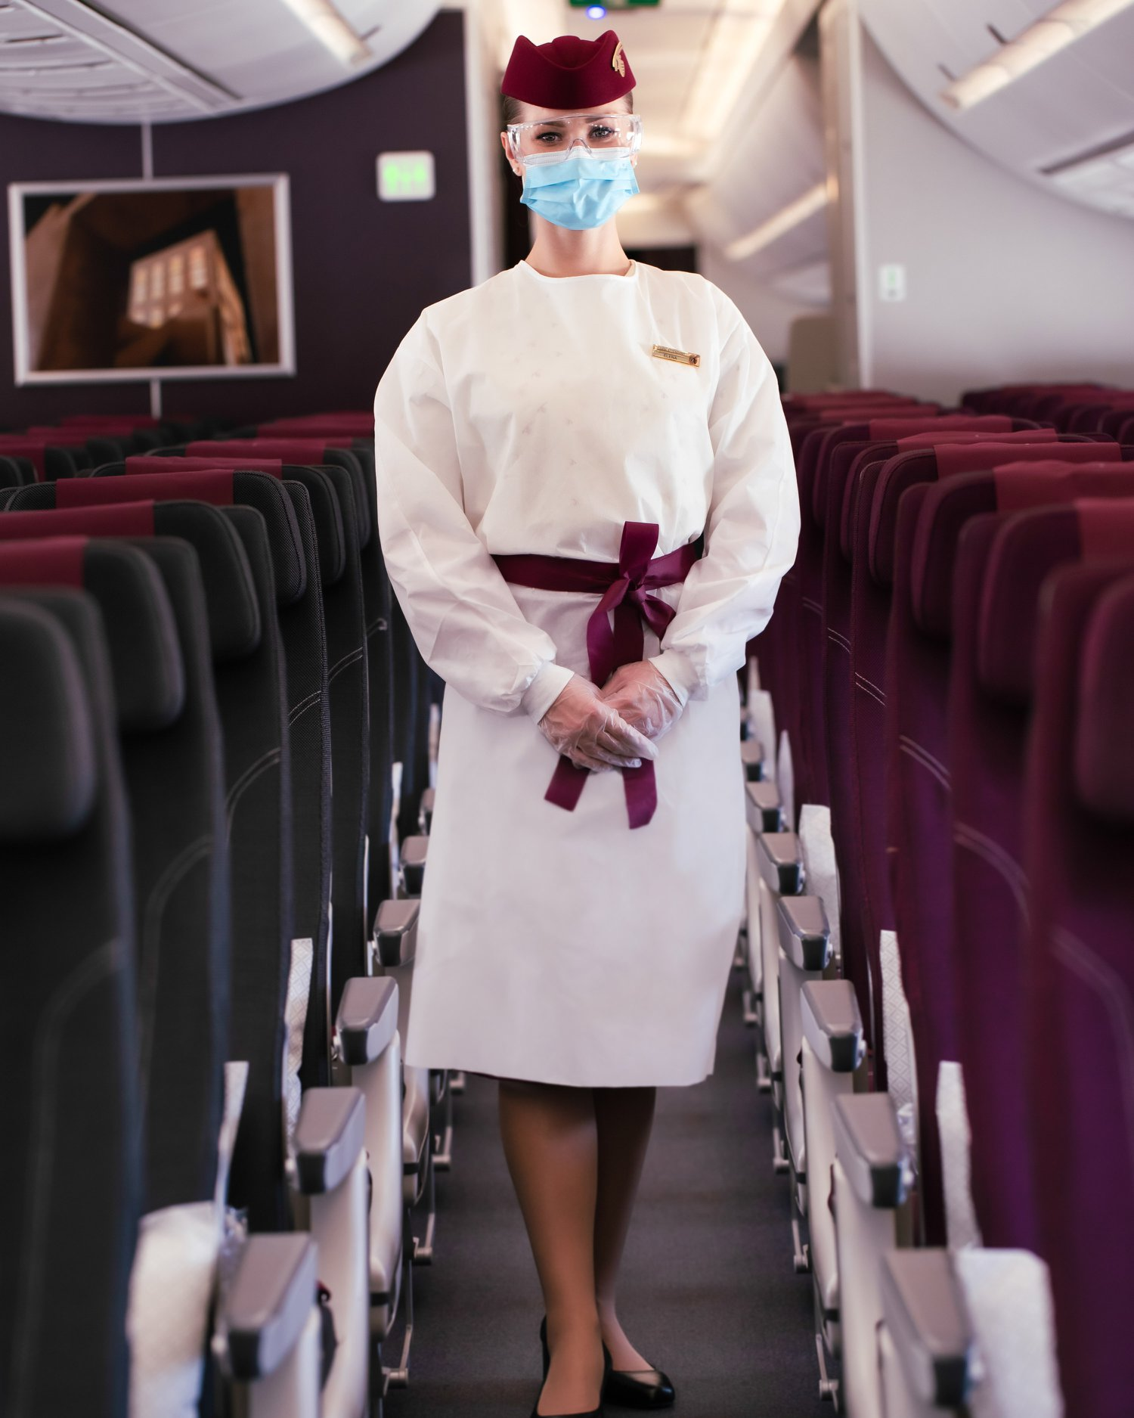
2000 – beyond
Aircraft manufacturers launched high innovative aircraft, such as B744-8, A380, B787 Dreamliner.
Aviation industry faced several threats, such as terrorism 9/11 (September 11, 2001), SARS, the Avian Flu in 2003, and COVID-19.
increase
danger
Epidemic
pandemic
www.qatarairways.com

Slide 15
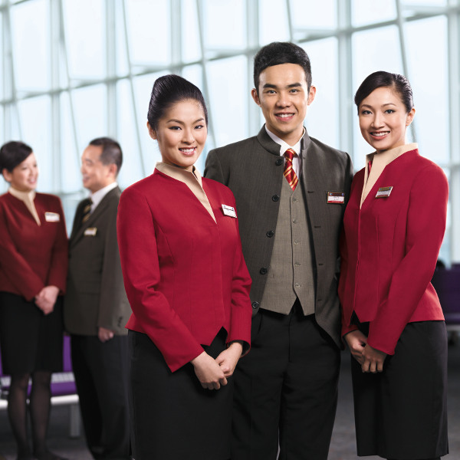
Male flight attendant
Female flight attendant
Flight attendant
Cabin crew
Air host/ Air hostess
Steward/ Stewardess
Purser/ CIC (Cabin Incharge)
Chief purser
Customer service supervisor
Customer service manager
In-flight manager
https://www.travelstart.com.ng/

Slide 16
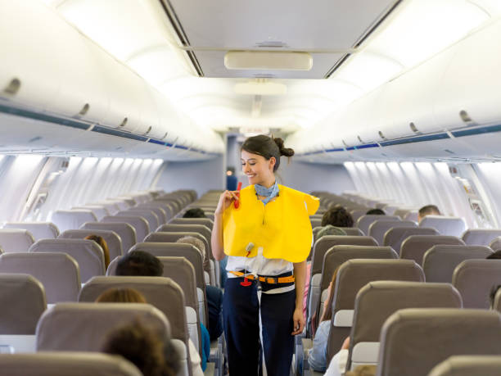
The job of cabin crew revolves around safety to a much greater extent than those of similar staff on other forms of transportation.
https://www.istockphoto.com/

Slide 17
Competency – ability, suitability
A set of individual performance behaviors which are observable, measurable and critical successful individual performance.
Individual characteristics of a person which result in an effective and superior performance in a job.
https://www.managementstudyguide.com/
Cabin Crew’s Competency
K
S
A
attitude

Slide 18
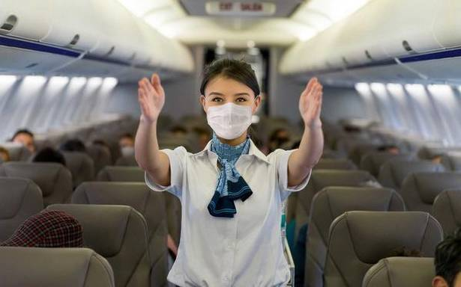
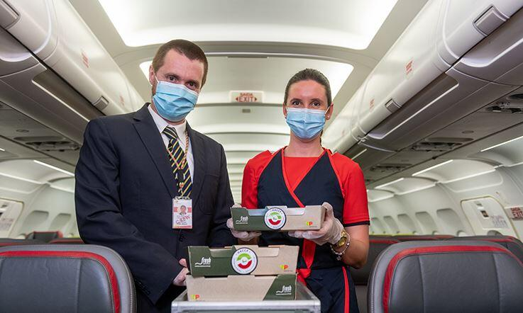
Competency of Cabin Crew
20101 Safety and security
20102 Emergency procedure
20201 Regulations and standards
on air traveling
- 20202 Customer services in flight
Thailand Professional Qualification Institute (Public Organization : TPQI)
Cabin Crew’s Competency
https://www.thehindubusinessline.com/
https://www.flytap.com/

Slide 19
1. On-ground Preparation
2. Boarding and Pre-takeoff
3. After Takeoff Services
4. Pre-landing Duties
5. Post-flight Services
1. On-ground Preparation
Safety check on safety equipment
Safety check service equipment
Safety check on passenger cabin environment
Cabin Crew’s Responsibility
https://www.travelandleisure.com/

Slide 20
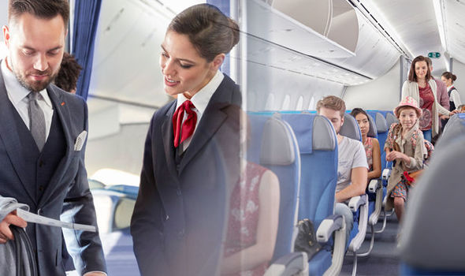
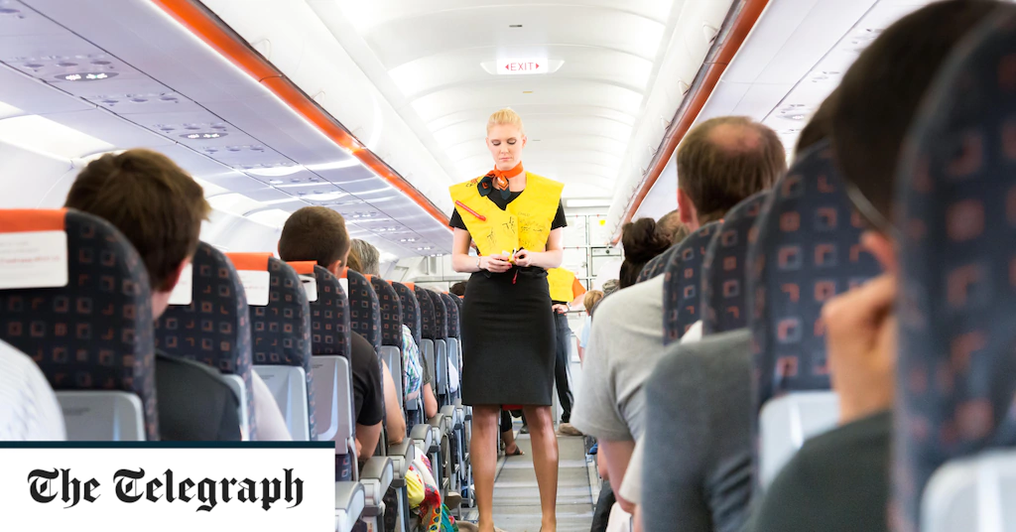
2. Boarding and Pre-takeoff
Welcome service
Assist with loading of carry-on baggage
Check for dangerous goods
Emergency exit briefing
Safety demonstration
Secure cabin before takeoff
Cabin Crew’s Responsibility
https://www.express.co.uk/

Slide 21
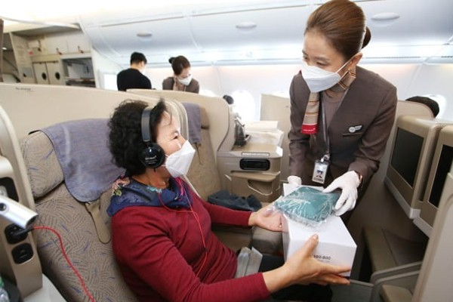
3. After Takeoff Service
Cabin check
Check lavatories
Cockpit check
Meals and drinks services
Respond to call light
Ensure cabin secure during turbulence
Others services, duty free, travel document, water
Cabin Crew’s Responsibility
https://pulsenews.co.kr/

Slide 22
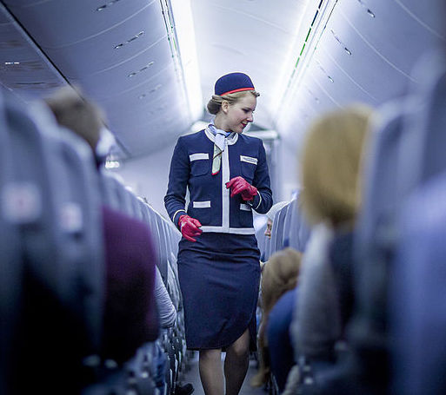
4. Pre-landing Duties
Collect and secure all loose items
Cabin secure or cabin check
Remain awareness of possible emergencies
Cabin Crew’s Responsibility
https://www.nkytribune.com/

Slide 23
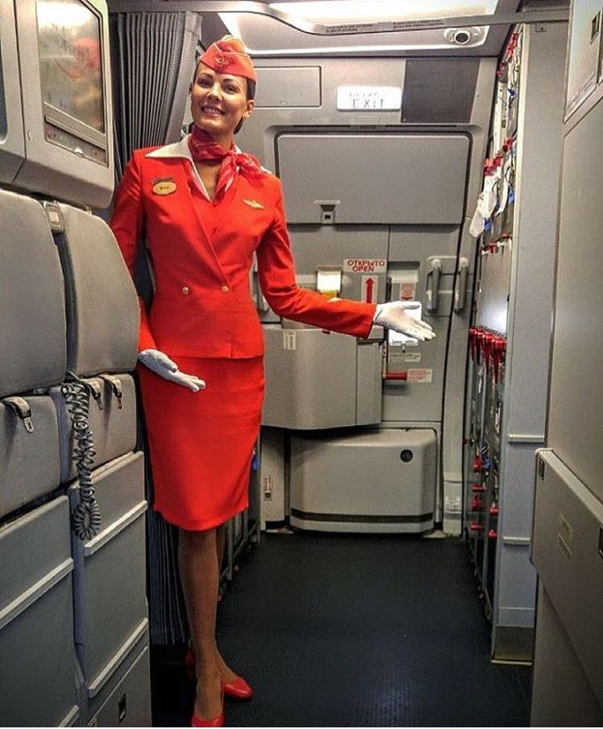
5. Post-flight Services
Remain stationed at the emergency exits
Monitor the airplane and passenger cabin
Assist any special needs passengers and small children
Disembark
Get off
Cabin Crew’s Responsibility
https://www.pinterest.com/

Slide 24
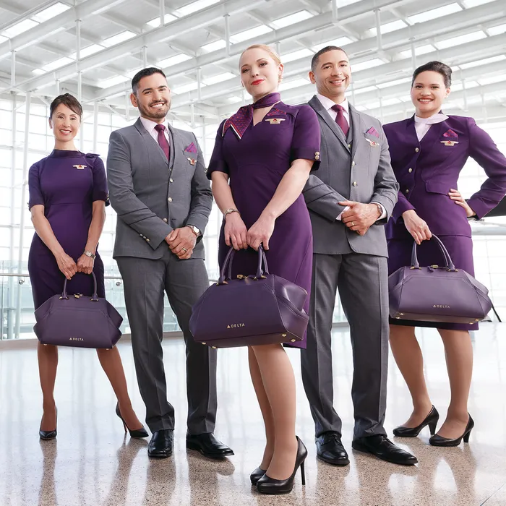
Presentable
Safety
Airlines select cabin crew who suit to competency and airline organizational culture.
Have the right to work in the country
Clean criminal record
Pass an aviation medical examination
Provide employment and education reference documents
Have good swimming skills
Be at least 160cm tall (5 ft. 3 inches)
Be at least 20 years old
To be fluent in English
No visible tattoos or piercing
Requirements on Cabin Crew
https://www.thecut.com/

Slide 25
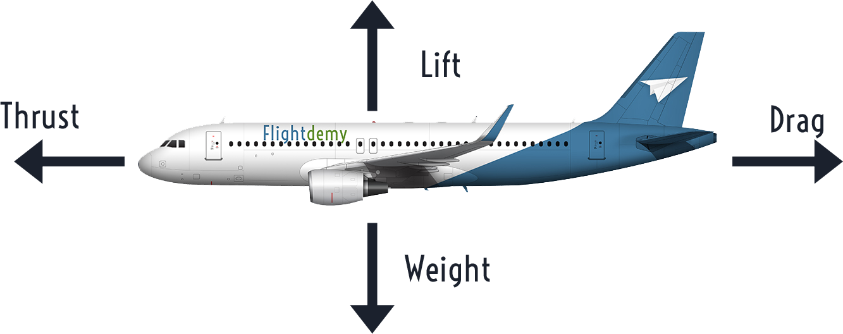

Slide 27
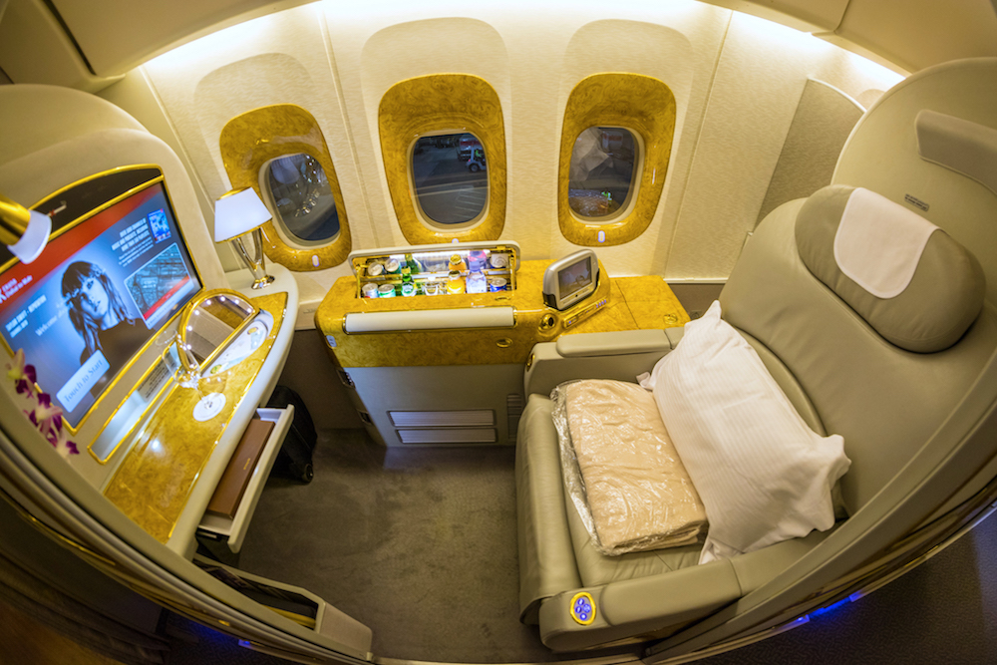

Slide 28
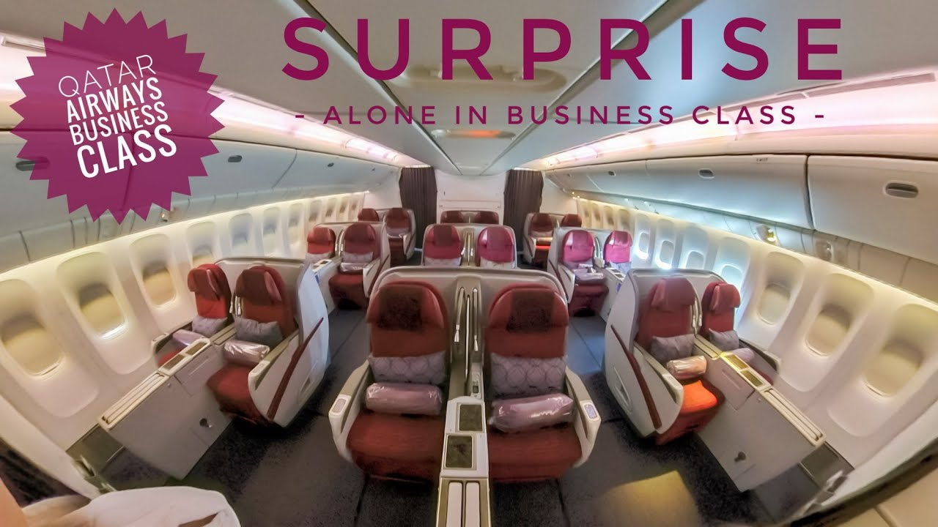

Slide 29
