Slide 1
IAC 2207 Ground Service Management
Unit 8
Arrival

Slide 3
It is the responsibility of GSA to ensure that arrival passenger are heading toward the right location to either connect to another flight or to proceed to the arrival facilities.

Slide 4
Arrival Passengers
Transit https://youtu.be/bJUlOYF-inw
Transfer
Arrival passengers

Slide 5
Transit
Arrive and depart via the same airline / same aircraft the boarding pass are issued at the check-in at departure airport

Slide 6
Transfer
Immediate connect with same airline but different flight number or with other airline
Interline agreements were developed to provide convenience for customers who could only get to their destination via a connection using two different airlines
If yes , the airlines will issue boarding passes and check baggage to the final destination
If no , passenger have to go to transfer counter to get a new boarding pass

Slide 7
GSA will wait at the bridge to show a list of connecting flight and gate number

Slide 8
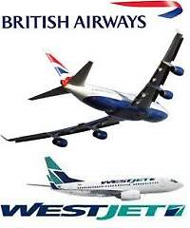
WestJet Airlines has signed an interline agreement with British Airways, allowing the airlines to work together on baggage handling and other tasks and making it easier for travellers to transfer from one carrier to the other

Slide 9
Change of Gauge
In Air transport is change of aircraft without changing the flight number
BKK
MH 789
A/C A330
KUL
MH 789
A/C 747
LHR

Slide 10
Arrival passengers
Domestic – go direct to pick-up the luggage
International – pass the immigration and pick-up the luggage

Slide 12
Transit passengers or transfer passenger holding onward boarding passes disembark from arrival aircraft then proceed through the security and to the departure level for boarding the connecting flight
Passengers with boarding pass
Security
Boarding gate

Slide 13
Transfer passengers without onward boarding passes disembark from the aircraft proceeding to the transfer counter (in airside area) to check-in.
After obtaining boarding pass for the connecting flight, going through security and proceed to the departure level to board the connecting flight.
The passenger’s baggage will be automatically
transferred to the connecting flight
Transfer counter
security
Boarding gate

Slide 14
International arrival passengers disembark and proceed to immigration counter . Collect baggage and proceed to clear customs and quarantine.
Immigration
Baggage claim
Custom &Quarantine

Slide 15
CIQ
Custom – no prohibited items entered and collect tax from the government allowed
Immigration – control movement in and out and prohibited unauthorized person to enter the country
Quarantine – control pests or diseases ,monitor both human and animal’s health condition

Slide 16
Exemption from CIQ
Some countries do not required to go through CIQ when pax traveling from one inter flight to another with immediate connecting and staying in airside area
Cdg by Air france
Sin by Quantas
Bne

Slide 17
Location of CIQ facilities
International flight or domestic flight
CIQ at one location
All international arriving pax are required to go through CIQ at first port of entry (POE)

Slide 18
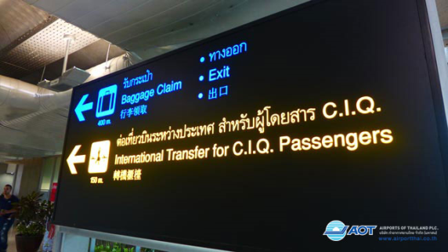
CIQ at different location
Pax arriving from inter flight with connecting to domestic flights are sometimes required to perform CIQ at different airport , pax pass immigration at first POE and declare custom and quarantine at final destination

Slide 19
CIQ sticker
Departure CIQ
Pax will be given identification sticker to show GSA that they have pass through CIQ from international-domestic airport ex. CNX, HKT and will transit at BKK to change to international flight.
ex; CNX-BKK-NRT

Slide 20
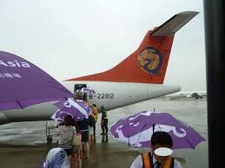
Arrival preparation
GSA has to arrange the necessary support to passenger such as parking at remote bay ,GSA has to prepare the bus to pick up pax from aircraft.
During rainy weather ,GSA has to prepare raincoat or umbrella for pax

Slide 21
Arrival manifest
GSA has to rely on flight manifest that show the number of transit/transfer/special handling :includes
WCHR
UMNR
MAAS
Deportee
Pet in cabin

Slide 22
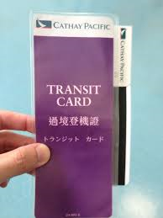
Number of transit passenger
Some airline allow transit pax to stay in the cabin or disembark.
Passenger who would like to disembark have to arrive at the arrival concourse with their belonging.
The airlines will give them a transit card

Slide 23
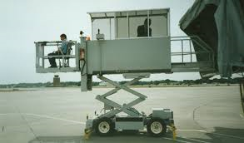
Passenger with special need
WCHR
GSA have to make arrangement for sufficient wheelchairs to be available upon arrival.
Deplane last, boarding first
If park at remote bay will prepare a high-lift truck

Slide 24
UMNR
GSA will contact um’s parent at destination to confirm ETA and to ensure that they will meet at the arrival hall after GSA escort Um to the arrival hall.
Deplane first, boarding first
MAAS
GSA will take extra attention during transit , transfer and arrival.
Deplane first, boarding last

Slide 25
Deportee
GSA has to make contact with immigration office in advance and escort to immigration for further investigation.
Pet in cabin
GSA has to notify the quarantine in advance .
GSA has to examine the manifest carefully to look for any pet in cabin.

Slide 26
Flight arrival
When the aircraft is stopped . Most airlines ground agent will knock 3 times and thumb up, to give the signal to aircrew that the aircraft is ready to open the door
GSA received all concerned documents from aircrew : PM, GD , other documents
GSA required to be present to make sure that all passenger have disembarked

Slide 27
Additional responsibilities
Inadmissible passenger on arrival
GSA will be responsibilities for providing assistance for returning flight , making reservation and preparing necessary air ticket
Crew assistance
GSA is required to prepare GD and provide a copy for immigration at crew’s channel to assist in crew’s disembarkation

Slide 28
Firearms
GSA will be required to assist air marshal to turn in their firearms to custom or the police authority at the a/p
Emergencies
Sick passengers or misbehaving passenger
GSA has to contact the authorities to coordinated the required assistance

Slide 29
Key term
CIQ the process that international passengers are required to go through upon arrival at another country
Transit : arrive and immediately depart on the same aircraft

Slide 30
Transfer : arrive with one airline and make an immediate connection to their next or final destination with same airline or with another airline
Meet and assist : those who required help upon departure and arrival

Slide 33
Any Question?

Slide 34
References
Colin C. Law and Mary R. Doerflein (2014) Introduction to Airline Ground Service.Cengage Learning Asia Pte.Ltd. Singapore.
International Aviation Training Program.(2012). Introduction to the Airline Industry. Canada: International Air Transport Association: Author.
http://www.wordsonimages.com/pics/60756-o.jpg
http://i2.wp.com/www.notegazine.com/wp-content/uploads/2014/08/08-21-02.gif
http://www.glutenfreejetset.com/wp-content/uploads/2015/02/EtihadAirways-3.jpg
https://farm4.staticflickr.com/3908/14424861511_991051634c_c.jpg
http://air-ddf.kxcdn.com/wp-content/uploads/2014/05/140501-QatarA320Hamad-01.jpg
http://media.nbcdfw.com/images/1200*675/qantas-a380-dfw-10.jpg

