Slide 1
EHL1202 English for Hotel and Lodging 2
Unit 6 Tourist information
Describing Place of Interest
Tour Program suggestion
Give Direction

Slide 2
Describing Place of Interest
ในการอธิบายสถานที่ท่องเที่ยวจะต้องตอบคำถามเหล่านี้ก่อน
What city/town/village is it? เมืองใหญ่ / เมืองเล็ก / หมู่บ้านนี้คืออะไร
Where is it? สถานที่นี้อยู่ที่ไหน
What is there to see and do? มีอะไรให้ดูและให้ทำอะไร
What is the city like? เมืองเป็นอย่างไร
It’s famous for...... มีชื่อเสียงในเรื่องของ ......
What’s the weather like? อากาศเป็นอย่างไร
How are the people? ผู้คนเป็นอย่างไร

Slide 3
Describing Place of Interest
Useful Expressions
It offers...... มันมี ........
The views are..... ทิวทัศน์......
You shouldn’t miss.... คุณไม่ควรพลาด.........
The atmosphere is..... บรรยากาศ......
It’s located in.... มันอยู่ที่.....
It’s far away from..... มันไกลจาก......
What I like about it is..... สิ่งที่ฉันชอบเกี่ยวกับสถานที่นี้คือ......
The good thing about it is.... สิ่งที่ดีเกี่ยวกับสถานที่นี้คือ......
It’s popular with tourists because…. มันมีชื่อเสียงในหมู่นักท่องเที่ยวเพราะ .....
It’s well-known for.... ที่นี่มีชื่อเสียงในเรื่องของ ......
11. It’s got.... มันมี.....
12. It’s close to.... มันใกล้......
13. You can see.... คณุสามารถเห็น.......

Slide 4
Describing Place of Interest
Location
by the sea ตรงทะเล
on the coast ตรงชายฝั่ง
in the country ที่บ้านนอก / ที่ต่างประเทศ
in the north/south/east/west of.. ตรงทิศเหนือ/ใต้/ตะวันออก/ตะวันตก....
on the mountains บนภูขา
on the river (name) ตรงแม่น้ำ
near a forest/desert ใกล้ป่า/ทะเลทราย

Slide 5
Describing Place of Interest
Vocabulary for Describing Atmosphere (Adjective)
Peaceful/quiet เงียบสงบ
Ancient เก่าแก่
Beautiful สวย
Charming/picturesque มีเสน่ห์
Cosmopolitan เป็นสากลนิยม
Boring น่าเบื่อ
Bustling คับคั่ง
Compact กระชับ
Stunning สวยล้ำเลิศ
Historic ที่สำคัญในประวัติศาสตร์

Slide 6
Describing Place of Interest
Vocabulary for Describing Atmosphere (Adjective)
Undestroyed ยังไม่ถูกทำลาย
Lively มีชีวิตชีวา
Fascinating น่าหลงใหล
Compact กระชับ
Huge ใหญ่
Touristic เต็มไปด้วยนักท่องเที่ยว
Popular มีชื่อเสียง
Exciting น่าตื่นเต้น
Crowded เต็มไปด้วยผู้คน
Hospitable มีมิตรไมตรีจิต

Slide 7
Describing Place of Interest
Vocabulary for Describing Activities
Lots of nightlife เต็มไปด้วยกิจกรรมกลางคืน
Spectacular view ทิวทัศน์สวยงาม
Good shops / transport ร้านขายของ / การขนส่งที่ดี
Go sight-seeing / shopping ไปทอ่งเที่ยว / ซื้อของ
Go hiking ไปปีนเขา
Visit museum/ art gallery ไปพิพิธภัณฑ์ / หอศิลป์
Take lots of photos ถ่ายรูปเยอะ
Go to concerts/ the theatres ไปคอนเสิร์ต / โรงแสดงละคร
Go to exhibitions/ museum ไปงานนิทรรศการ / พิพิธภัณฑ์

Slide 8
Describing Place of Interest
Vocabulary for Describing Activities
Do business เต็มไปด้วยกิจกรรมกลางคืน
Practice sports_ for example: horse-riding / cycling / wind-surfing / jet-skiing / snowboarding ขี่ม้า / ปั่นจักรยาน / เล่นวินเซิรฟ์ / เจ็ทสกี / เลน่สโนว์บอร์ด
Meeting people เจอผู้คน
Relax on wonderful beaches ผ่อนคลายที่ทะเลที่สวยงาม
Wonder around town/shops เดินเล่นในเมือง / ร้านขายของ
Go on a boat on river/lake ล่องเรือในแม่น้ำ / ทะเลสาป
Get on the tourist bus นั่งรถบัสนักท่องเที่ยว

Slide 9
Which of these attractions do you have in your city or town?
Museum/ theatre/ concert hall
Famous monument/ national park/ art gallery/ place of worship/city tour
Famous building/ special attractions (e.g. swimming with dolphins, firework displays)

Slide 10
Which of these attractions do you have in your city or town?
Example: Temple of the Emerald Buddha (Wat Phra Kaew)
Also known as the Temple of the Emerald Buddha, Wat Phra Kaew is situated by the banks of the Chao Phraya River that snakes its way through the middle of Bangkok. Located on the grounds of the Grand Palace, the temple is one of the city's most popular attractions, and is cantered around the treasured artefact of the Emerald Buddha.
Carved from a single block of jade, the Buddha measures just 66 centimeters tall and has made its way from temple to temple over its lifetime. It was first discovered in 1464 and is now housed in the radiant gold-dipped building on the palace grounds.
Visitors aren't permitted to take photos of the Buddha and you need to wear fairly modest attire that covers your shoulders, and long trousers (sweatpants and sweatshirts are off limits, too). You'll have to be wearing closed shoes to enter the Grand Palace as well.

Slide 11
Where do guests at your hotel want to visit? What places do you recommend to guests? Do you know how many of these famous sites are in Bangkok/ Thailand?
Grand Palace/ Wat Arun/ Ayutthaya
Lumpini Park/ Jatujak Sunday Market
Koh Samui/ Phuket/ Pattaya/ Chiang Mai
The Erawan Falls, Kanchanaburi
Sukhothai Historical Park,

Slide 12
Speaking Practice
Guest 1:
Guest: Hello can you help me? We’ve a few hours free this afternoon, and we’d like to see some of the sights. What do you suggest we visit?
Employee: Well, sir, Bangkok is full of great places to visit – museums, art galleries, concerts, famous building. Do you have any particular interest?
Guest: Well, yes, art. We’d like to visit some of the famous art galleries. And we’d like to do some shopping.
Employee: You’ve come to the right place, sir. The Museum of Modern Art is only a few minutes from here. You must see it while you’re here. And the shopping area is very close too. Here, I’ll show you on the map.
Guest: Thank you.
Employee: You’re welcome.

Slide 13
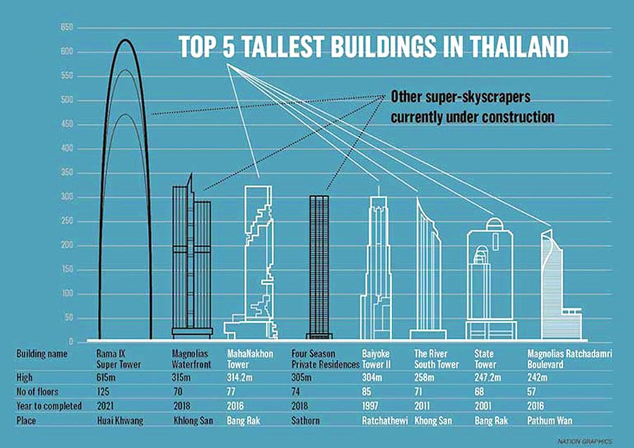
Speaking Practice

Slide 14
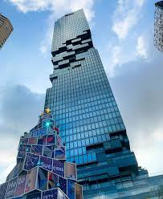
Speaking Practice
Guest 2:
Guest: My husband and I would like to visit the city. Can you recommend some places to go?
Employee: Certainly, madam, Bangkok is full of very interesting places to go to. I’ll show you a few here on the brochure. Here’s the Emerald Buddha – you’d like to the trip there. And you shouldn’t miss Mahanakorn Building – the view from the top is one of the best in Bangkok. Or here, look, you could go down to the shopping area, – here you can see it on the map.
Guest: Is Mahanakorn Building open every day?
Employee: Oh, yes, every day from 09.30 a.m. to midnight. And it is not very far from here.
Guest: Sounds great, thanks.
Employee: You’re welcome.

Slide 15
Speaking Practice
Guest 3:
Guest: Could you tell me where I’ll find a really good tour of the city?
Employee: Yes, madam, there are a few here to choose from. Look, I’ll show you the brochure.
Guest: And what about music? I like all kinds of music.
Employee: You’re in luck. There’s a free concert today in Lumpini Park. Why not go to it? I’ll just get you the information. Here is a brochure for you, and here is a list of all the other concerts in the city at the moment.
Guest: Thank you very much.
Employee: You’re welcome.

Slide 16
Be clear and polite
Useful sentences for suggesting places to visit.
Bangkok is full of great places to visit
You must see it while you are here.
You should not miss the Emerald Buddha Temple.
( e.g. Mahanakorn Building etc.)
You could go down to the …………….. (e.g. department store on …… Road)
I will show you on this brochure.
Why not go to the concert in Lumpini Park.

Slide 17
Reading Practices I

Slide 18
Rome, Italy

Slide 19
A short break in Rome
Rome, called the Eternal City, founded over 2,700 years ago, is today one of the most popular tourist spots in the world, and for many people one of the most interesting. From a population of 200,000 a century ago, Rome now has over three million inhabitants.
For the visitor there is some thing to see and do for all tastes and all budgets. Rome is full of museums containing priceless works of art, beautiful monuments pizzas, churches, and great places to ear.
There are of course many reasonably priced shops and restaurants but if you want a taste of the more expensive high fashion items, stroll up to the Via Veneto or along the Corso.
Right in the center of Rome is the smallest state in Europe, the Vatican, but it contains the biggest church in the world, St Peter’s. Here too you will find one of the largest museums in Rome and one of the most crowed, the Vatican Museum. Give yourself a day to get round it if you can.

Slide 20
A short break in Rome
A very popular tourist spot is the Spanish Steps (Pizza di Spagna), popular with tourists and locals alike. Another sight worth visiting is the historic Pantheon – older even tan the Coliseum (Colosseo). And there is a beach, though it’s about half an hour by car from the center of the city.
Getting around even in summer the busiest season is not generally a problem, as long as you don’t take the car. There are plenty of buses and taxis, and a metro too.
To see Rome in relative comfort, why not take a city bus tour around the most famous monuments? Tour buses leave Piazza dei Cinquecento, just in front of the railway station (Statione Termini), every day between 10.30 and 18.00 The tour takes 2 ½ hours.

Slide 21
True or False
Rome is busier during the winter than the summer.
Shops in Via Veneto and the Corso are generally more expensive than elsewhere.
The beach is about half an hour by car from the city.
The Vatican Museum is not very crowded.
The Spanish Steps is more popular with locals than with tourists.
The Coliseum is older than the Pantheon.

Slide 22
Assignment
You are the hotel employee at the Wang Suan Sunandha Hotel,
U-Thong Rd. in Bangkok.
Choose one of these places below. Then, find the information of attractions in each province. Create VDO to tell the guests about interesting place to visit. Answer the guest’s question about these place. Use the comparative or superlatives of these adjectives as appropriate: interesting, modern, pretty, popular, busy, crowded, big, small, exciting, safe cheap, expensive etc.
1. What is the best way to travel there? And how to get there.?
2. How much does it cost to get there?
3. Where are some of the best places to stay?
4. How much do they cost?
5. What are two places that are interesting to visit?

