Slide 1
Unit 1 Reservation

Slide 5
Types of room
Double room = room with a double bed (for two people)
Twin room = room with two beds
Single room = room with one bed (for one person)
Suite = more than one room (e.g. bedroom and living room
cot = a bed for a baby
Availability
fully-booked = no rooms available

Slide 8
Other facilities
Ensuite bathroom = a bathroom attached to the bedroom
A safe = a box with a key where you put valuables (passport, jewellery, money etc)
A minibar = a small fridge with drinks inside such as coke, water, juice, wine
Tea and coffee making facilities = a kettle (to boil water), cups, coffee, milk, sugar and tea sachets
(24-hour) room service = meals delivered to your room
Laundry / dry cleaning service = your clothes can be washed

Slide 9
Ensuite bathroom

Slide 10
Bar and restaurant = the hotel has a bar and a restaurant for drinks and meals
Wifi = internet connection
Full English breakfast = big breakfast with toast, eggs, bacon, cereal, etc
Continental breakfast = small breakfast with croissant, coffee, juice
A wake-up call = when the telephone rings to wake you up

Slide 11
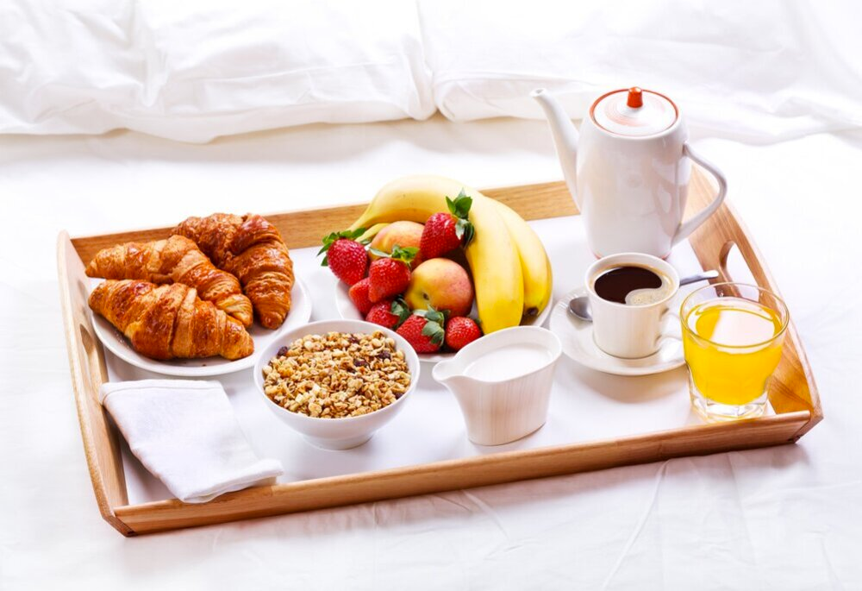

Slide 12
Checking Availability
Do you have any vacancies?
From what date?
For how many nights?
How long will you stay?
What sort of room would you like?
I would like a single room, double room, twin room , triple room, suite
-I ‘d like a room with…., an en-suite bathroom, a bath, a shower, a view, a sea-view, a balcony
Could we have an extra bed?

Slide 13
Asking about facilities
Does the room have..?
Internet access
air condition
Is there a..?
swimming pool,
sauna,
gym,
beauty salon,
lift

Slide 14
Do you allow pets?
Do you have a wheelchair access?
Do you have a car park?
The room has a shared bathroom

Slide 15
Discussing terms
What’s the price per night?
Is the breakfast included?
That’s a bit more than I wanted to pay
Can you offer me any discount?

Slide 16
Have you got anything…….?
cheaper
bigger
quieter
Could I see the room?

Slide 17
Making the booking
Here are some phrases you can use on the phone to make a booking in English.
I’d like to book a (single / double / twin) room for two nights, please.
I’d like to make a reservation for a (single / double / twin) room for the night of (date), please.
(a reservation = a booking)
Do you have any double rooms left for the weekend?
Do you have any double rooms available this weekend?
(left = available)

Slide 18
How much is… a single room / a double room / a suite?
What time is check-in? (check-in = when you arrive and give your
passport information)
What time is check-out? (when you leave and pay)
What time is breakfast?
Are all your rooms ensuite? (= with bathroom)
Is there wifi in the room?
Is there a lift? (life / elevator)

Slide 19
Starting the conversation
I’d like to…..
…. book a double room (for two nights from Monday 2 August to…)
…. book a table (for two at 9 pm tomorrow night)
…. book a flight (from London to Paris on Tuesday 10 November)
…. book seats (tonight for “Phantom of the Opera”)
You can also reserve a room, a table or seats.

Slide 20
Responding to questions
How many people is the booking for?
… It’s for two people.
How would you like to pay?
… Can I pay by credit card?
Can you spell your surname?
… Yes, it’s B – R – O – W – N.
Can you give me your credit card number and expiry date?
…Yes, it’s …….

Slide 21
Travel bookings
What time do you want to leave / arrive / check-out?
… I’d like to arrive in London by 6 pm.
Do you like to take advantage of our special insurance / extra facilities?
… No thank you / Could you give me extra information?

Slide 22
Asking for more information
Does this price include all taxes? (for hotels and flights)
Is there a booking fee? (for flights, theatre tickets)
How much is the baggage allowance? (for flights)
Could you confirm my booking?
What time should I arrive? (for theatre, restaurants)
What time do I have to check in / do I have to check out? (for flights, hotels)
Is there an ensuite bathroom? (for hotels)

Slide 23
Tips
Remember the essential information:
– how many nights (at a hotel)
– how many people (at a restaurant or the theatre)
– what time (for a flight or at a restaurant)
– how much does it cost (for a flight, theatre tickets or a hotel room)

Slide 24
Dialogue
Hotel Reservation
Receptionist: Good afternoon! This is Capitol Hotels in Washington, D.C. How may I help you?
Mr. Abrams: Hi, I’d like to schedule a reservation for this upcoming weekend from Friday night until Sunday.
Receptionist: Sure! Let me check and see what rooms are available. Do you need a room with one bed or two?
Mr. Abrams: My wife and I will be visiting the city, but a room with one bed will be just fine.
Receptionist: Alright... It looks like we have several rooms available. Would you care for a room with a balcony?

Slide 25
Mr. Abrams: A single room with no balcony will suit our needs just fine. I did notice on your website that you have a pool and an exercise room. Are these facilities available for all hotel guests?
Receptionist: Yes, all hotel guests are allowed access to those facilities. The hotel stay also includes breakfast. We have a restaurant on-site that also serves lunch and dinner, but those meals are not included in your lodging fee.Mr.
Abrams: Okay, that’s fine. What time are both check-in and check-out?
Receptionist: Check-in for you on Friday can be any time after 3:00 p.m. Check-out will be on Sunday before noon.
Mr. Abrams: Sounds great!

Slide 26
Mr. Abrams: Okay, that’s fine. What time are both check-in and check-out?
Receptionist: Check-in for you on Friday can be any time after 3:00 p.m. Check-out will be on Sunday before noon.
Mr. Abrams: Sounds great!
Receptionist: I am glad that I could help you today. Is there anything else that you need at this point in time?
Mr. Abrams: Would you like my credit card information now, or can I take care of that upon my arrival to the hotel’s reception desk?
Receptionist: We can handle payment upon your arrival on Friday. We look forward to seeing you then!
Mr. Abrams: Thank you! I look forward to my stay.
Receptionist: Enjoy the rest of your week!

Slide 27
What is the name of the hotel where Mr. Abrams plans on staying?
a Kennedy Hotels | b Washington D.C.
c Lincoln Hotels | d Capitol Hotels
For how long does Mr. Abrams plan on staying at the hotel?
a Three nights | b Two nights
c Overnight | d A week

Slide 28
Question 3:
What kind of room does Mr. Abrams request to stay in?
Question 4:
All of the following are amenities the hotel offers its guests except:
a A double room without a balcony. | b A double room with a balcony.
c A single room with a balcony. | d A single room without a balcony.
a Free breakfast | b An exercise room
c A massage room | d A swimming pool

Slide 29
Question 5:
At what time can Mr. Abrams check into the hotel on Friday?
Question 6:
When does Mr. Abrams plan on giving the hotel his credit card information?
 | b Before 11:00 a.m.
c After 3:00 p.m. | d After 1:00 p.m.
a Before noon
a Upon his arrival to the reception desk | b At the end of his stay
c Mr. Abrams wants to pay in cash | d During the phone call

Slide 30
https://english-at-home.com/booking-a-hotel-room/

