Slide 1
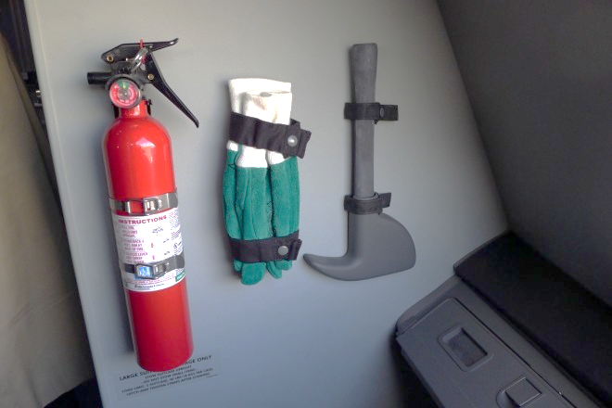
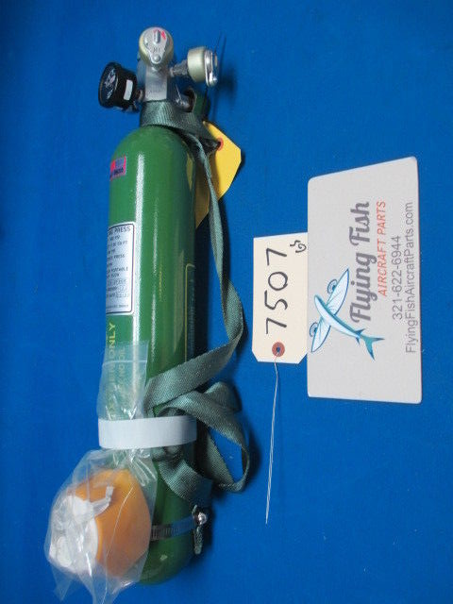
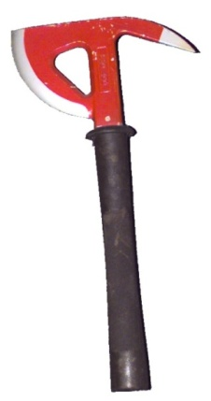
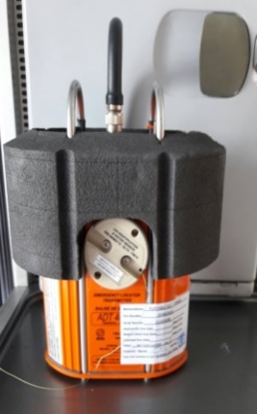
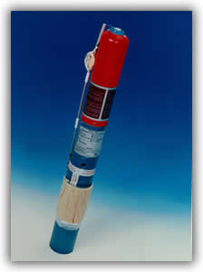

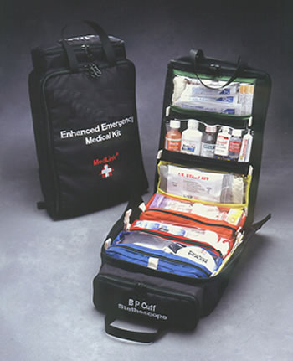
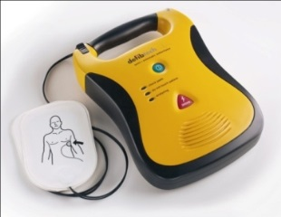
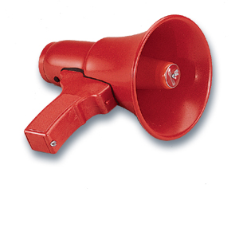
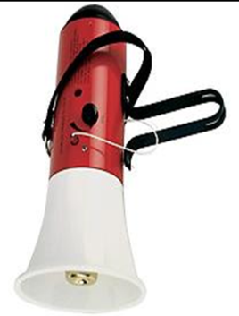
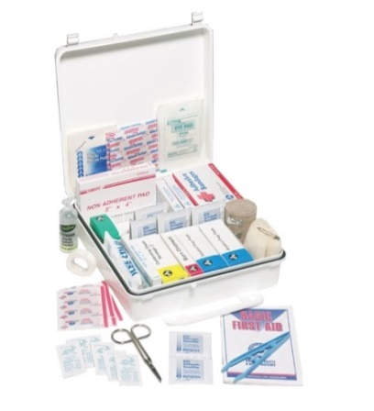
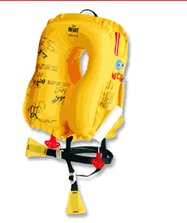
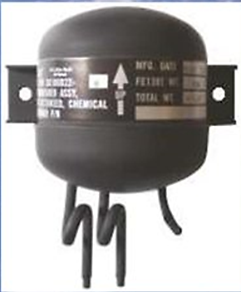
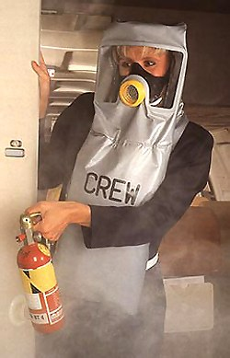
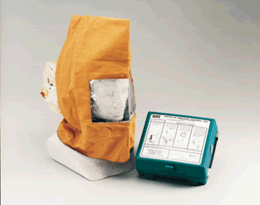
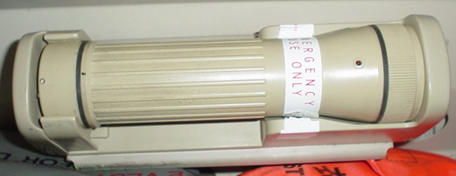
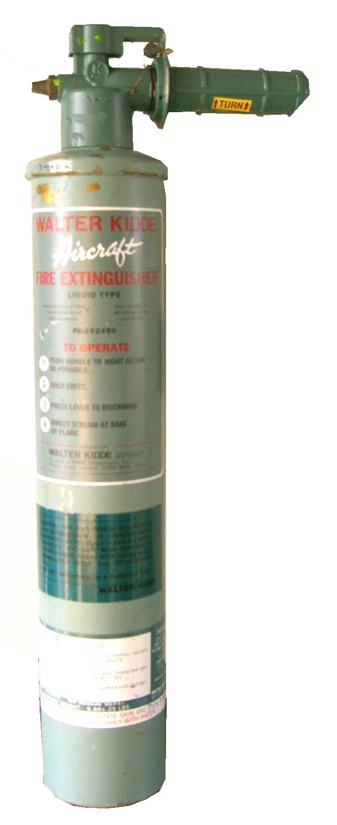
Unit 6 : EMERGENCY EQUIPMENT
Notes:
1

Slide 2
EQUIPMENT CATAGORY
1) Equipment for First Aid
First Aid kit, Medical Kit, POB,
2) Equipment for Fire Fighting
H, W, Auto fire extinguisher, PBE, Axe, gloves, goggles
3) Equipment for signaling
ELT, Megaphone, Flashlight
4) Equipment for Over - water Flights
Life vest, Life Raft + Survival kit
5) Others Safety Equipment
Safety card, Demo kit, Extension belt, Restraint, Barrier straps

Slide 3
Cabin Crew Preflight safety equipment check
1. Location
2. Number
3. Readiness
According to the checklist

Slide 4
First Aid
Basic first aid and survival training including care of:
The unconscious;
Burns;
Wounds; and
Fractures and soft tissue injuries;

Slide 5
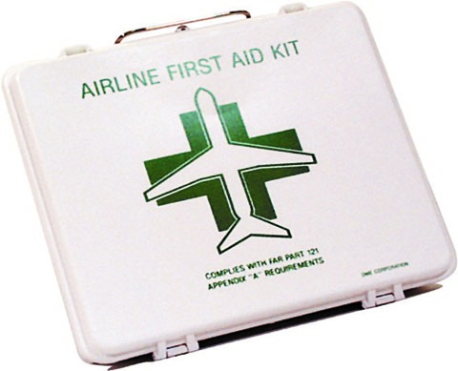
First Aid Kit
For treatment of minor injuries/medical emergencies occur during flight.
First aid kits must be throughout cabin & be accessible.
Minimum number of first aid kit required is set in the following table.
No. of Pax Seats | No. of First Aid Kits
0-50 51-150 151-250 251-350 351-450 Over 450 | At least 1 kits At least 2 kits At least 3 kits At least 4 kits At least 5 kits At least 6 kits

Slide 6
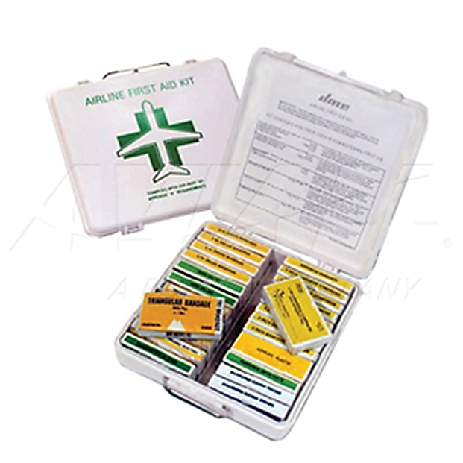
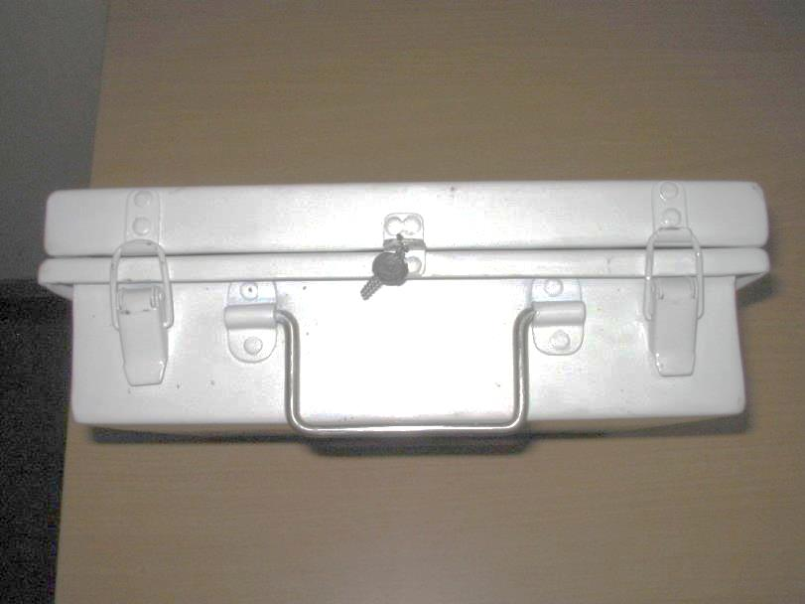
First Aid Kit Content
Items | Qty | Items | Qty
Adhesive bandages Adhesive tape Ammonia inhalants Antiseptic swabs Compresses bandages | 1 1 1 2 8 | Gauze bandages Burn compound Scissors Triangular bandages Wire splints | 4 6 1 5 2

Slide 7
Pre flight check
Verify it is secured in its proper location. Verify the content list is present. 3. Verify the seals are intact. 4. Verify expiration date has not expired.

Slide 8
Medical emergencies in aviation including
Asthma; Chocking;
Heart attacks; Stress reactions and allergic reactions;
Shock; Stroke;
Epilepsy; Diabetes;
Air sickness; Hyperventilation;
Gastro-intestinal disturbances;
Emergency childbirth;

Slide 9
Emergency Kit (EMK)

Slide 10
EMK Contents sample
Ampules/Vials Manual Oral Medications
Prefilled Syringes Airway Equipment
Resuscitation Tourniquet
Monitoring Equipment Blood Pressure Cuff (1)
Stethoscope (1)
  Ambu Bag (1)
  Mask, Pediatric (1)
  Mask, Small Adult (1)
  Mask, Large Adult (1) CPR Mask Adapter (1)

Slide 11
Pre flight check
Verify it is secured in its proper location. Verify the content list is present. 3. Verify the seals are intact. 4. Verify expiration date has not expired.

Slide 12
Emergency Medical Kit (EMK)
Operating Procedure:
Purser pages for medical doctor.
Purser verifies medical credentials of volunteer by requesting ID.
PIC authorizes the use of EMK
Show list of EMK contents to doctor.
After use, PIC, Purser & doctor completed report forms

Slide 13
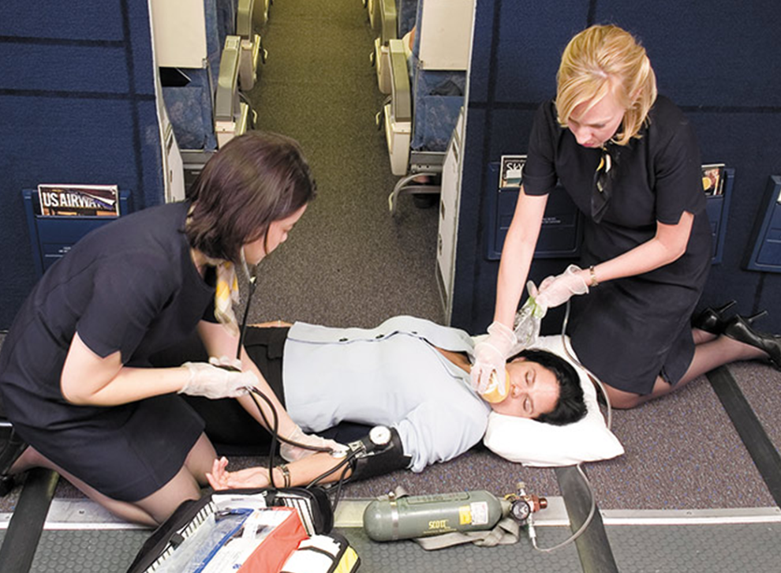
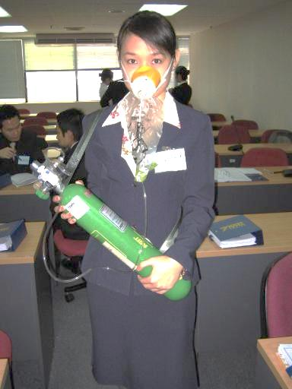
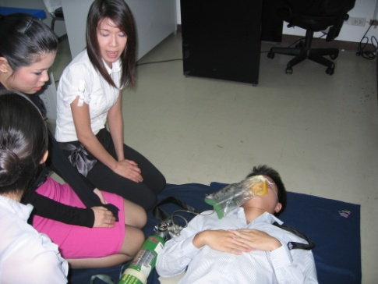
Portable oxygen Bottles (POB)
Primarily using for
1) Cabin crew use after decompression &
2) First aid use for pax/crew.

Slide 14
Pre flight check
1. Verify it is secure in its proper location.
2. Verify the needle of the gauge is in the red/green "FULL" band.
3. Verify the carrying strap is attached.
4. Verify two masks are present in each tote bag.
5. Verify masks and tubing are not torn.
6. Verify both bayonet fittings are attached to an outlet.

Slide 15
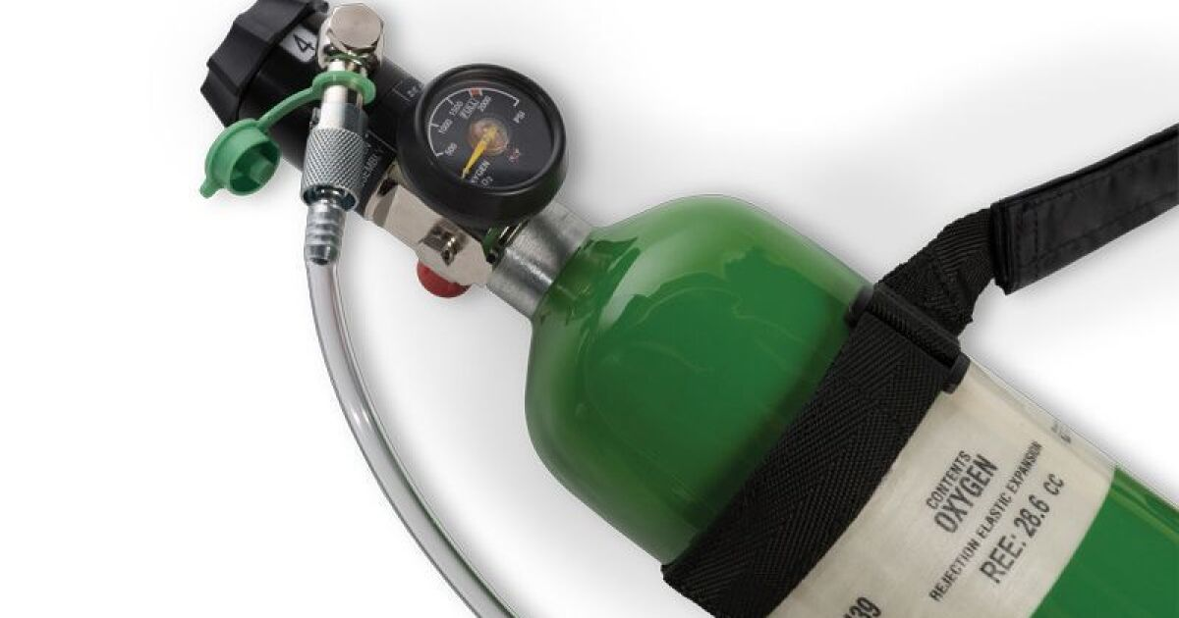

Slide 16
Operating Procedure:
Turn on / Connect/ Check flow
Fit the carrying strap over head & shoulder.
Ensure mask tube fitting connected to O2 outlet completely locked.
Turn knob in direction of arrow to start o2 flow.
Pinching rebreathing bag to test O2 flow.

Slide 17
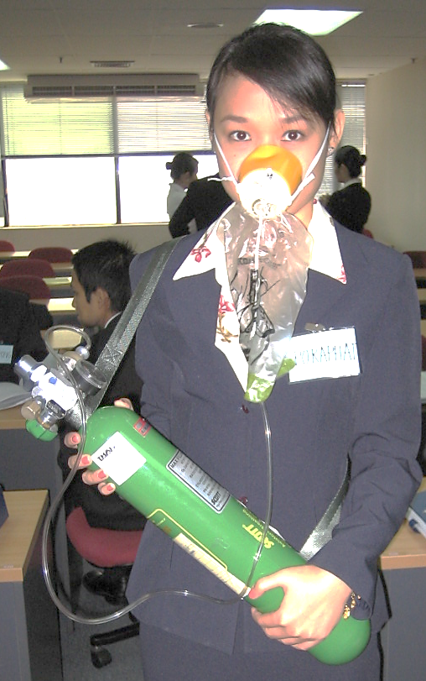
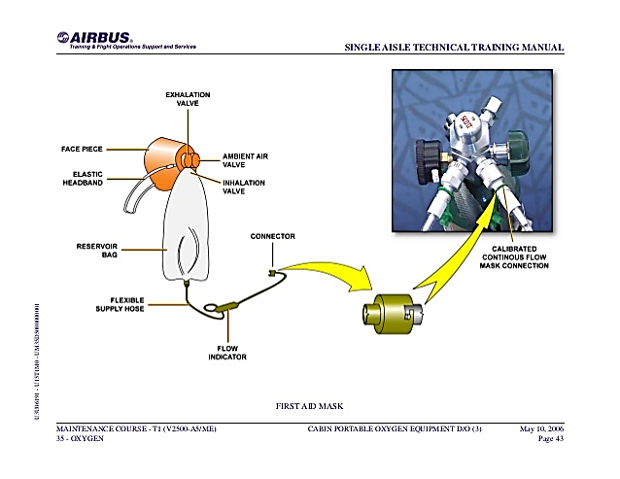
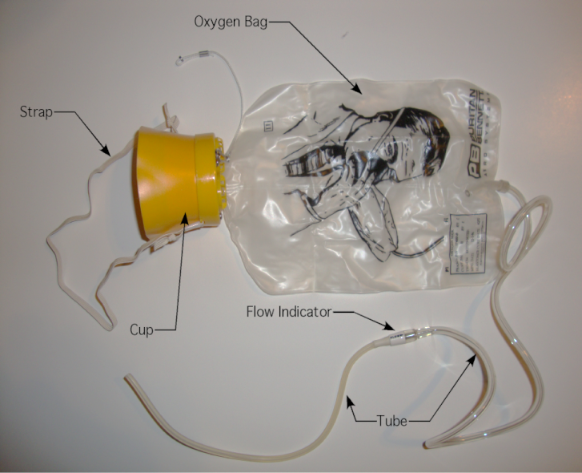
3
1
2

Slide 18
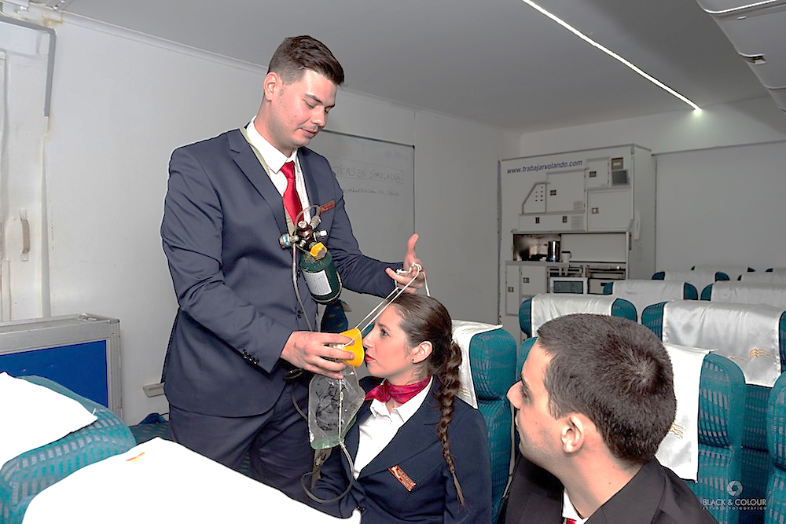
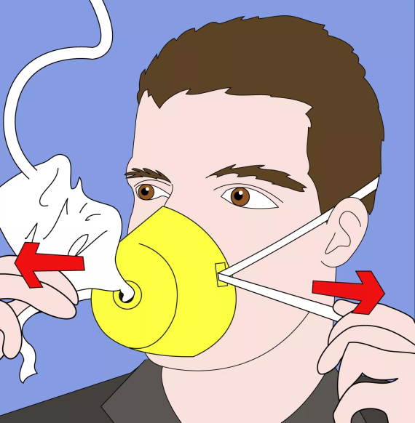
Portable oxygen Bottles (POB)
5. Place & adjust mask over nose & mouth.
6. Secure bottle strap to armrest.
7. Monitor patient from time to time.
If pressure gauge reaches 50 PSI, change bottle.
If patient recover – turn knob to stop O2 flow & return location.
using.

Slide 19
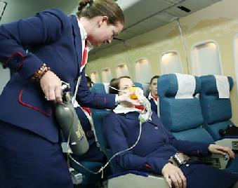
Portable oxygen Bottles (POB)
Duration O2 flow | HI (4LPM) | LOW (2 LPM)
310 liters | 75 minutes | 150 minutes

Slide 20
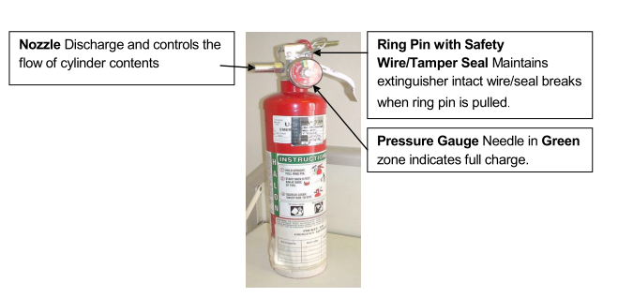
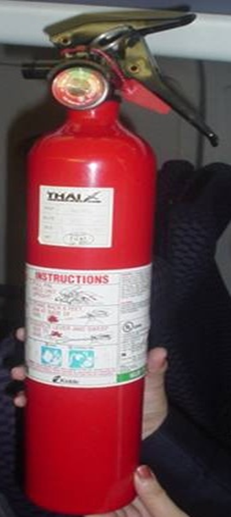

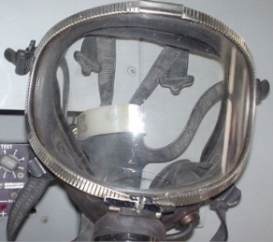
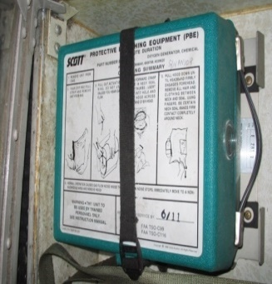
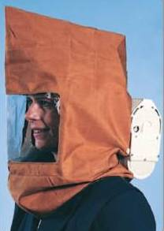
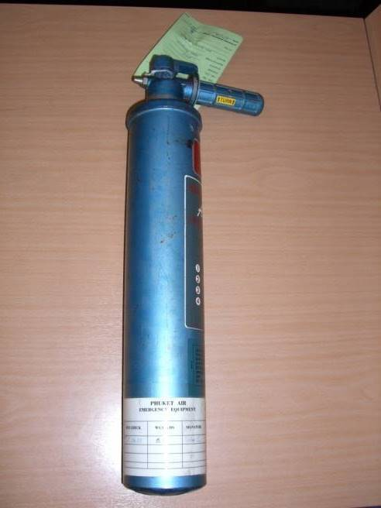
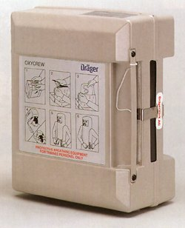
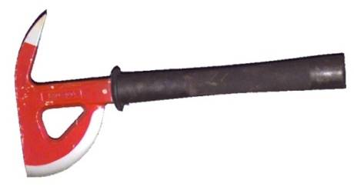
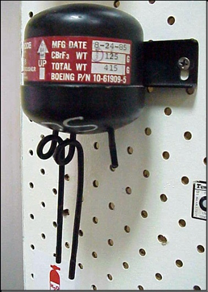

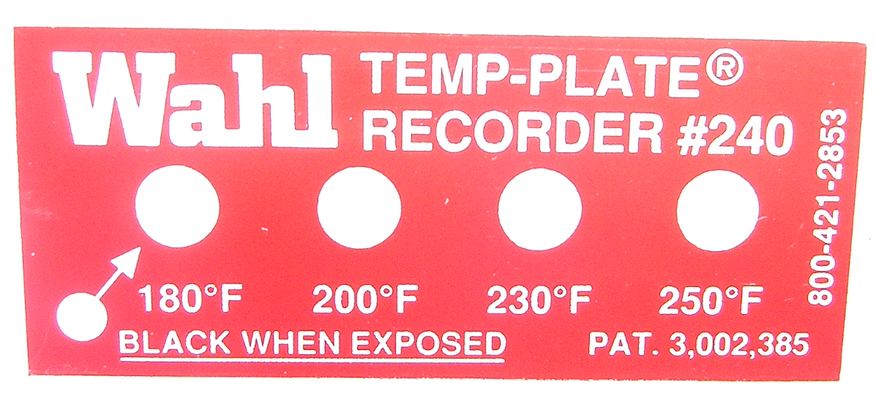
Equipment for Fire Fighting

Slide 21
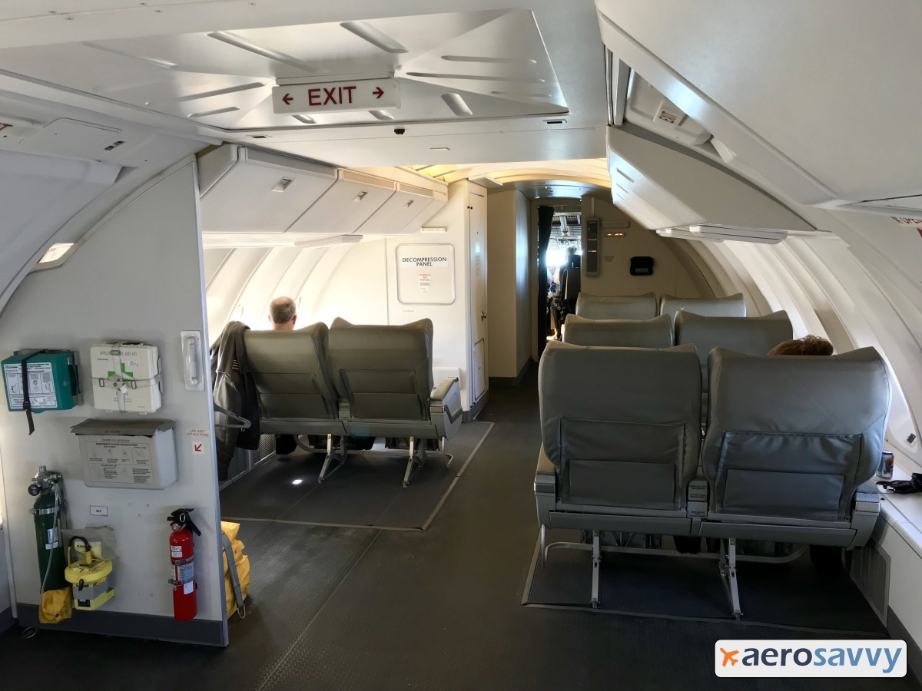

Slide 22
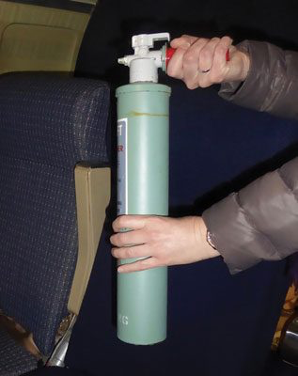
Fire Fighting Equipment
Water Extinguisher
is very effective on class A fires (common combustibles like wood and paper).

Slide 23
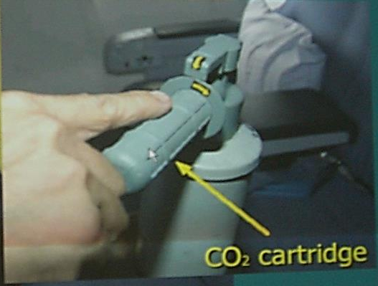
Pre flight check: Water Fire Extinguisher
1. Verify it is secure in its proper location.
2. Verify the wire seal is intact.
3. Verify the carbon dioxide cartridge is visible through the small hole in handle.

Slide 24
How to operate
Rotate the handle clockwise as far as it will go. This will cause the CO₂ cartridge in the handle to pressurize the water extinguisher.
Hold the extinguisher upright and aim at the base of the fire.
To discharge water, squeeze the lever on top of the extinguisher with your thumb.
Use a circular motion to fight fire

Slide 25
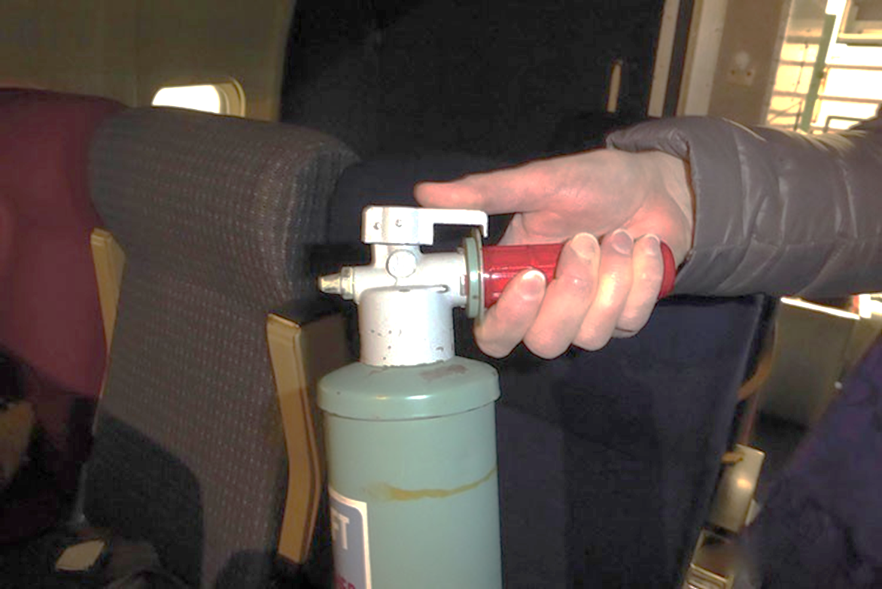
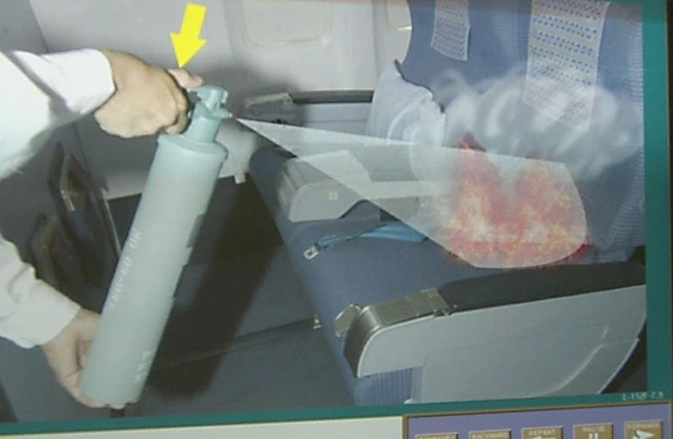

Slide 26
Water (H2O) Fire Extinguisher
Caution
Never discharge against electric or flammable liquid fire (Class B,C,D)
Water inside not to be consumed
Anti - freeze additive may irritate skin and eyes.
Note:
Use on class A fire only
Extinguish the fire by reducing temperature
Effective to remove the heat after using Halon extinguish the fire

Slide 27
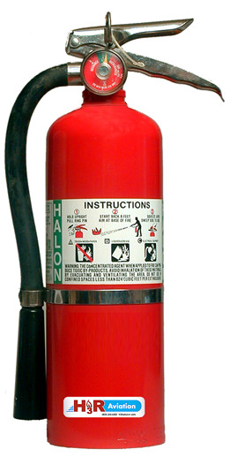
Halon Extinguisher
A liquefied, compressed gas that stops the spread of fire by chemically disrupting combustion.
Halon is rated for class "B" (flammable liquids) and "C" (electrical fires)
, but it is also effective on class "A" (common combustibles) fires.
https://youtu.be/R-gqVUPrkJQ

Slide 28
Pre flight check: Halon fire extinguisher
Verify it is secure in its proper location.
Verify pin and seal are intact.
Verify the needle of the gauge is in GREEN zone.
Verify the hose is properly attached and
unobstructed.

Slide 29
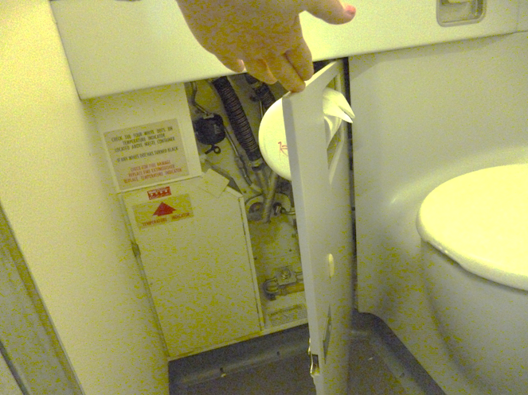
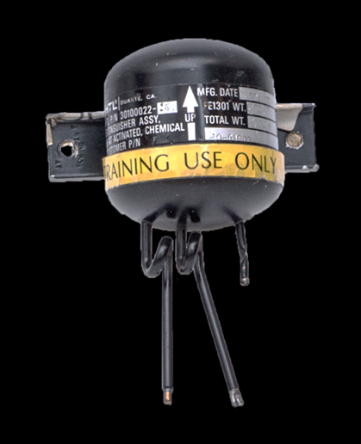
Auto Fire Extinguisher Bottle
The bottle under lavatory basin automatically discharges Freon gas into waste container when temperature is more than 77-82 ̊ C.
Color on nozzle tips changes to silver or aluminum when extinguisher has discharged.
Nozzle tips
***Located under basin, above waste bin

Slide 32
Temperature Indicator Placard
Pre-flight check
Check white dots on temperature indicator placard
Note: Dots will change from WHITE to BLACK when expose to high temp.

Slide 33
Fire/Crash axe
Fire axes were provided to obtain emergency access to areas and parts of the airplane which are not easily accessible (e.g. behind sidewall, electrical or ceiling panels).

Slide 34
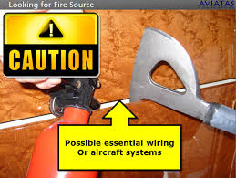
Pre-flight check
1.Ensure availability
2.Ensure it is properly secured in the correct location
Concealed Fire, if suspected

Slide 35

Protective Breathing Equipment (PBE)
Drager
scott

Slide 36
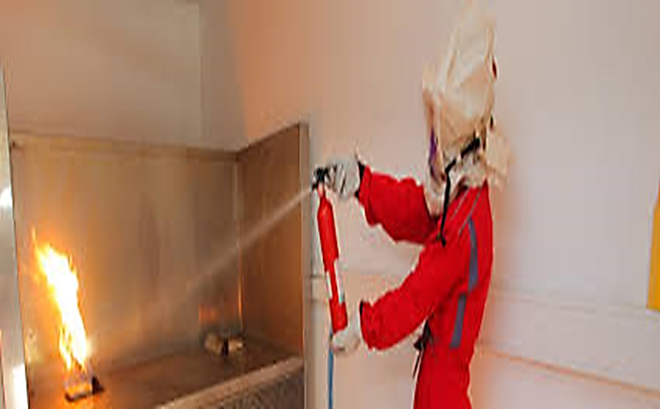
Protective Breathing Equipment (PBE)
PBE or smoke hood is a closed circuit breathing apparatus designed to protect eye & respiratory tract while fighting a fire.
Used only “dense smoke or toxic fumes” when fight fire.
PBE protects from smoke, not fire. For one-time use.

Slide 37
Pre flight check
1. Verify it is secured in its proper location.
2. Verify seals are intact.
3. Expiry Date

Slide 38
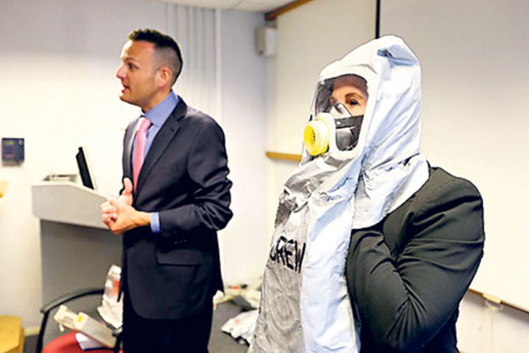



Drager PBE
Operating procedure
Open box
Tear off red tag to break sealed pack
Spread neck seal both hand, put hood over head
Fit inner mask to nose & mouth
Pull down lanyard to activate O2 flow
Fasten body belt around the waist
4
1
3
5

Slide 39




Operating procedure
Open box
Tear off red tag to break vacuum sealed pack
Pull actuation ring to start O2 flow
Spread neck seal with thumbs (remove oil base cosmetic before donning)
Bend fwd, chin first &pull neck seal across
Standing upright, pull hood down
Scott PBE
1
3
5
4

Slide 40

Smoke Goggles
Each Flight Deck is provided with a set of smoke goggle located t to their respective crew stations.
They are used in conjunction with quick donning oxygen masks for protection against smoke.

Slide 41
Emergency locator transmitters/ELT
ELTs are emergency transmitters that are carried aboard most aviation aircraft.
In the event of an aircraft accident, these devices are designed to transmit a distress signal on 121.5 and 243.0 MHz frequencies, and for newer ELTs, on 406 MHz.

Slide 42
There are 2 types
Fixed
Survival

Slide 43


RESCU 406 ELT
RESCU 406 is an ELT buoyant beacon with water activated battery.
A self-erecting antenna is secured by a water soluble tape.
antenna

Slide 44





Operating: On land
Unroll lanyard & erect Antenna
Fill plastic envelope with water - based liquid,
*mix provided salt
Put the lower end of ELT in the envelope
Tie lanyard at the mouth of envelope
Place ELT in clear area & higher place
RESCU 406 ELT
**Best activate in Salt water only 5 seconds, if fresh water take 5 minutes

Slide 45
Preflight check
2. Secure in its bracket
(During preflight checks the type of ELT must be identified - the RESCU 406 (SE) is identified by the strobe ring at the top)
1. Verify it is Correct number and location

Slide 46

Megaphone
Pre - flight check
Proper location
Squeeze handle for click sound & green LED indicator flashes.
Operation
Squeeze handle & speak.
Remove pin to activate siren.
Re-insert pin to stop siren or squeeze handle
Pin

Slide 47


Flashlight
Description
Emergency use only, near/under jump seat
Waterproof , No ON/OFF switch, Battery time is approx. 8 hours
Red light flashing (1 time less than 10 second)
For monitoring battery & lamp condition
Easy to locate flashlight in darkness

Slide 48
Pre flight check
1. Verify it is secure in its proper location.
2. Verify the red light flashes at intervals of 5-10 seconds or less
3. Verify the "Emergency Use Only" seal is intact.

Slide 49

Question?

