Slide 1
Air Cargo management chapter 1
What is Air Cargo ?
It is the Cargo transported by air.
What can be defined as Air Cargo?
Everything can be defined as Air Cargo.

Slide 3
Air Cargo management
Why we need to send cargo by air?
Because it is a sensitive, vulnerable, valuable goods needed rapid delivery.
Why does Air Cargo has a significant role in Economics?
It is a part of supporting domestic and international trade.

Slide 4
Air Cargo management
How many type of aircrafts that cargo can be uplifted?
Two types.
Passenger aircraft
Freighter aircraft

Slide 8
Air Cargo management
Passenger aircraft divide into two decks.
Upper deck called cabin used for passenger seating.
Lower deck called compartment used for cargo.

Slide 9
Air Cargo management
There 4 basic types of carriers.
Freighter ( all- cargo carriers )
Express ( Integrator/express carrier )
Scheduled ( Commercial service passenger airlines)
Ad-hoc cargo charter carriers

Slide 14
Air Cargo management
The air cargo service has three types.
Integrator/express service
Freight forwarding service
Airport-to-airport service

Slide 19
Integrator/express service
There are many procedures.
Door-to-door
Pick up
Ship via air / truck and delivery
Most of operators are FedEX, UPS, DHL, TNT, NIPPON Express etc.

Slide 20
Freight forwarding
Freight forwarding operates as an agent between shippers and the carriers.
Gather all kinds of cargo and necessary documents, process custom , cooperate with carriers and load cargo into ULD

Slide 21
Airport-to-airport service
This type of service provided by
Passenger airlines
Freighter
Ad-hoc charter

Slide 22
Airport Infrastructure
Air cargo hub or warehouse provides export, import, express and transit cargo warehouse.
Rather than those areas it also provides facilities, such as strong room for valuable cargo, cool room for perishable cargo, Hum room for Human remain and so forth.

Slide 24
Warehouse structure
Warehouse in Thailand mostly can be divided into two parts. (Thai airways international Cargo Department)
The first one is for Thai airways international public company.
The second one is for customer Airlines, such as SQ, CX, KU, etc.

Slide 25
Warehouse structure
Each part above can be divide into many divisions
Express division and Perishable Center (Under Export and Transit division)
Export and Transit division
ULD building up division
Import division
Service division

Slide 26
Warehouse structure
ULD service division
Tracing division
Documentation division
Mechanical division
Financial division
Administration division

Slide 27
Warehouse facilities
There are a lot of facilities used in the warehouse.
Cargo acceptance platform
Scales
Automated Storage/Retrieval System (ASRS)

Slide 29
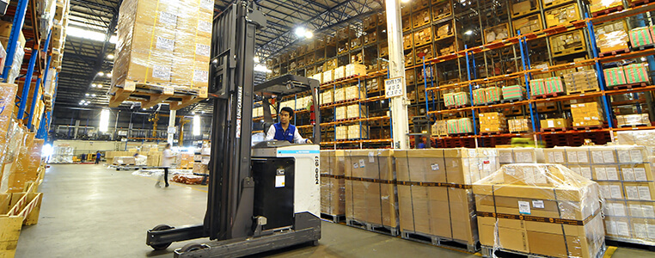

Slide 34
Warehouse facilities
Trucks, Tow tractor
Lift truck
Folk lift, Hand lift
Racks and bins
Locations ( small, big, od size cargo )

Slide 35
Warehouse facilities
Stand for loading
Transfer vehicle for cool room (TV)
Elevated transfer vehicles (ETV)
ULD storage (Containers and Pallets)

Slide 38
Fleet type of the Aircraft
The aircrafts served as air transportation in the world can be classified into 3 types.
Wide-body jet
Narrow-body jet
Narrow-body tuboprop

Slide 39
Fleet type of the Aircraft
The wide-body aircraft have two decks.
One is main deck and another is lower deck.
Both have rollers for moving ULD to the position.

Slide 40
Fleet type of the Aircraft
The narrow-body aircraft have two decks the similar to wide-body; however, its lower deck is just only bulk loaded or manually loaded.

Slide 41
Who involve in Cargo business?
In Airline industries, we classified stakeholders into six types.
Shipper or consignor is the one who want to transport the cargo
Shipper may directly contact to the carrier or via agent (forwarder)
Forwarder operates like a travel agent with passengers.

Slide 42
Who involve in Cargo business?
What do forwarders do?
They manipulate everything starting from picking up cargo from-to warehouse.
Process all documents concerning of Export, Import and Transit cargo, such as Custom, AOT
Coordinate with carriers who transport those cargo.

Slide 43
Who involve in Cargo business?
Carrier staffs, cooperate with concerned persons, division, organization, such as
forwarder, custom, Airport authority of Thailand, Agricultural officer
Ramp officer, crew, Load controller and captain.

Slide 44
Who involve in Cargo business?
Consignee or importer stand for the one who receives the cargo or goods or product.
Carrier means the company who provides the air delivery of cargo from original airport to destination airport

Slide 45
Air cargo transportation procedures
In most stations, they follow these steps.
1. Making reservation or booking by forwarder.
Forwarder or individual person are needed to call carrier to inform the details of cargo in order to book a space.

Slide 46
Air cargo transportation procedures
2. Confirm booking; if the forwarder or individual person has already reserved space, the carrier will confirm space, then the forwarder will continue to do the next step.
3. Packaging/Packing; shipper may directly deliver to carrier’s office or to agents.

Slide 47
Air cargo transportation procedures
4. Marking and Labeling; after all cargo are packed, shipper/forwarder has to fix marking and labeling to notify the contented products detailing the nature of goods, quantities, port of loading/unloading, routing and handle instruction.

Slide 48
Air cargo transportation procedures
5. Documentation;
Forwarder will fill out the air waybill with the details received from shipper and ask he/she to sign the name and process to the custom.
The custom office may locate at the free zone or at the shipper’s factory in order to facilitate the shipper.

Slide 49
Air cargo transportation procedures
7. Loading; this process refers to load all cargo not only for export cargo but also together with transited cargo at BKK station.
Loading can be divided into 3 types.
Container, pallet and bulk
Bulk means loose cotton which cannot be loaded in container and pallet and loaded at the end of aircraft.

Slide 50
Air cargo transportation procedures
8. Boarding; After completed loading, all ULD must be hung with the tags which written with point of loading/unloading and towed to the aircraft side and lifted into the compartment.
9. Delivering; when cargo is already unloaded at the destination, the process of custom will be done and deliver to consignee by forwarder.

Slide 51
Air cargo transportation procedures
10. claim;
The last process of shipping cargo by air is claiming. In case of lost or damage, consignee will claim to forwarder or carrier.

