Slide 1
Chapter 3 type of cargo
There are two types of cargo.
1. General cargo
2. Special cargo
General cargo refers to any cargo or shipment rather than special cargo and is charged for transportation as general cargo.

Slide 2
type of cargo
Special cargo refers to all cargos required special specially taking care as per nature of goods, such as perishable cargo, vulnerable cargo, live animal, Dangerous Goods, Diplomatic mail and Human remain
This includes cargos that easy to be stolen, broken, such as cell phone, i-pad, some electronic devices, glass and so on.

Slide 3
type of cargo

Slide 4
type of cargo

Slide 5
type of cargo

Slide 6
type of cargo
The factors that have to be aware for special cargo are;
Timing; cargos need to be transported as soon as possible in order to reach final destination on time.
For example; Perishable cargo must be transported according to flight schedule.

Slide 7
type of cargo
Treatment is a factor that carrier, forwarder must consider whether the cargos may harm with persons, animals and contaminate to other cargos, such as foods if they are not properly taken care.

Slide 8
type of cargo
Security; Some special cargos, such as vulnerable, valuable have high risk to be stolen or lost in every procedure of transportation.
From origin of cargo( Manufacturers)
From Agent procedure
From loading procedure
From towing procedure
From breaking down at Destination

Slide 9
type of cargo

Slide 10
type of cargo

Slide 11
type of cargo
Due to there are many types of special cargos, IATA has set three letter codes as following;
Live animal…………..AVI
Perishable cargo……PER ( Medicines, serum)
EAT ( Food for human or animal consumption)
PEM ( Fresh meat and poultry and meat product.
PPH ( Pharmaceuticals temperature 10-30c.

Slide 12
type of cargo

Slide 13
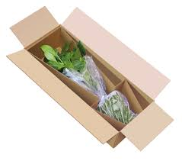
type of cargo
PPL ( Pharmaceuticals temperature 2-8c )
PEF ( Fresh flower and plants )
PEP ( Fruit and vegetable )
PES ( Fresh fish seafood )

Slide 14
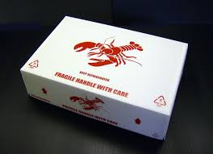
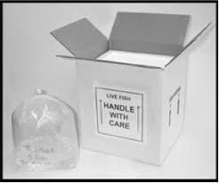
type of cargo

Slide 15
type of cargo
Diplomatic mail ……Dip

Slide 16
type of cargo
Valuable cargo……VAL

Slide 17
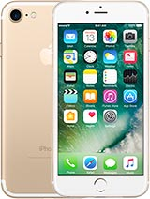
type of cargo
Vulnerable cargo

Slide 18
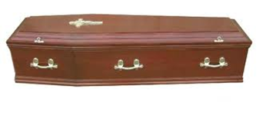
type of cargo
Human Remain…..HUM

Slide 19
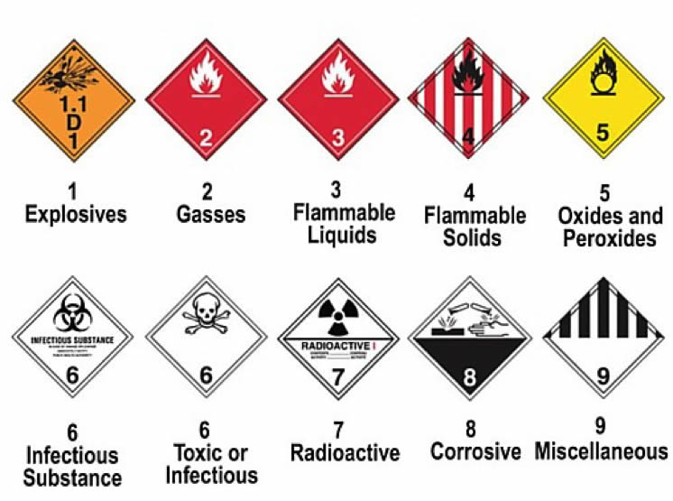
type of cargo Dangerous Goods……DGR

Slide 20
type of cargo
Each type of special cargo requires different in treatment, such as handling procedure, charges, and documents.
For instance; Shipper must provides health certificate for animal, plant and animal quarantine approving and/or gets approval from destination.

Slide 21
type of cargo
VAL; The declaration of valuable cargo is at least $1,000/KG.
An additional charge for valuable cargo is 200 percent of general cargo.

Slide 22
type of cargo
Sacks and bags
The carrier uses sacks and bags for loading small items. Normally, sacks and bags will be loaded in bulk ( its position at the tail of the aircraft). And the color of the sacks and bags as following;
Cargo….Yellow
Mail……blue
Valuable cargo……Orange

Slide 23
type of cargo
Shipping of Live Animal (AVI)
Before ship animal, shipper must;
Check the destination regulations and requirements and the law.
Provide Health certificate
Provide Vaccination information and import license
Ensure to comply with IATA and carrier regulations

Slide 24
type of cargo
Provide feeding instructions
Notify a physical state of animal ( ex. Pregnant or has given birth within 48 hrs.)
Give all details about animal, such as age breed, weight, type of container, dimension of container, name, contact information of shipper and consignee
Provide container specified by IATA or carrier.

Slide 25
type of cargo
General requirements for Live Animal container.
Safe for animal and persons who handle.
Strong structure
Has sufficient ventilation
Suitable size for animal
Clean and leak proof
Doors cannot be opened from inside and outside
Use absorbent material on the floor.

Slide 26
type of cargo

Slide 27
type of cargo

Slide 28
type of cargo

Slide 29
type of cargo
The airlines have divided Live Animal procedure into three stages.
At the airport;
Shipper should bring the animal to cargo office.
Animal that travels with the owner is considered as passenger’s baggage.
The space has to be reserved 20 days in advance

Slide 30
type of cargo
When Live Animal need to be transited at transfer station, it will not be accepted until all carrier have confirmed their flights.
In some countries, Live Animal is required to be shipped as cargo only.
Food and water containers must be attached in the container.

Slide 31
type of cargo
Water must be filled before departure from origin airport.
Feeding must follow shipper instruction, however, in case of long delay, carrier’s staff can provide some from catering division.

Slide 32
type of cargo
During the flight
At the outset, the captain will adjust the temperature and pressurization of the compartment according to NOTOC ( Special Load Notification To Captain)
The compartment light will be switched off during the flight.

Slide 33
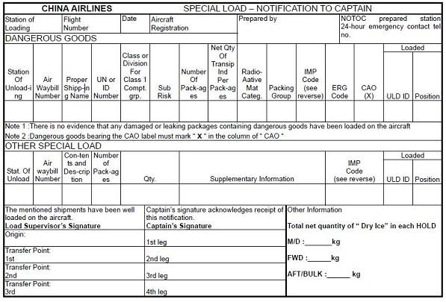
type of cargo NOTOC

