Slide 1
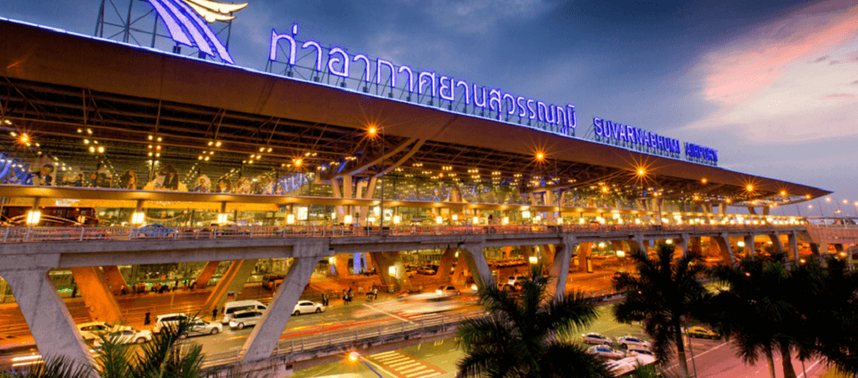
Unit 8: Airport Operations and Airport Roles
https://blog.airpaz.com/en/suvarnabhumi-airport-layout-and-guide/

Slide 2
Airport operations
The effective management of the facilities that exist on and around an airport’s airfield is vital to the safety and efficiency of aircraft operations.

Slide 3
Airport Operations include:
Pavement Management
Aircraft rescue and fire fighting (ARFF)
Safety Inspection Programs
Bird hazard management

Slide 4
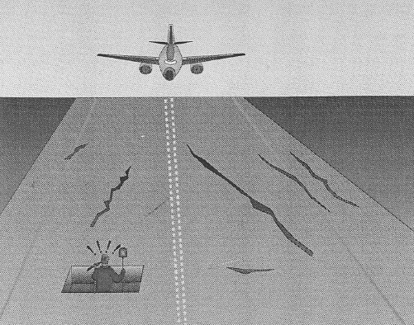
1. Pavement Management
Pavement is surface section of runway/taxiway (concrete or asphalt).
To serve its purpose, a pavement must have:
  Adequate load-carrying capability,
  Good ride ability
  And must allow safe operation of aircraft.

Slide 5
Pavement Management
Strong, level, dry and well-maintained pavement are required for the safe movement of aircraft.
Minimum quality standard for runway pavements, including:
  No holes
  No cracks and surface variations which could impair directional control of an aircraft
  No contamination such as mud, dirt & foreign object.
  * Foreign Objects : solid objects or materials on runway surfaces which are capable of damaging aircraft.

Slide 6
Pavement Management
Inspection & maintenance of the runway/taxiway pavement are thus importance to airport management
Actions in pavement maintenance are:
Pavement repairing: including sealing of small surface cracks. Purpose to ensure pavement always in good condition.
Pavement reconstruction: Adding an additional layer of asphalt to increase the strength of pavement. Replaced the pavement entirely. Expensive process.

Slide 7
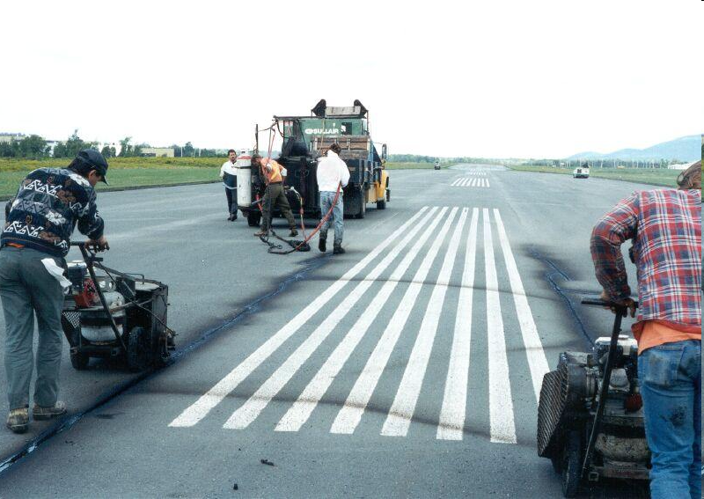
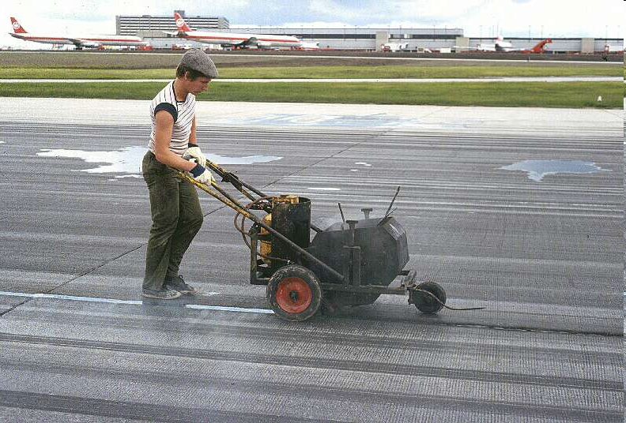
pavement maintenance
Purpose of pavement maintenance are:
To prevent further runway crack.
To provide good runway surface friction.
To increase safety by providing correct and clearly visible runway marking
Crack Sealing

Slide 8
2. Safety Inspection Programs
Timely inspections are important to maintain airport operational safety.
Areas under Safety Inspection Programs include:
Runways
Taxiways
Apron-Aircraft Parking Area
Fueling Facilities
Buildings and Hangars

Slide 9
Safety Inspection Programs
The purpose of the inspection are to ensure these areas are free from:
Foreign Object Damages (FOD) such as misplaced tools, aircraft parts and tyre debris.
Hazards created by weather conditions (snow/ice/mud).
Hazards created by damaged facilities (unsealed runway pavements).
Hazards occurring during construction activity (holes or obstacles).
Bird or wildlife hazard.
Notes:
As airports worldwide continue to increase the number of aircraft movements, the requirement to inspect runways for FOD is too growing in importance. The current four-per-day runway inspection standard was introduced as long ago as 1944 when the busiest airport in the world, Chicago, handled just 10-15 aircraft movements every six hours.
Today airports in Europe handle hundred of aircraft movements every six hours, yet still continue with the same number of runway inspections, while in the US, FOD checks have been reduced to just one inspection a day.
"Airports near landfills, constructions sites and the like, are all slightly more vulnerable to FOD incidents, but, generally, the risk has more to do with how well the airport controls FOD throughout the Airport Operations Area (AOA) rather than being runway specific," McCreary says.
"Development has been slow and the problem lies in airline awareness. Most airlines are, from a financial perspective, rather poorly run. The issues are management culture and weak financial accounting."

Slide 10
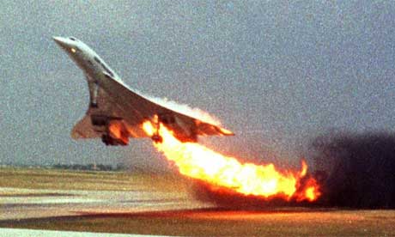
FOD cases
Year 2000, FOD burst the tyre, damaged the aircraft's fuel tanks causing a fire of an Air France Concorde soon after taking off from Charles de Gaulle airport, Paris. 109 people were killed.
Notes:
Ten years ago, a titanium strip measuring only 40cm in length, burst the tyre of an Air France Concorde, which subsequently ruptured one of the aircraft's fuel tanks causing a fire that tragically killed more than a hundred people onboard the flight. That relatively small piece of metal also proved to be the beginning of the end for the Concorde, which several years later was pushed into retirement.
Several more minor incidents have been caused by FOD on runways in recent years - a Biman Bangladesh Airlines flight crashing in Dubai in 2007 and a similar incident on a Kalitta Air aircraft in 2008 again highlight the need to protect runways from FOD. Yet today, only six automatic FOD prevention systems have been fully installed worldwide and just a few other locations are trialling the technology. Adoption of technology to counter the risks of FOD has, to date, been noticeably slow and it's not due to a lack of solutions on the market.

Slide 11
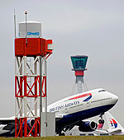
automatic FOD prevention systems
Radar, optical cameras or sensors: can be used to locate foreign object once it is present on the runway.
This technology only available at London Heathrow, Vancouver, Dubai And Doha International
Notes:
This technology only available at London Heathrow, Vancouver, Dubai And Doha International

Slide 12
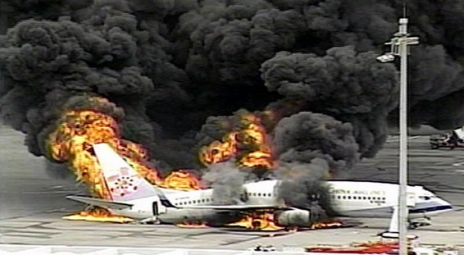
3. Aircraft rescue and fire fighting (ARFF)
All airports are required to provide ARFF services.
Notes:
Japan Jet Fire

Slide 13
3. Aircraft rescue and fire fighting (ARFF)
The objective of a rescue and fire fighting service is to save lives.
ARFF important because aircraft accident occurring at area that there are the greatest opportunities of saving lives.
ARFF capabilities at airport determine difference between life and death for pilots, all crews and passengers.
Notes:
9.2 Rescue and fire fighting
General
Introductory Note.—
The principal objective of a rescue and fire fighting service is to save lives. For this reason, the provision of means of dealing with an aircraft accident or incident occurring at, or in the immediate vicinity of, an aerodrome assumes primary importance because it is within this area that there are the greatest opportunities of saving lives. This must assume at all times the possibility of, and need for, extinguishing a fire which may occur either immediately following an aircraft accident or incident, or at any time during rescue operations.

Slide 14
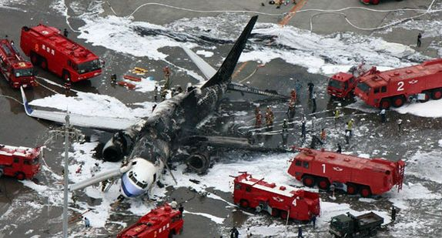
3. Aircraft rescue and fire fighting (ARFF)
For any incidents of fires or emergencies ARFF have to RESPOND within 3 minutes.
Normally foam are used because they can stop the fire efficiently. Basically, foam smothers the flames and cools the surrounding area to prevent further outbreak of fire.

Slide 15
Effectiveness of ARFF
Intensive in-service training programs and live-fire drills are required to ensure ARFF personnel and equipment in top working order.
Notes:
General
Introductory Note.—
The most important factors bearing on effective rescue in a survivable aircraft accident are: the training received, the effectiveness of the equipment and the speed with which personnel and equipment designated for rescue and fire fighting purposes can be put into use.
Requirements to combat building and fuel farm fires, or to deal with foaming of runways, are not taken into account.
Application
9.2.1 Rescue and fire fighting equipment and services shall be provided at an aerodrome.
Note.— Public or private organizations, suitably located and equipped, may be designated to provide the rescue and fire fighting service. It is intended that the fire station housing these organizations be normally located on the aerodrome, although an off-aerodrome location is not precluded provided the response time can be met.

Slide 16
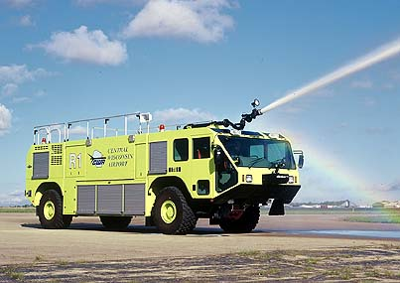
ARFF
Typical ARFF Vehicles

Slide 17
Snow and Ice Control
Snow & ice control plan is established to ensure airport operations safety in the event of snow and ice conditions.
Procedures to follow are:
Timely removal of control of snow and icing.
Selection and application of approved materials for snow and ice control
Timely notification to aircraft when any portion of the pavement is less than satisfactory.
Notes:
RegionalJet B-3072 was parked overnight at the Baotou Airport in cold weather conditions. Prior to departure on the morning service to Shanghai (SHA), flight MU5210 was not de-iced. The wings were contaminated by the overnight frost, which severly degraded the aerodynamic characteristics of the wing. Shortly after the airplane rotated, it entered a stall. The pilots were not able to regain control. The CRJ200 crashed into a frozen lake in Nanhai Park just two kilometers past the runway. The aircraft struck a park ticket office, killing two park employees, before it crashed into the water.

Slide 18
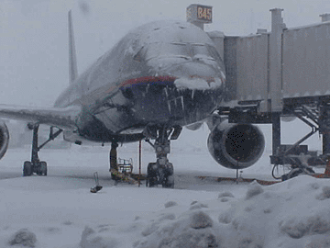
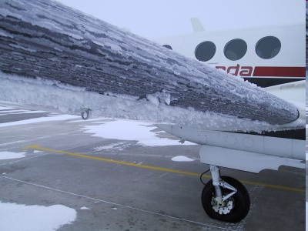
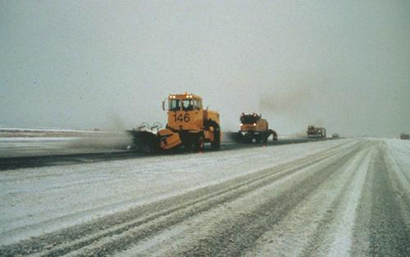
Icing Effect
Icing is the accumulation of ice on the exposed surfaces of aircraft or on the surface of runway .
Icing effect can cause problems to the aircraft thus can lead to accident.
Ice forming on aircraft surface can cause aircraft loss of directional control, reduce aircraft performance and even can cause aircraft loss radio communications.
While ice forming on runway makes slippery surface that can cause aircraft loss of control during take-off or landing.

Slide 19
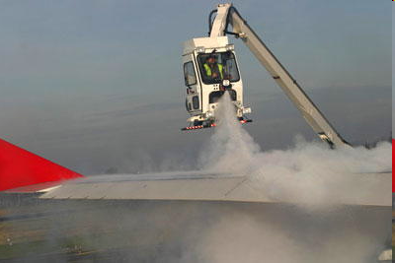
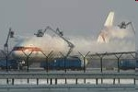
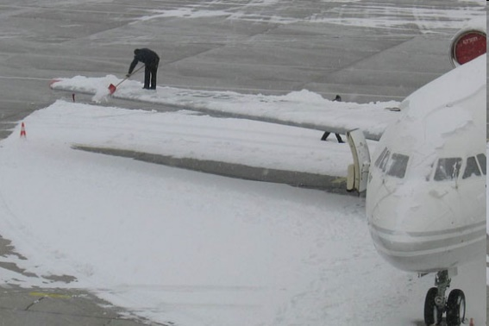
Snow and Ice Control
Anti-icing: To prevent ice from forming.
The process of spraying a glycol solution on the parts of an aircraft to prevent the formation of ice
De-icing: To remove ice after it has formed
De-icing is the process of removing snow & ice from an aircraft surface or runway surface.
Notes:
The process of spraying a glycol solution on the wings of an aircraft to prevent the formation of ice during inclement weather conditions

Slide 20
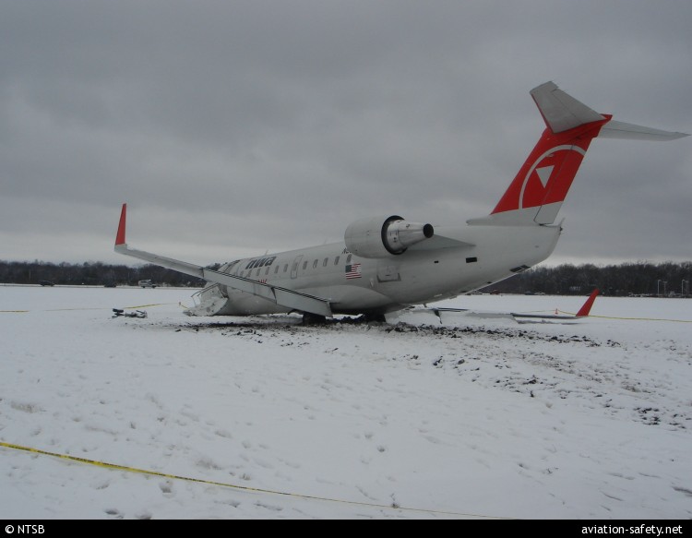
Why is snow and ice control important?
Snow & Ice control plan at an airport important because
  To avoid accidents.
  To enable the aircraft can brake in any emergency case.
  **Landing or taking off on a slippery surface is much more dangerous for a plane.
  To avoid flight delays.
Notes:
Why is snow and ice control important?
Winter weather can have a serious impact on safe airport operations, often resulting in conditions that may lead to incidents, accidents, or delays. For that reason, snow and ice control at an airport is extremely important, regardless of the size of the airport or the aircraft using it. Landing or taking off on a slippery surface is much more dangerous for a plane than driving on a slippery surface is for a car, as planes are not able to brake in the same way. Snow and ice control on the last third of the runway is especially critical, as this area must offer a clear pavement if a pilot decides to abort a takeoff.

Slide 21
Why is snow and ice control important?
Winter weather can have a serious impact on safe airport operations, often resulting in conditions that may lead to incidents, accidents, or delays. For that reason, snow and ice control at an airport is extremely important, regardless of the size of the airport or the aircraft using it. Landing or taking off on a slippery surface is much more dangerous for a plane as aircraft brake is not efficient. Snow and ice control on the last third of the runway is especially critical, as this area must offer a clear pavement if a pilot decides to abort a takeoff.

Slide 22
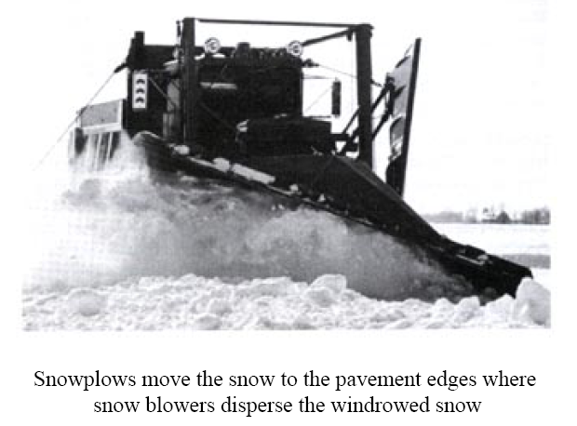
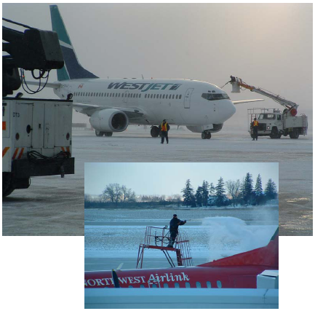
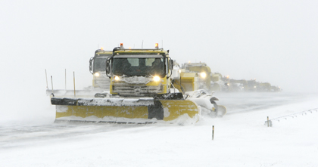

Slide 23
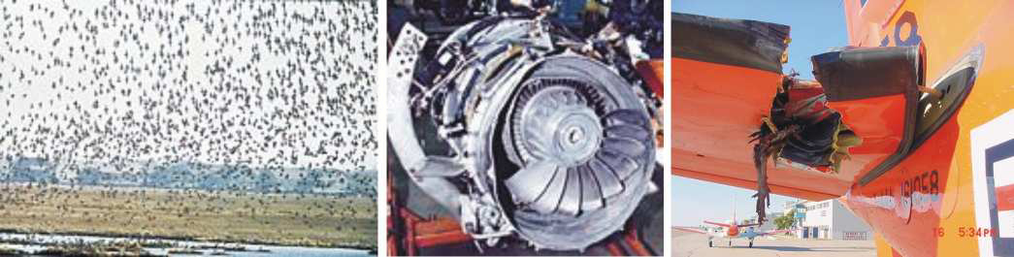
4. Bird hazard management
Bird hazards especially near to airport has the big potential to cause serious aircraft damage and loss of human life.
Every years there are many aviation accidents reported caused by bird hazards.
.

Slide 24
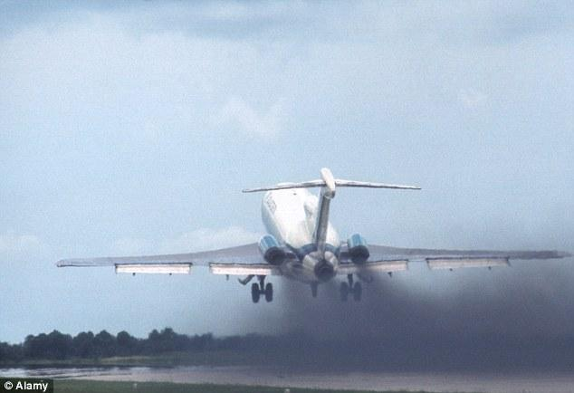
Bird hazard
bird strikes
aborted take off

Slide 25
Bird hazard
Example: Bird Hazard That Caused The Tragedy at Brussels Airport, Belgium.
The Boeing 747 crashed after take-off when the right engine experienced a momentary loss of power because of bird strike.

Slide 26
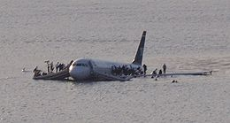
Bird hazard
US Airways Flight 1549 experienced total engine failure due to multiple bird strikes (flock of Canada Geese) no fatalities, 5 injuries.

Slide 27
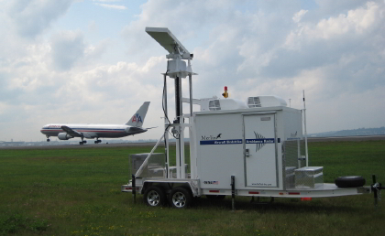
Bird hazard Control Techniques
There are several control techniques available to solve the bird hazard problem. Some of the techniques are:
Elimination of habitat such as trees
to discourage bird populations.
The ground crews must inform the ATC of movements of birds detected.
4. Noisemakers tools, this tool will
scare the bird and cause the bird to
move away from airport.

Slide 28
NOTAMS
NOTAM is stand for Notice to Airmen
NOTAM is the notices containing updated information which is essential to personnel concerned with flight operations. The information including airport condition, or change in any component and any hazard.
A NOTAM is filed with an aviation authority to alert aircraft pilots of any hazards at a specific location.
Notes:
At an airport, when the basic or regulated services cannot be made available, a Notam must be issued advising pilots of the type or level of service that no longer is available.

Slide 29
NOTAMs are issued (and reported) for a number of reasons, such as:
Closed runways
Inoperable radio navigational aids or lights
Military exercises with resulting airspace restrictions
Temporary obstacles near airfields (ex: Cranes)
Passage of flocks of birds through airspace
Notifications of runway/taxiway/apron status with respect to snow, ice and standing water.
Notification of an operationally significant change in volcanic ash or other dust contamination.
Hazards such as air-shows, parachute jumps, kite flying, rocket launches, etc.
Flights by important people such as heads of state

Slide 30
The airport roles on economic and social
https://blog.airpaz.com/en/suvarnabhumi-airport-layout-and-guide/
      The airport supports the growth of business and industry by providing air connected for firms that must meet the demands, supply, competition, and market expansion.
      The city without airport or sufficient air access have constraint on their economic growth.

Slide 31
1. The airport roles on economic and social
1.1 Economic impact of airport
  Direct or primary impact
  Indirect or primary impact
  Induced impact
  Catalytic impact
1.2 Social impact of airport

Slide 32
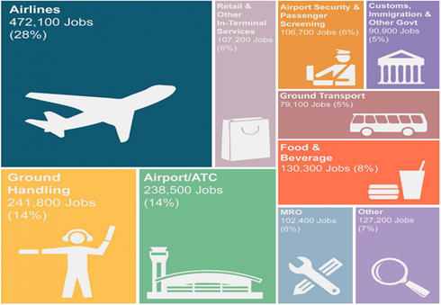
1.1 Economic impact of airport
  Direct jobs by employment type by the presence of an airport.

Slide 33
4 Types of the economic impact of airport
Type of impact | Description of typical impact
Direct | The activities required to provide the product. Operation of airlines and airports (technical support and handling, catering, fuel, security and cleaning); commercial activities (shopping, restaurants, motor vehicle rental, parking); land transport and air cargo
Indirect | Sub supplies (goods and services) to direct activities that are covered in the region. Including; wholesalers providing food for in-flight catering, oil refining activities for jet fuel, accounting and legal services to airlines, travel agents booking flights.
Induced | Impacts of income generated by direct and indirect. For example, an airline employee might spend his/her income on groceries, restaurants, child care, dental services, home renovations which, in turn, generate employment in a wide range of sectors of the general economy.
Catalytic | a-Location impacts (firms and labour), e.g. industrial/commercial investment decisions; b- Tourism and trade (e.g. export markets) c- Productivity. Air transportation offers access to new markets which in turn enables businesses to achieve greater economies of scale while air access also enables companies to attract and retain high quality employees.

Slide 34
1.2 Social impact of airport
The aviation can have impact on social as well.
Strengthening ethic and cultural links between countries
Enhancing travel opportunities and increasing consumer choices for products
Employment and living patterns will change with implication of housing, health, education and other needs on surrounding areas
The airport can have major role in promoting social, such as remote and island communities’ promotion
  The remote area, without an airport would suffer and have minimize quality of life. Since, the airport can enable regions to have access to crucial services, for example hospitals and higher education

Slide 35
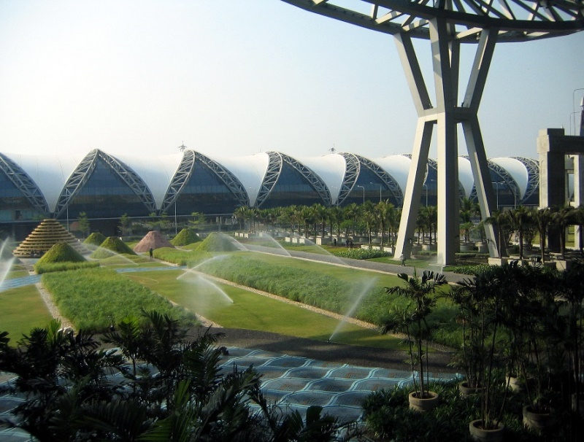
2. The airport and environmental impact
There are 5 main types of environmental impact at the airport (Graham, 2014)
Noise
Emission or air pollution
Water pollution
Waste and energy management
Wildlife, heritage and landscape

Slide 36
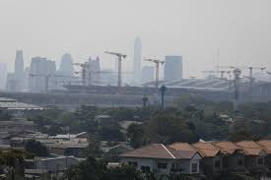
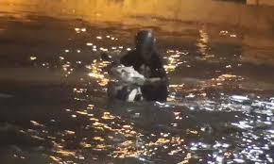
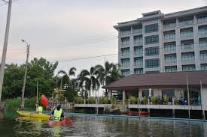
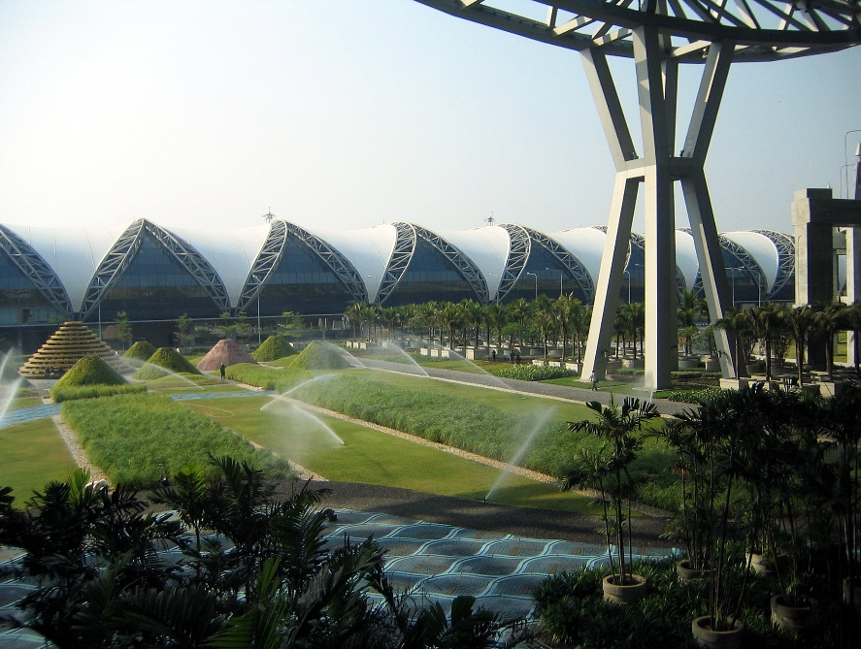
2. The airport and environmental impact
Source: www.dailymail.co.uk [Retrieved on November 22, 2016]

Slide 37
Tangible Services at Airports
Airside infrastructure (taxiways, runways, ramp, apron, navigational aids),
Landside infrastructure (terminals, ground transport, parking facilities)
Airport support infrastructure (aircraft maintenance, in-flight catering services, security and police facilities)
Support areas (industrial areas, duty free zone)

Slide 38
Intangible Services
Administration (airport management, air traffic control)
Operations (airport safety and security)
Airport maintenance
External factors ex. regulations and environment

Slide 39
The airport promotion and reduction
The airport products, seemingly, are the same. Hence, it is depending on promotion tactics of each airport to attract various users.
For example; The Singapore Straits Times (2015) reported that Singapore Changi Airport cuts fees for passengers, airlines to boost competitiveness details as follow;
“SINGAPORE - Changi Airport has cut charges for selected travelers, airlines and other partners amid intense competition from rivals in the region, including airports in Hong Kong and the Middle East.
Include lower passenger service fees for transit travelers, discounted landing fees for large aircraft and rebates for flight catering and other ground handling services.

Slide 40
The airport promotion and reduction
Include;
Lower fuel prices
Discounted landing fees for large aircraft
Lower passenger service fees for transit travelers
Cut charges for selected travelers to boost competitiveness
Rebates for flight catering and other ground handling services
Incentives - being offered to encourage staff to boost productivity

Slide 41
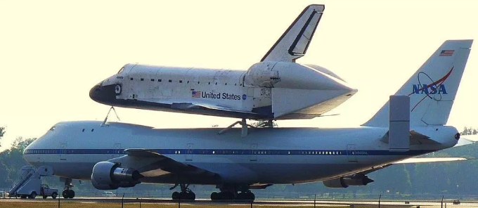
Example of Assignment
Wide-body aircraft
a passenger airplane – a jetliner – whose fuselage is wide enough to accommodate two passenger aisles, i.e. a twin-aisle aircraft.
Source: Market Business News. (2019, May 1). What is a wide body aircraft. Retrieved from https://marketbusinessnews.com/financial-glossary/wide-body-aircraft-definition-meaning/

