Slide 1
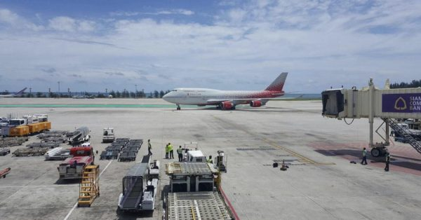
Unit 7 Airport Security and Safety

Slide 2
Learning Outcomes
Be able to explain the airport security procedures
Be able to describe the airport security program
Understand the airside safety practices

Slide 3
Security & Safety (IATA)
Aviation safety : Efforts that are taken to ensure aircrafts are free from factors that may lead to injuries to loss.
Aviation security : combination of measures human and material resources intended to safeguard civil aviation security against acts of unlawful inference.

Slide 4
Security Procedures at Airport
Protect passenger, cabin and cockpit
Prevent explosion of baggage
Prevent threats external aircrafts

Slide 5
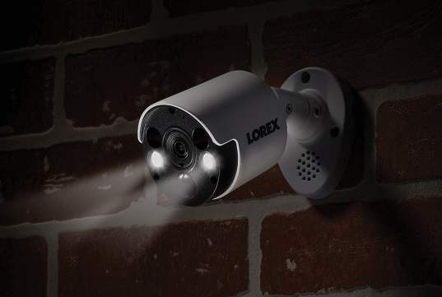
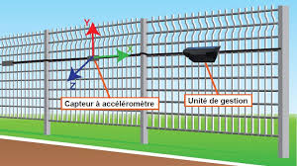
Preventive Measure
Deter
Prevent action by persuading
intruders that their intentions is too
Risky (Active deterrence camera)
Detect
Indicate that an action has taken
place, therefore appropriate
countermeasures can be employed
(Detection cables)

Slide 6
Deterrence Measures

Slide 7
Deterrence Measures
Signs/ lighting
Access control
Presence of guards, dogs, cameras
Staff displaying permits
Vigilant staff

Slide 8
Detection Methods
Intruder detection alarm systems
Security patrols and inspections
Closed circuit television cameras

Slide 9
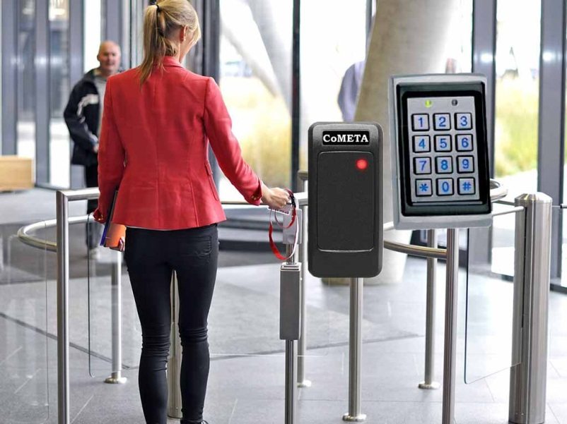
Purpose of Access Control
Ensure that only authorized persons and vehicles are allowed access
Ensure that persons in security restricted areas have valid permit
Protect cargo from interference

Slide 10
Protect passenger, cabin and cockpit
Pax are asked to show ID, biometric evidence (finger print, digital photogrph)
Terrorist watch list
Strengthened cockpit door by install bulletproof
Monitor Pax’s behavior
Carry-on baggage are physical inspection
Pat down ( pass hands over pax to search concealed items

Slide 11
Protect passenger, cabin and cockpit (Cont.)
WTMD (walk- through metal detector)

Slide 12
Protect passenger, cabin and cockpit (Cont.)
HHMD (hand-held metal detector)

Slide 14
Prevent explosion of baggage
Employ explosion equipment some scan provide colored images of objects that contain explosive compounds.
K 9 tea, dogs are trained to react to the scents of various explosives
Hand searches of luggage
Positive passenger baggage match (PPBM) PA pax not leave baggage unattended.
Trusted shipper program.

Slide 15
Prevent threats external aircrafts
Guarding against truck bomb
CCTV (closed- circuit television)
Staff background checks
Electronic barrier
Prohibit parking

Slide 16
Airport Security Program
Approved by National Aviation Security Authority, It include;
Responsibility of airport operator
Coordinate and communication
Plan for protect airport, aircraft, ATC and facilities
Detail of security personnel
Evaluate of the effectiveness by experts
Contingency plan

Slide 17
Airside Safety Practices
Employee who work around aircraft
Condition of pavement, runway, taxiway
Obstacles around airport such as construction
Broken or damage marking, signs, lighting system
Presence of debris

Slide 18
Suspicious Circumstances (People)
Loitering outside premises
Attempting to gain access
Insisting on particular flight
Over-detailed questions

Slide 19
Suspicious Circumstances (Goods)
Changes to paperwork
Broken seals
Resealed packages
Poor or damaged packaging

Slide 21
Annex 17 - Standard
“Each Contracting State shall require that measures are implemented to ensure adequate supervision over the movement of persons and vehicles to and from the aircraft in order to prevent unauthorized access to aircraft.”

Slide 22
Safety Around Aircraft
Aircrafts are tied down or chocked.
No authorized person approaches any A/c without permission
Not park or stand within 3 meters of any A/C
Aircraft always gets priority of way over vehicle
Mobile phones not permit within 15 meters.

Slide 23
