Slide 1
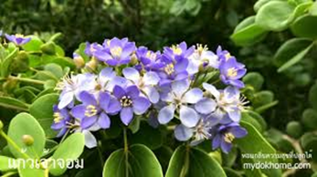
EDM 1101 Teachership, Morality and Ethics for Teachers (ความเป็นครู คุณธรรมและจริยธรรมสำหรับครู)
Dr.Boonthong Boontawee

Slide 2
Aims and Objectives
the student will reach to six domains
Morals and Ethics
Knowledge
Cognitive Skills
Interpersonal Skills and Responsibility

Slide 3
Aims and Objectives
the student will reach to six domains
5. Numerical Analysis, Communication
and Information Technology Skills
6. Learning Management Skills
Credits : 3(2-2-5)

Slide 4
EDM 1101
Course Introduction
- Course outlines
- Grading criteria
Pre-Test
Chapter 1

Slide 5
Course Outline
The importance of teaching profession.
(ความสำคัญของวิชาชีพครู)
Teacher’s roles, duties, characteristics
(บทบาท หน้าที่ คุณลักษณะของครู)
Standard of teaching profession
(มาตรฐานวิชาชีพครู)

Slide 6
Course Outline
Constructing a spirituality in teachers
(การสร้างจิตสำนึกของความเป็นครู)
Regulation of the Teachers Council of Thailand on Professional Standards and Ethics
(ข้อบังคับคุรุสภาว่าด้วย มาตรฐานวิชาชีพครู จรรยาบรรณของวิชาชีพครู)

Slide 7
Course Outline
Virtue and Morality of teaching profession
(ศีลธรรมและคุณธรรมของวิชาชีพครู)
Good governance
(หลักธรรมาภิบาล)
Self-confidence and positive attitudes towards teachership
(ความเชื่อมั่นในตนเอง และเจตคติเชิงบวกต่อความเป็นครู)

Slide 8
Course Outline
good teacher (การเป็นครูที่ดี)
Teacher’s Knowledge Management
(การจัดการการเรียนรู้ของครู)
Continuing professional development of teacher
(ครูผู้พัฒนาวิชาชีพครู)

Slide 9
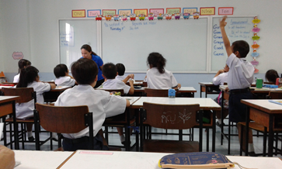
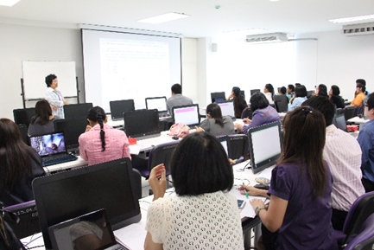
The importance of Teaching Profession

Slide 10
The importance of Teaching Profession
VDO “ We can try “ https://www.youtube.com/watch?v=5evijBBLU2Q

Slide 11
We can try
No | activities | yes | no | Not sure
1 | Mother has a lesson plan.
2. | Mother has the object to teach her daughter.
3. | Mother and daughter talk appropriate.
4 | There is cultural instruction in this activity

Slide 12
Answer the Quession
Who are the interesting people in “ We can try “ ?
mother , daughter
What do they do ?
daughter watching the been sprout seller , ………

Slide 13
When did it happen?
in the morning ,
in the night,
Where is the scene ?
the market , their house ,…….
Why did they grow the been sprout ?
They want to sell the been sprout or make money.

Slide 14
How do they study ?
………………………………….....................................
How many times persisted in the experiment until they was successful?
………………………………….....................................
Task 1 - Please write a Summary
of your observed

Slide 15
VDO“สับปะรด” (Pineapple)
https://www.youtube.com/watch?v=UIHPIESyIXM
Task 2 - Please write a Summary
of your observed

Slide 16
TEACHER
T - Teaching and Training
E - Ethics Instruction
A - Action Research
C - Cultural Heritage
H – Human Relationship
E – Extra Job
R – Reporting and Counselling
S- Student Activities

Slide 17
Good Luck

