Slide 1
TIM 4404 Tourism Project Management 3(2-2-5)
Benjaporn Yaemjamuang

Slide 2
Tourism project management planning, processes, systematic study methods. to achieve the goal Human resource management and details of various activities within the project by predicting the direction and duration of work from project start to completion Determining the time period for the performance of various activities within the project based on the relationship between resources, time, and budget constraints. by still having quality and the benefits and worthiness of organizing the project to related parties as well as bringing modern tools, equipment, technology or knowledge come to apply to benefit the project

Slide 3
1. To study about tourism project management planning, processes, systematic study methods.
2. To be able to carry out the project as intended and be able to manage human resources and details of activities within the project.
3. To be able to predict the direction and duration of the work. from project start to completion Including determining the performance period of various activities within the project based on the relationship between resources, time, and budget constraints. by still having quality And the benefits and worthiness of the project to the parties involved.
4. To be able to bring modern tools, equipment, technology or knowledge come to apply to benefit the project

Slide 4
Evaluation
group project
(30 score)
Involvement
(10 score)
public relations project
(20 score)
FINAL
(30 score)
other
(10 score)

Slide 5
Group Project
creative work benefit society learn from real experience bring integrated knowledge into practice

Slide 6
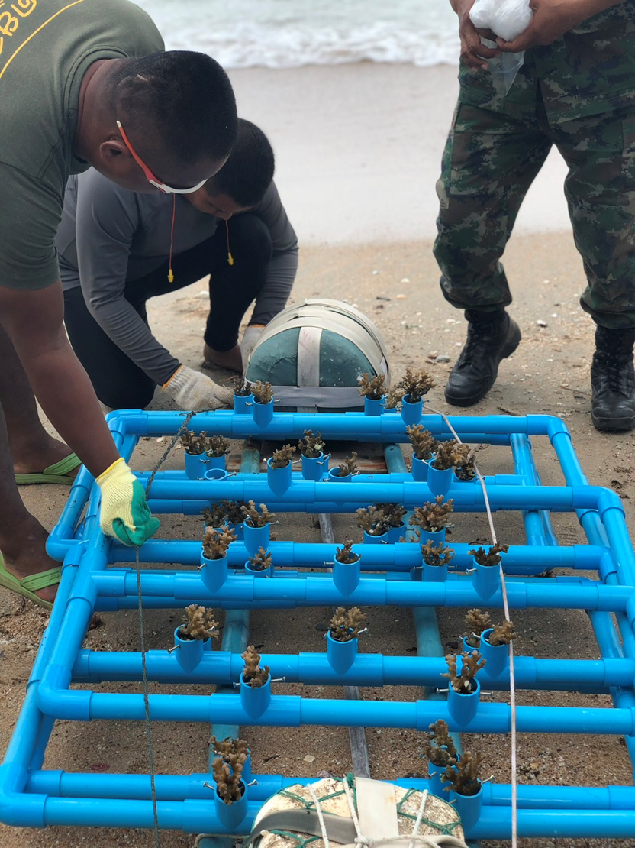
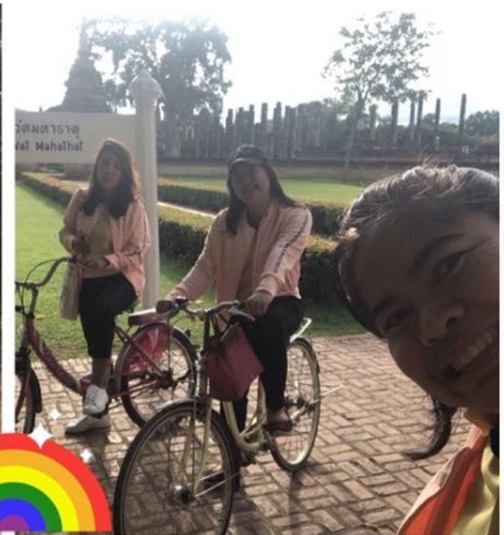
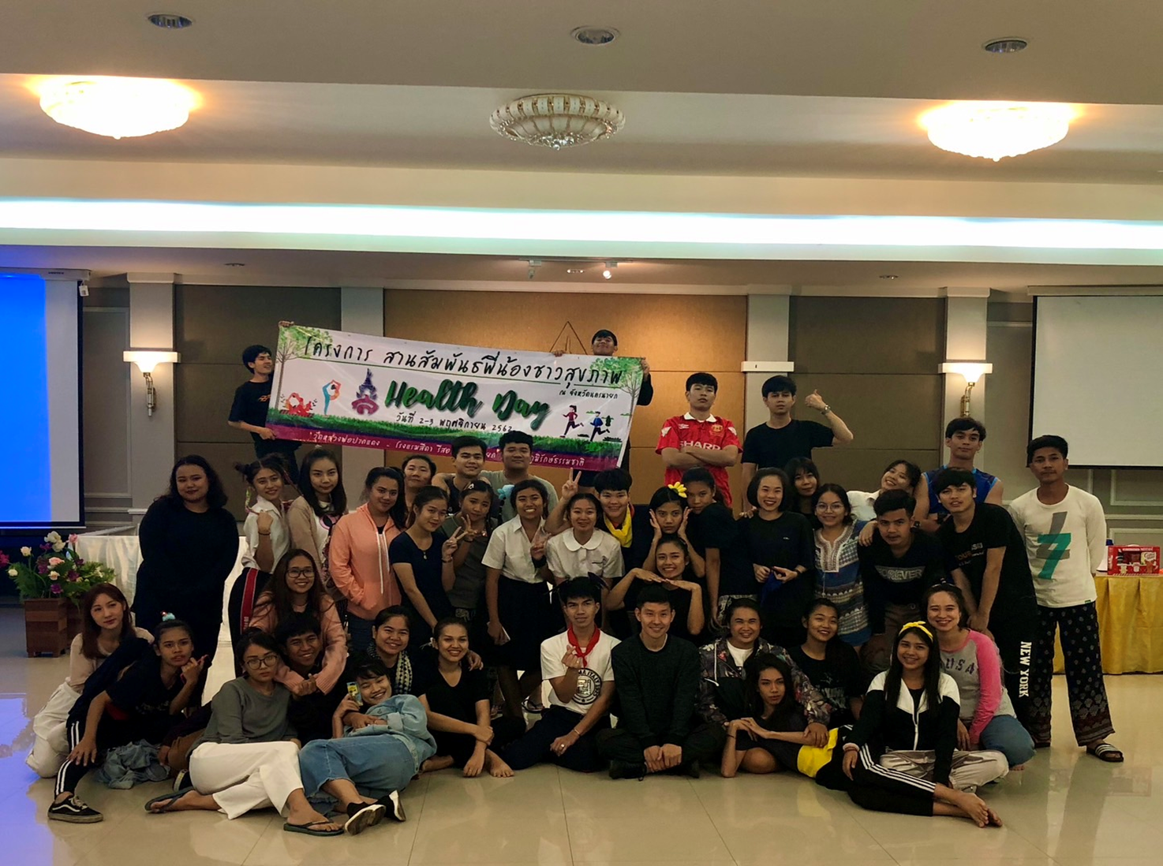
Public Relations Project
Introducing and promoting a good image of the tourism and service industry management field to make it known and interesting.

Slide 7
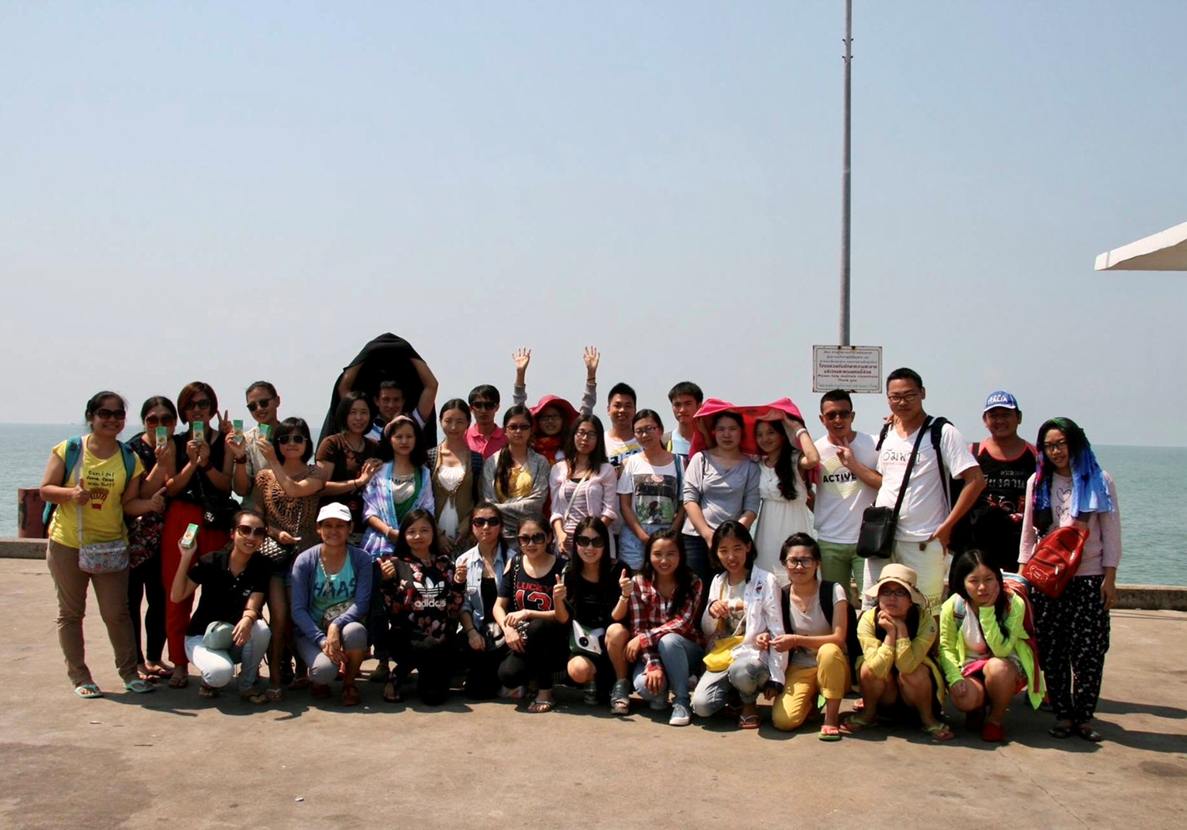
Involvement
Participate in activities both inside and outside the classroom information can be shared share your opinion in order to further develop

Slide 8
other extra points
FINAL
Theory

Slide 9
Important Characteristics of The Project
1. Have a separate scope of work
2. There is a temporary responsible organization.
3. There are changes that benefit the target audience.
4. There is an exposure to uncertainty/risk.
5. Focus on integration with the main organization.
6. Consider time, cost and quality constraints.

Slide 10
Project Cycle
1. Defining the Project

Slide 11
Project Cycle
2. Planning
Planning gives teams the opportunity to think together before acting. which will directly benefit the operation
- to set various tasks that must be done before starting the project
- Have studied and understood those jobs before actually working
- Planning helps to see problems ahead and find solutions in advance.
- Know more information needed to complete the different stages of the project. must answer that What work needs to be done, who does it, how to do it, where to do it, what to do, when to do it

Slide 12
Position | Responsibilities | Note
Project Manager | - It is the principle of planning the project implementation. division of responsibilities Take care of decision-making in operations ...........
.......... | ..........

Slide 13
Project Cycle
3. Implementing

Slide 14
Project Cycle
4. project closure

Slide 15
1. Project name
2. Project leader name
3. Budget
4. Processing time
5. Background of project
6. Objective
7. Relevant information / Feasibility of project
8. Target group
9. Action plan
10. Project area
11. Budget details
12. Project risks
13. Benefits expected to be received / people who benefit from the project
14. Project attachment

Slide 16
benjaporn.ya@ssru.ac.th

