Slide 1
TIM 4404 Tourism Project Management 3(2-2-5)
Benjaporn Yaemjamuang
​

Slide 2
Characteristics of the project
1. Temporary
Temporary means that every project has a definite beginning and a definite end
2. Unique
Unique means that the product or service is different in some distinguish way from all similar products or services

Slide 3
Characteristics of the project
Unique Scope
Beneficial
Temporary Organization
3
2
1

Slide 4
Characteristics of the project
Risk
Time Cost & Quality
Integrate
6
5
4

Slide 5
The difference between project work and regular work

Slide 6
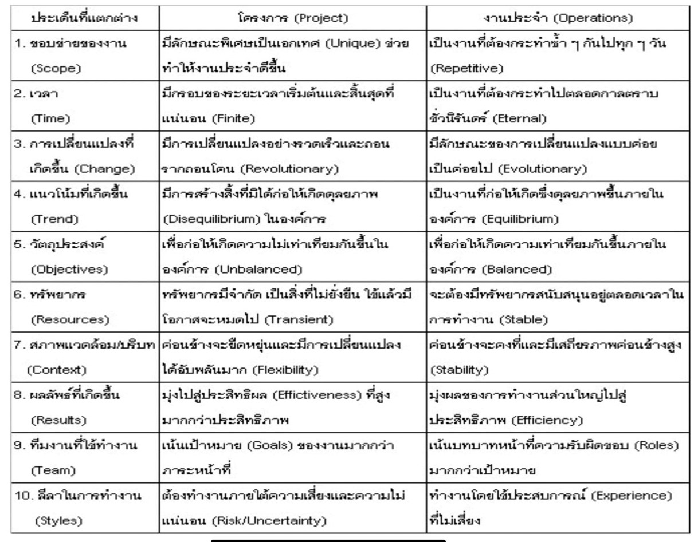

Slide 7
benjaporn.ya@ssru.ac.th

