Slide 1
TIM 4404 Tourism Project Management 3(2-2-5)
Benjaporn Yaemjamuang

Slide 2
Group Project
creative work benefit society learn from real experience bring integrated knowledge into practice

Slide 3
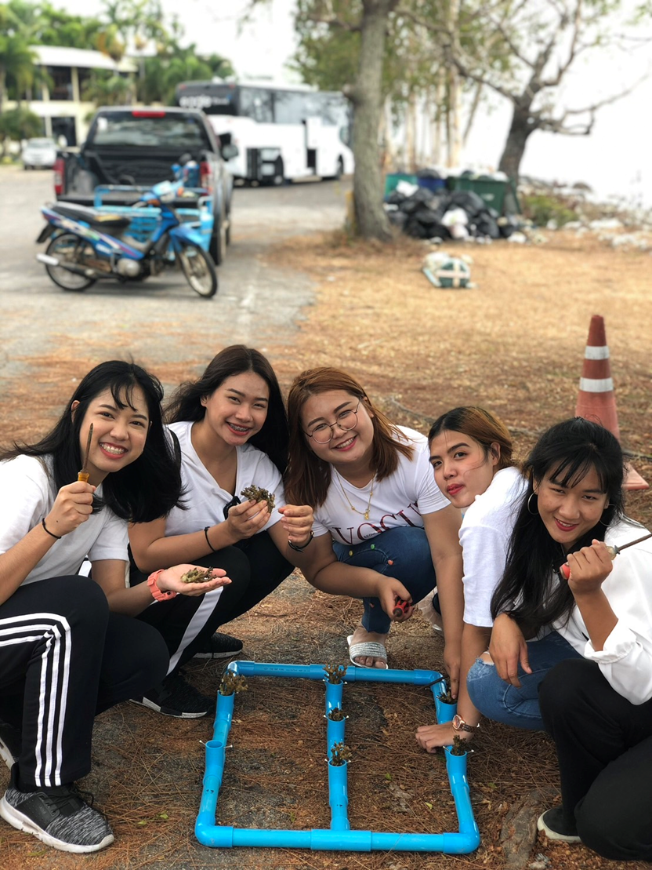
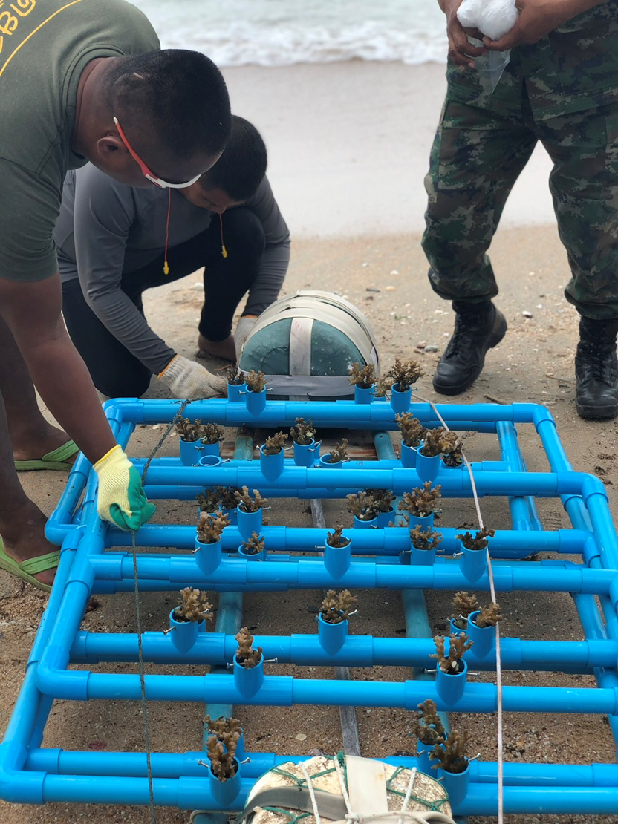
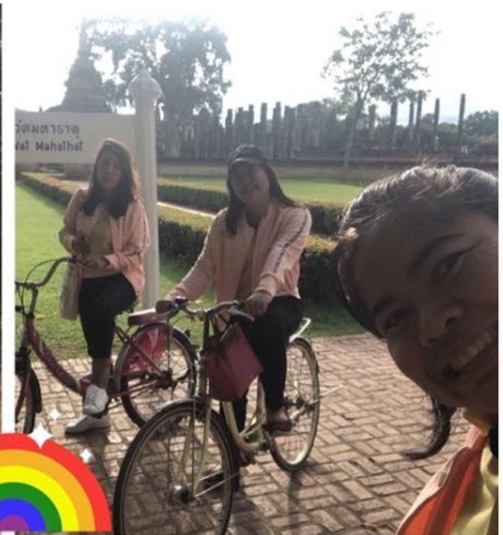
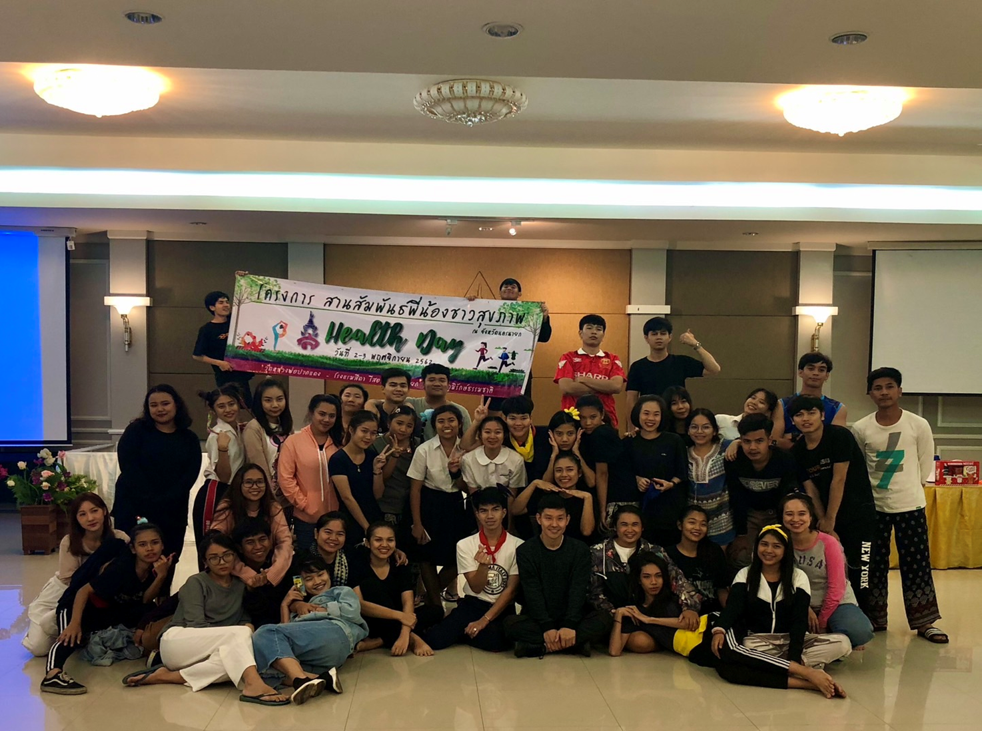
Public Relations Project
Introducing and promoting a good image of the tourism and service industry management field to make it known and interesting.

Slide 4
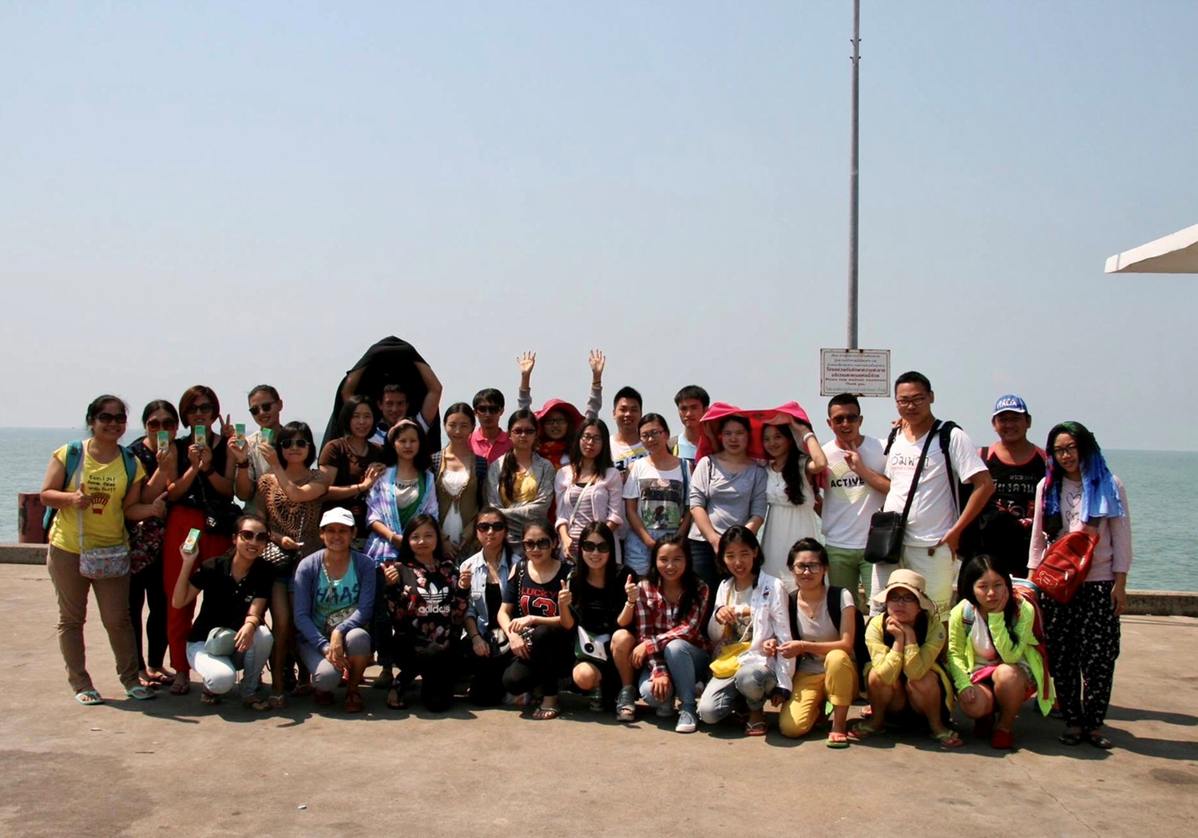
Involvement
Participate in activities both inside and outside the classroom information can be shared share your opinion in order to further develop

Slide 5
benjaporn.ya@ssru.ac.th

